Slide 1
Warm Up 5/7 (#3)
What was Americanization in Vietnam and what did it involve?

Slide 2
May 7, 2018
Out for checkoff:
Agenda:
Strategies and the Draft in Vietnam
Skills:
Learning Target (I can…):
Explain what was different about war in Vietnam and why it was so difficult.
Upcoming Dates
5/7: Socratic Seminar make-up
5/7: Reading Notes TCI 51.1-51.2

Slide 3
Junior Project Debrief
Shorthand to understand
TP – Third Person
PT –Past Tense
Awk –Awkward wording/sentence
RO –Run on Sentence
¶ - Paragraph
MW –Missing Word
WC – questionable word choice

Slide 4
Junior Project Debrief
Break up paragraphs!!
Stay on topic
Don’t just say it, prove it
Evidence does not all have to be about your person/event, it should be portraying your how and proving your so what
You may have evidence of other events/people that show the lasting impact. Just make sure you connect it back to your topic and thesis.
Integrate and analyze quotes/evidence

Slide 5
Facing Frustration in Vietnam

Slide 6
Imagine
You’re in a tug of war
Half your team can only use one arm
There are multiple people pulling the opposite direction
The other side is bigger and stronger and has unlimited backup
If you start to win
You supporters give half-hearted clapping but…
The other side has highly trained and big supporters that will jump in
If you lose your supporters begin to boo and jeer
And every 10 seconds, someone drops out

Slide 7
Unfamiliar Terrain
Few American GIs had ever experienced such hot and humid conditions
temperatures rose above 90°F much of the year
heavy monsoon rains fell from May to October.
Greatest geographic challenge for U.S. soldiers was Vietnam’s rugged topography.
soggy, lowland rice paddies
swamps and over steep jungle-clad mountains
heavily forested

Slide 8
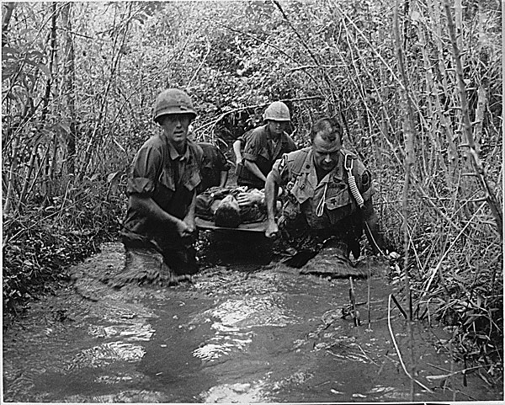
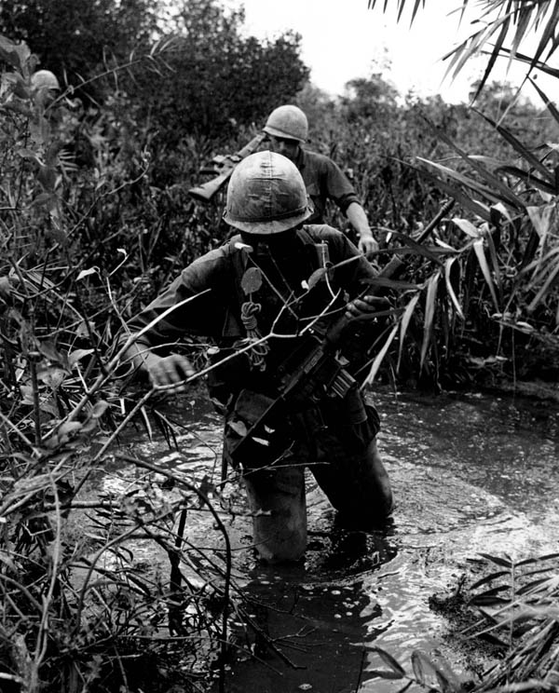
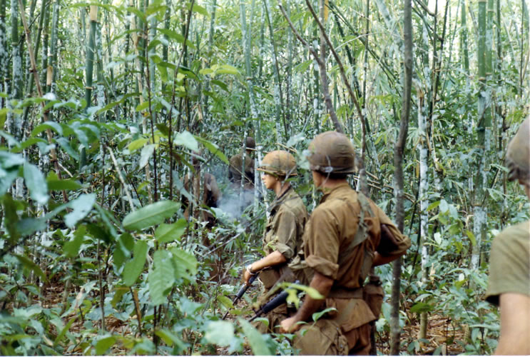

Slide 9
Tactics & Strategies
Viet Cong Advantages
Guerilla warfare
Familiar with terrain
Protection in Cambodia and Laos
Local population
US Disadvantages
Confused and frustrated
People seemed indifferent
Friend vs foe?
Women and children posed threat

Slide 10
The Ground War
War of Attrition
William Westmoreland
Wear down the enemy
Search and Destroy
Small units of soldiers (platoons)
Search for insurgents
Draw them into a fight
Call in air support
Effectiveness?
Easy targets – body count

Slide 11
The Ground War
VC avoided head-on clashes
Small group sneak attacks
Hide in elaborate underground tunnels
Running water and electricity
Booby traps
Punji trap – camouflaged pit of sharp stakes
Land mines
Trip wires
Made little contact with the enemy

Slide 12
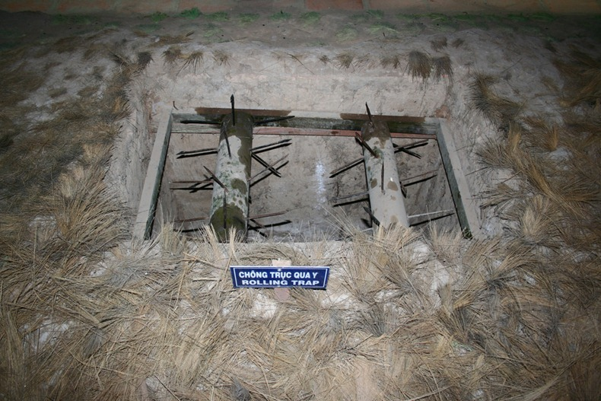
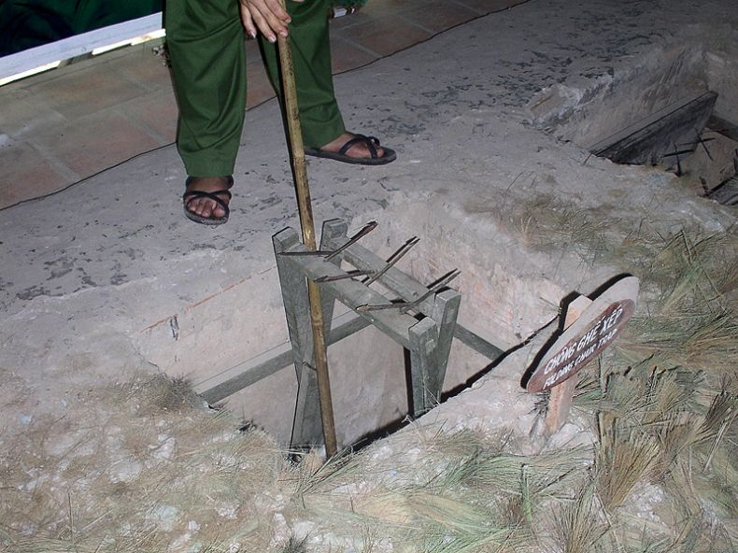

Slide 13
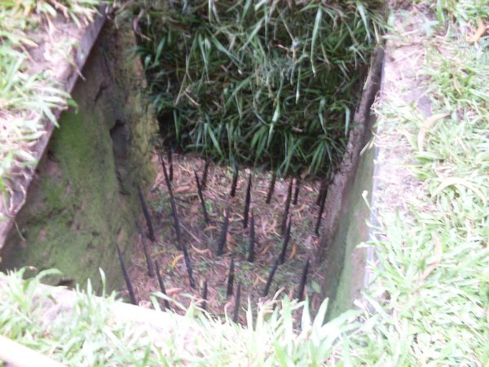

Slide 14
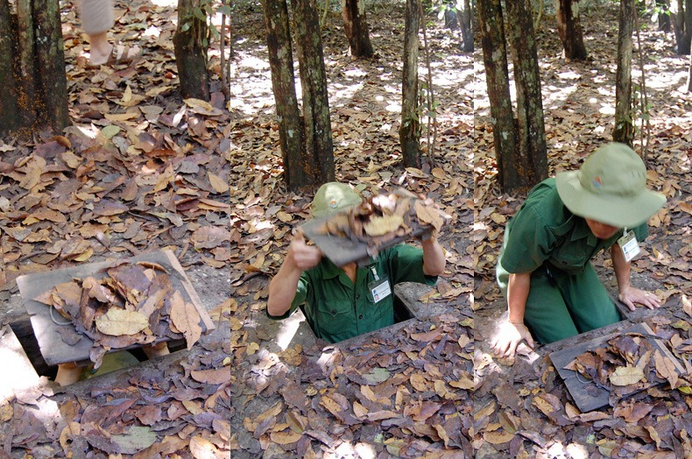

Slide 15
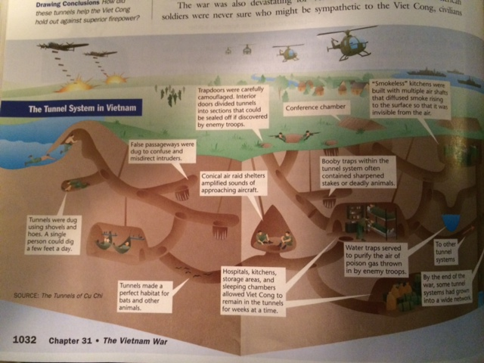

Slide 17
Air War
B-52 bomber
Roads and bridges targets
Thousands of tons of explosives
Saturation bombing
Fragmentation bombs
Many civilians killed
Chemical weapons
Agent orange
Herbicide
Expose hiding places
Crops, human and livestock
Napalm
Jellylike substance
intense burning

Slide 18
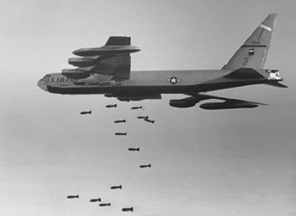

Slide 19
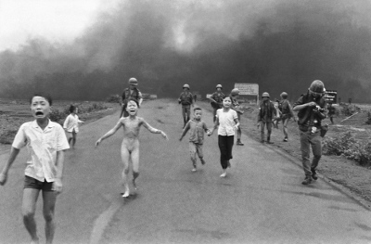

Slide 20
Pacification
Campaign to win over the Vietnamese people and undermine support for the Viet Cong
Policy designed to promote security and stability in South Vietnam.
First aimed to bring economic development to rural South Vietnam
Supplying villages with food and other goods to building schools and bridges
Spread propaganda
United States hoped to “win the hearts and minds” of the Vietnamese people.

Slide 21
Pacification
Second, sought to undermine the communist insurgency
Army of the Republic of Vietnam (ARVN) remove the Viet Cong and their sympathizers from villages.
cut off the flow of recruits to the enemy
make it safe for rural Vietnamese to support the Saigon government.
Problems:
ARVN lacked the leadership, skills, and dedication
Second, the U.S. forces in Vietnam were too busy fighting the Viet Cong to pay much attention to “the other war” for villagers’ “hearts and minds.”
The lack of security
difficult to carry out their mission.
Notes:
https://www.youtube.com/watch?v=0l4pj4agv58

Slide 22
The Draft
66% of US armed forces were drafted
Accounted for 30% of all combat deaths
Many tried to find ways to avoid it
Most of these means were catered toward upper-middle class Americans (80% of soldiers from lower economic classes)
College deferment most common
Other ways:
Medical deferment
More lenient draft boards
Joining national guard
Conscientious objector (religious or moral objections
Rarely granted, many arrested for refusing on these grounds
Running to Canada (considered draft dodgers)

Slide 23
Homework Due Tuesday
Critically read Into the Dark about the My Lai massacre.
Look for things that depict the nature of the war as well as what actually happened at My Lai and why.

