Slide 1
Warm Up 5/11 (#7)
Name 2 lasting effects of the Vietnam War.

Slide 2
May 11, 2018
Out for checkoff:
Vietnam Legacy notes
Agenda:
Legacy of Vietnam
Review
Skills:
Learning Target (I can…):
Describe the lasting effects of the Vietnam on the U.S. and SE Asia
Upcoming Dates
5/14: Vietnam Test
5/15: Final due date for pre-Vietnam units late work
5/17: Final due date for all Vietnam late work

Slide 3
The Costs
3,000,000 Vietnamese killed
58,000 Americans killed; 365,000 wounded
Under-funding of Great Society programs
$150,000,000,000 in U.S. spending
U.S. morale, self-confidence, trust of government, decimated
Notes:
Diversion of capital to the war indirectly caused economic recession: 11% inflation and 12% unemployment!

Slide 4
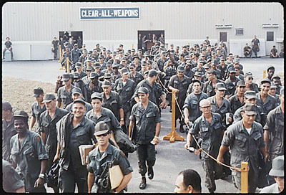
Veterans
Arrive home to widespread indifference and hostility
Many develop PTSD and other issues in their efforts to cope
Suicide rate is high
In and effort to honor Veterans, government commissions Memorial
Notes:
Diversion of capital to the war indirectly caused economic recession: 11% inflation and 12% unemployment!

Slide 5
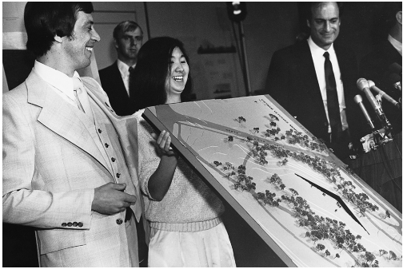
Vietnam Memorial
Inscribed on the black granite walls are the names of more than 58,000 men and women who gave their lives or remain missing.
The winning design was the work of Maya Ying Lin of Athens, Ohio, a 21-year-old senior at Yale University.
Ground broken on Friday, March 26, 1982.
Lin’s intention from the beginning was to have the names appear chronologically.
She wanted the names to tell the journey, or the timeline, of the war.

Slide 6
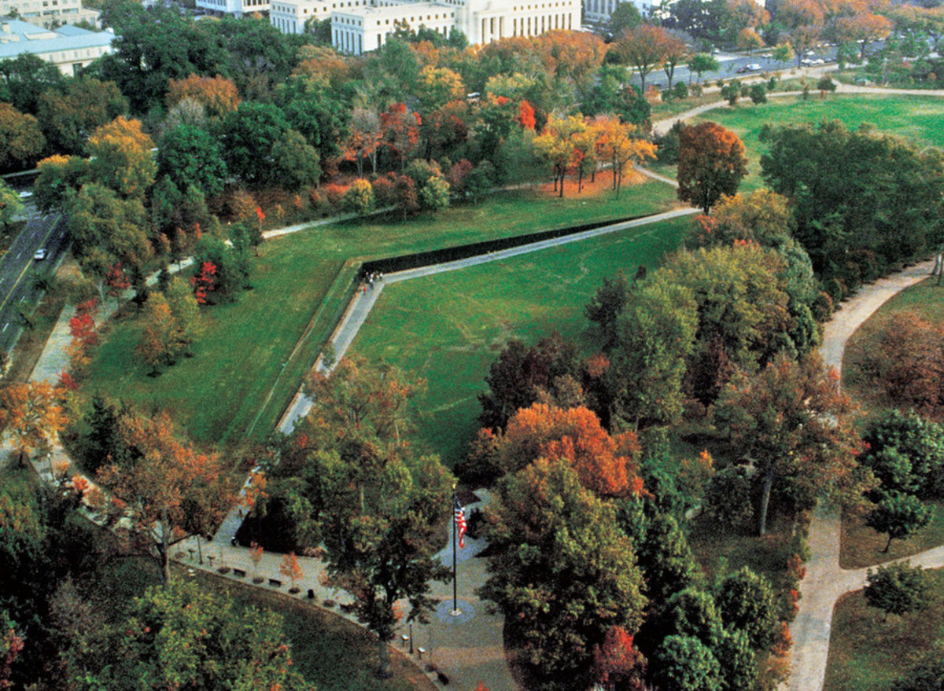

Slide 7
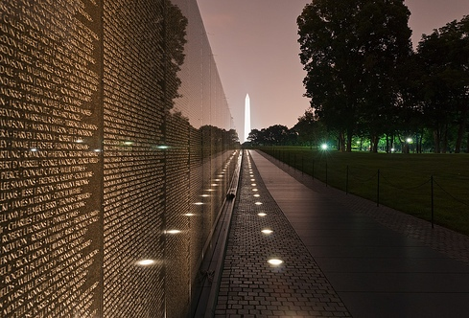

Slide 8
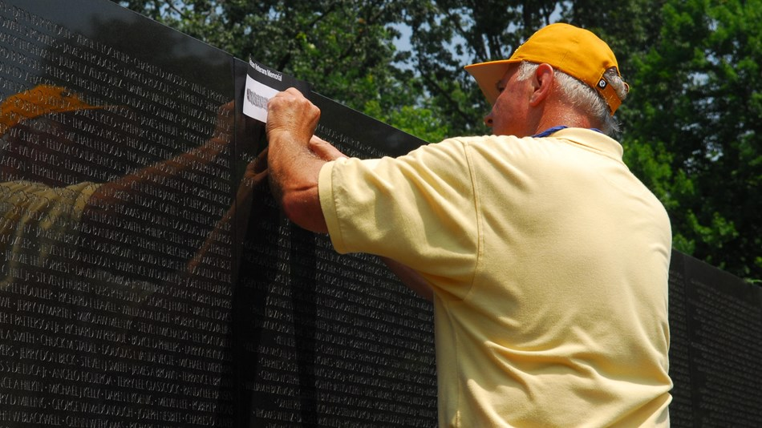

Slide 9
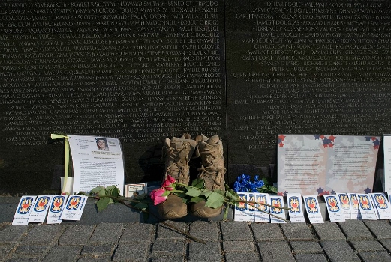

Slide 10
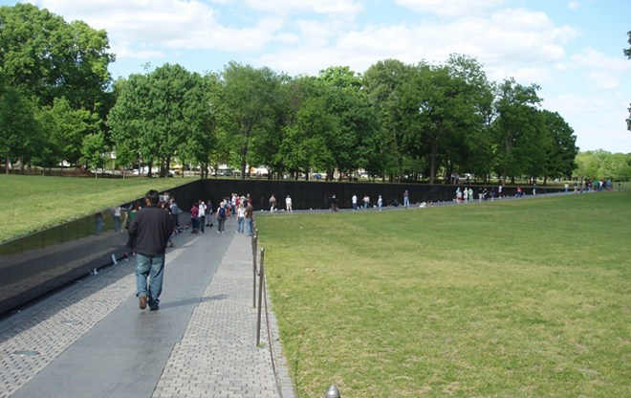

Slide 11
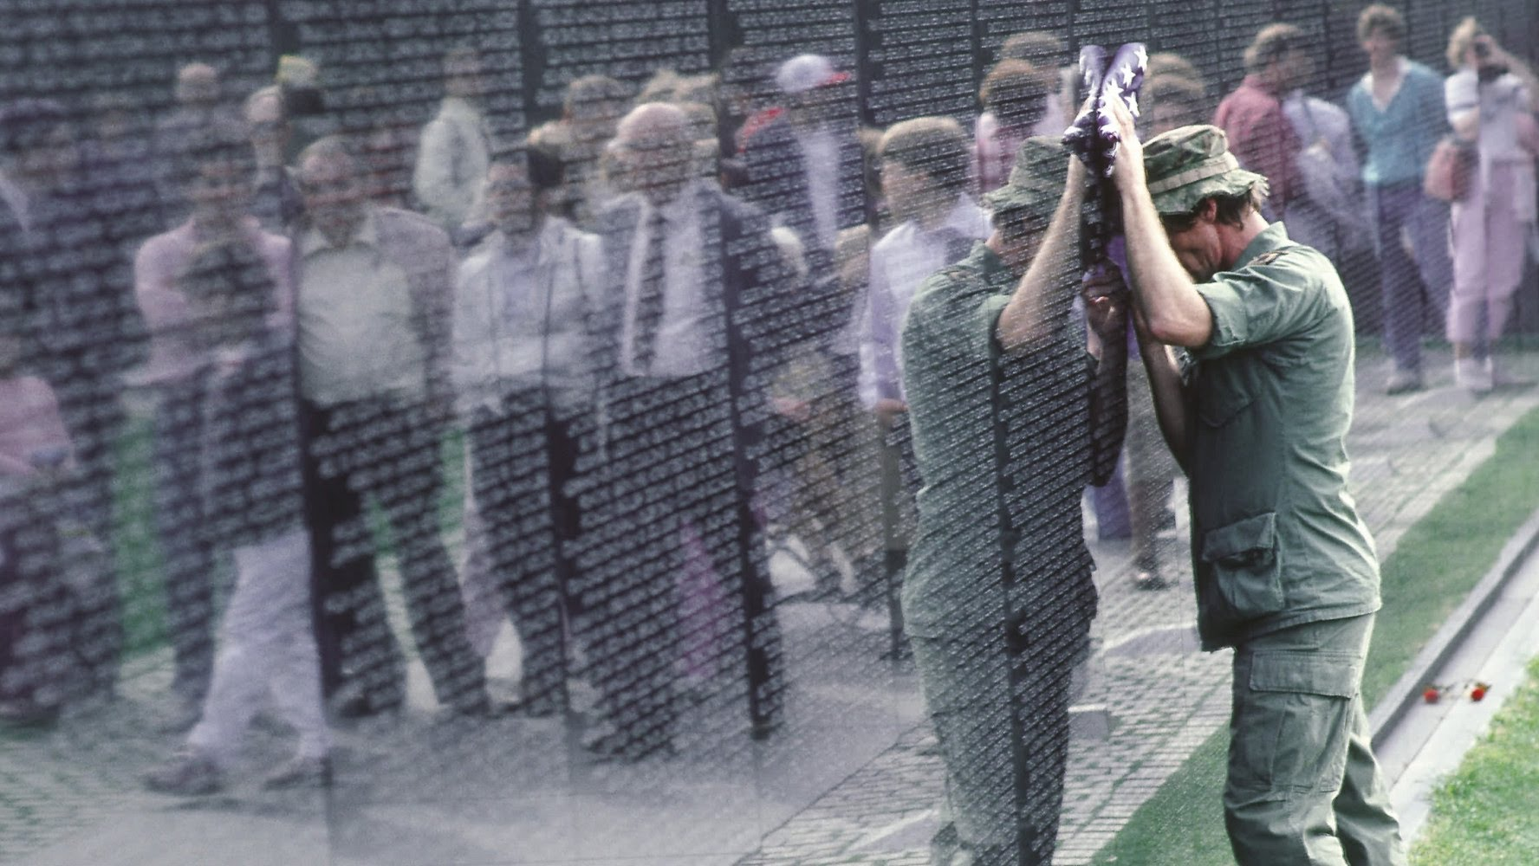

Slide 12
Lasting effects in SE Asia
Millions flee Vietnam as communists imprison thousands in “reeducation” attempt
Well off expelled as businesses nationalized
Many poor flee in boats, often not surviving
Vietnam was eventually able to rebuild but memories and psychological effects last
Notes:
Diversion of capital to the war indirectly caused economic recession: 11% inflation and 12% unemployment!

Slide 13
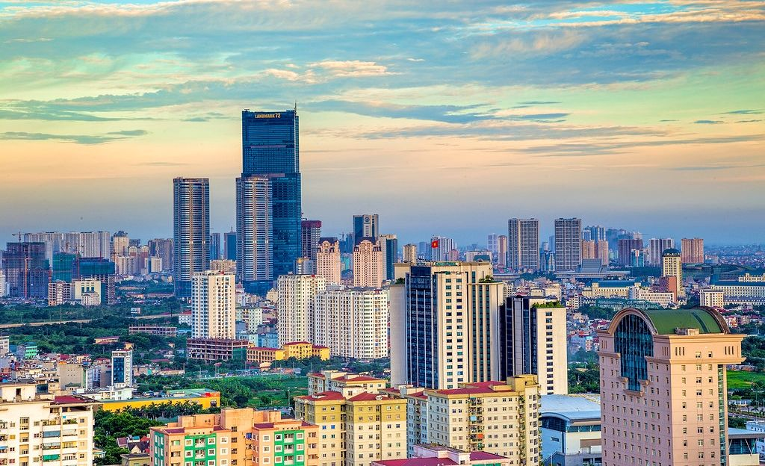
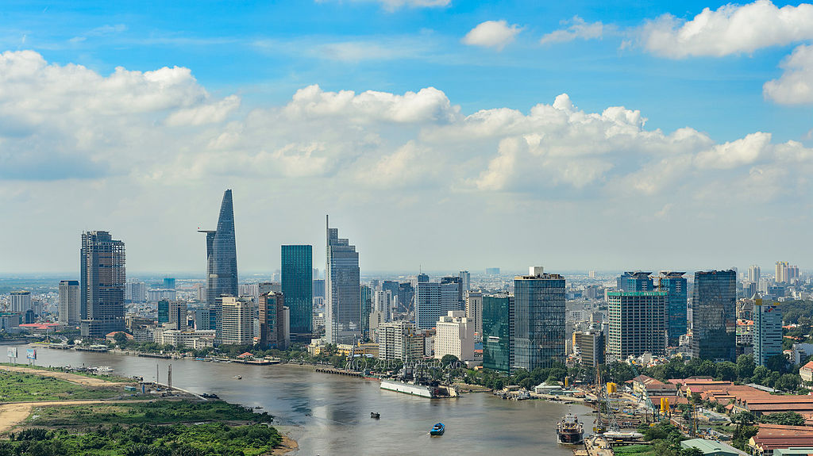
Vietnam Today
Agriculture's share of economic output has shrunk from about 25% in 2000 to 18% in 2014
Vietnamese authorities have reaffirmed their commitment to economic modernization and a more open economy
GDP ranked 37/230

Slide 14
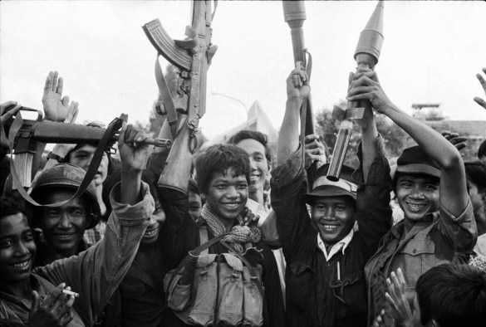
Lasting effects in SE Asia
Cambodia
Plunges into Civil War after invasion
Khmer Rouge cease power and attempt to establish peasant society
As many as 2 million killed during brutal reign and attempted genocide
Notes:
Diversion of capital to the war indirectly caused economic recession: 11% inflation and 12% unemployment!

Slide 15
Your Questions
Why did we fight?/Why did we think this was a good idea?
What is communism?
Did we have a backup plan to stop communism?
Was support high in the beginning?
Why didn’t they weight the options more?

Slide 16
Your Questions
Is it what the President wanted? And how did he respond to advisors?
How long did it last?
Why did it last so long?
Why didn’t we pull out sooner if we knew we couldn’t win?
Why did we keep so much of it a secret?

Slide 17
Your Questions
What would’ve happened if we pulled out?
Were all North Vietnamese Communist?
Did the Vietnamese have a draft also?
Why didn’t we try harder to protect civilians?
How long did it take Vietnam to recover?

