Slide 1
Warm Up 1/2
What were the general world views in America after WWI?

Slide 2
Welcome Back!
If you missed either the WWI quiz or the Socratic Seminar, you have until Friday to make those up.
Fall paper scores are in Skyward. If you have questions about your paper, please see me in my office before or after school.
Remember, finals are in 3 weeks! So put forth your very best for Unit 6. If you have concerns about your grade, visit me before school or email me.

Slide 3
Fall Paper Thoughts
What went well:
Generally, good evidence
Generally, good thesis statements

Slide 4
Fall Paper Thoughts
What we can do better:
Avoiding overlong paragraphs
Staying in third person and past tense
ANALYSIS!
Connect to your thesis (strong so what)
Go deeper, make connections, be clear
Be Brave!! Make a claim
Watch run-on sentences
MLA in-text citations
ACADEMIC SOURCES!!

Slide 5
Unit 6 Overview – 1920s
Politics and the Red Scare
Harlem Renaissance and the KKK
Prohibition and Christian Fundamentalism
Flappers and the Modern Woman
Leisure/Culture/Rise of Celebrity
Economy and Causes of the Great Depression

Slide 6
So, where did we leave off?
Post-WWI World
U.S. wary of global involvement
What do we call this worldview?
Isolationism
Renewed Nativism
Suspicion of foreigners
Seeking a return to “normalcy”
Political conservativism

Slide 7
“America’s present need is not heroics, but healing; not nostrums [fake cures] but normalcy; not surgery, but serenity; not the dramatic, but the dispassionate; not experiment, but equipoise [stability]; not submergence in internationality, but sustainment in triumphant nationality.”
-Warren G. Harding, 1920

Slide 8
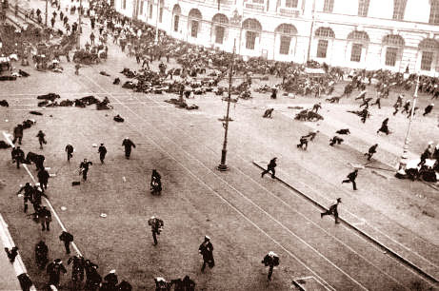
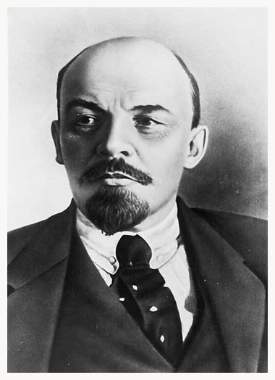
Red Scare
Started with the Russian Revolution
The Bolsheviks took power
Lead by Vladimir Lenin
The red flag is the party’s emblem
Union of Soviet Socialist Republics (USSR)
Official ideology: Communism

Slide 9
Red Scare
Communism
government owned property
single political party
needs of country over rights of individuals
Bolsheviks seek to spread Communism
Against American beliefs and values
Capitalism
Private ownership
First Amendment freedoms

Slide 10
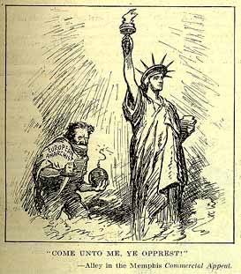
Red Scare
Red Scare: intense fear of communism and other politically radical ideas
Leads to widespread distrust of European (particularly Eastern European) immigrants
Communist Party forms in U.S. (includes IWW and other socialist radicals)
Very small but rhetoric begins to scare the public

Slide 11
Red Scare – Hysteria takes over
Several bombs mailed to government and business leaders, igniting a panic over fear of “Red” takeover
Government decides to take action

Slide 12
Red Scare – Hysteria takes over
Palmer Raids
Attorney General (Palmer) appoints J. Edgar Hoover to hunt down suspected Communists and anarchists
Antiradical department later becomes FBI
Suspension of rights
Raided private property without search warrants
Jailed and deported suspects without lawyers or trials
No evidence found. Palmer lose credit after predicting government overthrow that never happens.

Slide 13
Red Scare – Hysteria takes over
Sacco and Vanzetti
Italian immigrants
Arrested after meeting description of fugitives who killed factory paymaster and stole the money
Both had alibis
Circumstantial evidence
Prejudiced judge
Sentenced to die in electric chair
50 years later, governor ruled that trial had been unfair

Slide 14
Devil in New England
As Puritans began losing a stronghold on their “city upon a hill” fear of witchcraft heightened
Prompted by accusations of young girls against societal outcasts, a witchhunt hysteria broke out in 1692
Hundreds (majority women, but many men as well) will be accused and imprisoned
20 will be executed (19 hanged, 1 pressed)
Trials were based on presumption of guilt
Accused could admit being a witch to avoid execution, but only if they were willing to accuse others.
Accusations seemed at times to be politically motivated

Slide 15
Social Hysteria Formula
Fear
(often irrational &/or ignorant)
↓
Hatred
(prejudice, paranoia)
↓
Action
(violent, legal, political)

Slide 16
Hysteria Cycle
Social Hysteria has occurred over and over again in US History on different levels.
Using the formula, can you think of 3 other examples besides the Salem Witch Trials?

Slide 17
Social Hysteria Today
Muslims
Travel bans, general distrust
Undocumented immigrants
Seattle property manager

Slide 18
Homework
Prepare for our Structured Academic Controversy (mini mini debate)
Read the documents provided and fill in your prep worksheet. You can also use Section 26.4 of your book. Good academic internet research is acceptable (only as needed).
Be ready to give a 3 minute argument and a 3 minute rebuttal

