Slide 1
The British Raj
The British imperialize India
Tre, Jackson, Maya, Saya

Slide 2
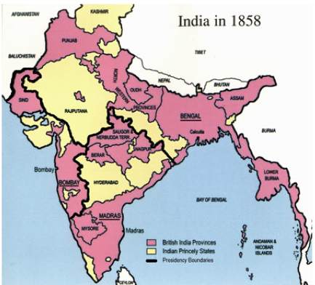
Before the start of the Raj 1858
Ruling Mughals became weak in power
The British East India company took over India
Great Britain saw India as the “Jewel in the Crown”
New developments (railroad Networks)
The Sepoy Rebellion

Slide 3
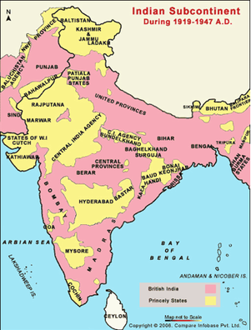
During the Raj (1919-1947)
Amritsar Massacre
General Dyer opened fire on 20,000 unarmed civilians
Swaraj Party end the boycott movement started by Gandhi
Dandi March began in 1930
walk from Sabarmati Ashram in Ahmedabad to the place called Dandi in Mumbai

Slide 4
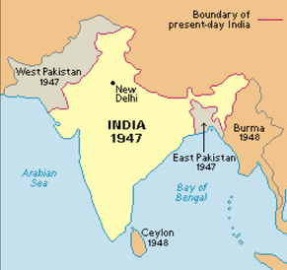
After the Raj 1947
After the British withdrew, separated muslims into their own country (Pakistan) and Hindus in their own (India)
Violence continued due to territorial disputes
Jawaharlal Nehru:
first prime minister after the British left
helped India become a stable democracy

Slide 5
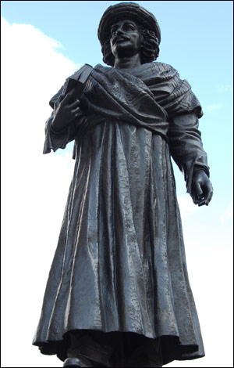
Ram Mohun Roy
Born: May 22, 1772, Died: September 27, 1833
Importance:
social vision and the striking modernity of his thought
Began campaign to move India away from traditional practices/ideas
Inspired other indian reformers
adoption of western ways
founded social reforms movement that changed india

Slide 6
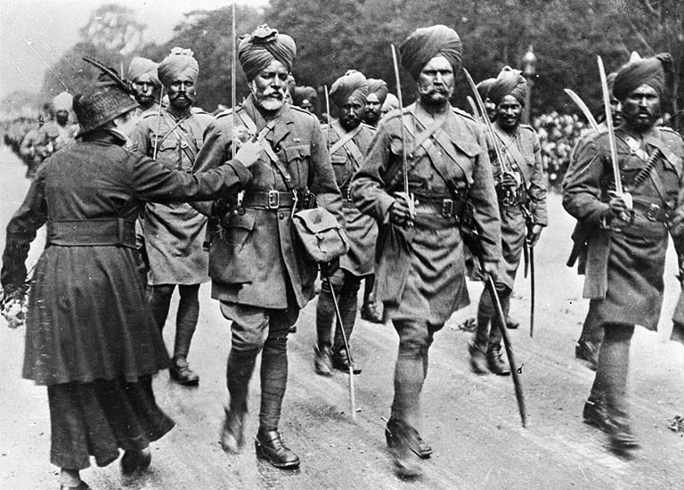
Sepoys
Indian soldiers who staffed the East India Company’s army
“A delicate and dangerous machine, which a little mismanagement may easily turn against us”
Rebelled and fled to Delhi during the Sepoy mutiny

Slide 7
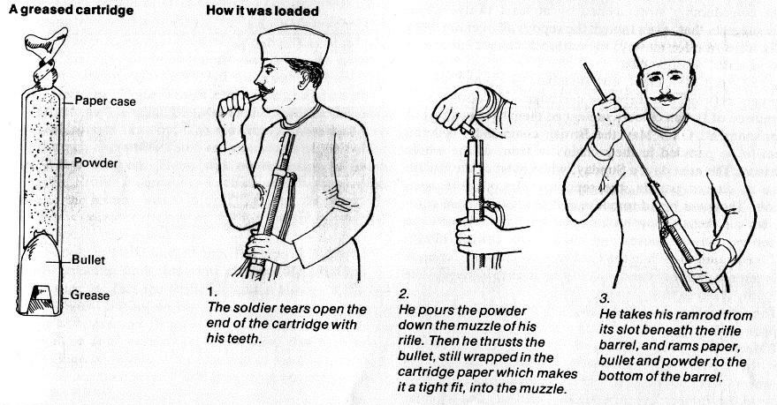
Sepoy Mutiny (Rebellion)
Enfield rifles (guns)
to load ammo, soldiers bite open cartridges
Rumors: cartridges greased with pig/cow
85 sepoys refused to use the guns
Muslims and Hindus outraged
May 10th, Sepoys rebelled
Fled to Delhi
British and Sepoys slaughtered one another
Indians and British could not unite
Due to weak leadership/opposition of Hindus and Muslims

Slide 8
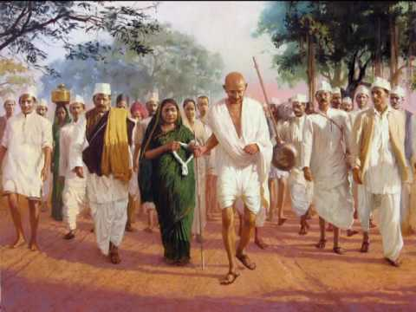
Dandi March
Dandi March was a major nonviolent protest located in India, led by Mohandas Gandhi in March–April 1930
The march was the first act in an larger movement of civil disobedience
Gandhi’s intent:
Try to overthrow British rule in India that went into the early 1931

Slide 9
Nationalists Groups Form
Growing nationalism >> 2 nationalist groups
The Indian National Congress 1885
Muslim League 1906
Created concerns for the Indians
Both wanted self-government
Nationalists inflamed by Partition of Bengal
Too large for administrative purposes
Led to division of Hindus/Muslims
Also led to terrorism

Slide 10
Government
The government consisted of British officials that were headed by the viceroy and the appointed members of the council
The British government regulated the East India Company in London and India
Each of British India's eleven provinces had its own governor, assisted by similar provincial legislative councils of appointed officials

Slide 11
Social Organization
Indian Servants
Reflects the class system in India
Indian Servants: divided into 4 categories called Varna
The British Army
Brahmin
Priests
Kshatriya
Warriors/Kings
Officers
Vaishya
Merchants/Landowners
Sergeants
Sudra
Commoners/Peasants/Servants

Slide 12
Economy
After independence India rebuilt their economy with the 5 year plan
The British set up restrictions
Prevented the Indian economy from operating on its own
British forced India to produce raw materials for the British and to buy the goods produced

Slide 13
Works Cited
"Bristol Honours Indian Reformer." BBC.co.uk, www.bbc.co.uk/bristol/content/articles/2008/10/03/rammohun_roy_feature.shtml. Accessed 25 May 2018.
Eger, Chris. "How Gun Lube Brought down the British Empire." guns.com, 9 Jan. 2013, www.guns.com/2013/01/19/how-gun-lube-brought-down-the-british-empire. Accessed 25 May 2018.
"Government of the Raj 1858-1914." Parliament.uk, www.parliament.uk/about/living-heritage/evolutionofparliament/legislativescrutiny/parliament-and-empire/parliament-and-the-american-colonies-before-1765/government-of-the-raj-1858-1914. Accessed 24 May 2018.
"History of Indian Economy." Cgijeddah.mkcl.org, cgijeddah.mkcl.org/WebFiles/History-of-Indian-Economy.pdf. Accessed 25 May 2018.
"The Indian Sepoy." Yprespeacemonument, www.yprespeacemonument.com/the-indian-sepoy. Accessed 24 May 2018.
"Presentation on Dandi March." Youtube.com, uploaded by Priyanshu Dhokne, 7 Feb. 2017, www.youtube.com/watch?v=LZfpP236_oo. Accessed 25 May 2018.
"Ram Mohun Roy." Britannica, Encyclopedia Britannica, Inc., 18 May 2018, www.britannica.com/biography/Ram-Mohun-Roy. Accessed 24 May 2018.
Reddy, Saicharan. "The British Caste System and India." Icytales, 15 Aug. 2015, www.icytales.com/british-caste-system/. Accessed 24 May 2018.
Turner, Taylor. "The British Raj." TheBritishRraj.weebly, thebritishraj.weebly.com/maps.html. Accessed 22 May 2018.
Walsh, Judith W. “Beginning of British Rule of India.” A Brief History of India, Second Edition, Facts On File, 2011. History, online.infobase.com/Auth/Index?aid=150531&itemid=WEHRC&articleId=264301. Accessed 23 May 2018.
Walsh, Ben. "Case Study 3 Background: The End of The British Empire in India." Nationalarchives.gov.uk, www.nationalarchives.gov.uk/education/empire/g3/cs3/background.htm. Accessed 23 May 2018.

Slide 14
Thank You!

