Slide 1
Template by Kevin Dufendach Updates at http://sites.google.com/site/dufmedical/jeopardy
JEOPARDY!
JEOPARDY!
Instructions
Board
not in any way endorsed or affiliated with the Jeopardy Game Show

Slide 2
Instructions
Reset
To start a new game, click the “reset” button on the board slide. This will reset the board, set each player’s score to 0, and randomly move the Daily Double.
Click “Adj Scores” from the board to manually change scores.
Click on the lights at the bottom to start a countdown (click below to change).
Incorrect response: Click the “incorrect” button if the player responds incorrectly, and their score will subtract.
Correct response: Press the “correct” button if the player responds correctly, and the correct response will then be shown.
To skip viewing the correct response, check the box below
If no one gets the question correct, press the arrow to go to the next slide (or return to the board if the checkbox below is checked).
Troubleshooting:
Do not delete the value shape (e.g. $400) from any slide. If you don’t like it, you can move it off the screen, but DON’T DELETE IT, and don’t change its text!!!
Do not delete question slides and copy them in from somewhere else. You can do this to replace “answer” slides, but just not question slides (unless you re-apply the hyperlinks to the board)
If none of the functions are working, see “Macro Troubleshooting”
Adjust Countdown Timer
Import from Excel Template (Template available online)
Template by Kevin Dufendach. Updates at http://sites.google.com/site/dufmedical/jeopardy
Please send questions and comments to krd.public+Jeopardy@gmail.com

Slide 3
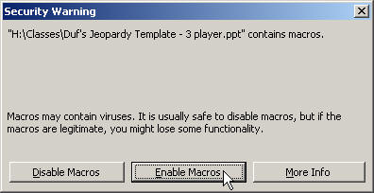
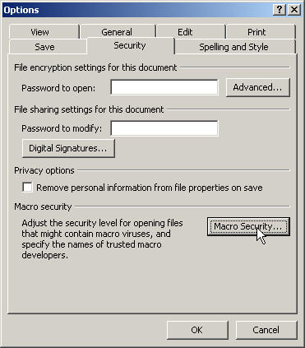
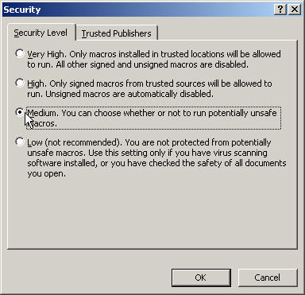
Macro Troubleshooting
If you’re having trouble getting this PowerPoint to work, be sure to “Enable Macros” when opening the file.
If you don’t see this box when you open PowerPoint, your security settings may be set too high. In this case, go to the “Tools” menu and select “Options.” Click on [Macro Security…] and then select “Medium.” Press OK until you return to the show. Now save this file and then re-open it. You should now receive the dialog shown above. Click “Enable Macros”
Note: some of the functions may not work with versions of PowerPoint other than PowerPoint 2010 for Windows

Slide 4
Board
E3
The Daily Double is located at:
Move to reveal location
Instructions
Adj Scores
Reset
Double
GD/New Deal
WWII
1950s
Cold War
1960s
Civil Rights
$100
$100
$100
$100
$100
$100
$200
$200
$200
$200
$200
$200
$300
$300
$300
$300
$300
$300
$400
$400
$400
$400
$400
$400
$500
$500
$500
$500
$500
$500

Slide 5
Shanty towns built outside cities
$100

Slide 6
What is a Hooverville?
$100

Slide 7
Provided work for artists, actors, musicians
$200

Slide 8
What is the WPA?
$200

Slide 9
Photos documented lives of migrant workers
$300

Slide 10
Who is Dorothea Lange?
$300

Slide 11
Separates commercial and investment banking
$400

Slide 12
What is Glass-Steagall?
$400

Slide 13
First female cabinet member
$500

Slide 14
Who is Frances Perkins?
$500

Slide 15
Brutal march of U.S. POWs across the Philippines
$100

Slide 16
What is the Bataan Death March?
$100

Slide 17
September 2, 1945
$200

Slide 18
What is VJ Day?
$200

Slide 19
Ordered the internment of Japanese Americans
$300

Slide 20
What is Executive Order 9066?
$300

Slide 21
Project to develop the Atomic bomb
$400

Slide 22
What is the Manhattan Project?
$400

Slide 23
The Japanese went on the defense after this battle
$500

Slide 24
What is the Battle of Midway?
$500

Slide 25
Group of movie directors accused of Communist activities
$100

Slide 26
Who are the Hollywood Ten?
$100

Slide 27
Fear, Anger, Action
$200

Slide 28
What is the Social Hysteria Formula?
$200

Slide 29
Organization to find and questions suspected communists
$300

Slide 30
What is HUAC?
$300

Slide 31
Led a hunt against Soviet spies in America
$400

Slide 32
Who is Joseph McCarthy?
$400

Slide 33
Nickname for the Korean War.
$500

Slide 34
What is the Forgotten War?
$500

Slide 35
MAD
$100

Slide 36
What is Mutual Assured Destruction?
$100

Slide 37
13 day standoff in Cuba between the U.S. and USSR
$200

Slide 38
What is the Cuban Missile Crisis?
$200

Slide 39
Policy of keeping communism from spreading
$300

Slide 40
What is containment?
$300

Slide 41
The Berlin Wall came down in this year
$400

Slide 42
What is 1989?
$400

Slide 43
Decisions at this conference are said to have led to the Cold War.
$500

Slide 44
What is Yalta?
$500

Slide 45
LBJ's domestic policy
$100

Slide 46
What is the Great Society?
$100

Slide 47
The sexual revolution is an example of this
$200

Slide 48
What is counterculture?
$200

Slide 49
JFK's domestic policy
$300

Slide 50
What is The New Frontier?
$300

Slide 51
Main goal of LBJ's domestic policy
$400

Slide 52
What is reduce poverty?
$400

Slide 53
JFK was assassinated on this day
$500

Slide 54
What is November 22, 1963
$500

Slide 55
LBJ sent in the National Guard to protect this group
$100

Slide 56
Who are the Little Rock Nine?
$100

Slide 57
Phrase that made enforcing Brown v. Board difficult
$200

Slide 58
What is "All deliberate speed"?
$200

Slide 59
Organized farm workers into unions for better working conditions
$300

Slide 60
Who is Cesar Chavez?
$300

Slide 61
The goal of Freedom Summer
$400

Slide 62
What is to register voters?
$400

Slide 63
This outlawed poll taxes
$500

Slide 64
What is the 24th amendment?
$500

Slide 65
DAILY
DOUBLE
Enter your wager:
$
Go!

Slide 66
Board
Move to reveal location
D2
B4
The Daily Doubles are located at:
Move to reveal location
Instructions
Adj Scores
Single
Final
Vietnam
1970s/80s
1990s/Modern America
Wars
People
Grab Bag
$200
$200
$200
$200
$200
$200
$400
$400
$400
$400
$400
$400
$600
$600
$600
$600
$600
$600
$800
$800
$800
$800
$800
$800
$1000
$1000
$1000
$1000
$1000
$1000

Slide 67
A massacre by U.S. soldiers in this village was hidden by the government
$200

Slide 68
What is My Lai?
$200

Slide 69
Main tactic used to find the Viet Cong
$400

Slide 70
What is Search and Destroy missions?
$400

Slide 71
Lowered the voting age to 18
$600

Slide 72
What is the 26th amendment?
$600

Slide 73
Gave President Nixon almost complete power over the war
$800

Slide 74
What is the Gulf of Tonkin Resolution?
$800

Slide 75
Year of the cease-fire in Vietnam
$1000

Slide 76
What is 1973?
$1000

Slide 77
Series of staff firings by Nixon during the Watergate Scandal
$200

Slide 78
What is the Saturday Night Massacre?
$200

Slide 79
Reagan illegally gave money from arms sales to this country
$400

Slide 80
What is Nicaraugua
$400

Slide 81
Washington Post reporters that exposed the Watergate scandal
$600

Slide 82
Who are Woodward and Bernstein?
$600

Slide 83
A U.S. satellite shield against Soviet missiles
$800

Slide 84
What is the Strategic Defense Initiative?
$800

Slide 85
Policy that foreign nations must do more to help themselves
$1000

Slide 86
What is the Nixon Doctrine?
$1000

Slide 87
This person lost the election of 1992
$200

Slide 88
Who is George H.W. Bush?
$200

Slide 89
The Persian Gulf War was fought to free this country from Iraqi control
$400

Slide 90
What is Kuwait?
$400

Slide 91
This was the Republican plan for what they would do if they won control of the House
$600

Slide 92
What is the Contract with America?
$600

Slide 93
The U.S. stepped in to help stop a genocide in this country
$800

Slide 94
What is Bosnia?
$800

Slide 95
First female secretary of state
$1000

Slide 96
Who is Madeleine Albright?
$1000

Slide 97
Policy used by Great Britain to try and pacify Hitler
$200

Slide 98
What is appeasement?
$200

Slide 99
Korea was divided along this line
$400

Slide 100
What is the 38th parallel?
$400

Slide 101
Attack by North Vietnam on S. Vietnam, including the U.S. Embassy
$600

Slide 102
What is the Tet Offensive?
$600

Slide 103
Leader of the army during the Persian Gulf War
$800

Slide 104
Who is Norman Schwarzkopf?
$800

Slide 105
Policy used to get around Neutrality and help China after the Rape of Nanking
$1000

Slide 106
What is Cash and Carry?
$1000

Slide 107
Leader of U.S. forces during the Korean War
$200

Slide 108
Who is General MacArthur?
$200

Slide 109
Believed Black people to be the superior race and did not agree with desegregation
$400

Slide 110
Who is Pre-Mecca Malcolm X?
$400

Slide 111
Leader of North Vietnam at the beginning of the war.
$600

Slide 112
Who is Ho Chi Minh?
$600

Slide 113
First female attorney general
$800

Slide 114
Who is Janet Reno?
$800

Slide 115
Special prosecutor during the Watergate Scandal
$1000

Slide 116
Who is Archibald Cox?
$1000

Slide 117
Massive recounts in this state led to a delay in the election of 2000
$200

Slide 118
What is Florida?
$200

Slide 119
Mistrust created by government lies during the Vietnam War
$400

Slide 120
What is the Credibility Gap?
$400

Slide 121
Lunch counter sit-in during the civil Rights Movement
$600

Slide 122
What is the Woolworth incident?
$600

Slide 123
Nationalized congressional elections during the early 1990s
$800

Slide 124
Who is Newt Gingrich?
$800

Slide 125
Mrs. Santos was talking about this when she accidentally said a swear word.
$1000

Slide 126
What is Hitler's invasion of Russia?
$1000

Slide 127
DAILY
DOUBLE
Enter your wager:
$
Go!

Slide 128
DAILY
DOUBLE
Enter your wager:
$
Go!

Slide 129
Civil Rights Movement
Final
Jeopardy
This created laws against discrimination in public places and the workplace
Reveal Prompt
Reveal Response

Slide 130
What is the Civil Rights Act of 1964?
✓
✗
✓
✗
✓
✗
✓
✗
✓
✗
✓
✗
✓
✗
✓
✗

