Slide 1
Warm Up 10/9
What ideas influenced the creation the world’s first modern democracy?
Think back: people, movements, ideals

Slide 2
Ideas that shaped colonial views on government
Drew on political ideas and ethics from ancient times
Judeo-Christian traditions
Justice
Morality (right from wrong)
Natural Law of Nature’s God

Slide 3
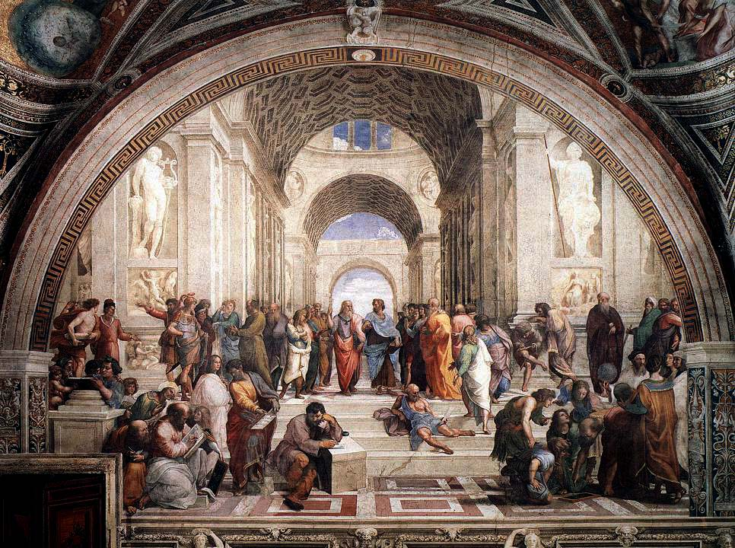
Ideas that shaped colonial views on government
Ancient Greece
Direct Democracy – decisions made by all citizens
Roman Republic
Representative Gov’t
Civic Virtue –Your duty to serve your country

Slide 4
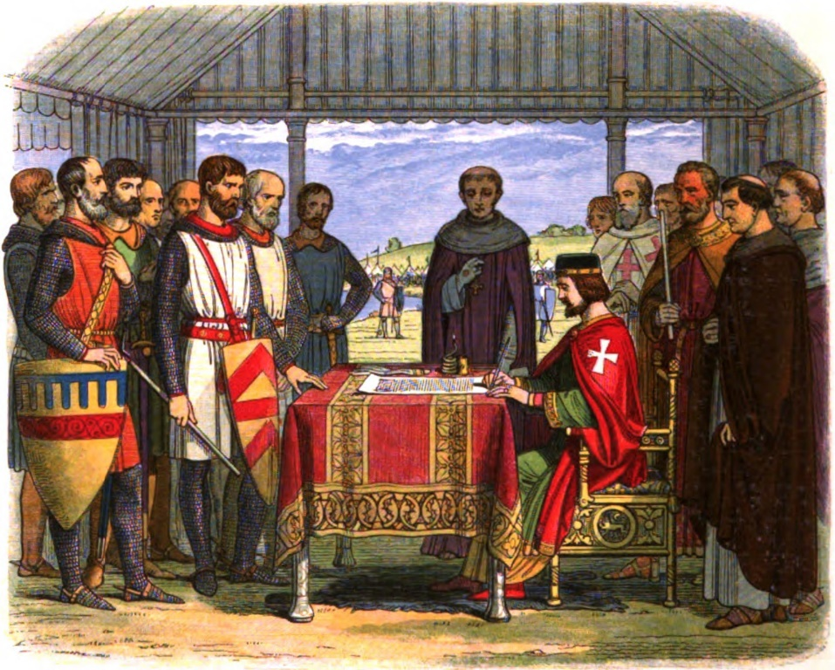
English Roots of American Government
English common law & Constitution
Set of laws, customs and practices that limited government and protected certain rights
3 key documents
Magna Carta
Limited King’s power
Rule of Law
King subject to law

Slide 5
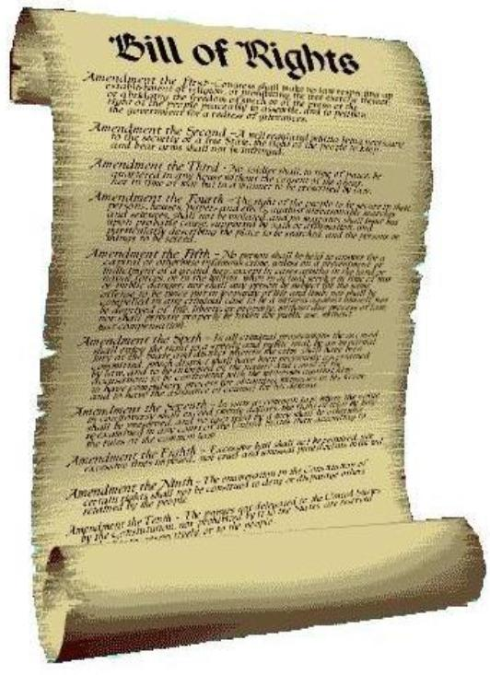
English Roots of American Government
3 key documents
Petition of Rights
Prohibited arrests
Prohibited quartering of troops
King’s power not absolute
English Bill of Rights
Reaffirmed individual rights
Similar to U.S.

Slide 6
English Enlightenment Thinkers
Enlightenment = science/reason to improve society and government
Thomas Hobbes
Social Contract Theory with absolute government
John Locke
Social Contract Theory with natural rights
Power can be taken
Social Contract Theory: Give up some freedom in exchange for security and order –gov’t by the people
Justifies the revolution. If gov’t abuses power, it’s the people’s right to overthrow the Gov’t.

Slide 7
French Enlightenment Thinkers
Baron de Montesquieu
Gov’t organization should prevent one group/person from dominating
Separation of Powers or 3 branches
Jean-Jacques Rousseau
Added idea of popular sovereignty to the social contract
Legitimacy comes from the will of the people
If not the will of the people, gov’t should be dissolved

Slide 9
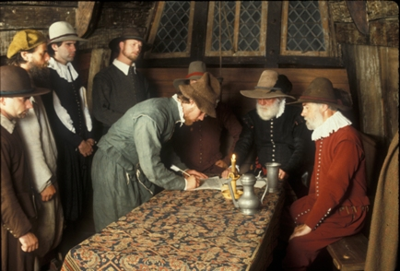
From Ideas to Independence
First colonies were created for financial purposes.
The 13 developed differently depending on resources, location, etc.
Each developed their own forms of Democracy
First Form of Self government- The Mayflower Compact
First elected assembly:
Virginia’s House of Burgesses

Slide 10
Road to Independence
French and Indian War – Ends in 1763
Thought colonist should pay for war and protection
Stamp Act- “Taxation without Representation”
Colonist united in protest against the British Govt.
Tea Act > Boston Tea Party > Intolerable Acts
Militias begin forming
Reps meet to seek peace, but eventually declare independence.

Slide 11
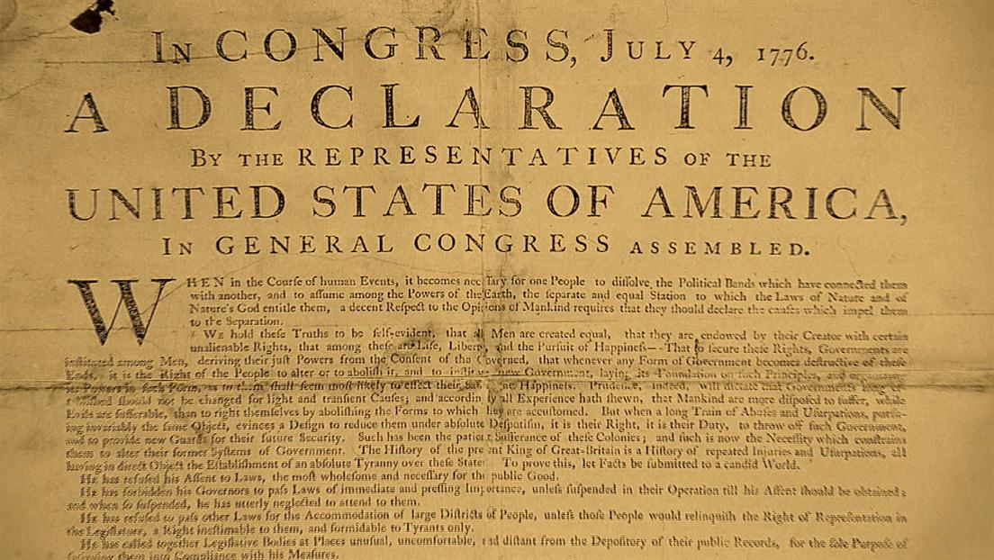
Winning Independence
Declaration of Independence
Influenced by Enlightenment ideals
America wins (barely, with French help)
Initially governed by Articles of Confederation
Loose contract between states
Limited government taken too far
Quickly becomes a problem

Slide 12
Homework Due Tomorrow
Critically read the Declaration of Independence
Highlight the Enlightenment Ideas
For each one try to annotate the source of the idea
Judeo Christian value
Magna Carta
English Bill of Rights
Locke, Rousseau, Montesquieu
Specify things like Social Contract Theory, individual rights, popular sovereignty, civic virtue

