Slide 1
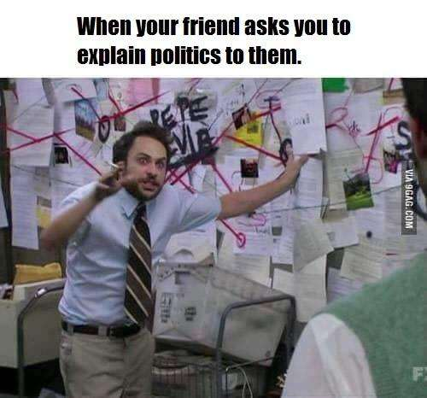
Warm Up 11/13
Name 3 things you know about our political party system.

Slide 2
Political Parties
What is a Political Party?
An organization that seeks to gain power by electing members to public office.
What type of party system do we have?
Two Party system (vs. multi-party)
Not intended by Founders

Slide 3
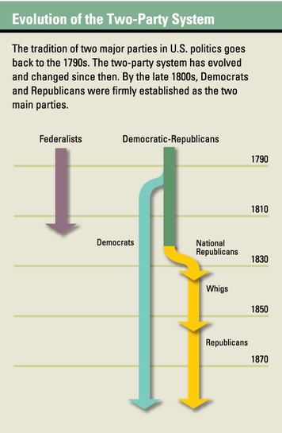

Slide 4
Two Party System
Benefits (supposedly)
Stability
Wide coverage of issues
Drawbacks
Contention and division
Less choice in candidates
Corruption
Divided government
Less informed public
Civic disengagement

Slide 5
Political Parties
Roles of Political Parties
Recruit Candidates and support campaigns
Organize elections and inform voters
Help organize government
Roles have become widely corrupted in recent years
Tend to choose candidates that will win rather than those that will be good at their jobs
Often use attacks of other side instead of informing voters
Create deep divide in government that makes enacting policies difficult

Slide 6
Republicans and Democrats
Different opinions around major issues
Size of national government
Taxes
Regulation of Business
Social Issues
Environment
Nothing is set in stone and opinions change depending on the situation.
Very difficult to say someone is “conservative” or “liberal”

Slide 7
The Political Spectrum
Liberals
2016
Conservatives
B. Sanders
H. Clinton
Sarah Palin
G. Johnson
Democrats
Republicans
*Jeffersonian Republicans
Green Party
*Federalists
Tea Party
Taliban
Fascists
Communists
*Whigs
Constitution Party
Socialists
Occupy Wall Street
Libertarians
Moderates
Revolutionaries
Radicals

Slide 8
Third Parties
Single Issue
Green Party
Ideology
Socialist Party
Economic Protest
Populist Party
Splinter Groups
Tea Party

Slide 9
Special Interest Groups
Basically a club within politics that tries to influence policy to achieve a specific goal
NRA
PETA
Wilderness Society
Achieve goals through lobbying $$$
Is this good or bad?
Political Action Committees (PACs)
Group that collects money and funnels it into campaigns
Often seen as a way to bypass campaign finance laws

Slide 10
Discuss
Are interest groups more good or bad? What makes them powerful?

Slide 11
What We Will See
Political Parties are not stagnant
Platforms and ideologies are constantly changing
Party affiliation does not determine action
Individuals will be diverse within parties
Parties can be reactionary
May change rhetoric in response to other side or events
What they say is not the same as what they do
What they claim to be can be very different from what they actually are

Slide 12
Warm Up 11/14
Name 3 things you think Republican believe.

Slide 13
Who is the Republican Party today?
Today you (or you and one other person) will be researching the Republican Party. Start at the official GOP site and look at the party platform (no need to read every detail). Then I want you to find AT LEAST 3 other legitimate sources about Republican beliefs. By the end, you should be able to answer the following (IN YOUR OWN WORDS):
What are the GOP’s core beliefs?
Look specifically at government, economics, and social issues.
What do people think the GOP wants?
What does the GOP claim it will do? (Try to look at different Republican politicians for this)
You must cite each source and give a brief explanation of the potential bias in the source. Use good news analysis!
Upload answers and Works Cited (MLA format) to Turnitin.com when you are finished.

Slide 14
Warm Up 11/16
How does the Republican platform line up with what others think they want and with what they claim to do?

Slide 15
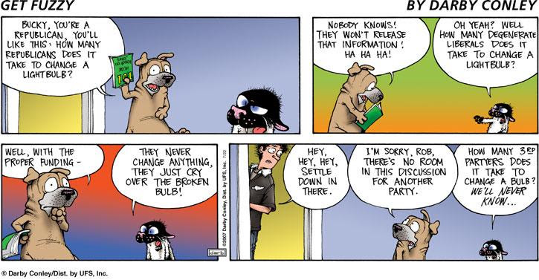

Slide 16
GOP and Reagan
For nearly 30 years, the Republican Party has increasingly resembled a religion, with Ronald Reagan as its deity. Party leaders endlessly quote him, and every GOP presidential nominee until Donald Trump ran on a platform they thought was barely changed from Reagan’s 1980 campaign. No wonder conservative talk radio icon Rush Limbaugh calls our 40th president “Ronaldus Magnus”: Ronald the Great.
This religion’s creed—let’s call it Reaganism—is simple. Government and taxes are bad, private entrepreneurship and supply-side economics is good. Social conservatism and unofficial endorsement of Christianity is essential to national well-being. Around the world, America should speak loudly, carry the biggest stick and never be afraid of using it. Proclaim and practice these truths and political success will be yours. (Politico)
Reagan’s conservatism actually fit squarely within Franklin D. Roosevelt’s New Deal consensus, not the anti-New Deal conservatism that forms Reaganism’s heart.

Slide 17
Ronald Reagan: 1981-1989
During his term in office, Reagan campaigned vigorously to restore organized prayer to the schools, first as a moment of prayer and later as a Moment of Silence
1981 tax cuts sent country into recession.

Slide 18
Ronald Reagan: 1981-1989
Reagan is viewed as an antitax hero despite raising taxes eleven times over the course of his presidency, all in the name of fiscal responsibility. According to Paul Krugman, "Over all, the 1982 tax increase undid about a third of the 1981 cut; as a share of GDP, the increase was substantially larger than Mr. Clinton's 1993 tax increase." According to historian and domestic policy adviser Bruce Bartlett, Reagan's tax increases over the course of his presidency took back half of the 1981 tax cut.

Slide 19
Ronald Reagan: 1981-1989
Some economists, such as Nobel Prize winners Milton Friedman and Robert Mundell, argue that Reagan's tax policies invigorated America's economy and contributed to the economic boom of the 1990s. Other economists, such as Nobel Prize winner Robert Solow, argue that Reagan's deficits were a major reason his successor, George H. W. Bush, reneged on a campaign promise and resorted to raising taxes.

Slide 20
Ronald Reagan: 1981-1989
Of course, Reagan was not just an ideologue; he had a pragmatic streak that allowed him to cut deals with Democratic foes on Capitol Hill. Despite his reputation as a driver of economic growth, his policies produced large deficits. He presided over tax increases that would be out of the question for conservatives now, and he extended an amnesty to undocumented immigrants, a step no GOP candidate could contemplate today
Reagan, though an anti-communist to his core, also recognized that sometimes it pays to talk to America's enemies -- seeing in Soviet leader Mikhail Gorbachev a man with whom he could hasten the end of the Cold War. While Republicans slam President Barack Obama for making concessions to Iran, it's often forgotten that the Reagan administration sold arms to Tehran to win the release of hostages in Lebanon.

Slide 21
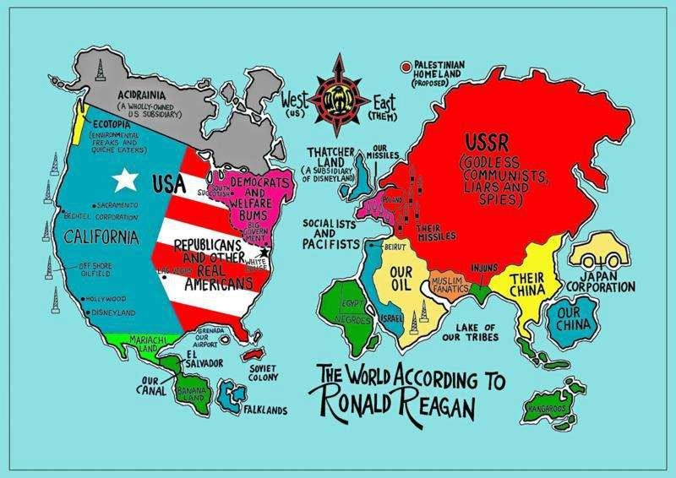

Slide 22
GOP and Reagan
Republicans embraced the political knife-fighting tactics of Newt Gingrich in the 1990s and light-as-air political figures like Sarah Palin in the 2000s. Many Republicans--including self-proclaimed "constitutional conservatives"--began to speak of compromise as a synonym for capitulation, which is odd given that the Constitution itself was the result of a whole series of accommodations--and Reagan was a gifted compromiser.
Republicans became suspicious too of the "spirit of moderation" that James Madison argued is essential in understanding which measures are in the public good. What many modern Republicans are looking for is conflict, confrontation, the politics of the cage match.

Slide 23
GOP and Reagan
The shadow he cast was so large that many of the Republicans who followed him could not escape it. For them, every year was 1981. Every problem could be solved by simplistically applying Reagan's policy to it, even if the situations were not remotely comparable. (When Reagan took office, the inflation rate was in the double digits. Today it is less than 2%.) Republicans became uncreative and intellectually lazy. They placed themselves in an ideological straitjacket, trying to be more Reagan than Reagan (for example, promising they would not raise any taxes under any conditions for any amount of spending cuts). In the process, they became captive to the past.
Notes:
2012 Candidate question

Slide 24
Homework Due 11/17
Find and bring a hard copy of a current new article about the Republican party. It can be about the party as a whole (positive or negative, a specific politician, or a news article about a current issue from a heavily biased republican source (like Fox News etc.)
You will be sharing your news with the group in a graded discussion and comparing/contrasting how your source fits in with Republican ideology/Reaganism/the public perspective of the party.

Slide 25
Warm Up 11/17
Write down a brief analysis of your source for today. Consider the purpose, audience, and any apparent bias you noticed.

Slide 26
Discussion Questions
What does your article tell us about the Republican Party?
What connections to the GOP idea of Reaganism do you see?
What can these sources tell us about the public perspective on Republicans?

Slide 27
Homework Due 11/20 Take 2!
This weekend you will research both the GOP and the DNC. The official party websites should be your main source (https://www.gop.com/platform/ , https://www.democrats.org/party-platform )
though other legitimate, relatively unbiased sources may also be used.
You should focus on what their party claims to believe/do in regards to the following issues:
Government reform/elections, Taxes/middle class/wealthy, families/healthcare/education, foreign policy
Making a table/chart of the parties side by side would be a good way to record your information.

Slide 28
Warm Up 11/20
After your research, what do you think is the main difference between Republicans and Democrats?

Slide 29
Let’s see what we learned!
(You should be adding to your chart/notes from the weekend).

Slide 30
Government Reform/Elections
Democrats (DNC)
Republicans (GOP)
Protect/Expand Social Security
LGBTQ Rights
Government for social reform
Make voting easier
Publicly financed elections
Eliminate Super PACs
Combat Climate change
College funding and more funding for public schools
Saving Social Security
Reduce size of government
Term Limits
Less government regulation
Pro-Electoral College
Strict voter ID laws
Notes:
GOP: nothing on Campaign Finance

Slide 31
Taxes
Democrats (DNC)
Republicans (GOP)
Taxes wealthy (over $250,000) to help SS
Close loopholes and tax evasions
Tax Wall Street
Tax relief for disabled
Child care tax relief
Clean energy tax cuts
No raising taxes
Reform tax code
Notes:
GOP: nothing on Campaign Finance

Slide 32
Families/Healthcare/Education
Democrats (DNC)
Republicans (GOP)
LGBTQ Rights
Universal Health Care
Mental Health/Addiction programs
Medicare/Medicaid protection
Federal involvement in education
One man/one woman
Education choices
No federal, one size fits all gov. education program
Repeal ACA
Notes:
GOP: nothing on Campaign Finance

Slide 33
Foreign Policy
Democrats (DNC)
Republicans (GOP)
Avoid ground troops in foreign conflicts
Iran nuclear agreement
Fighting foreign aggression
Negotiate when it’s in our interests
Support for Israel
Anti-Iran Deal
Destroy threats to allies
Taiwan Reagan policy
Notes:
Lying on both sides (Trump praised North Korea, Trump forged NATO)

Slide 34
How did the wording differ between the 2 platforms? What were their tactics?

Slide 35
Homework
Review your Landmark Supreme Court Case notes.
Quiz on Wednesday!
Notes:
https://youtu.be/XoBFL6iwid4
https://youtu.be/Pt-LDpxS5iQ
http://www.politifact.com/truth-o-meter/statements/2015/aug/19/bill-clinton/bill-clinton-glass-steagall-had-nothing-do-financi/
https://www.theatlantic.com/politics/archive/2016/07/newt-broke-politicsnow-he-wants-back-in/491390/
https://www.huffingtonpost.com/steven-m-gillon/the-gingrich-revolution-a_b_8272054.html

Slide 36
Warm Up 11/21
What has been your favorite thing to discuss so far this year?
Least favorite?
Notes:
http://www.politifact.com/truth-o-meter/statements/2015/aug/19/bill-clinton/bill-clinton-glass-steagall-had-nothing-do-financi/
https://www.theatlantic.com/politics/archive/2016/07/newt-broke-politicsnow-he-wants-back-in/491390/
https://www.huffingtonpost.com/steven-m-gillon/the-gingrich-revolution-a_b_8272054.html
https://verdict.justia.com/2012/11/16/the-politics-of-polarization-and-obstructionism

Slide 37
Socratic Seminar
Your assessment for political parties/campaigns and elections will be a Socratic seminar revolving around the people and events that impacted the evolution of political parties into what we know today. You should be taking careful notes and keeping track of your readings to collect evidence to use in our seminar.

Slide 38
The Clinton Presidency
1993-2001
Former governor of Arkansas
Highly successful
Plagued with rumors of scandal
First Democrat to win 2 terms since FDR
Ran as “New Democrat”
https://youtu.be/XoBFL6iwid4
https://youtu.be/Pt-LDpxS5iQ

Slide 39
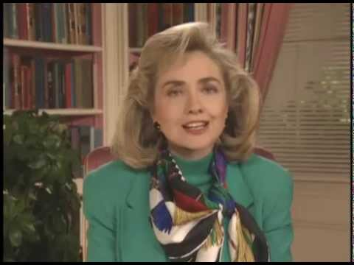
The Clinton Presidency
Democratic policies
Universal Health Care
Ultimately failed
Appointment of Hillary controversial
Seen as too socialist

Slide 40
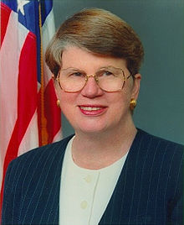
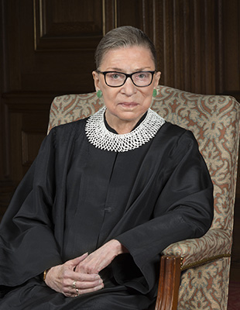
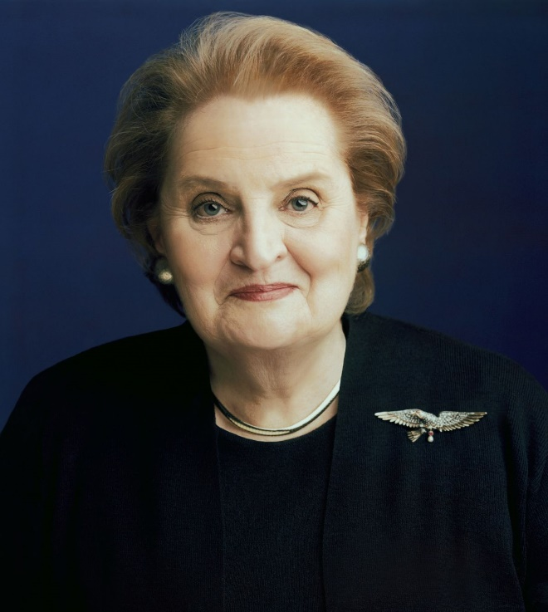
The Clinton Presidency
Democratic policies
Female appointments
Janet Reno
Madeleine Albright
Ruth Bader Ginsburg

Slide 41
The Clinton Presidency
Democratic policies
Social Reform
Violence Against Women Act
Family and Medical Leave Act

Slide 42
The Clinton Presidency
Right/Centrist Compromises
Don’t Ask Don’t Tell
Defense of Marriage Act (ironic much?)
Strict Immigration laws
Repeal of Glass-Steagall
https://youtu.be/gCVFWWZ-gRM

Slide 43
The Clinton Presidency
Plagued by Scandal
Early appointments resigned
Monica Lewinsky
Impeachment
Not for having the affair, but for lying about it

Slide 44
Activity
Read the article about the repeal of Glass-Steagall. Answer the following on a separate sheet of paper
Was the repeal of Glass-Steagall as bad as people make it out to be?
Based on what we’ve learned thus far, what effect did Clinton have on the Democratic Party?
Did Clinton live up to Democratic ideals, or was he indeed a “new democrat”?

Slide 45
Quiz Time!
Take 3 minutes to review your notes.

Slide 46
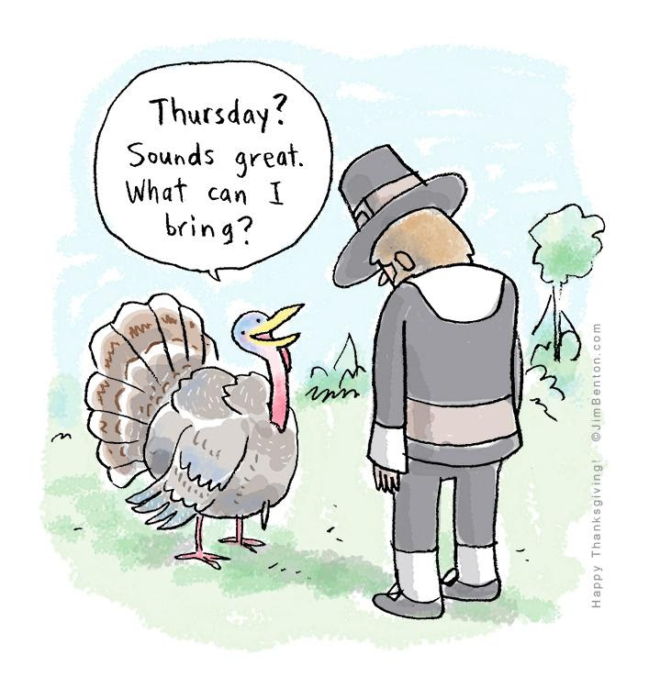
Warm Up 11/22
Turn to your table group and discuss your answers to the homework questions.

Slide 47
Gingrich Politics
1994 Contract with America
detailed the actions the Republicans promised to take if they became the majority party in the United States House of Representatives
in part using text from former President Ronald Reagan's 1985 State of the Union Address
Offered specific legislation in detail
Nationalized the Congressional Election

Slide 48
Gingrich Politics
Gingrich literally created the vocabulary of modern conservatism. During the 1980s, he hired marketing professionals to identify issues, “65 percenters,” that would resonate with a majority of the public. He then turned to a political action committee, GOPAC, to create tapes that were distributed to aspiring Republican candidates. The tapes developed a vocabulary of positive words (magnets) to use to describe Republican initiatives — liberty, freedom, truth, opportunity — while using “bad” words (wedges) to label the Democrats — decay, corrupt, permissive, and pathetic. The tapes taught an entire generation of young, combative Republicans to speak “Gingrich.”
The “wedges” and “magnets” would find their way into the 1994 “Contract with America” — perhaps Gingrich’s greatest political achievement. The contract turned Tip O’Neill’s dictum that “all politics is local” on its head. Instead, Gingrich nationalized 435 local races, turning them into a referendum on President Bill Clinton. Using GOPAC as a recruitment and training organization, Gingrich spent more than $8 million identifying the strongest potential Republican challengers and providing them with the themes, the “wedges and magnets,” to use against their Democratic opponents. Every month, GOPAC sent tapes to Republican candidates with ideas, tips, and advice from Gingrich.

Slide 49
Gingrich Politics
Gingrich’s strategy succeeded brilliantly. Not a single Republican incumbent for Congress or governor was defeated. Republicans seized control of both houses of Congress for the first time in 40 years. In Senate races, they won all nine open elections and defeated two incumbent Democrats. Republicans also scored well in the states, where they controlled the governor’s mansions in eight of the nine most populous states.
The new freshmen were “Gingrich’s children,” and they reflected his combative style of politics. They were young — over half were under the age of 45. They viewed themselves as outsiders, not professional politicians. Since they all won election in 1994 campaigning on the same platform of balancing the budget, reforming welfare, and cutting taxes, they were convinced they had a mandate to change the way politics was practiced in Washington. They were going to force change, not make deals.
On election night, Gingrich sat in his Atlanta headquarters waiting for the results. “How are we doing?” he asked one of his advisors. “Do you want the good news or the bad news?” the advisor responded. “Both,” Gingrich said. “The good news is that we are going to pick up a lot of seats.” Gingrich then asked for the bad news. “Wait until you meet them,” the advisor responded. “You won’t believe what a bunch of ideologues you are going to have to deal with,” he said, predicting: “They are going to kill you.”

Slide 50
Gingrich Politics
Unfortunately for him, an entire generation of Republicans have come to power adopting his strategy and his message, but failing to appreciate the distinction between means and ends. Today’s “Freedom Caucus” has embraced Gingrich’s strident political style, but they lack his appreciation of the art of governance. They seem nostalgic about the Gingrich-led government shutdowns in his first year as Speaker, but they forget that after initially overreaching, Gingrich worked closely with Clinton on a number of important legislative achievements, including a balanced budget bill…
http://abcnews.go.com/Politics/government-shutdown-president-obama-threatens-veto-house-republican/story?id=13314777
https://www.youtube.com/watch?v=Gj5-G01iRyk
Notes:
Citation: https://www.huffingtonpost.com/steven-m-gillon/the-gingrich-revolution-a_b_8272054.html

Slide 51
Gingrich Politics
Gingrich’s willingness to work with Clinton outraged conservatives — many of whom he had helped elect — who attacked him for making deals with the devil. After an abortive coup, they eventually forced him out of office
Notes:
Citation: https://www.huffingtonpost.com/steven-m-gillon/the-gingrich-revolution-a_b_8272054.html

Slide 52
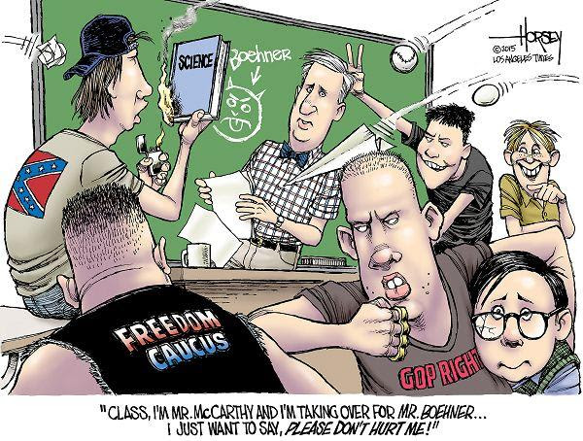

Slide 53
Gingrich Politics
Turning Government officials into full time politicians:
Gingrich’s acceleration of congressional money grubbing. As Lawrence Lessig, a Harvard Law professor and campaign-finance-reform obsessive, charged during Newt’s 2012 presidential run: “The transformation to this ‘Fundraising Congress’ began in 1993. Newt Gingrich was its leader.” Having ridden to power on a flood of money, Gingrich had every intention of staying there, noted Lessig. “The four years between 1994 and 1998, Republican candidates and party committees would raise over $1 billion. Never before had a party come anywhere close to raising that amount of money, because never before had any party’s leaders so effectively focused the energy of their members on this single task: fundraising.”
Then, of course, there was Gingrich’s push to nationalize congressional elections, making the qualities of any individual candidate less important than voters’ devotion to the overall party (or at least their antipathy toward the opposing team). And let us not forget Gingrich’s shortening of the congressional work “week” to three days. (Do not get House conservatives started on the insanity of the current schedule!)
http://fortune.com/2016/04/04/john-oliver-congress-fundraising-money/
https://www.cbsnews.com/news/60-minutes-are-members-of-congress-becoming-telemarketers/
Notes:
Citation: https://www.huffingtonpost.com/steven-m-gillon/the-gingrich-revolution-a_b_8272054.html

Slide 54
Gingrich Politics
It should be understood that political polarization is not merely a Republican election strategy, nor is it a consequence of Republicans’ rigid ideological thinking. Rather, polarization has long been part of a philosophy for controlling the country politically. It is a scheme that can be used to deliberately alienate Americans, by influencing their attitudes toward their government, while at the same, making the system unworkable. It can also be used to manipulate voters. (For instance, placing polarizing issues on a ballot can bring out voters who might not otherwise have voted). Republican partisans (with whom I have spoken) are planning to continue their efforts to frustrate President Obama with ongoing obstructionism and increasingly shrill politics, which they understand will further polarize Americans. They are angry that they losing and they are good at gumming up the works, for they have nothing to offer the country other than preventing Democrats from having their way. Making government unworkable is totally consistent with their philosophical feelings towards government. (Dean 2012)
Notes:
Citation: https://www.huffingtonpost.com/steven-m-gillon/the-gingrich-revolution-a_b_8272054.html

Slide 55
Warm Up 11/27
Do you think the American election system is a good one?

Slide 56
Elections/Campaigns Jigsaw
Section 10.3: Process/Problems in primary elections (include key words)
Section 10.4: General election campaigning (Tactics/potential Problems)
Section 10.5: Campaign Finance (tactics, laws, change/potential problems)

Slide 57
Warm Up 11/28
Name 2 new things you learned about the American election system.
Notes:
https://www.youtube.com/watch?v=2A5QlpAyKSQ

Slide 58
Election Process: Primaries
How a candidate gets the party nomination
Closed Primaries
Only registered party members vote
Open Primaries
Anyone can vote

Slide 59
Election Process: Campaigns
Issues v. Image
Packaging a candidates views to appeal to voters
Backing candidates that have a good political “image” and are thus more likely to win
Financing
Fill in gaps. Look for 527 committees, super PACs, McCain-Feingold, Citizens United v FEC
https://www.youtube.com/watch?v=2A5QlpAyKSQ

Slide 60
Election Process: Winning
Majority vs. Plurality
Idea is that candidate with majority wins
Reality is that whoever gets the most wins in a winner take all system
Candidates tend to focus on populous and battleground states
States likely to be close and can go to either party
Notes:
Winner take all vs. proportional representation – allows smaller parties to participate

Slide 61
Election Process: Potential Problems
Electoral College
Campaign finance abuse/corruption
Tends to favor wealthy individuals
Voting methods and close elections
Electronic – hacking/glitches
Paper
Hanging chads
Butterfly ballots
Faulty vote counting machines
Notes:
https://www.youtube.com/watch?v=j_k_k-bHigM ideology
https://www.youtube.com/watch?v=VEmOUHxessE parties

Slide 62
Homework
Critically read the article on Bush v. Gore and answer the questions at the end.
Notes:
https://www.youtube.com/watch?v=2A5QlpAyKSQ

Slide 63
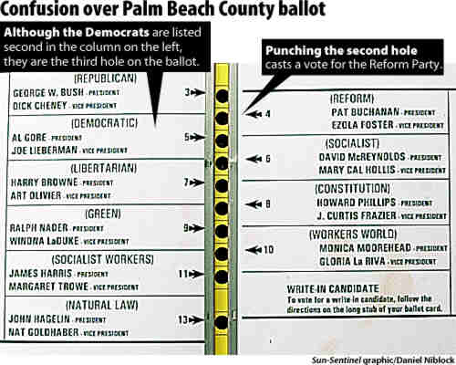
http://www.cc.com/video-clips/r127by/the-daily-show-with-jon-stewart-dancing-bush-fan
http://www.cc.com/video-clips/dwyr9r/the-daily-show-with-jon-stewart-indecision-2000---choose-and-loose
http://www.cc.com/video-clips/d9h4uc/the-daily-show-with-jon-stewart-indecision-2000---recount
http://www.cc.com/video-clips/5pbw5a/the-daily-show-with-jon-stewart-indecision-2000---decision-delivery
http://www.cc.com/video-clips/f9faj8/the-daily-show-with-jon-stewart-headlines---indecision-2000---victory--bush
http://www.cc.com/video-clips/woqxfl/the-daily-show-with-jon-stewart-exclusive---the-bush-years---jon-s-dubya-impression Dubya impression

Slide 64
Warm Up 11/30
Name 2 ways in which the government regulates the economy.

Slide 65
Questions
What caused the crisis?
What role did the government play in the collapse?
Should the government have regulated the economy more?
What are the reasons this was allowed to happen?
Why is this still a problem?

Slide 66
Warm Up 12/4: Make sure you have the answers to the following read to turn in.
What caused the crisis?
What role did the government play in the collapse?
Should the government have regulated the economy more?
What are the reasons this was allowed to happen?
Why is this still a problem?

Slide 67
Socratic Seminar 12/15
Discuss the major problems/corruptions in government (as mentioned in class) and their connection to
campaign finance, corporate lobbying, and the two-party system.

Slide 68
Weekend News
Surprise!! Republicans cut taxes…
on the wealthy…
under pressure from corporations…
and it’s a mess…
because they threatened to shut down the government.
https://www.washingtonpost.com/news/politics/wp/2017/12/02/democrats-fume-over-absurd-gop-tax-bill-full-of-last-minute-handwritten-edits/?utm_term=.47318f7cd90b
Notes:
Private airplanes are now tax free…
Teachers can’t deduct school supplies
College loans are taxed as income
Removed estate tax (more than $5 million)

Slide 69
Your Task Today
In small groups, read your assigned article.
On your given paper, write down the main points of what you learned.
Be prepared to share with the class.
Notes:
Private airplanes are now tax free…
Teachers can’t deduct school supplies
College loans are taxed as income
Removed estate tax (more than $5 million)

Slide 70
Warm Up 12/11
Name 3 things you remember about the Tea Party movement.

Slide 71
Socratic Prep
You should be able to talk about the following using evidence from class, readings, videos, and events/people we’ve discussed.
Discuss the problems and/or corruptions in our government and how they relate to the following:
The Two Party system and polarization
Think Reaganism, Gingrich politics, Tea Party Movement
Consider the changes that have occurred in the parties and the disparity between what the party platforms claim and what we actually see
Campaign Finance and the Two Party election system
Corporate Lobbying and Government regulation
You should be able to discuss specific events like the 2008 financial crisis and its causes in relation to the above

Slide 72
The Tea Party Takeover
http://www.cc.com/video-clips/yiu2to/the-daily-show-with-jon-stewart-indecision-2012---take-the-money-and-don-t-run
http://www.cc.com/video-clips/fksavv/the-daily-show-with-jon-stewart-indecision-2012---mercy-rule-edition
http://www.cc.com/video-clips/nhjh6l/the-daily-show-with-jon-stewart-indecision-2012---michele-bachmann-fever---rick-perry-s-america
http://www.cc.com/video-clips/1wz0n6/the-daily-show-with-jon-stewart-indecision-2012---come-on--really-
http://www.cc.com/video-clips/rvc6cm/the-daily-show-with-jon-stewart-indecision-2012---2012--a-space-oddity
http://www.cc.com/video-clips/jwybws/the-daily-show-with-jon-stewart-indecision-2012---black-to-the-future
Notes:
Private airplanes are now tax free…
Teachers can’t deduct school supplies
College loans are taxed as income
Removed estate tax (more than $5 million)

