Slide 1
Mughals: Creators of the Taj Mahal (After AKbar)
Chloe, Andrew, Nate

Slide 2
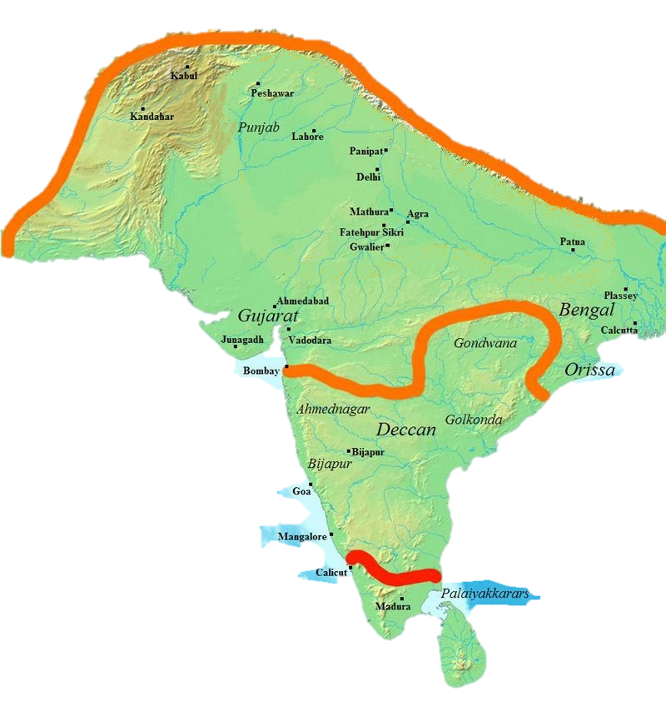
From Akbar’s Death in 1605 to Decline in 1707
The Mughal Empire
1605 Death of Akbar
1707 Death of Aurangzeb

Slide 3
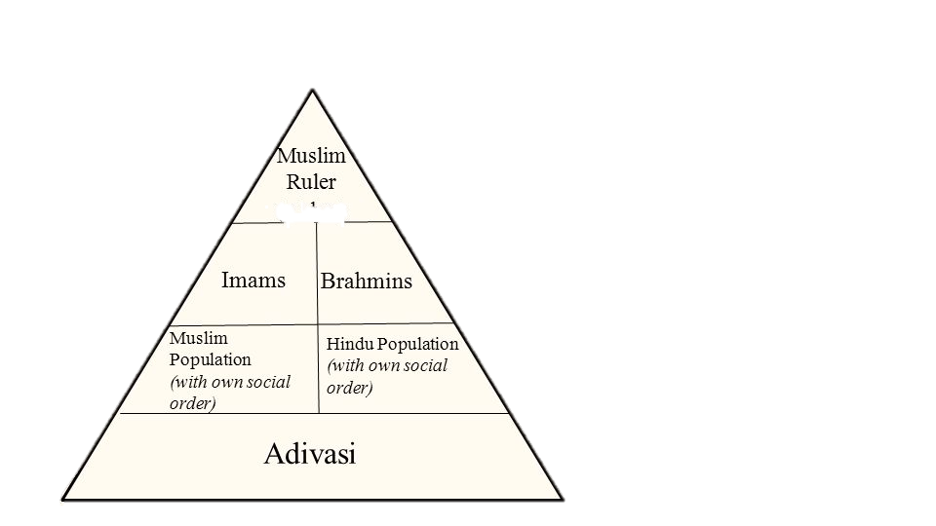
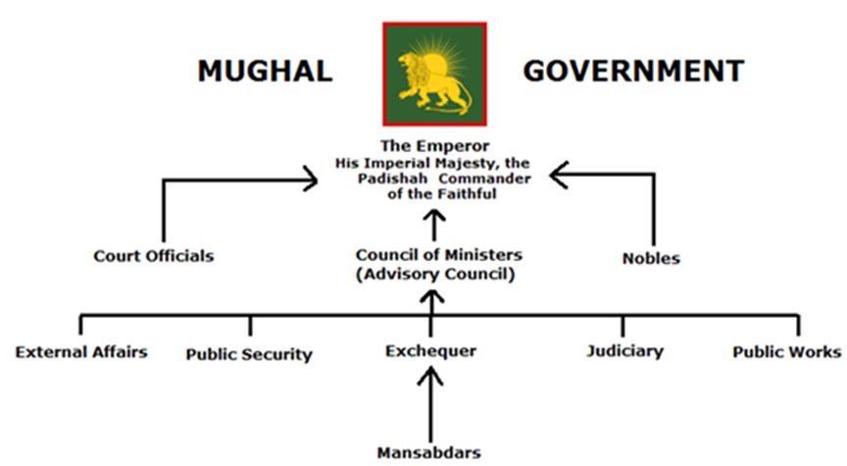
Who Runs the country
Social Organization
Centralized Government
Notes:
Centralized Government
Top of pyramid has all power
Lower levels subjected to top of pyramid
Name of Social Organization
Info on organization
Technologies Developed
List
Cultural Achievements
idk
A centralized government is one in which a small group or executive at the highest level of government holds all political authority, and all other political units are subject to it.
Manṣabdār, member of the imperial bureaucracy of the Mughal Empire in India. The manṣabdārs governed the empire and commanded its armies in the emperor’s name.
Mughal Government is often considered an Imperial Bureaucracy as well, because they applied imperial policies to their whole empire.
http://blog.iasscore.in/wp-content/uploads/2017/03/1.6-12.png
Adivasi are people from south Asia
Imams are muslim leaders
Brahmans are hindu leaders

Slide 4
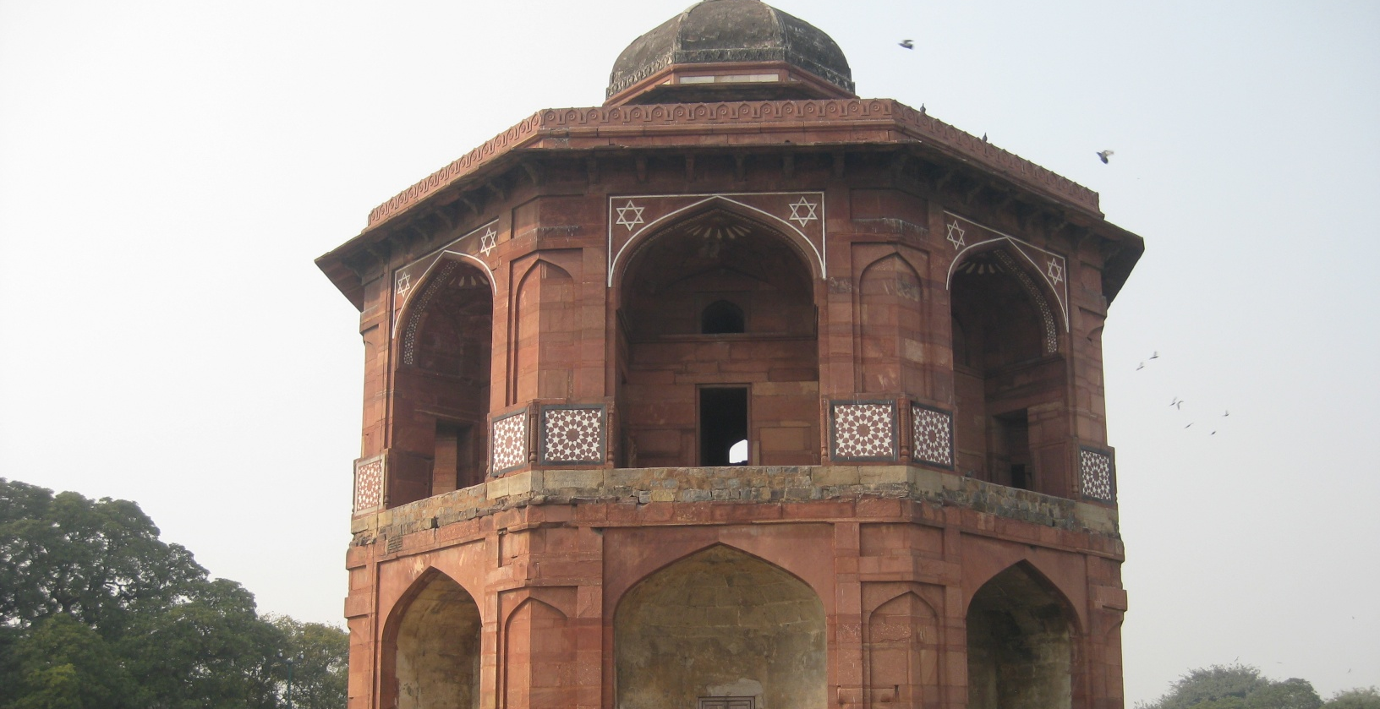
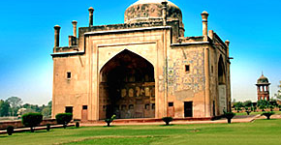
Cultural Advancements
Art
Architecture
Technology
Astronomy

Slide 5
Significant Events & Leaders
Most Important Leaders:
Shah Jahan – 1628 to 1658
Aurangzeb – 1658 to 1707
Most Important Events:
Building the Taj Mahal – Finished in 1648
War between Shah Jahan’s sons – 1657 to 1659
Aurangzeb’s Taxes

Slide 6
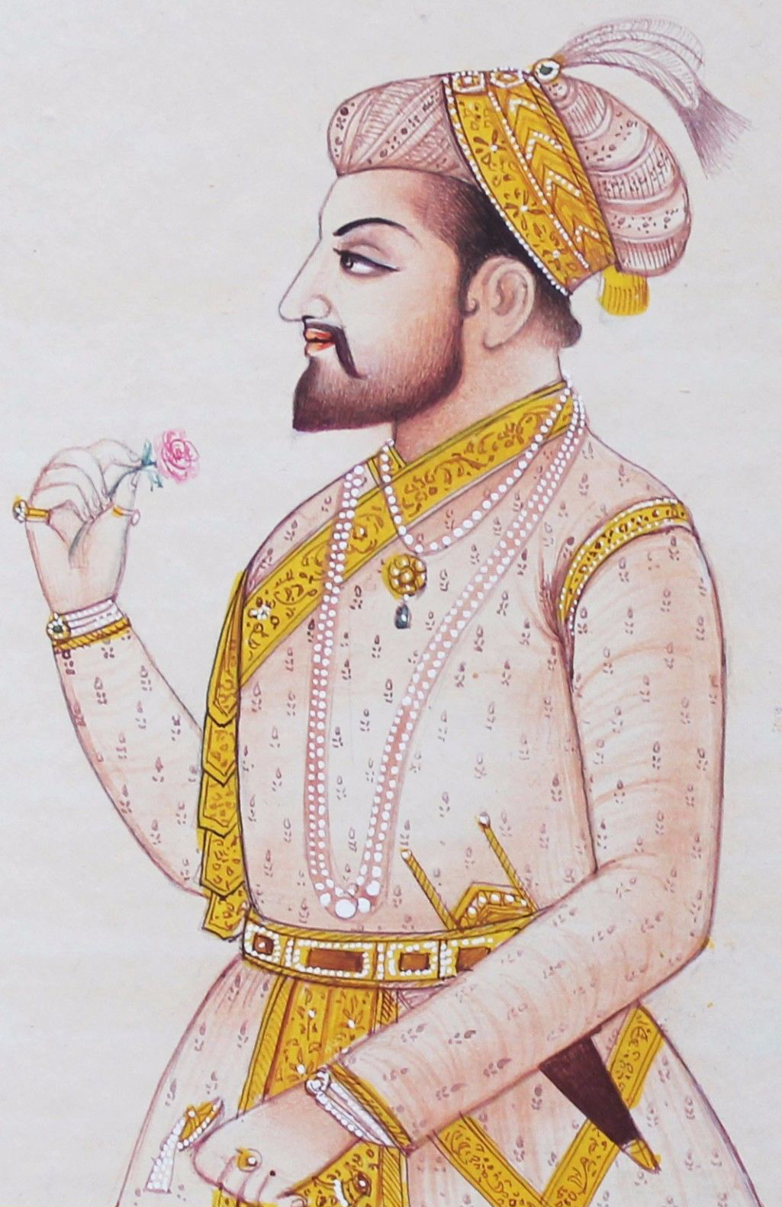
Shah Jahan 1628-1658
Third son of emperor Jahangir
Obsessed with building
Built Taj Mahal for best wife
Built some monuments
Citizens did not like him
Notes:
Fun Fact: he had 15 kiddos
after Jahangir's death in late 1627, when a war of succession ensued

Slide 7
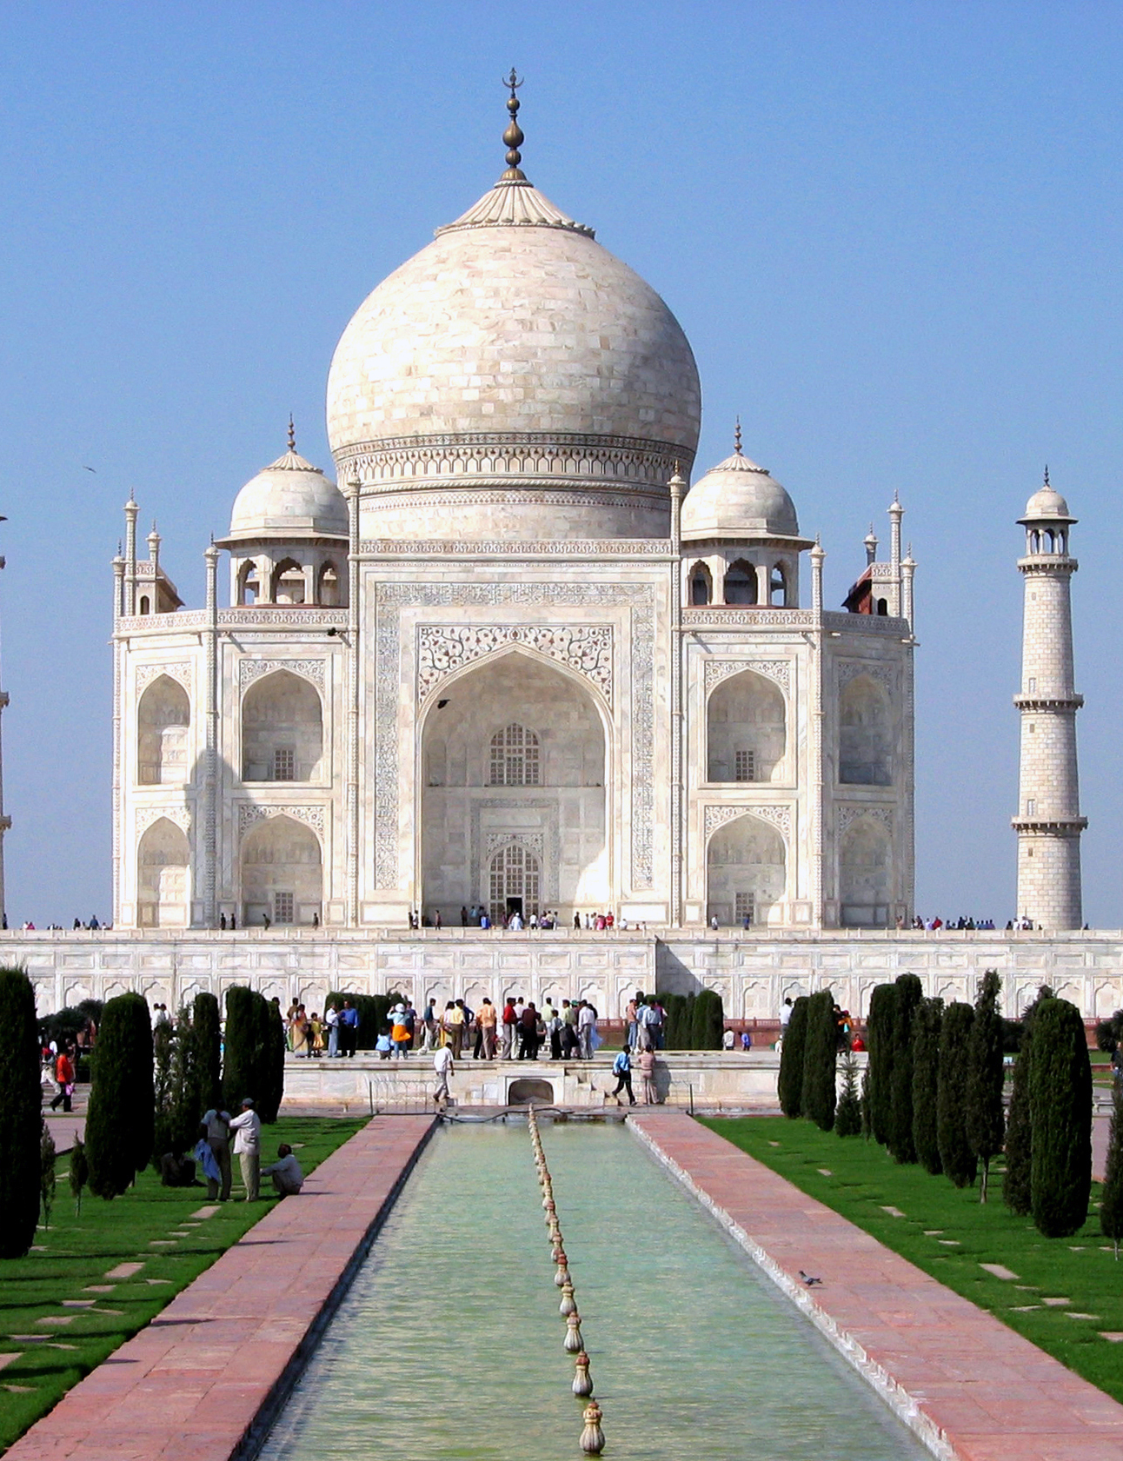
Building The Taj Mahal Finished in 1648
Shah Jahan’s favorite wife died
Depression
Decided to build memorial/grave
The Taj Mahal’s construction killed many people
Shah Jahan’s obsessive building furthered technologies like architecture and furthered arts, but did worse for the economy
Notes:
The Taj Majal was made by Shah Jahan. He got really depressed over it. So he decided to build his wife a memorial as a sweet way to say deal with grief.

Slide 8
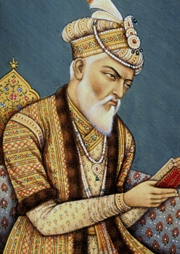
Aurangzeb 1657-1707
One of Shah Jahan’s sons, Killed brother for power
Strict Islamic Ideals:
Banned drinking, smoking
Outlawed Hindus and tried to erase Hindu accomplishments from Akbar’s time
Hindus did not like him
Reversed Akbar’s tax policies
Banned Hindu things
Notes:
He also tried to outlaw hindus. He even tried to erase Hindu accomplishments from Akbar’s time.
Taxed unfairly

Slide 9
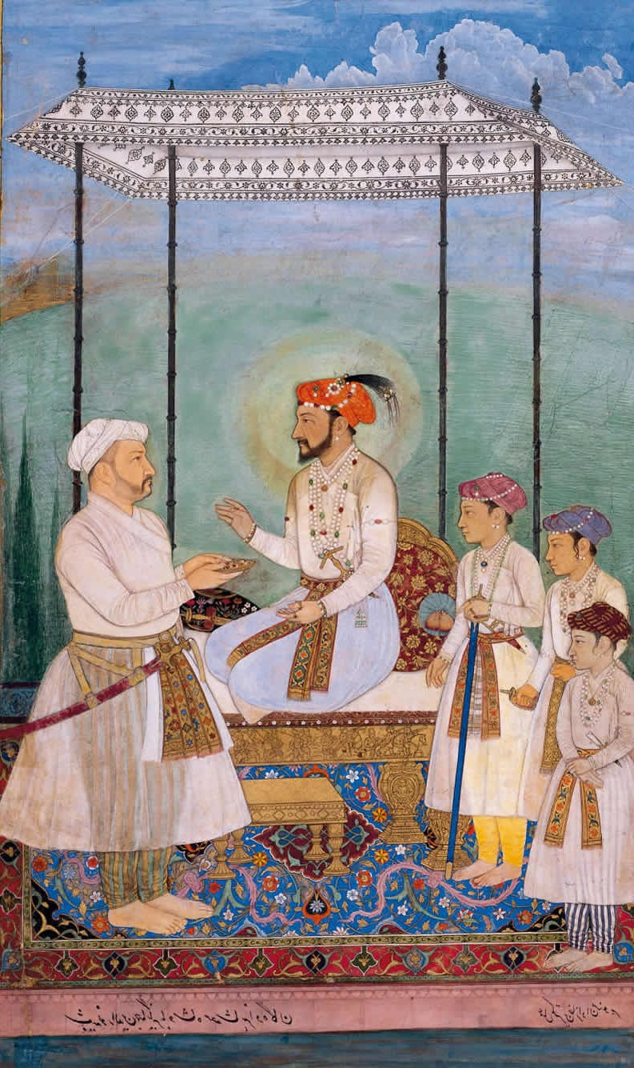
war between shah Jahan’s Sons 1657-1659
Shah Jahan became very ill and had not been able to rule
Aurangzeb saw this as an opportunity to take over
Prisoned father
His brothers fought for the throne but Aurangzeb won
Aurangzeb took over and he was biased against Hindus
Notes:
Son of Shah Jahan, but started a civil war between his brother and won

Slide 10
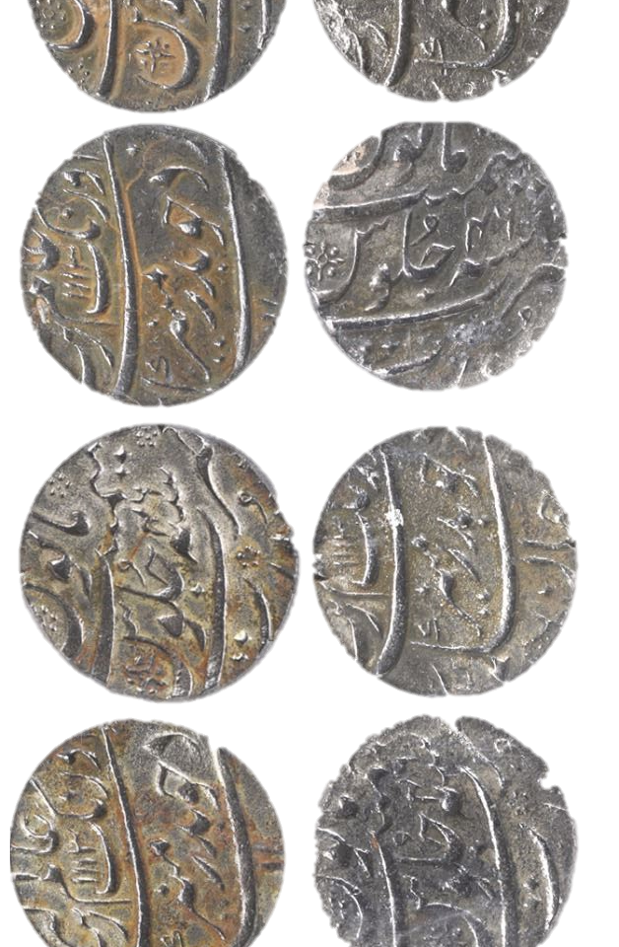
Aurangzeb’s Taxes
Aurangzeb reversed tax policies and taxed the Hindus
Ruined economy
Banned construction of temples and Hindu movements
Diminished religion and arts
Caused the end of the empire
Notes:
Aurangzeb Hated the Hindus a ton so he taxed them a lot extra. This caused the downfall of the Mughal Empire
Because Aurangzeb banned all of the hindu monuments and movements, and taxed the Hindu, religion, arts, and the economy diminished rapidly, causing the end of the Mughals.
http://media.liveauctiongroup.net/i/25467/23424499_1.jpg?v=8D2C91F137587E0

