Slide 1
Warm Up 4/16 (#3)
Briefly describe why the Cuban Missile Crisis was so tense. What actions did JFK take and how was it resolved?

Slide 2
April 16, 2018
Learning Target (I can…):
Explain JFK’s domestic policy
Describe the Kennedy assassination and its impact
Upcoming Dates
4/17: All late work due for Quarter 3
*NO late work will be accepted after this day.
Out for Stamp:
Take out:
Notes
Agenda:
JFK Domestic and Assassination
Skills:

Slide 3
Life in Camelot

Slide 4
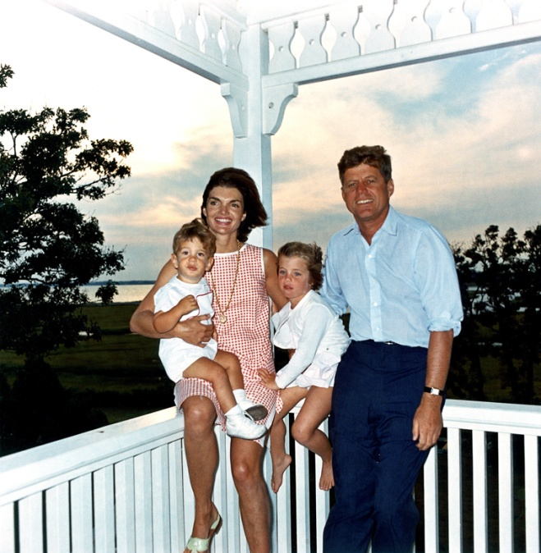
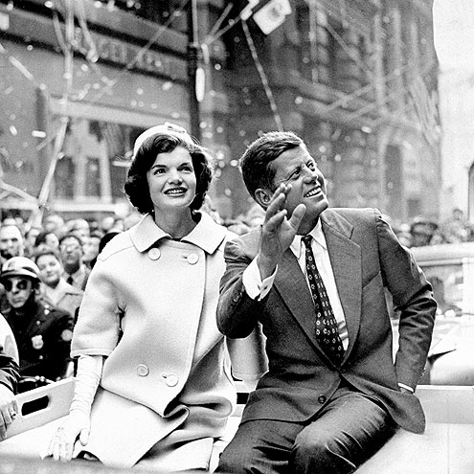
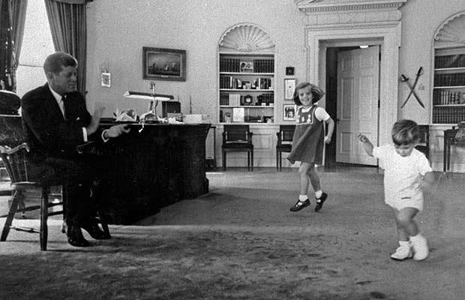
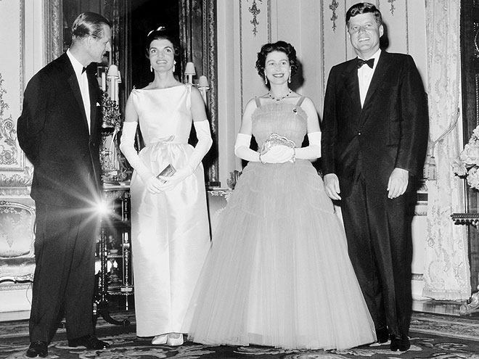
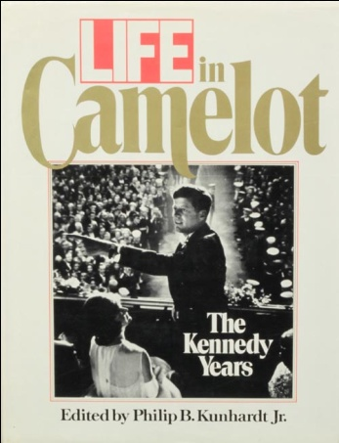
Youngest elected president
Handsome and charming
Seen as American Royalty
White house was warm, exciting to visit
Became a showcase for arts/culture
Compared to King Arthur and his knights
Period of happiness and enchantment
Jackie Kennedy
Beautiful and young
Fashion/popular culture
Children
Caroline
John Jr.

Slide 5
Domestic AFFAIRS

Slide 6
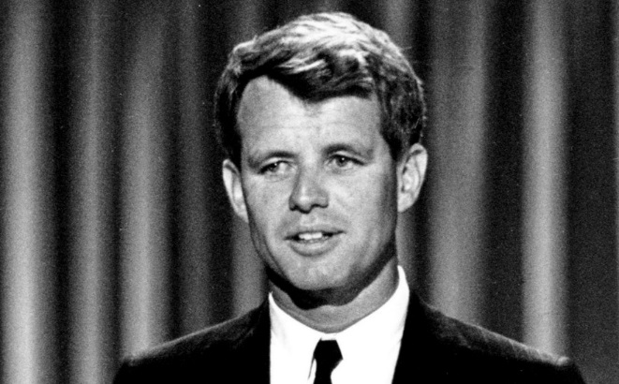
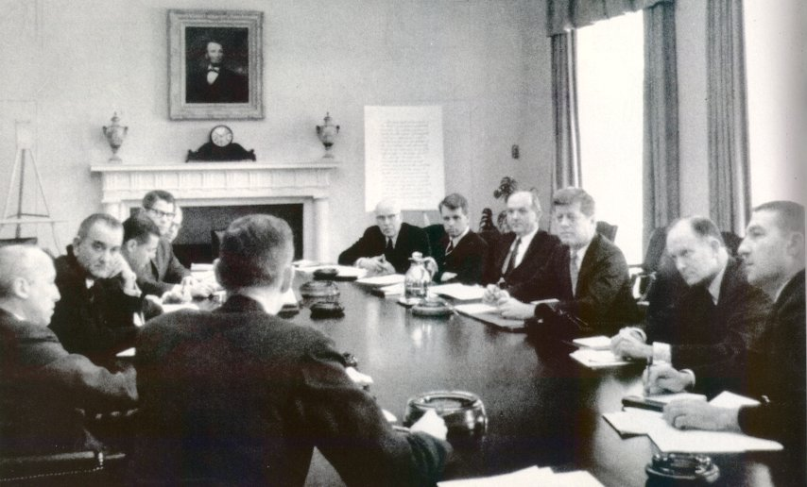
The Best and the Brightest
Wanted to surround himself with the best advisors
Top executives and elite universities
Brother, Robert (Bobby) Kennedy became Attorney General
35 years old
Fueled by idealism, they all wanted to change the world

Slide 7
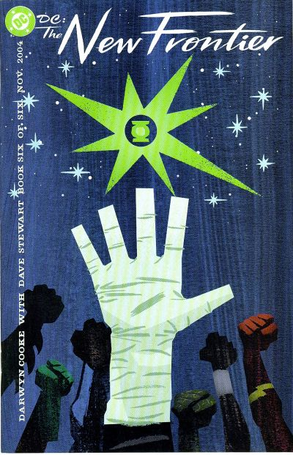
New Frontier
Name of Kennedy’s domestic policy plan
Increase support for education
Programs against poverty
Care for the elderly
Lower taxes
Raise min. wage
Prohibit racial discrimination
Increase defense spending
https://ezproxy.kcls.org/login?url=http://avod.infobase.com/PortalPlaylists.aspx?wID=3380&xtid=113438&loid=411651

Slide 8
Civil Rights
Small success with Republican congress
Much more cautious when he became President
Afraid to split democratic support north/south
Wanted to enforce current laws, but not create new ones
After violent protests in Birmingham
submitted a broad civil rights bill to Congress.
Blocked by Congress

Slide 9
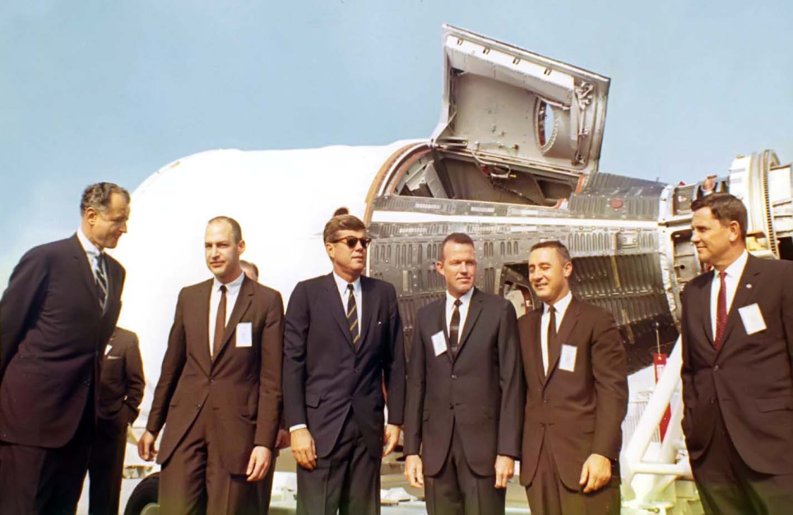
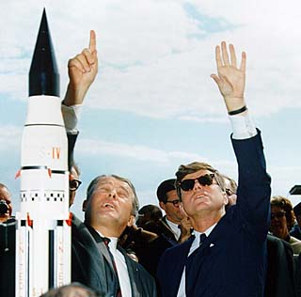
Space Program
Delays and failed launches had plagued American efforts to send rockets into space.
“flopniks” and “kaputniks.
“I believe that this nation should commit itself to . . . landing a man on the moon and returning him safely to the earth.”

Slide 10
Space Program
On July 20, 1969
Neil Armstrong, Michael Collins, and Edwin “Buzz” Aldrin Jr. reached the moon as part of the Apollo space program.
The world watched in awe as Armstrong stepped onto the moon’s surface.
“That’s one small step for a man,” he said as he stepped onto the lunar soil, “one giant leap for mankind.”

Slide 11
Assassination

Slide 12
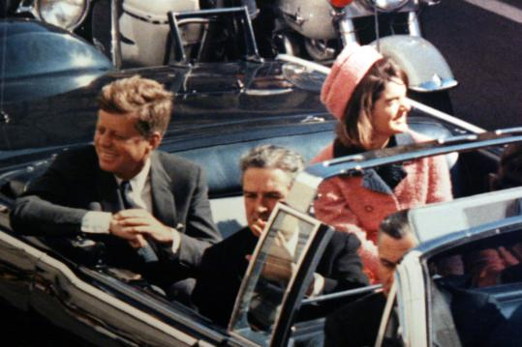
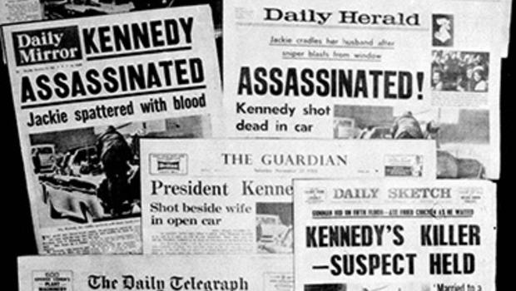
Tragedy in Dallas
November 22, 1963
Motorcade through the city
Lee Harvey Oswald
Two bullets hit Kennedy in the neck and head
LBJ Sworn in as POTUS hours after the shooting
Millions of American watched and mourned during the funeral procession
The Warren Commission investigated the assassination and determined that Oswald had indeed acted alone

Slide 13
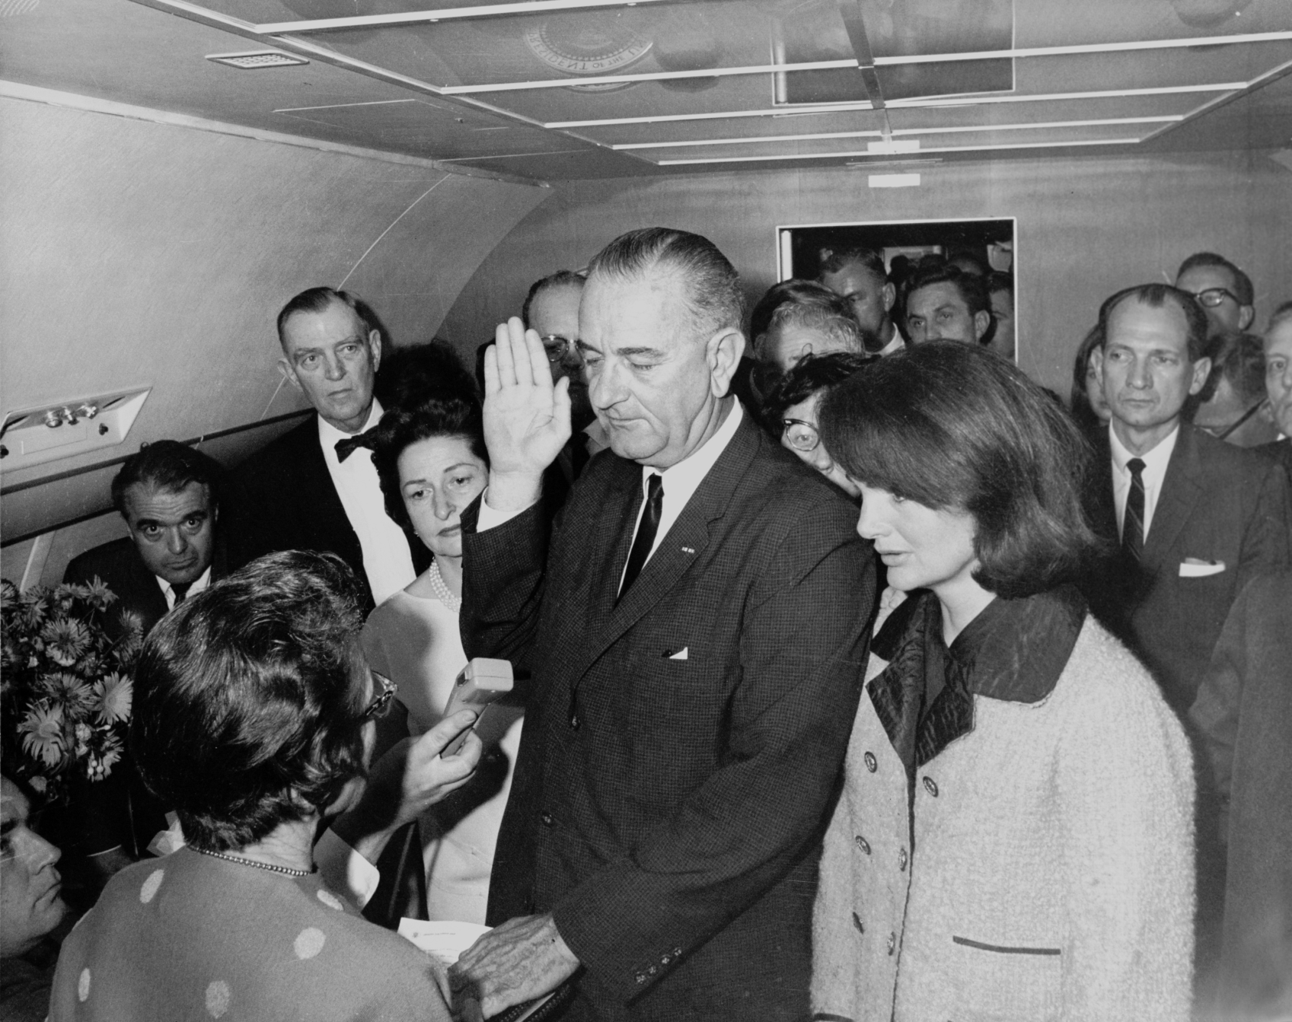
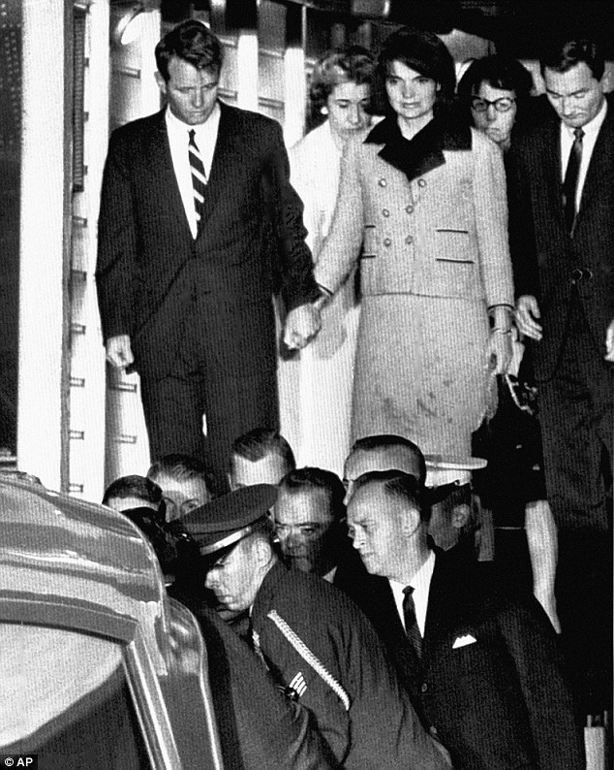

Slide 14
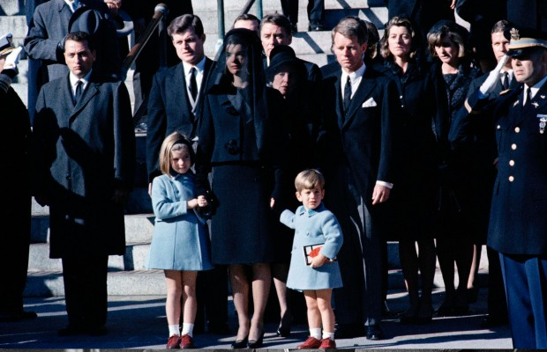
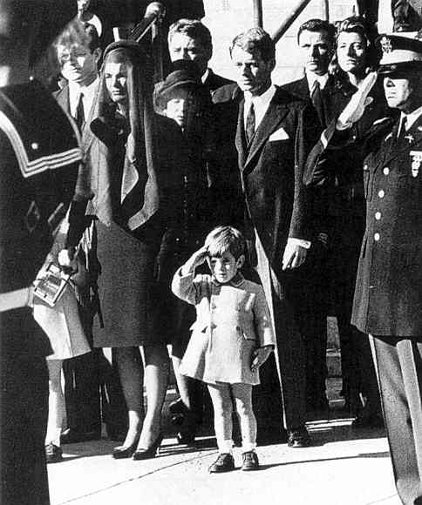
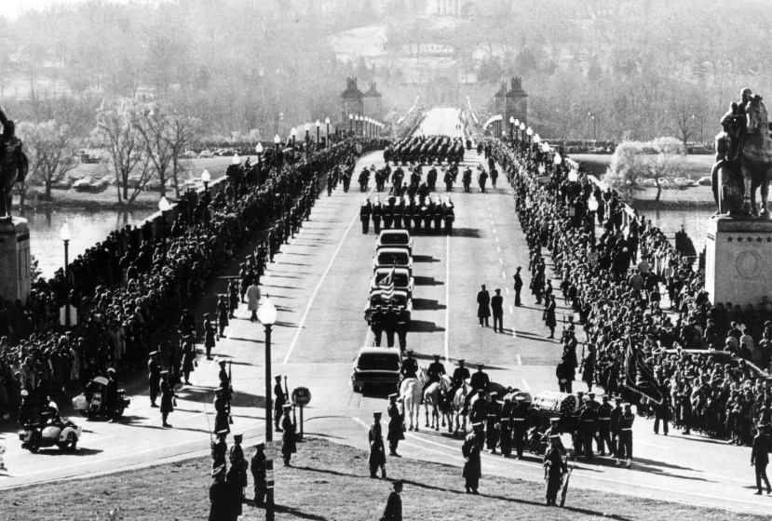

Slide 15
Reaction – Exit Slip
What was the public reaction to Kennedy’s assassination?
Why do you think they reacted that way?
What other examples, modern or 20th century, can you think of where the public had a similar reaction to the death of a public figure?
What are the connections?
Why does the public react so strongly to the deaths of people they don’t know personally?

