Slide 1
Warm Up 10/12
Based on your reading, how did Andrew Jackson alter/expand the power of the executive branch?
Have reading notes on desk.

Slide 2
Today’s Objectives
Gain an understanding of the Andrew Jackson presidency and its impact
Prepare for test tomorrow
Homework Packets/Warm-ups
Study Guide

Slide 3
Discussion Questions
How did Andrew Jackson expand the role of the president?
Analyze the controversy around Jackson’s decisions/tactics.
Was Jackson’s administration more good than bad? More bad than good? What legacy did he leave?

Slide 4
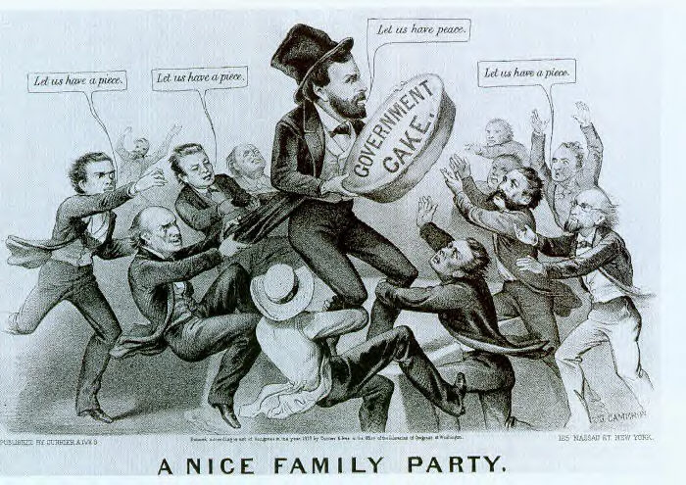
Andrew Jackson – People’s President
Spoils System
Awarded positions to party loyalists
Set a precedent

Slide 5
Andrew Jackson – People’s President
Tariffs and the Nullification Crisis
Tariff of 1828 = “Tariff of Abominations” → renewed 1832
Originally issued to protect American industry
South angered over Northern favoritism
South Carolina nullifies and refuses to collect taxes, threatens secession
Jackson threatens force and other southern states back away
Quietly compromises on tariff rates and S.C. backs down.
Fear of majority rule seeps into the stability of the union

Slide 6
Andrew Jackson – People’s President
Indian Removal Act 1830
Provide for negotiation of 90 treaties that would force N.A. to move west
Cherokee fight in the courts and win
Jackson ignores and manipulates minority
Later forced to relocate by Van Buren – Trail of Tears
Precedent: Not the last time a president would “negotiate” treaties with N.A.

Slide 7
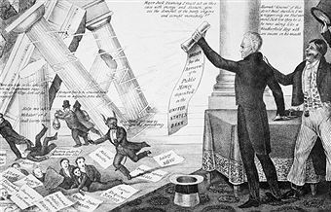
Andrew Jackson – People’s President
National Banks v. Pet Banks
Jackson blames BUS for financial crisis – vetoes charter
Orders treasury funds placed in state “pet” banks
Effectively kills bank 10 years later
Opponents of “King Andrew’s” tactics form new political party – Whigs

