Slide 1
Warm Up 10/24
How did Industrialization and new inventions affect movement and expansion in the United States in the Pre-Civil War era?

Slide 2
Class Business
Due Dates!!
Full credit on due date (turned in or stamped)
-10% each day after up to 50%
½ credit on test day
Test Day Homework Packets and warm-ups
NO work from unit accepted after test date

Slide 3
Agenda
Understand the connection between Industrialization, geographic movement, and the American identity
Big Ideas
Manifest Destiny
Migration motivations
Expansion/slavery/politics

Slide 4
Industrialization
Expansion of Market Economy
Specialization in agriculture
Rise of entrepreneurs
Rise of consumers
Mass manufacturing

Slide 5
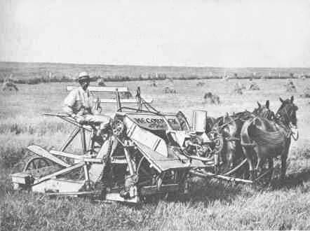
Expanding Markets
Big inventions connect the country
Telegraph
Canal systems/steamboats
Railroads/steam engines
Steel plows and mechanical reapers
Bigger markets, bigger production

Slide 6
North vs. South
North
Manufacturing/factories
Cities → massive immigration
Welcomed commerce/transportation
South
See north as overcrowded and dirty
Embrace agricultural improvements
Slower transportation development
Notes:
Overcrowded plus commercial agricultural leads to need for what?

Slide 7
Manifest Destiny
“Our manifest destiny to overspread the continent allotted by Providence for the free development of our yearly multiplying millions“
-John L. O’Sullivan
Notes:
We are Americans! Manifest = obvious, inevitable. It is their right and duty to expand

Slide 8
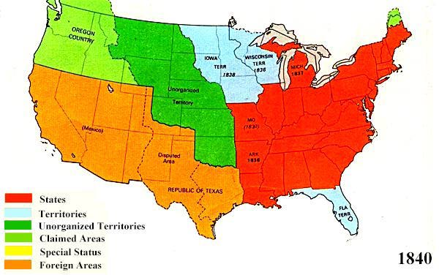
Where are we going?

Slide 9
Motivations
Religious
2nd Great Awakening needs somewhere to grow
Build towns around congregations
Preach to Native Americans
Mormon Migration
Head west to avoid religious persecution
Develop trails, bridges, stopping points
Salt Lake – only major city between Mississippi and California/Oregon

Slide 10
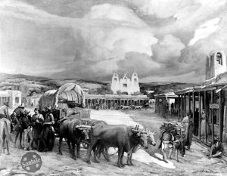
Motivations
Economic Opportunity
Santa Fe Trail
Huge market for traders
Establishes presence in New Mexico/Arizona

Slide 11
Motivations
Economic Opportunity
Oregon Country (Not yet territory)
Run by U.S./Great Britain
Spain and Russia had given up claims
Mostly U.S. settlers
Fertile land and access to Pacific trade

Slide 12
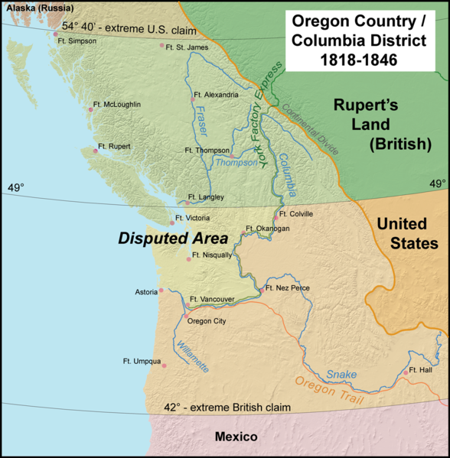
54’40’ or Fight!

Slide 13
Motivations
Economic Opportunity
Oregon Territory
Polk deems Northern areas unfit for agriculture
Dispute settled at 49th Parallel

Slide 14
Texas and Southwest
Mexico declares independence in 1821 from Spain
The country of Mexico included present day Texas, California, New Mexico, Colorado, Utah, Arizona, and Nevada
These areas were sparsely populated and Mexico encouraged American immigration.
In 1823, Mexico gives large land grants to Stephen Austin in order to encourage flow of immigrants into Texas.
Notes:
177 inexpensive farming acres or 4,428 grazing acres

Slide 15
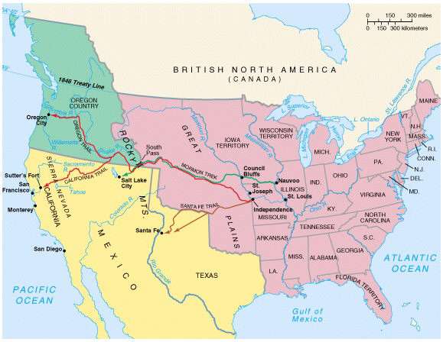
Notes:
Texas had so much potential, talks of extending U.S. border to Rio Grande begins
Adams and Jackson both try to by Texas but Mexico refuses

Slide 16
Texas Tension Builds
Mexico starts to clamp down on immigration
Sets limits on numbers
Forbids slaves from being brought in
By 1830, 30,000 American settlers in Texas
When Mexican government refused to help settlers with Native American violence, an independence movement forms
The Texas War for Independence begins in 1835
Notes:
Austin wins repeal of immigrant limits because Mexico unable to enforce

Slide 17
Texan War for Independence = Brutal
1835 Oct. 2 – Mexican troops attempt to retrieve a cannon that had been given to colonists for protection from Indian attack. The skirmish that ensues is considered the opening battle of the Texas Revolution.
1835 Nov. 24 – The Texas Rangers organization is officially established by Texas' provisional government. Although Stephen F. Austin had hired 10 frontiersmen as "rangers" to help protect his colonists against Indian raids in 1823, not until 1835 was the law-enforcement group formally organized.
1836 March 2 – The Texas Declaration of Independence is adopted at Washington-on-the-Brazos.
1836 March 6 – A 13-day siege of the Alamo by Mexican troops led by Gen. Antonio López de Santa Anna ends on this day with a battle in which all remaining defenders are killed. (Davey Crockett)
1836 March 27 – About 350 Texan prisoners, including their commander James Fannin, are executed at Goliad by order of Santa Anna. An estimated 30 Texans escape.
1836 April 21 – In a battle starting about 4:30 p.m. and lasting 18 minutes, Texan troops led by Sam Houston defeat the Mexican army commanded by Santa Anna at San Jacinto near present-day Houston. Houston reports that 630 Mexican troops were killed and 730 were taken prisoner. Of the Texas troops, nine of a force of 910 were killed or mortally wounded, and 30 were less seriously wounded.

Slide 18
The Republic of Texas
From 1836 until 1845 Texas is an independent nation
Wanted to be annexed immediately by US
US refused in order to avoid conflict with Mexico and slavery debates that would arise
Sam Houston elected first president
Border conflicts with Mexico will continue and eventually lead to the Mexican-American War, as soon as the US annexes Texas.

Slide 19
