Slide 1
Warm Up 1/4
Choose the best piece of evidence you found in your KKK reading and write it down.
(If absent yesterday, write down why you think people tend to reject unfamiliar ideas.)

Slide 2
African American Struggles
Poverty and persecution in the South
Droughts, floods
Racial violence
Resurgence of KKK (what did you learn?)
Used Red Scare to promote “Americanism” and renew violent tactics and political pressure
Targeted not just African Americans, but anyone they deemed not American enough
Jews, Roman Catholics, unions, foreigners
Became very ritualistic

Slide 3
African American Struggles
Great Migration
Large scale migration of African Americans move north
1.5 million move to New York Chicago, Detroit in 1920s
Great Migration inspires race riots
Migrants shocked by attitude and mistreatment
NAACP, led by W.E.B. Du Bois will lead fight against the violence
African Americans will begin fighting back and finding ways create a better place for themselves in America

Slide 4
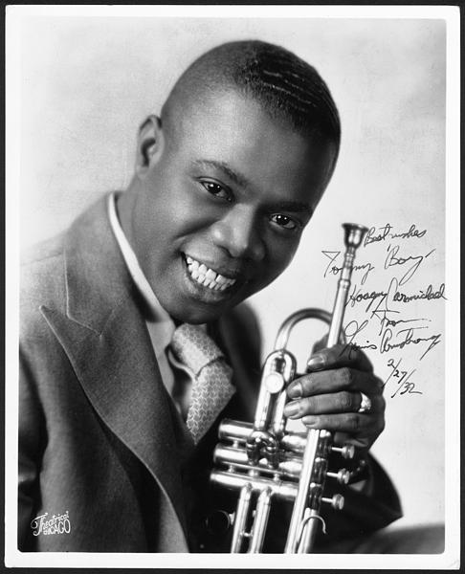
Jazz Age
Jazz grew out of African American music of the South (ragtime, blues)
Most of the best Jazz musicians of the 20s were African American
Louis Armstrong
Trumpet player (great at improv)
Made long solos a key element of jazz ensemble performances
Single most influential musician in jazz

Slide 5
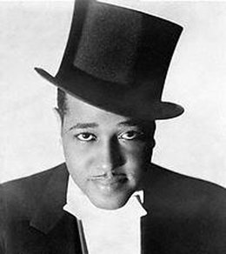
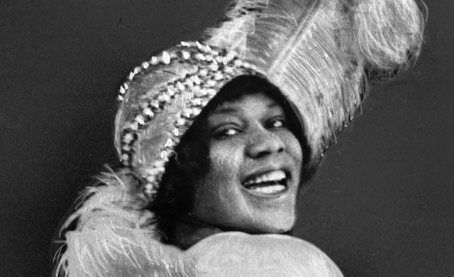
Jazz Age
Duke Ellington
Arranger, composer, leader of ten-piece orchestra
Would be known as one of America’s greatest composers
Bessie Smith
Blues singer
Highest paid black artist in the world 1927

Slide 6
Harlem Renaissance
African American literary and artistic movement
Expressed pride in African American experience
Wrote with defiance about the struggles living in a white world

Slide 7
Harlem Renaissance: Group Share
You will read a selection of works from one Harlem Renaissance writer and answer the attached questions.
As a group, share what you learned by discussing the following (record your answers on one paper):
What themes do you see between the authors?
What devices are common? Why do you think that is?
What differences do you see in the messages?
Why do you think these works were so popular?

Slide 8
Homework Due Tuesday 1/9
Complete Flapper Research Handout
Use Section 28.5 and 29.3 of your textbook, the 1920s women reading located on the website, and academic internet sources in needed.

