Slide 1
Warm Up 11/22
What kinds of problems often come with rapid industrialization?

Slide 2
Socratic Seminar
Focus questions
For each topic (Industrialization, expansion, etc) you should be analyzing the 2 layers of the Gilded Age (The Gilt and Below the Gilt)
Analyze the different types of oppression and marginalization that different minority groups face (immigrants, African American, Native Americans, women, children, etc.)

Slide 3
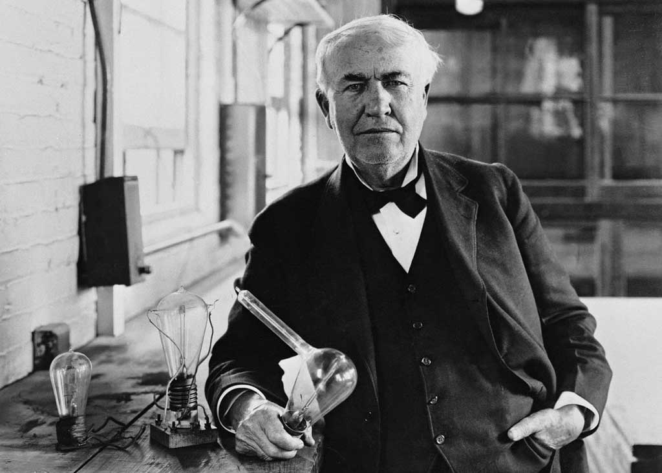
Gilded Age Inventions – The Gilt
Light bulb – Thomas Edison
Telegraph – Samuel F. B. Morse
Fast, cross-country communication
Telephone – Alexander Graham Bell
Person-person communication
Use of “rock” or land oil creating new fuel source
Bessemer process
Cheaper steel
Rise of Capitalism
New inventions spurred investment in hopes of making a profit

Slide 4
Rise of Big Business – The Gilt
Transcontinental Railroad
Government gives land grants to Union and Central Pacific Railroads
Hired immigrants (mostly Chinese) and migrant workers to lay track
Completed 1860
Railroads become first corporations as westward travel expands
Cornelius Vanderbilt
Beneath the Gilt
Widespread corruption
Panic of 1893 leads to large takeovers of failed businesses

Slide 5
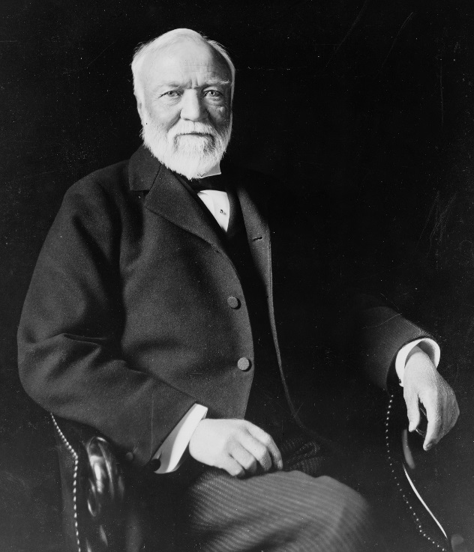
New Business– The Gilt
Andrew Carnegie
Vertical Integration
Controlling every step of the manufacturing process
Horizontal Integration
Buying out competitors
Creation of monopolies
Social Darwinism
Survival of the fittest in business
Justified laissez-faire (zero regulation) economics
Justified creation of monopolies

Slide 6
Rise of Big Business –The Gilt
Monopolies
J.P. Morgan
Created holding companies to acquire competition
United States Steel – world’s largest business
Rockefeller
Standard Oil
Trusts (legal gray areas) to control 90% of oil business
Later broken up to include Chevron, Conoco, and Exxon Mobile
“By the time Rockefeller died in 1937, his assets equaled 1.5% of America’s total economic output. To control an equivalent share today would require a net worth of about $340 billion dollars, more than four times that of Bill Gates, currently the world’s richest man.” (Forbes)

Slide 7
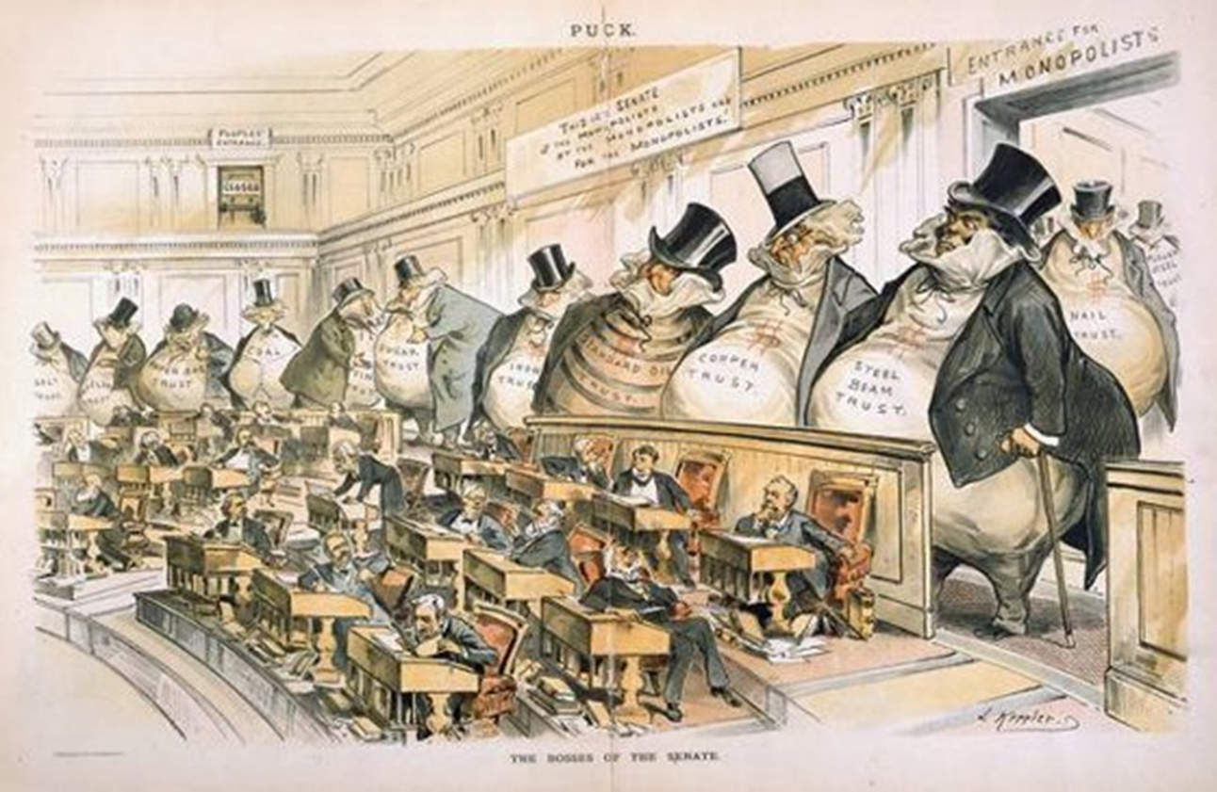
Big Business – Beneath The Gilt
Robber Barons
Achieved success through ruthless tactics
Suppressed competition
Low wages/harsh work conditions
Political Power

Slide 8
Warm Up 11/27
What is your research paper topic? Try to put it concisely.

Slide 9
Due Date Revision
Monday, November 20th (8:00pm) | Topic Selection
Wednesday, November 29th | Thesis Revision #1 (turnitin)
Thursday, November 30th Friday, December 1st | Outline (turnitin) Outline (hard copy)
Monday, December 4th | Source Analysis (hard copy OR turnitin)
Monday, December 4th | Works Cited (hard copy)
Wednesday, December 6th | Thesis Revision #2 (turnitin)
Wednesday, December 6th | Rough Draft (hard copy & turnitin)
Tuesday 12/12 | Final Draft (turnitin and hard copy)

Slide 10
Socratic Seminar
Focus questions
For each topic (Industrialization, expansion, etc) you should be analyzing the 2 layers of the Gilded Age (The Gilt and Below the Gilt)
Analyze the different types of oppression and marginalization that different minority groups face (immigrants, African American, Native Americans, women, children, etc.)

Slide 11
Quick Review!

Slide 12
Gilded Age Inventions – The Gilt
Light bulb – Thomas Edison
Telegraph – Samuel F. B. Morse
Fast, cross-country communication
Telephone – Alexander Graham Bell
Person-person communication
Use of “rock” or land oil creating new fuel source
Bessemer process
Cheaper steel
Rise of Capitalism
New inventions spurred investment in hopes of making a profit

Slide 13
Rise of Big Business – The Gilt
Transcontinental Railroad
Government gives land grants to Union and Central Pacific Railroads
Hired immigrants (mostly Chinese) and migrant workers to lay track
Completed 1860
Railroads become first corporations as westward travel expands
Cornelius Vanderbilt
Beneath the Gilt
Widespread corruption
Panic of 1893 leads to large takeovers of failed businesses

Slide 14
New Business– The Gilt
Andrew Carnegie
Vertical Integration
Controlling every step of the manufacturing process
Horizontal Integration
Buying out competitors
Creation of monopolies
Social Darwinism
Survival of the fittest in business
Justified laissez-faire (zero regulation) economics
Justified creation of monopolies

Slide 15
Rise of Big Business –The Gilt
Monopolies
J.P. Morgan
Created holding companies to acquire competition
United States Steel – world’s largest business
Rockefeller
Standard Oil
Trusts (legal gray areas) to control 90% of oil business
Later broken up to include Chevron, Conoco, and Exxon Mobile
“By the time Rockefeller died in 1937, his assets equaled 1.5% of America’s total economic output. To control an equivalent share today would require a net worth of about $340 billion dollars, more than four times that of Bill Gates, currently the world’s richest man.” (Forbes)

Slide 16
Big Business – Beneath The Gilt
Robber Barons
Achieved success through ruthless tactics
Suppressed competition
Low wages/harsh work conditions
Political Power

Slide 17
Big Business – Beneath The Gilt
Industrial Growth will mostly bypass the South
Still recovering economically and socially from Civil War

Slide 18
Big Business – Beneath The Gilt
Working conditions = BAD
Long days full of repetitive work (12-14 hours)
Health hazards in factories: bad air, enclosed spaces
Low wages force everyone to work
Widespread Child Labor
Often most dangerous jobs (small)
Child labor laws mostly ignored

Slide 19
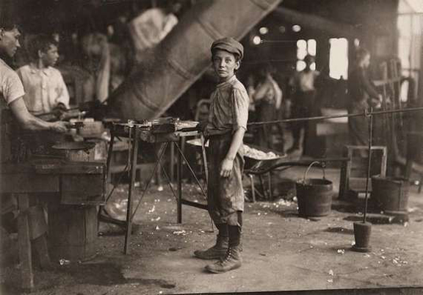

Slide 20
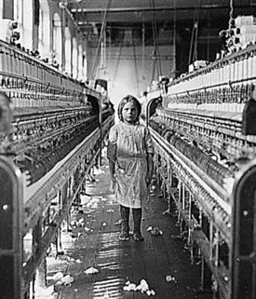

Slide 21
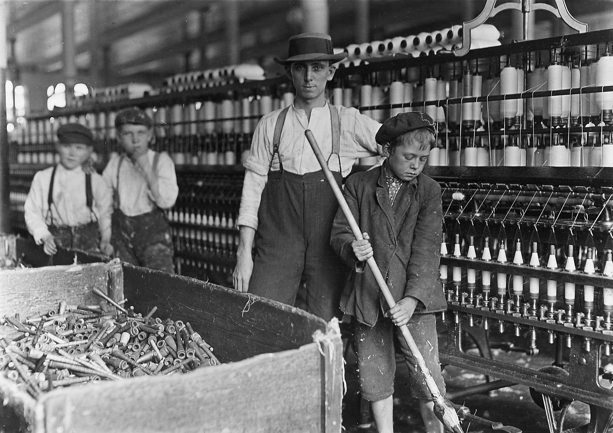

Slide 22
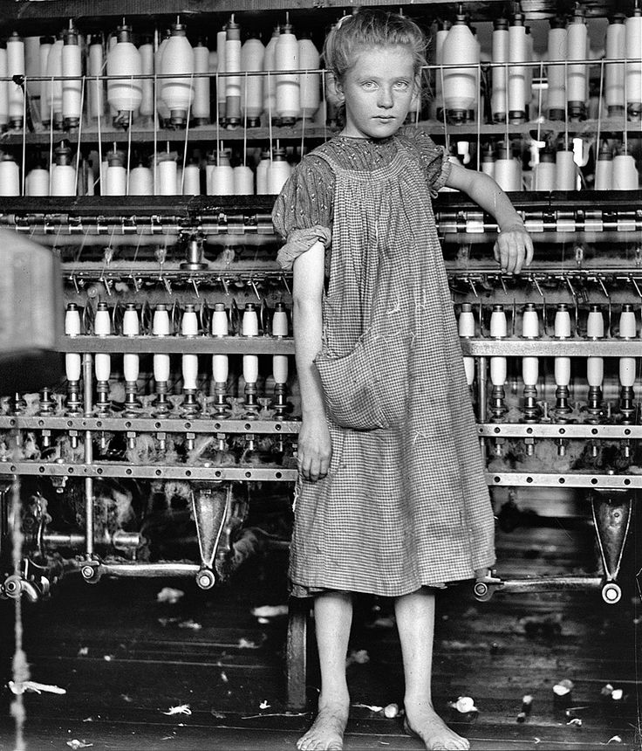

Slide 23
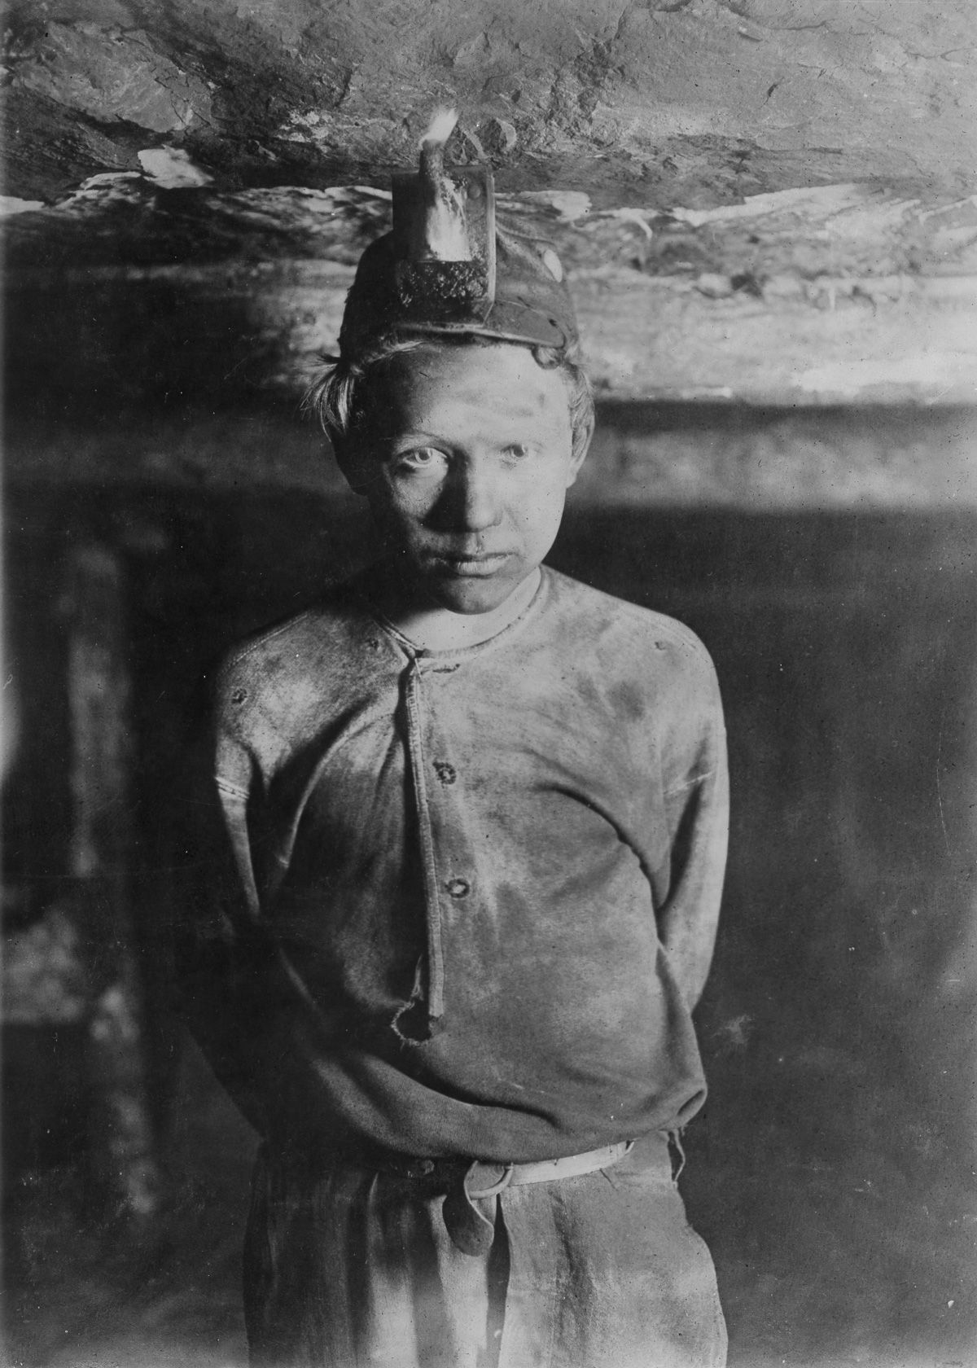

Slide 24
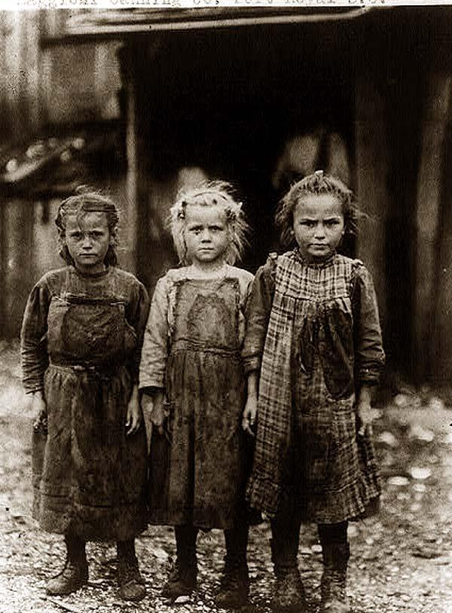

Slide 25
Big Business – Beneath The Gilt
Home life not much better
Tenement housing
Run down apartments housing 4 families on a floor
these families "cook, eat, and sleep in the same room, men, women, and children together." Disease flourished in such cramped and often airless quarters, and fire was an ever-present danger.

Slide 26
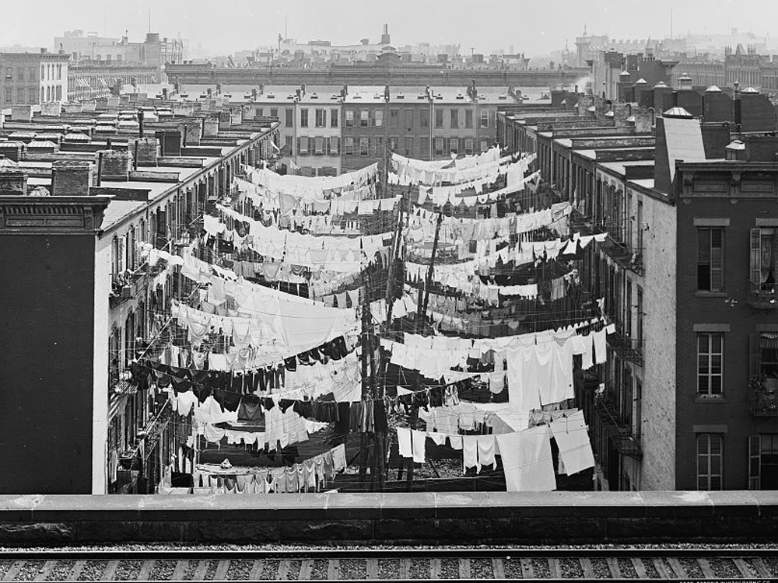

Slide 27
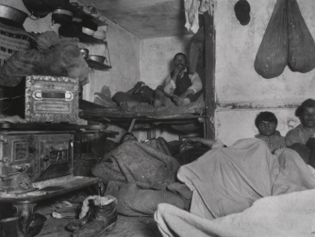

Slide 28
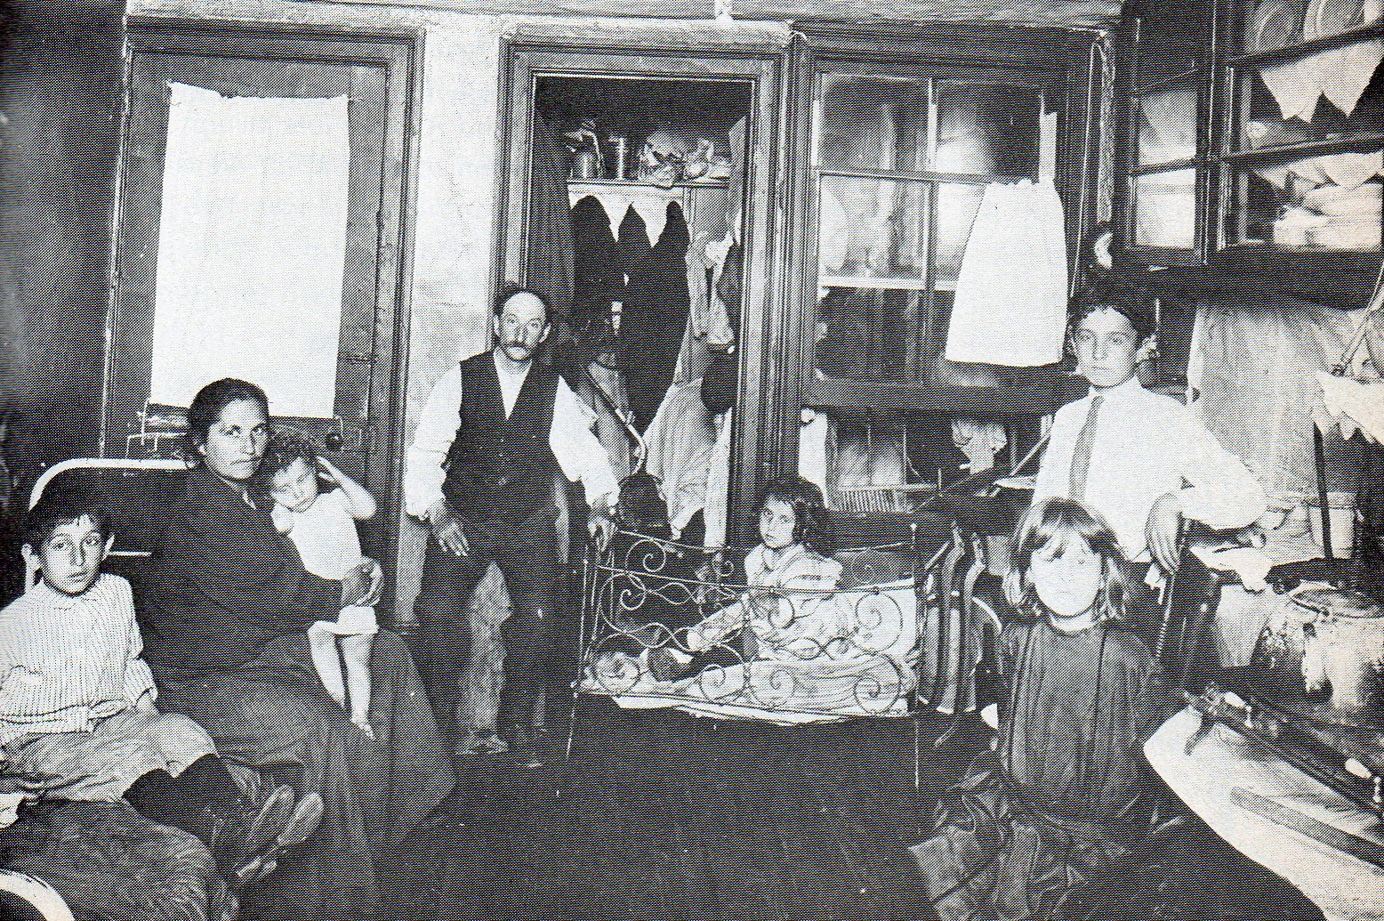

Slide 29
Labor Unions
Knights of Labor: accepts both skilled and unskilled workers (declines after 1886)
Strikes last resort
American Federation of Labor: skilled workers
Focused on “bread and butter” – higher wages/shorter work day
Collective bargaining and successful strikes
Industrial Workers of the World: unskilled, socialists

Slide 30
Labor Unions – Strikes/Violence
Railroad Strike 1877
During economic depression and wage loss
Shut down half of nation’s rail lines
Strikers battle police/militia
Boosts union membership
Haymarket Affair
Police break up workers/strike breakers
Protest gathers, police arrive, bomb goes off

Slide 31
Labor Unions – Strikes/Violence
Homestead Strike
Carnegie steel mill
Strikers successfully fight back and take control of town
Militia brought in and union shut out of mill
Pullman Strike
Strike against oppression of company town
Federal troops brought in when mail gets stopped

Slide 32
Labor Unions – Women
Women did mostly unskilled jobs and paid far less than men
Extremely harsh conditions
Long hours, bad air, no breaks
Sometimes locked in to ensure work
Women Unite
Mary Harris “Mother” Jones
Organized miners and strikes
Fought against child labor and working conditions

Slide 33
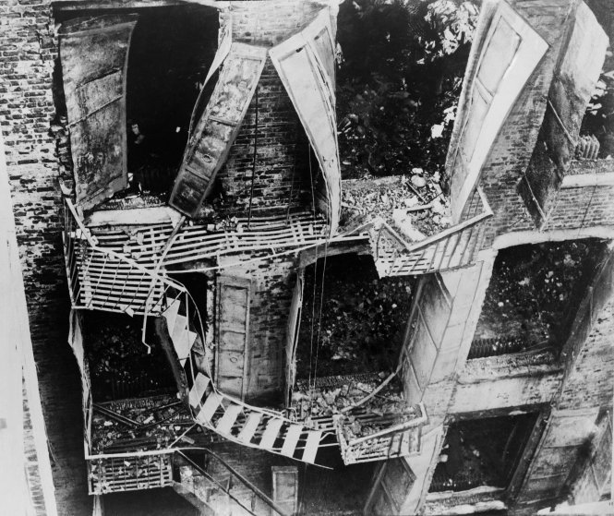
Labor Unions – Women
Triangle Shirtwaist Fire
Fire breaks out in garment factory
All but one door locked (unlocked blocked)
145 die trapped or falling 9 stories
Spurs major changes in women and child labor laws

Slide 34
Homework
Work on your research paper!

