Slide 1
Warm Up 12/15
What limits do you think there should be on U.S. involvement in foreign affairs?

Slide 2
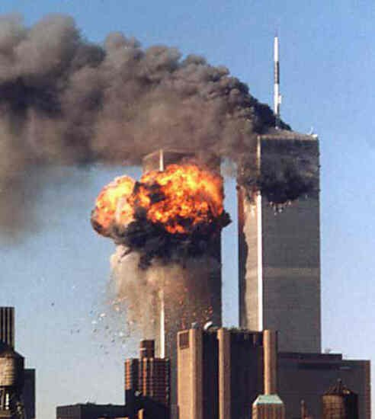
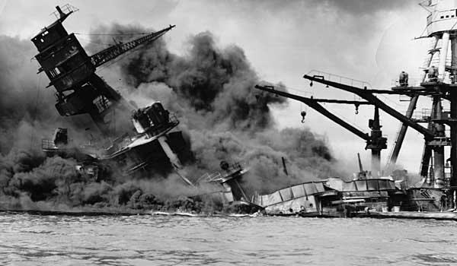
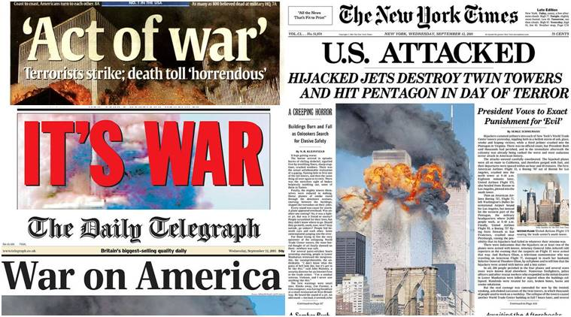
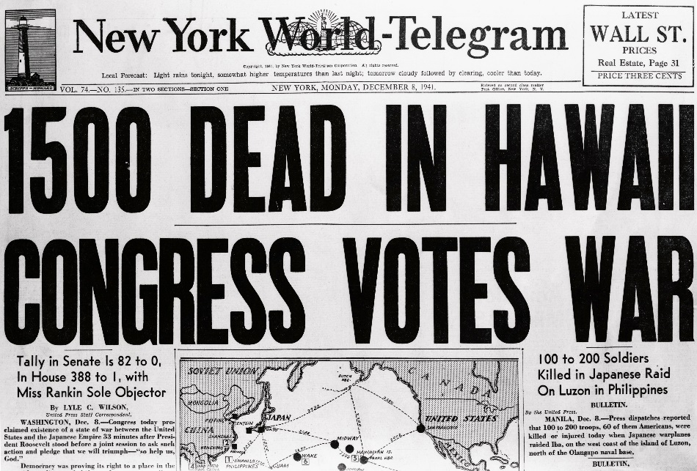
U.S. Foreign Policy
Goals
Protecting National Security
Foreign nations
Other threatening groups

Slide 3
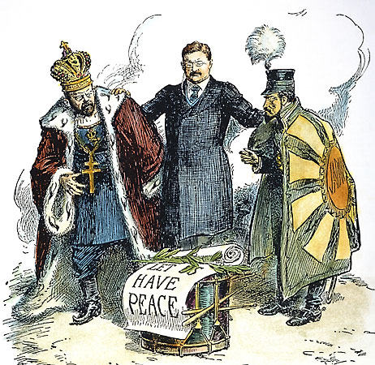
U.S. Foreign Policy
Goals
Preserving world peace
Mediating disputes
Promoting Economic Prosperity
Globalization in trade
Humanitarian Ideals
Foreign aid
Promoting democracy

Slide 4
Tools of Foreign Policy
Soft Power - persuasion
Diplomacy: Conducting Negotiations
Summits: Meetings of Heads of State
Treaties: Peaceful Agreements
Trade Relations: Cross-Border Commerce
Foreign Aid: Help for less wealthy countries
Cultural Exchanges: Contact of people
Foreign tours, study abroad, performing artists etc.

Slide 5
Tools of Foreign Policy
Hard Power - coercion
Intelligence Gathering: Assess the threat
CIA
Covert Action: Secret tactics to influence events
Capturing and eliminating threats
Boycotts and Sanctions: Economic Pressure
Tariffs, trade barriers
Military Alliances: Defend
NATO: attack against one = attack against all
Armed Force: Last resort

Slide 6
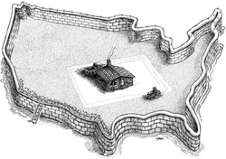
Worldviews and Foreign Policy
Isolationism – Withdrawing from the world
Monroe Doctrine
Prominent after WWI

Slide 7
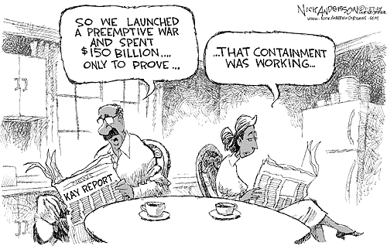
Worldviews and Foreign Policy
Containment – controlling aggressive nations
Post WWII
Worked to stop spread of Communism
Drew us into Korea and Vietnam

Slide 8
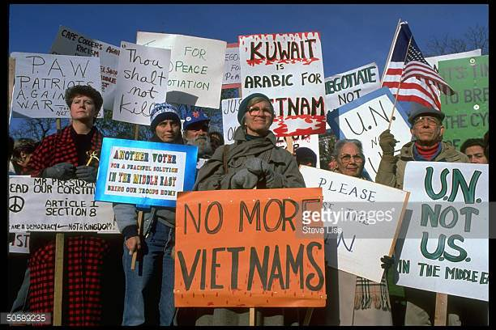
Worldviews and Foreign Policy
Disengagement – Avoid military involvement
Post Vietnam
Not against foreign aid, just unneeded war

Slide 9
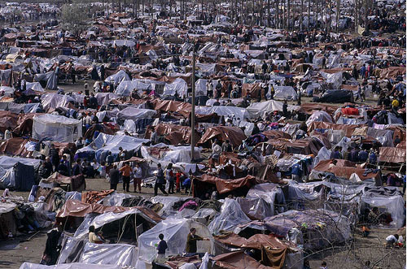
Worldviews and Foreign Policy
Human Rights – U.S. power to protect others
Attempts to stop human rights violations
Kosovo
Somalia

Slide 10
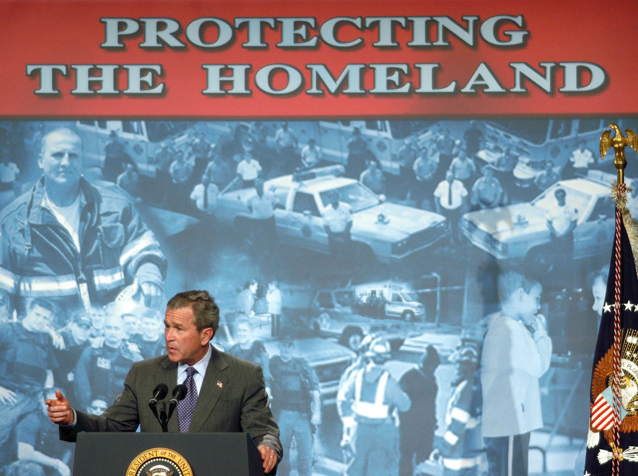
Worldviews and Foreign Policy
Antiterrorism – Protecting the homeland
Post 9/11 worldview
Seek out and destroy terrorists and those who help them
No weapons of mass destruction
Creation of Patriot Act

Slide 11
Warm Up 12/18
Do you think multi-country organizations are effective in keeping world peace?

Slide 12
Intergovernmental Organizations - IGOs
United Nations
Main goal = peacekeeping through collective security (state provided troops)
Usually authorized through Security Council
Korea, Kuwait
Nuclear Non-Proliferation Treaty
Seeks to halt spread of nuclear weapons
India, Pakistan, Israel, North Korea do not take part
Millennium Declaration
Reduce poverty, combat diseases, promote gender equality, preserve environment resources, global development

Slide 13
Intergovernmental Organizations - IGOs
United Nations
Limits
Reluctance to ceded sovereignty
Security Council members have veto power
Corruption scandals

Slide 14
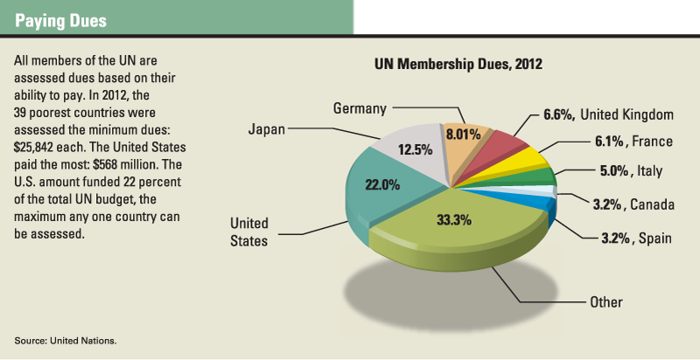

Slide 15
Intergovernmental Organizations - IGOs
Other IGOs
NATO
Military resources/strategies for protecting the region
African Union
ASEAN (Southeast Asia)
ANZUS (Australia, NZ, U.S.
ICC: International Criminal Court

Slide 16
Nongovernmental Organizations - NGOs
Most are non-profit
Focus on least developed countries (LDCs)
Purposes
Advocacy (International Campaign to Ban Landmines)
Disaster Relief (Red Cross)
Human Rights Abuses (Amnesty International)
Combatting Poverty and war (CARE)
More Hands on approach
Can be difficult to coordinate
Hard in areas of civil unrest

Slide 17
Defining Human Rights
Universal Declaration of Human Rights
International Bill of Humans Rights (aimed at specific groups)
UN Convention on the Rights of the Child
Human Rights Watch
Free the Children

Slide 18
Fighting Climate Change
Intergovernmental Panel on Climate Change
Research
Kyoto Protocol
37 nations agreed to reduce greenhouse gas emissions
U.S. not participating
Paris Agreement
Countries agreed to hold average temperature rising by setting limits on greenhouse emissions and pursuing research/investment in non-fossil fuels
U.S. announced withdrawal

Slide 19
Questions to Consider
Does the U.S. do enough to promote peace and well-being in the world?
Does the U.S. do more than its share?
Is the UN effective or does it not do enough?
What changes do you think need to happen in global cooperation?

