Slide 1
Warm Up 5/21 (#4)
Answer the following from your reading:
What were the twin capitals of the Indus people?
Contact with which other ancient city prompted the Indus to develop a writing system?
The Indus people were thought to be the first to cultivate which crop?

Slide 2
May 21, 2018
Out for Stamp:
Indus Valley reading
Take Out:
Agenda:
Research India project
Learning Targets (I can…):
Describe the important aspects of an era of early Indian civilization
Homework:
5/23: China Study Guide credit makeup
5/29: Final India project due
5/29: All China late work due
6/1: All India readings (critically read)

Slide 3
May 31, 2018
Out for Stamp:
Take Out:
Yellow India Notes
Agenda:
Hand back GCP
Finish India notes
Learning Targets (I can…):
Describe the important aspects of an era of early Indian civilization
Homework:
6/1: All India readings (critically read)
6/4: Open note quiz on Early India
6/13: Final Due Date for ALL late work

Slide 4
Global Conflict Paper Takeaways
Thesis statements looking good! However…
Make sure you know what your so what is and that it is addressed and proven throughout paper

Slide 5
Global Conflict Paper Takeaways
Be careful about your topic choice and KNOW YOUR RESEARCH QUESTION!
Many of you clearly did not have a good understanding of your topic.
Don’t just pick something because it sounds cool. If you can’t thoroughly explain what caused it, what happened, and why it’s a problem then DON’T WRITE ABOUT IT!

Slide 6
Global Conflict Paper Takeaways
Be careful about your topic choice and KNOW YOUR RESEARCH QUESTION!
Understand your research question. Know what kind of evidence you need to look for.

Slide 7
Global Conflict Paper Takeaways
Evidence was hit and miss
Don’t just have random evidence about your topic
Evidence should be proving your so what. If your so what is that your conflict created instability, you should have evidence of the instability. Don’t just give evidence of what happened in the conflict and then say “This further destabilized the country…”
NOT sufficient

Slide 8
Global Conflict Paper Takeaways
Analysis was hit and miss
Don’t just say it, show it. Again, have evidence to prove it.
Please avoid the following:
“This quote is saying…”
“This shows that…”
These are not analysis. These are you proving that you don’t know how to analyze.

Slide 9
Global Conflict Paper Takeaways
Body Thesis Statements
Not just a statement. They need to have an argument.

Slide 10
Global Conflict Paper Takeaways
LANGUAGE!!
Remember to keep your language academic
And for the love of all that is holy! RUN YOUR PAPER THROUGH A GRAMMAR CHECKER!!!!
Grammarly or MS Word’s own built in grammar check are excellent tools.
If you still don’t understand how to do MLA citations, GET HELP. Have someone who knows check all your citations against your sources. Ms. Bacon in the library or your teacher can both help with this.

Slide 11
Warm Up 6/1 (#5)
What was the name of the Spanish conquistador that conquered the Aztecs?

Slide 12
June 1, 2018
Out for Stamp:
India Readings
Take Out:
India Notes
Agenda:
Early India Debrief
Learning Targets (I can…):
Describe the important aspects of early Indian civilizations
Homework:
6/1: All India readings (critically read)
6/4: Open note quiz on Early India
6/13: Final Due Date for ALL late work

Slide 13
Indus Valley People
Harappa
Mohenjo-Daro
Built around one of India’s TWO most important rivers
Indus River
Ganges River
Agriculture and trade with Mesopotamia

Slide 14
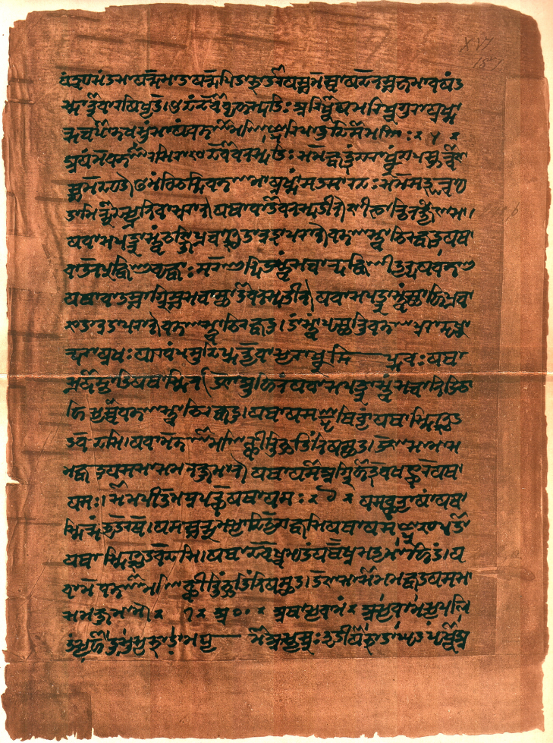
Aryans
Vedic age
Vedas = collection of hymns, rituals, and other religious instruction
Written in Sanskrit, ancient Indian language still used
Ruled by rajahs with a council of advisors

Slide 15
Aryan Caste System
Brahmin
Priests
Dalits
Were not considered part of the Caste system
Did work others would not do
Ex. making leather from animal skins
Kshatriya
Warriors/Kings
Vaishya
Merchants/Landowners
Sudra
Commoners/Peasants/Servants
Dalits

Slide 16
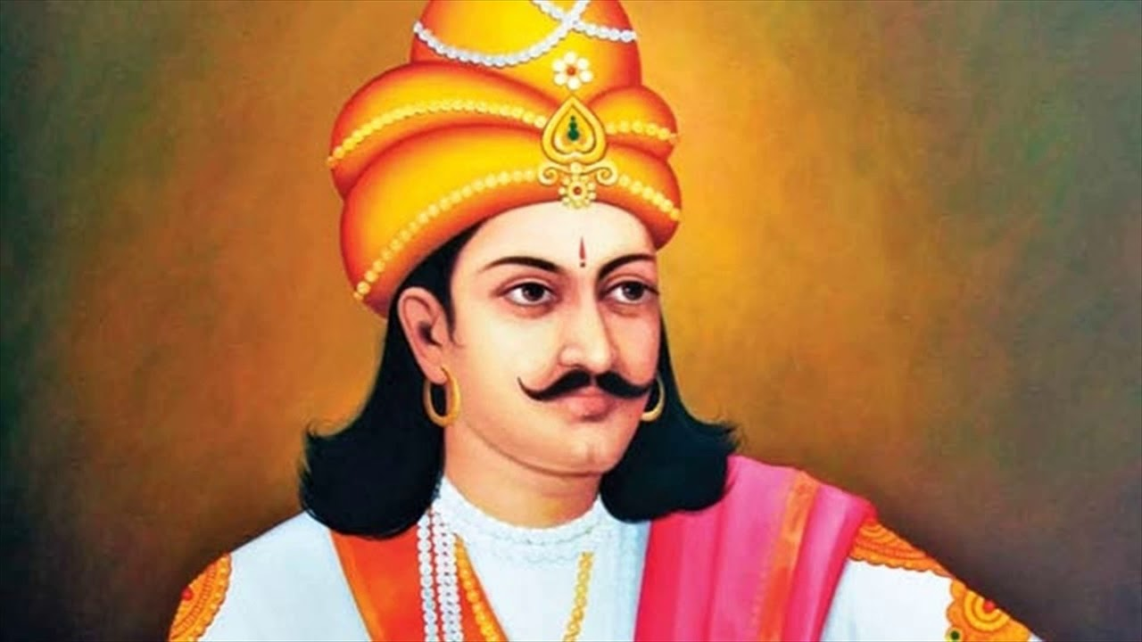
Mauryan Empire
Chandragupta Maurya
First king
Rules through strict bureaucracy

Slide 17
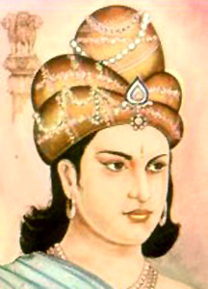
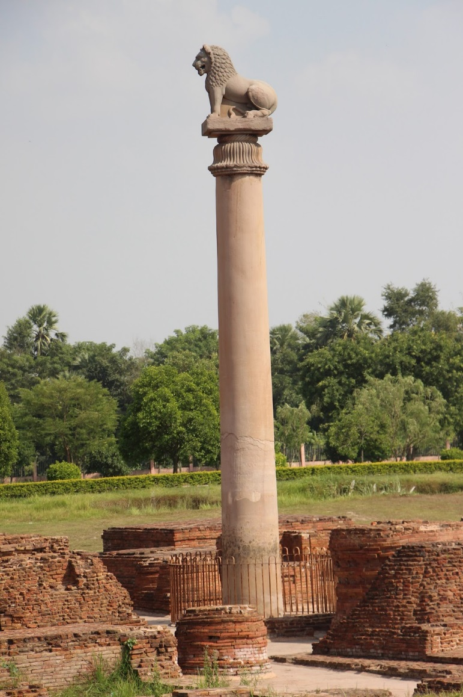
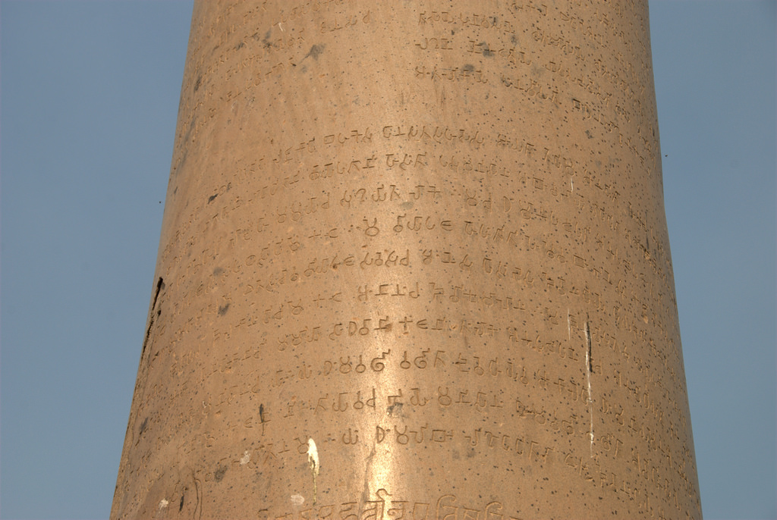
Mauryan Empire
Asoka (pronounced Ashoka)
Grandson of Chandragupta Maurya
Promoted Buddhism
Wrote edicts of his faith on stone pillars
Greatest age of the empire

Slide 18
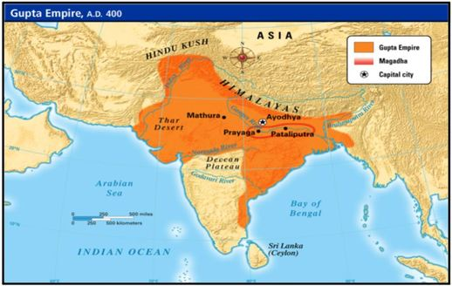
Gupta Empire
Chandra Gupta (first emperor)
Married daughter of influential family and proclaimed himself “Great King of Kings”
40 years of conquest to expand empire
Never conquered southern peoples
Tamil remained mostly untouched
Ruled in matriarchal society

Slide 19
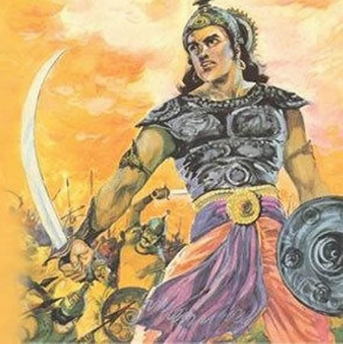
Gupta Empire
Chandra Gupta II
Defeats Shakas enabling trade with the Mediterranean in the west
Great age of arts, religion, science

Slide 20
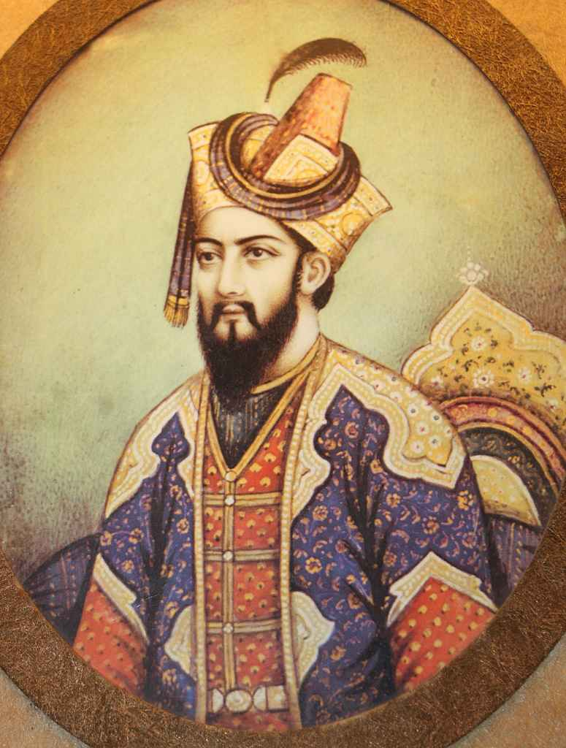
Mughal Empire
Begun by Babur
Built army in Uzbekistan and migrated down into India

Slide 21
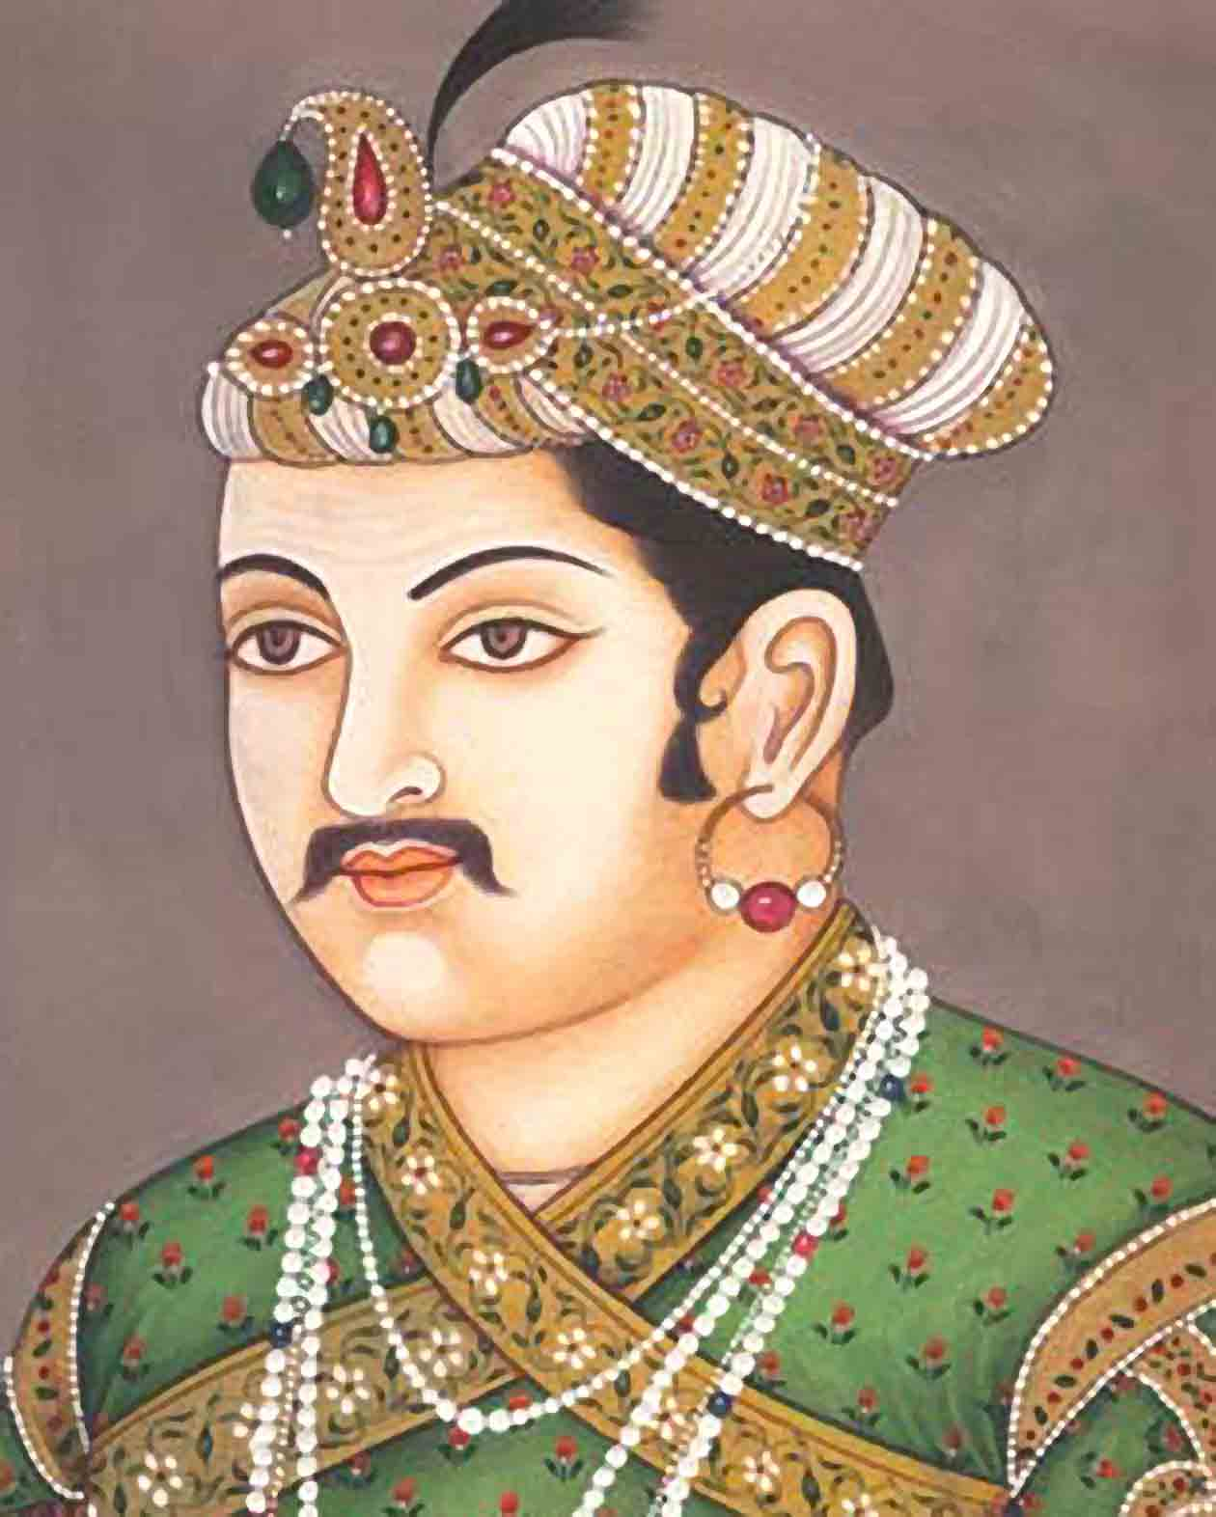
Mughal Empire
Golden Age begins with Akbar
Unified most of Indian subcontinent into largest empire yet.
Muslim, but defended religious freedom and promoted cultural blending
Smart tax practices
Graduated tax based on income; fair and more people paid as a result
Arts, architecture, and writing flourish

Slide 22
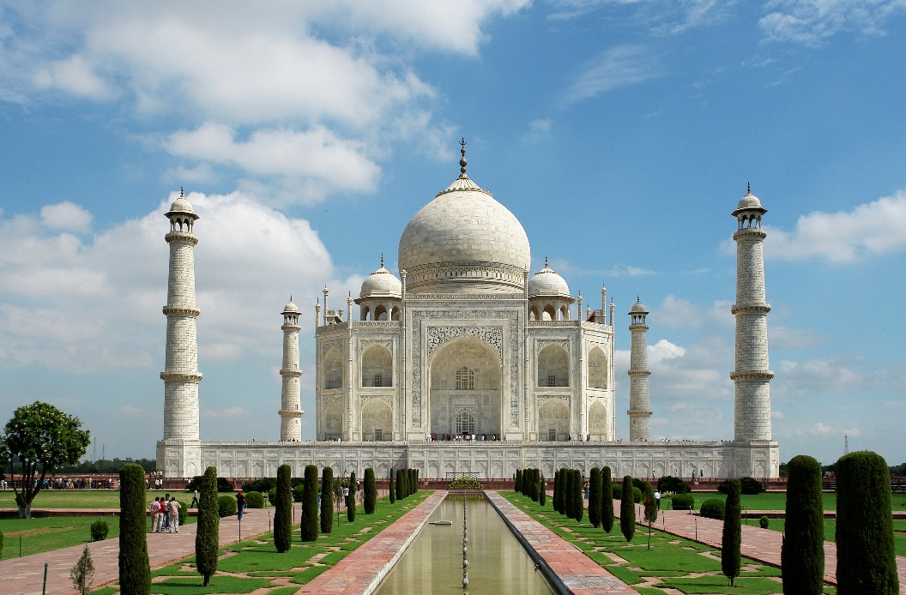
Mughal Empire
Akbar’s successors tightened control, but kept religious tolerance despite promotion of Islam
Shah Jahan
Building of Taj Mahal, extravagant lifestyle, and war cause increased taxes
People suffer during famine without support from government

Slide 23
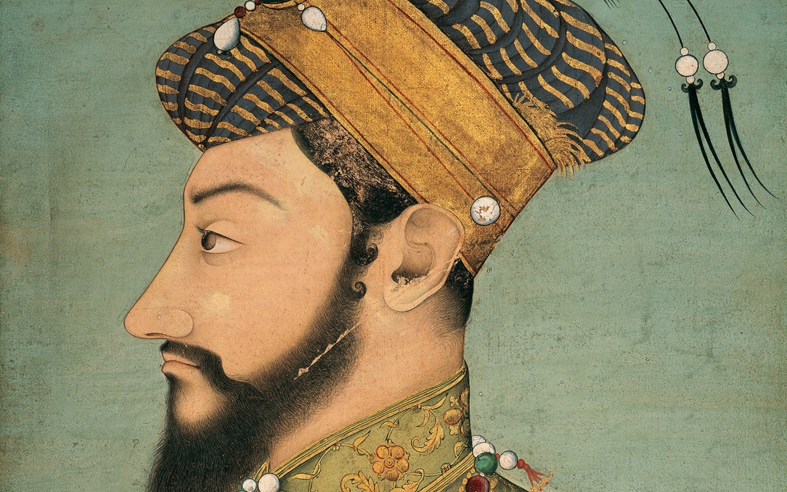
Mughal Empire
Aurangzeb (Shah Jahan’s son)
Kills brother and imprisons father to take throne
Expands empire to largest size
Removes religious tolerance and brings back tax on non-Muslims
Empire weakens and eventually succumbs to British rule

Slide 24
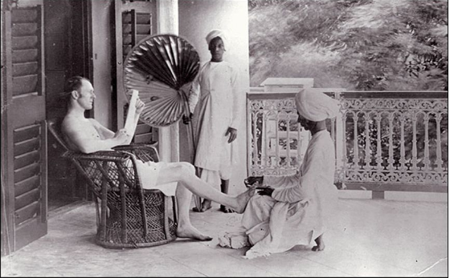
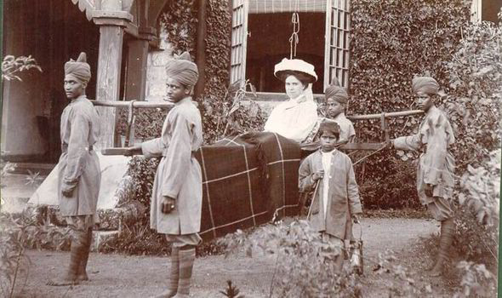
British Raj
British East India Company
Takes control of India after break-up of Mughal Empire
Ruled with personal army made up of sepoys, or Indian soldiers
Forced India to produce raw materials but only buy British goods in order to keep economic control

Slide 25
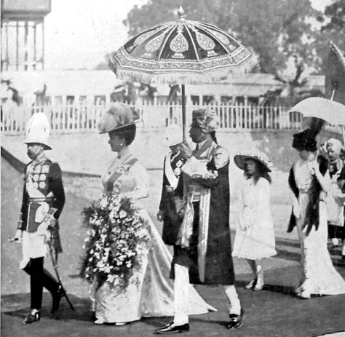
British Raj
Caste system essentially remains the same with British officers and families above even the highest castes, served by members of Indian society.
This racist system inspired increased Nationalism and anger amongst the Indian people.

Slide 26
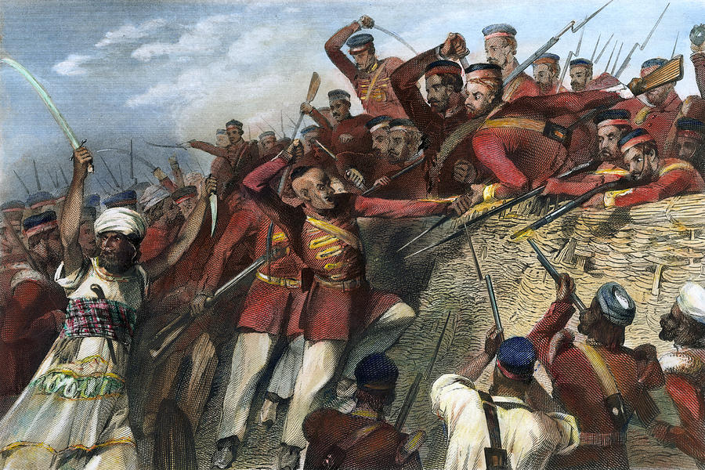
British Raj
Sepoy Mutiny
Gun cartridges greased with cow/pig fat causing outrage among Hindu/Muslim soldiers
Year long rebellion in which both British and sepoys try to destroy one another

Slide 27
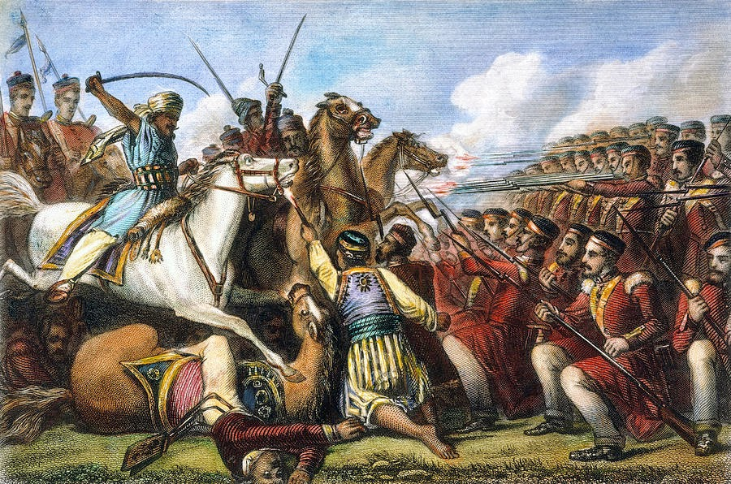
British Raj
Sepoy Mutiny
Sikhs and others side with British, Hindus/Muslims divided leading to downfall
British establish official control of all India, a period known as the British Raj

Slide 28
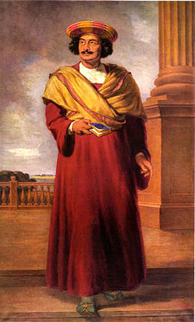
British Raj
Ram Mohan Roy
Spread new, non-traditional ideas
Often called the Father of Modern India
His ideas would inspire many to push for self-government

Slide 29
“India’s First Empires” Part 1Review
1. What empire was begun by Chandragupta Maurya?
Mauryan Empire
2. What tactics did the empire use to keep people in line?
High taxes spying assassinations bureaucracy
3. Describe the palace and capital city.
Gold pillars fountains thrones parks markets

Slide 30
“India’s First Empires” Part 1Review
6. List a group of people who were not forced to join the empire’s army.
farmers
7. What great leader gained control of the empire in 301 B. C. E.?
Asoka
8. What religion did he adopt?
Buddhism
9. How did he spread word about the religion?
Carved messages on pillars
10. How did he demonstrate “concern for his subjects’ well being” (the opposite of his grandfather)?
Officials looked out for people wells for clean water
rest houses for travelers religious tolerance

Slide 31
“India’s First Empires” Part 2 Review
1. List groups of people who moved to northern India after the Mauryan empire collapsed.
Greeks Persians Central Asians
2. What South Indian kingdoms remained free of Mauryan and Gupta control but often fought one another?
Tamil
3. How did Tamil and Gupta families differ in their cultural patterns?
Tamils were matriarchal & Guptas were patriarchal

Slide 32
“India’s First Empires” Part 2 Review
4. The Gupta empire, which took control in 320 C. E., promoted this religion.
Hinduism
5. Before the empire collapsed, about 535, it experienced great achievement in _____.
Arts Religious Thought Science

Slide 33
“The Mughal Empire in India” Part 1 Review
1. The Mughals claimed this Mongol conqueror as their ancestor.
Genghis Khan
2. Akbar, the “Greatest One,” who ruled from 1556 to 1605, said that _______ was the root of his strength.
Military strength
3. Akbar unified a land of 100 million people, and he governed this way:
Religious tolerance bureaucracy of officials turned enemies to allies
4. This was the type of tax levied on farmers.
Graduated income tax

Slide 34
“The Mughal Empire in India” Part 1 Review
5. This language, the most common in India, was a result of cultural blending during Akbar’s time.
Hindi
8. Name other cultural areas influenced by Akbar’s rule.
Arts and literature architecture

Slide 35
“The Mughal Empire in India” Part 2 Review
This Persian princess held the power after 1605.
Nur Jahan
2. This religious group, which espoused nonviolence, protected Khusrau after he became an enemy of the empire and Nur Jahan.
Sikhs
3. This building was built for Shah Jahan’s wife, to be “as beautiful as she was beautiful.”
Taj Mahal
4. Three reasons the empire decline during Shah Jahan’s time were …
Building of monuments rulers’ extravagant living war

Slide 36
“The Mughal Empire in India” Part 2 Review
5. Aurangzeb had this success during his reign.
Expanded the empire to its largest
6. Give examples of ineffective leadership from Aurangzeb.
Rigidly enforced Islamic laws on diverse population
Brought back unequal taxes
Banned new Hindu construction and destroyed monuments
7. More than _________ people died in famines at the end of Aurangzeb’s rule.
2 million

Slide 37
“British Imperialism in India” Part 1 Review
1. After 1757, this company became the leading power in India.
East India Company
2. Indian soldiers led by British officers were __________.
Sepoys
3. The British called India the brightest _________________ because of its value.
Jewel in the Crown
4. India was to produce ___________ for Britain and buy __________ from Britain.
Raw materials manufactured goods

Slide 38
“British Imperialism in India” Part 2 Review
According to the caste system, Indians could do a variety of different jobs.
False
2. The constant racism and proselytizing caused the Indians to develop ________.
Nationalism
3. The British government had to help the East India Company put down the _______ rebellion.
Sepoy
4. Two reasons the Indians did not unite against the British were …
Weak leadership splits between Muslims and Hindus

Slide 39
“British Imperialism in India” Part 2 Review
5. This religious group that had been hostile to the Mughals remained loyal to the British.
Sikhs
6. The part of India under direct control of the British government was the ____,
Raj
7. Ram Mohum Roy led India away from traditional practices and ideas and was called ___.
The father of modern India
8. By the early 1900s, Indian nationalist groups were calling for _________.
Self government

