Slide 1
Warm Up 10/10
Why is it not always easy to put good ideas into practice?
Have your Declaration Reading on your desk.

Slide 2
Let’s Debrief
Turn to your table groups.
What ideas did you see the most in the Declaration? Share some examples.

Slide 3
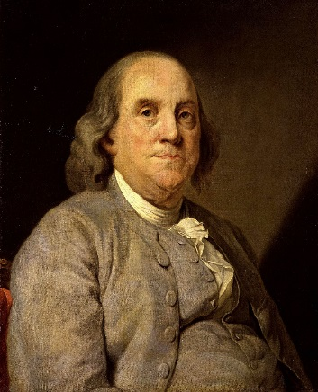
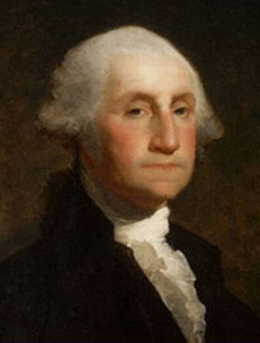
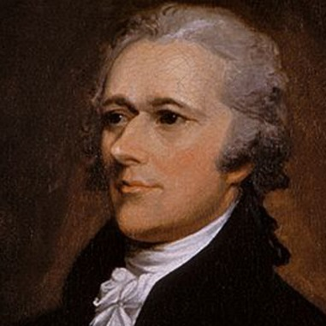
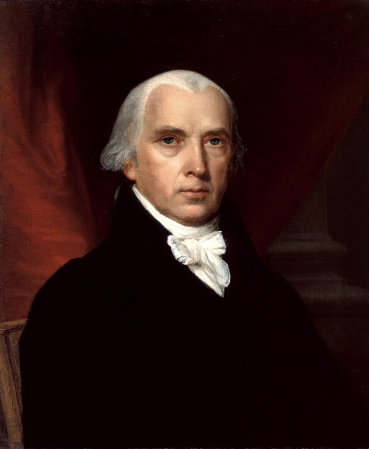
Constitutional Convention
Instructed by Congress to revise not replace Articles
America’s leading minds
Ben Franklin
George Washington
Alexander Hamilton
James Madison

Slide 4
A Series of Compromises
The Great Compromise
Virginia Plan
Replace Articles
Bicameral Legislature based on population
New Jersey Plan
Revise Articles
Unicameral with equal representation
Compromise
House = population, Senate = equal reps

Slide 5
A Series of Compromises
Three-Fifths Compromise
Slave counts for taxation vs representation
North vs. South
Compromise
Every 5 slaves counted as 3 white
Commerce
North vs. South
Compromise
Congress = foreign trade and interstate commerce
No taxing exports, no outlawing slave trade until 1808
All Men Created Equal

Slide 6
A Series of Compromises
Electoral College
Congressional vs popular vote for president
Senators plus representatives = number of electors
Elected president and vice president
Popular
Sovereignty
Santos Soapbox

Slide 7
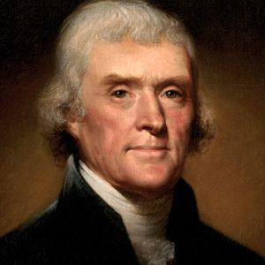
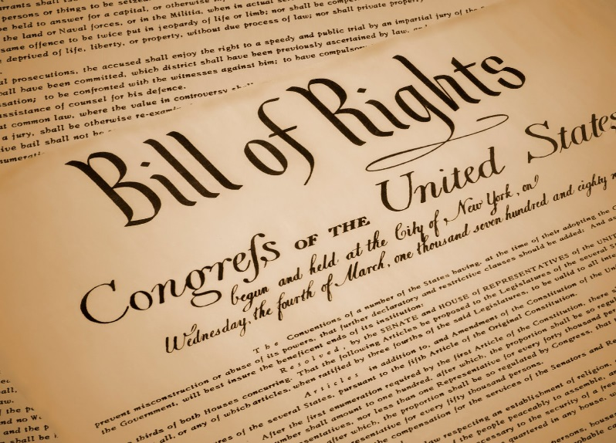
Ratification
Federalists
Pro constitution and strong government
Anti-Federalists
Pro state governments
Disliked lack of Bill of Rights

Slide 8
Ratification
Ratified by all but 2 states 1788
North Carolina 1789
Rhode Island 1790
Bill of Rights
Ratified 1791

Slide 9
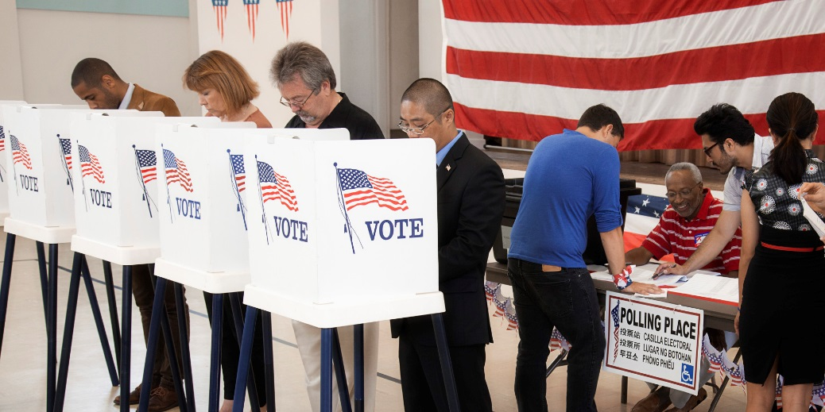
Guiding Principles of the Constitution
Popular Sovereignty
Power resides with the people
Republic system
Rule of Law
Government and people abide by laws
Constitution is supreme law

Slide 10
Guiding Principles of the Constitution
Separation of Powers/Check and Balances
3 Branches, separate powers
Ex: Treaty approval, Veto

Slide 11
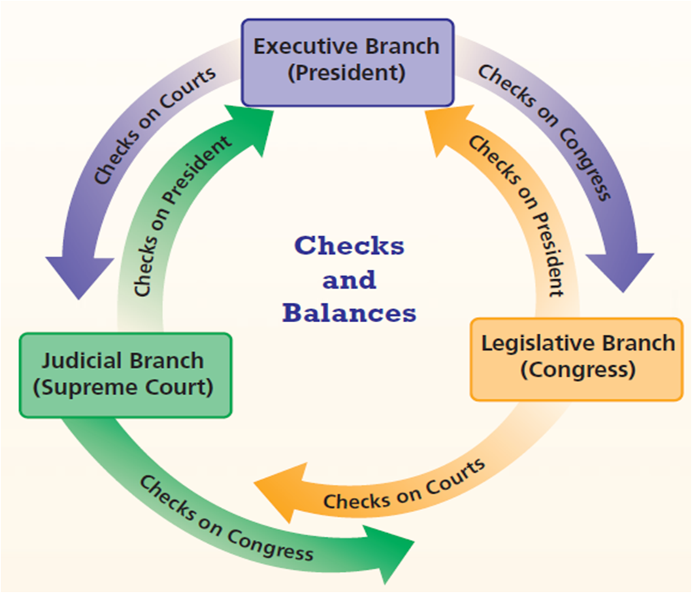

Slide 12
Guiding Principles of the Constitution
Federalism
State vs central power
Delegated powers
powers granted to national government
Enumerated or implied
Reserved Powers
Kept by the states
Concurrent Powers
Shared powers

Slide 13
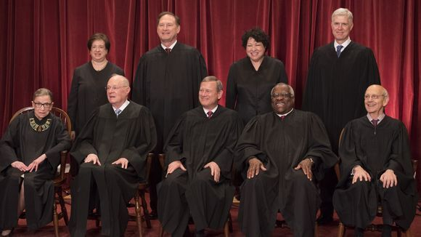
Guiding Principles of the Constitution
Independent Judiciary
To support rule of law
Protects against abuses of the system
Lifetime tenure/secure salary
Insulated from politics

Slide 14
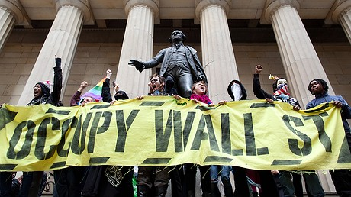
Guiding Principles of the Constitution
Individual Rights
Bill of Rights!!
Free speech protections

Slide 15
Warm Up 10/11
Which of the 6 Guiding Principles of the Constitution do you think is most important?

Slide 16
Today’s Objectives
Apply our knowledge of the guiding principles to propaganda
Skills
Group collaboration
Analysis/application of knowledge
Following instructions

