Slide 1
Warm Up 11/13
Click on the link on Mrs. Santos’ website agenda for today and complete the participation form for the member of your battle group.

Slide 2
Civil War Review (It’s about slavery)
Fort Sumter
Confederates take it
North Unites, Virginia secedes
Bull Run
Stonewall Jackson defeats Union
North calls for more soldiers
Shiloh
War will be a slaughter
Union might succeed in splitting south
Battle for capitals
Robert E. Lee drives back Union at Richmond
McClellan drives back Confederates at Antietam

Slide 3
Civil War Review (It’s about slavery)
Lincoln and slavery
Just wanted to save the Union
Emancipated to halt Confederate growth and to keep British out of the war
Emancipation Proclamation 1863
Freed slaves in rebellious states
Gettysburg
Turning point as Union hold its position
Massive losses on both sides
Lee actually offers to resign
Vicksburg
Last Confederate stronghold on Mississippi
Splits Confederacy in two
Ulysses S. Grant begins total warfare

Slide 4
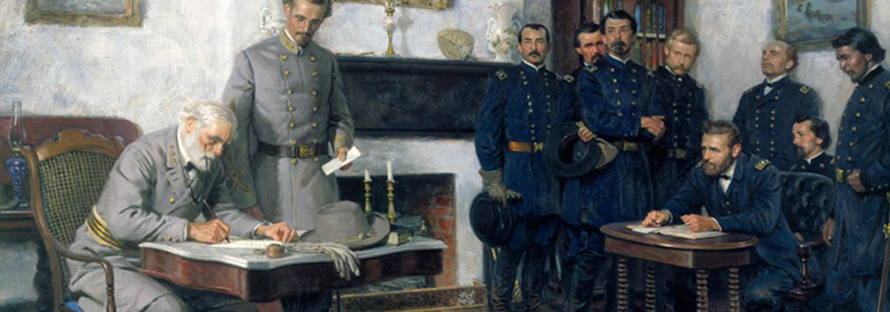
Civil War comes to an end
Sherman’s March to the Sea
Burn as you go tactic
Takes Atlanta and works back through Carolinas
Surrender at Appomattox
April 1865

Slide 5
April 1865
Lincoln assassinated 5 days after surrender.
What now?
What problems does the new nation face?

Slide 6
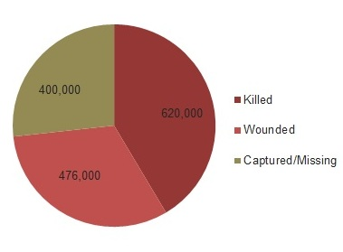
Human Toll of War
1.5 million combined casualties
North had 364,000 fatalities
Including 38,000 African-American soldiers
South had 260,000 fatalities
20% of all white men in the South died
33% of all men in South killed or severely wounded
Psychological toll was even worse

Slide 7
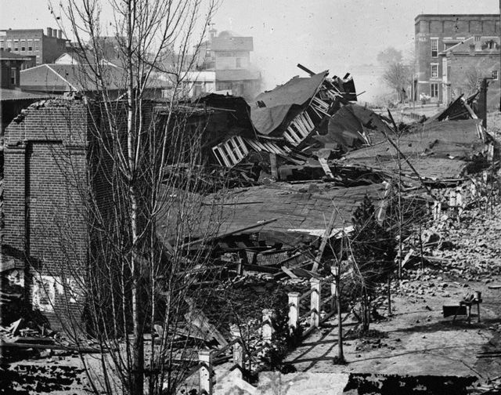
Toll of war
Physical Geographic toll (Remember Sherman?)
Destroyed 2/3 of South’s shipping industry
9,000 miles of railroad
2/3 of all livestock
Ruined bridges, canals, roads (infrastructure)
Value of southern farm property fell by 70%

Slide 8
Economic Toll
Southern Economy was destroyed
Confederate money worth nothing
Land was ruined
Labor Structure was dismantled
Slaves freed
Slave labor lost was worth about $3 billion
White men dead or seriously injured
Northern industry had boomed during war
Now they must brace for post-war decline

Slide 9
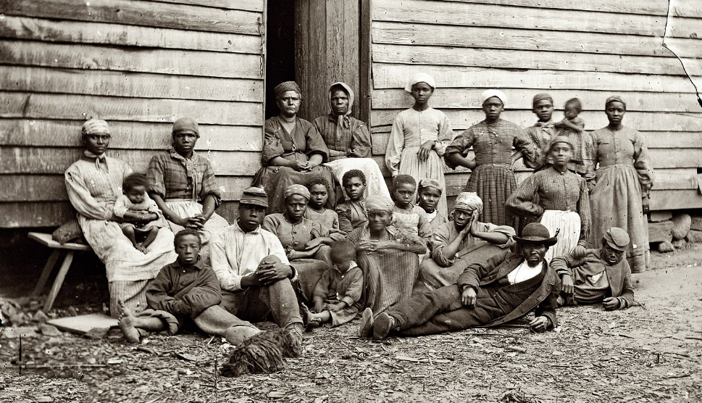
Three groups of survivors in the South
Black southerners: 4 million former slaves now free
Under slavery they had food and shelter
Now free, they had to find this on their own
Starvation and unemployment common
Many continued to work on former plantations
Some moved on to the West and to the North

Slide 10
Survivors
Plantation owners: slave labor lost was worth about $3 billion
Confederate money used by landowners now worthless
Many sold off land just to survive
Psychological and physical scars of war
Poor white southerners
Psychological and physical scars of war
White laborers had new competition with slaves being set free
Mass migration westward to Texas and beyond

Slide 11
Homework Due Wednesday 11/15
Read sections 11.2-11.5 of TCI’s History Alive and detail the following with good notes:
What was Andrew Johnson’s Reconstruction Plan?
What happened with the Freedman’s Bureau?
Explain black codes and their impact.
Describe Congressional Reconstruction.
Discuss the Johnson impeachment.
Freedmen, Scalawags, carpetbaggers, problems of sharecropping
Rise of Ku Klux Klan
Describe the end of Reconstruction and Jim Crow Laws
Plessy v. Ferguson

Slide 12
Bonus Project
Experience Seattle History

Slide 13
Reconstruction - 1865-1877
Federal government program to repair damage to the South
Restore and re-integrate confederate states into the Union
Hugely controversial for many reasons, and still debated today

Slide 14
Warm Up 11/14
In what ways will Reconstruction after the Civil War be difficult in both the North and the South?

Slide 15
Three Plans for Reconstruction
Lincoln’s 10% Plan
Lenient
Pardoned confederates who pledged allegiance
After 10% of state pledged, state could reinstate government
Radicals oppose
Want full citizenship and vote for former slaves
Proposed Congressional Reconstruction

Slide 16
Three Plans for Reconstruction
Johnson’s Plan
similar to 10%
Statehood = declare secession illegal, swear allegiance, ratify 13th Amendment
New legislators included former Confederate office holders, generals, and cabinet members – all pardoned
Also failed to extend rights to former slaves

Slide 17
Black codes
Restored many restrictions of slavery
Travel permits, weapons banned, marriage laws, etc.
Proved that little had changed in Confederate minds
Johnson vetoes Congressional attempts to help African Americans (Freedmen’s Bureau, Civil Rights Act 1866)

Slide 18
Congressional Reconstruction
Upset with the leniency of Johnson’s plan and the passing of black code laws in the South, Radical Republican pushed through the Reconstruction Act of 1867.
Broke the south into 5 zones under Northern military control
Did not recognize state governments created under presidential plans and ordered states to hold new elections for delegates to create new state constitutions (exc. Tennessee)
Required states to allow all qualified male voters, including African Americans to vote (disallowed confederate leaders)
Required ratification of the 14th Amendment
Required Southern states to guarantee equal rights

Slide 19
Fourteenth Amendment
Congress unhappy with Johnson’s soft reconstruction plan
Tries to pass a Civil Rights Act 1866, Johnson vetoes it
Congress overrides it, then proposes an amendment to Constitution which will be ratified as the 14th amendment in 1868
14th Amendment will become backbone of civil liberty in America

Slide 20
New Daily Lives of Former Slaves
Freedom of movement
Some former slaves went in search of family members.
Some moved North or West
African-American education increase
Freedman’s Bureau help set up schools
From beginning, schools were de facto segregated

Slide 21
New Southern Agricultural System
Old Plantation system was dead with the 13th Amendment
New system emerged soon after the Civil War
Before 1860, 90% of cotton picked by slaves
By 1875, 40% picked by white tenant farmers
New system was broken into two categories--Sharecropping & Tenant Farming
While this new system initially gave poor whites and African-Americans MORE economic freedom, it created generational poverty.

Slide 22
Sharecropping
1.
~Do not own land
~ Do not own seed
~ Do not own tools
~ All borrowed from land owner
2.
~Work land
~ Receive small % of crop
~ No $ for working land
3.
~ Sell small % crop
~ Earn enough for essentials to survive
~ MAYBE can save a small amount

Slide 23
Tenant Farming
1.
~ Rent Land
~ Own seed
~ Own tools
2.
~ Work land
~ Control ALL crop
3.
~ Buy living essentials
~ Pay rent
~ Buy seed
~ Buy tools
~ MAYBE can save a small amount

Slide 24
New Civil Rights of Reconstruction
13th, 14th , & 15th Amendments
Freedmen’s Bureau
African-American property rights
African-American political participation
African-Americans in state and local office

Slide 25
Republican South
Republican control of south helped continue progress.
Made up of Freedmen, Carpetbaggers, & Scalawags.
Carpetbaggers~ Northern Republicans who moved to South after Civil War (Some to help—Some to profit)
Scalawags~ Southerners who joined the Republican Party.

Slide 26
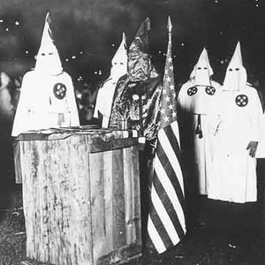
Rise of the Ku Klux Klan
Formed by former Confederate officers.
Initially was an open Social Club.
Primary goal was to stop African Americans from exerting new rights, & keep them at the bottom of the socio-economic hierarchy.
Used intimidation and extreme violence to stop African-Americans from voting.
Terror also expanded throughout the south even outside of the KKK scope

Slide 27
Factors Leading to the Failure of Reconstruction
Rise of the KKK
Fracture of the Republican Party
Panic of 1873
Supreme Court refusal to support 14th & 15th Amendments
Redemption of the Southern Democrats
Election of 1976
Rise of Jim Crow

Slide 28
Scandals & Disunion of the Republican Party
Impeachment of Johnson caused tension between Republican factions
Late in Grant’s first term, several political scandals of his administration broke.
Bribery & Fraud of cabinet members
NOT GRANT
Scandals will lead to split in the Republican Party for the 1872 elections.

Slide 29
Panic of 1873
Post CW 33,000 miles of new railroad were laid across the country between 1868 and 1873.
Railroads were the largest employer in the US outside of agriculture, but were primarily backed on gov’t subsidies and land grants
There was an explosion in investment/speculation around this growth which failed to produce capital.
Civil War and early Reconstruction economic balloon finally burst, triggering bank closures & stock market collapse.
Triggered by the failure of Jay Cooke & Company bank which had been a primary backer the Union during the Civil War and the primary backer the Northern Pacific Railway
This economic depression would pull Congressional focus and federal funding from Reconstruction

Slide 30
Supreme Court Impedes Civil Rights
On top of loss of focus and enforcement for Reconstructions policies, the Supreme Court also crippled progress.
Slaughterhouse Cases greatly limited scope of protection of the 14th amendment.
Only “federal” rights were protected.
No day-to-day rights were protected.
Day-to-day rights could only be protected by state and local law
US v. Reese also limited scope of 15th Amendment & opened up States’ right to voting restrictions.
Leads to Poll Taxes, Literacy Tests, etc.

Slide 31
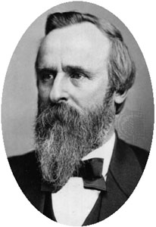
Southern “Redemption” & Home Rule
Problems with the republican party & activities of KKK will help topple Republicans in South.
Slowly in many places Southern Democrats will gain power.
The reemergence of Southern Democrat dominance was referred to as “redemption”
Would lead to Compromise of 1877 (1876 election)
Hayes became president in return for removal of troops

Slide 32
Southern “Redemption” & Home Rule
The combination of Southern ‘Redemption” & Supreme Court decisions ushered in an era of Home Rule in the South.
The Federal Government would no longer monitor civil rights.
States controlled all day-to day rights of their citizens
Home Rule in the South ushered in a new era of race relations that would be present for almost 100 years.

Slide 33
The Rise of Jim Crow
Racial Etiquette
Cultural “rules” on behavior for races
Segregation
Plessy v. Ferguson
Federal Supreme Court case that established “separate but equal”- legalizing segregation
Lynching Epidemic 1880-1910
Unchecked by local, state and federal gov’t

Slide 34
Homework Due Wednesday 11/15
Read sections 11.2-11.5 of TCI’s History Alive and detail the following with good notes:
What was Andrew Johnson’s Reconstruction Plan?
What happened with the Freedman’s Bureau?
Explain black codes and their impact.
Describe Congressional Reconstruction.
Discuss the Johnson impeachment.
Freedmen, Scalawags, carpetbaggers, problems of sharecropping
Rise of Ku Klux Klan
Describe the end of Reconstruction and Jim Crow Laws
Plessy v. Ferguson

Slide 35
Legacy of the Civil War
Why is the subject of racism still an issue today?
The Lost Cause
Basically Southern revisionist history
https://youtu.be/dOkFXPblLpU
Why is this important to know?
https://youtu.be/J5b_-TZwQ0I

Slide 36
Promoting “Lost Cause” Historiography and White-Washing History
"I would tell you that Robert E. Lee was an honorable man. He was a man that gave up his country to fight for his state, which 150 years ago was more important than country. It was always loyalty to state first back in those days. Now it's different today. But the lack of an ability to compromise led to the Civil War, and men and women of good faith on both sides made their stand where their conscience had them make their stand.“ – John Kelly
“I think we make a mistake, though, and as a society and certainly as, as individuals, when we take what is today accepted as right and wrong and go back 100, 200, 300 years or more and say what those, you know, what Christopher Columbus did was wrong. You know, 500 years later, it’s inconceivable to me that you would take what we think now and apply it back then.”- John Kelly

Slide 37
White House Doubles Down
"All of our leaders have flaws. Washington, Jefferson, JFK, Roosevelt, Kennedy -- that doesn't diminish their contributions to our country, and it certainly can't erase them from our history. And General Kelly was simply making the point that just because history isn't perfect, doesn't mean that it's not our history.“-Sarah Sanders
“I don’t know if I’m going to get into debating the Civil War. I do know many historians, including Shelby Foote and Ken Burns’ famous Civil War documentary, agree that a failure to compromise was a cause of the Civil War. There are a lot of historians that think that, and there are a lot of different versions of those compromises. I’m not going to get up here and relitigate the Civil War, but there’s certainly, I think, some historical documentation that many people, and there’s pretty strong consensus — people from the left, the right, the North and the South — that believe that if some of the individuals engaged had been willing to come to some compromises on different things, it might not have had occurred.”- Sarah Sanders

Slide 38
Burns Twitter Response
Many factors contributed to the Civil War. One caused it: slavery.
Historian Barbara Fields ended the film: “the Civil War is still going on. It's still to be fought and regrettably it can still be lost.”

Slide 39
1856 Robert E Lee on Slavery
In this enlightened age, there are few I believe, but what will acknowledge, that slavery as an institution, is a moral & political evil in any Country. It is useless to expatiate on its disadvantages. I think it however a greater evil to the white man than to the black race, & while my feelings are strongly enlisted in behalf of the latter, my sympathies are more strong for the former. The blacks are immeasurably better off here than in Africa, morally, socially & physically. The painful discipline they are undergoing, is necessary for their instruction as a race, & I hope will prepare & lead them to better things.

