Slide 1
The British Raj
ब्रिटिश राज
Sawyer Tamai, Grant McLeod, Matthew Preising

Slide 2
Time Period
The time period of British rule (Raj) in India started from 1757 to 1947.

Slide 3
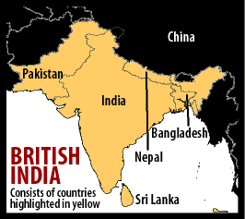
Important Site and Boundaries.
This time period took place in India. During the British Raj, England controlled most of India and some of Pakistan, Bangladesh, Nepal, and Sri Lanka.

Slide 4
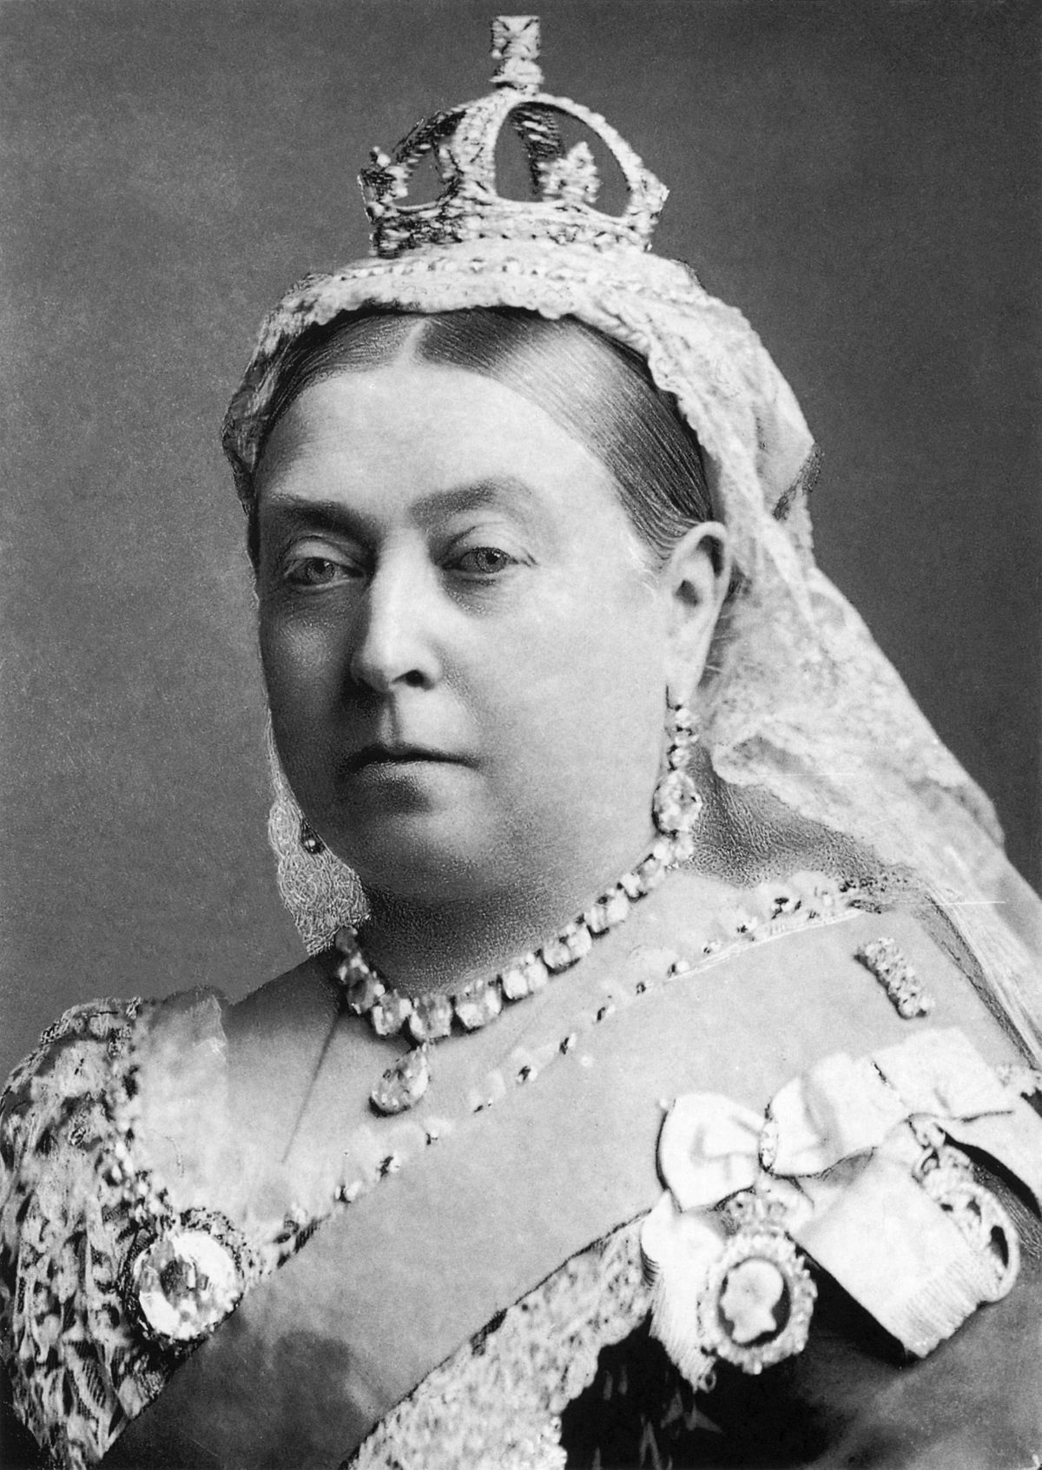
Key Figure: Queen Victoria
Queen Victoria was the Queen of England from 1837 to 1901.
After the British took control over India, Queen Victoria was proclaimed as the Empress of India
She assured in the Proclamation of 1858 that all Indians will be treated equally under British law regardless of race or religion. Her failure to do so lead to the Indian national movements.

Slide 5
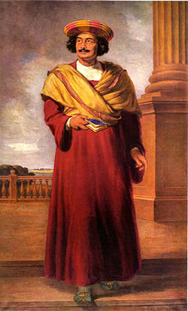
Key Figure: Ram Mohum Roy
Following the British control over India, nationalist Indians started to demand more modernization and a greater role in government.
Ram Mohum Roy, a well educated Indian rose and started a campaign to move India away from traditional practices.
He believed that India will continue to be controlled by foreign countries if they do not change their religious life such as arranged marriages and rigid caste systems.

Slide 6
Key Events: Britain takes over India
British began to show economic interest in India during the 1600’s.
British East India Company set up trading posts but were kept under control by the Mughal Dynasty.
However When the Mughal Dynasty started collapsing during 1707, the British took advantage over that and took over the country by defeating the Indian forces at the Battle of Plassey in 1757.

Slide 7
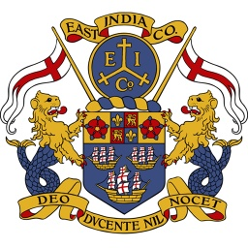
Key Events: British Rule in India
The British East India Company was regulated by the British government at first
But in the early 1900’s, the company began to rule India without any interference from the British Government. They built their own private army of sepoys or Indian soldiers led by British officers.

Slide 8
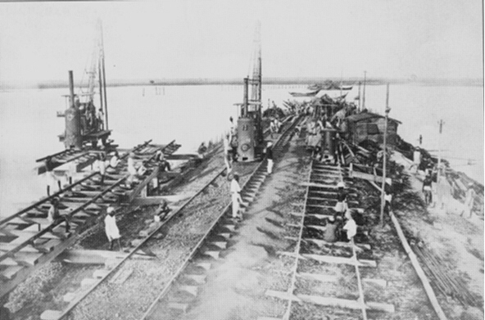
Key Events: Railroad Building
Building Railroads increased economic growth, and made moving troops safely easier
Between 1860 and 1880, miles of railroad tracks increased from 836 miles to almost 10,000

Slide 9
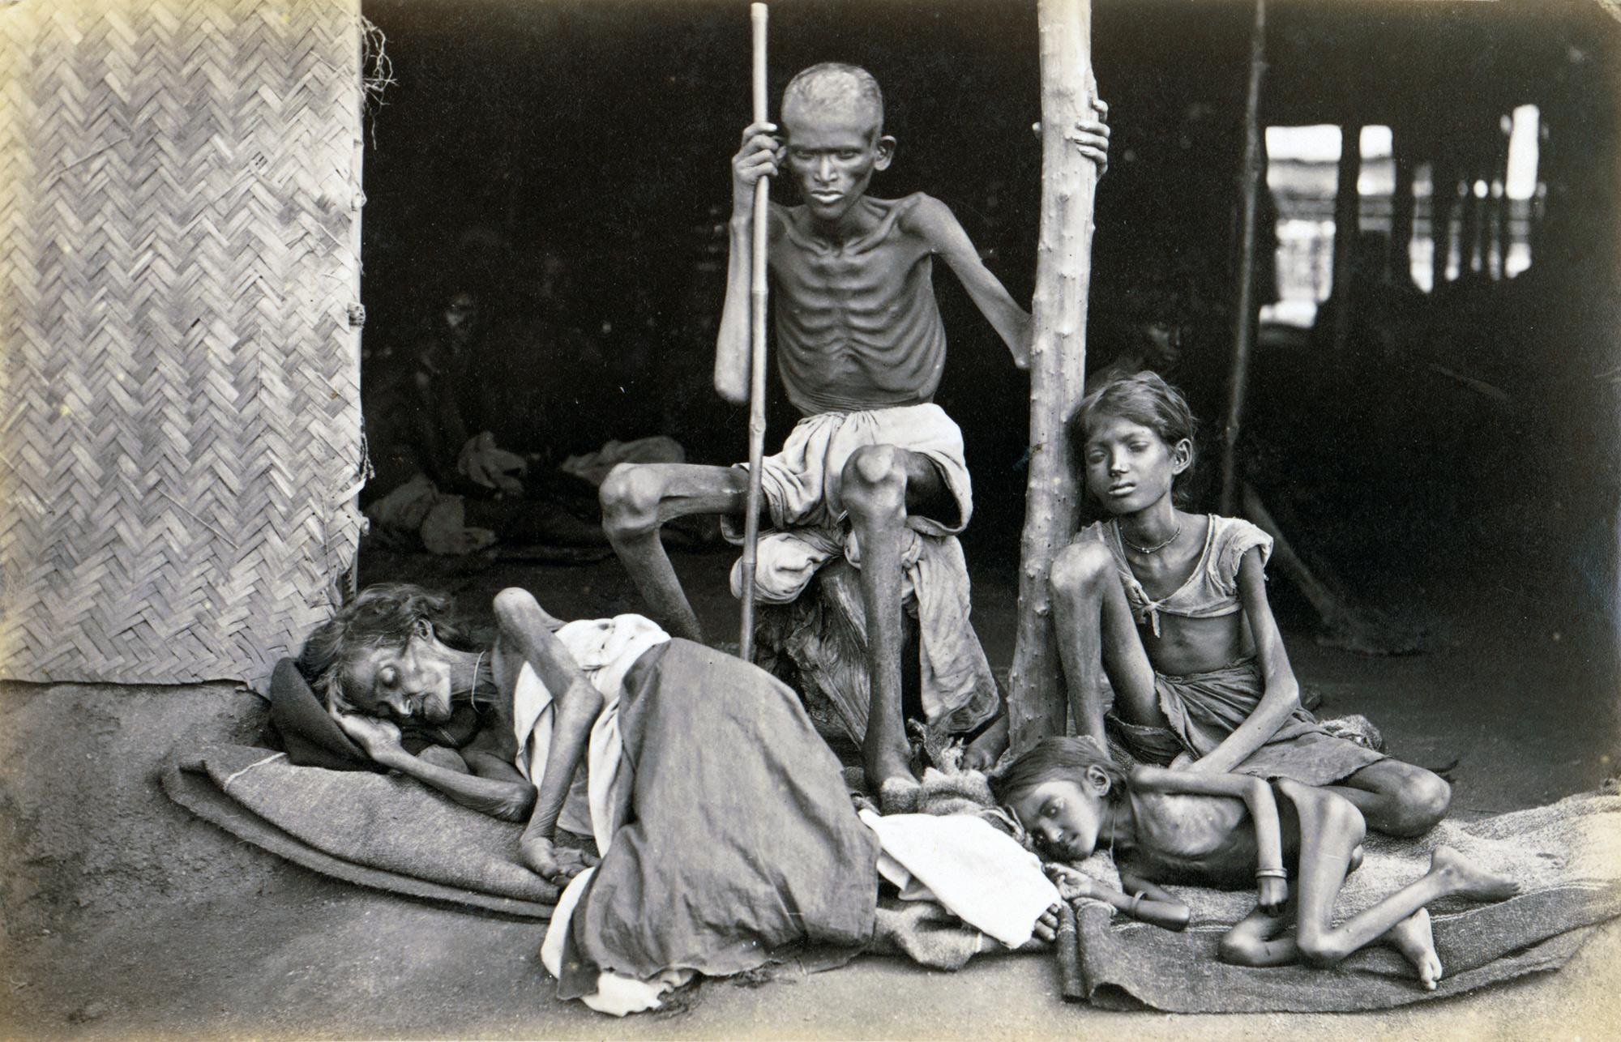
Key Events: Famines in the late 1800’s
The British wanted India to produce cash crops for them to profit.
Since the British had economic control and power over India, the Indian villagers’ had to grow the cash crops instead of crops to feed their family which lead to famines in the late 1800’s

Slide 10
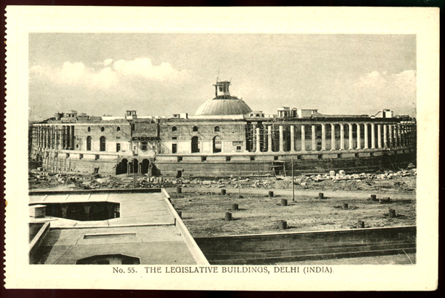
Key Events: Government
The British Raj relied on mostly Indians to do the heavy lifting in politics.
In 1900, 30% of government spending went to paying for the Indian Army which was to keep Indian civilians in check so they don’t rebel
As late as 1921, there were only 156,000 British citizens living in India

Slide 11
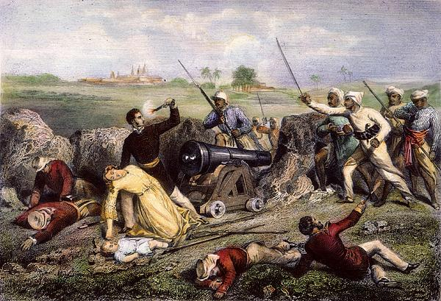
Key Events: Sepoy Mutiny
The British Enfield rifle required Sepoys to bite cow and pig fat which were considered sacred. The soldiers were outraged by the news.
The 85 people out of 90 who refused to bit the cow and pig fat were jailed by the British.
The very next day, the Sepoys rebelled. The soldiers marched and captured the city of Delhi and continue to spread the rebellion to northern and central India.
However, the Indians were weak compared to the British due to the tensions between Hindus and Muslims and poor leadership.

