Slide 1
Warm Up 11/27
Write down 5 things that come to mind when you think of Africa.

Slide 2
November 27, 2017
Objectives:
Introduce Africa Paper and Unit
Homework:
11/28: Monotheistic Religions AND Egypt/Mesopotamia reading notes and 5 warm ups (beginning 11/7)
11/28: Diverse Societies in Africa-notes any format (located on website)
Turn in: Promises Viewing guide (6th)
Take out:
Africa Map for stamp
Agenda:
Africa Research Project Intro

Slide 3
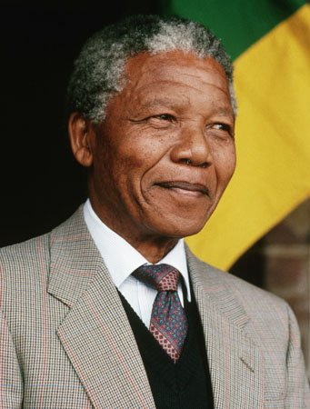
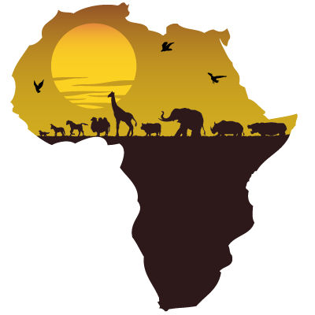
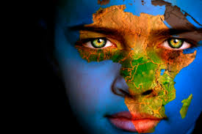
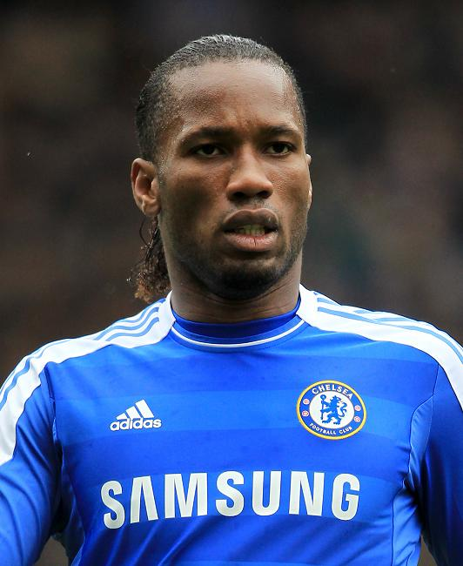
Africa!
54 Countries
Over 1 billion people
Over 2100 languages
18 of the 20 poorest countries on Earth
50% of Africa’s population born after 1991
Largest City:
Lagos, Nigeria
21 million people

Slide 4
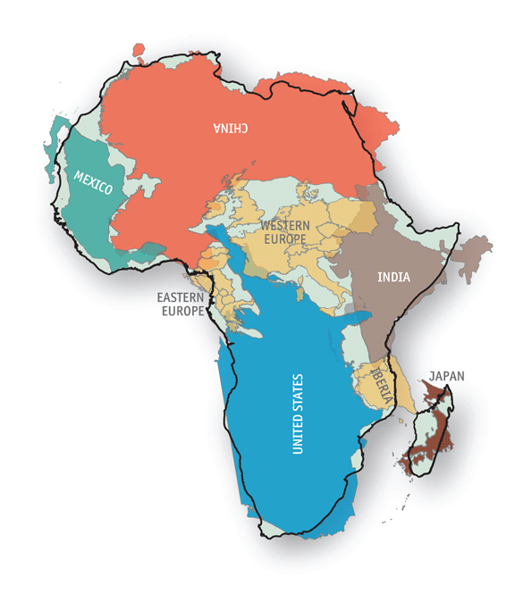

Slide 5
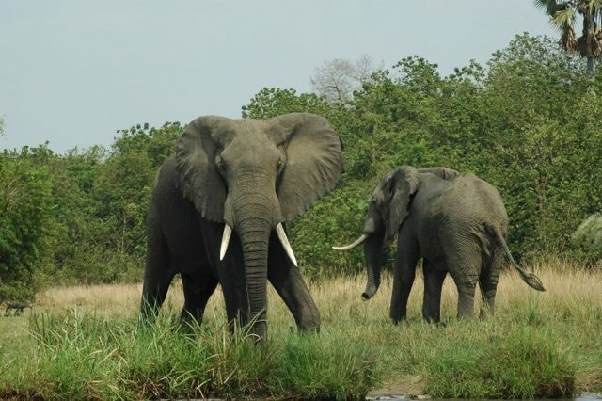

Slide 6
Ancient African Kingdoms
Ancient Kingdoms
Traditions of early cultures (oral stories, trading, etc.)
Physical and Political Geography
What technologies did African civilizations have access to?
How did migration and trade affect African history?
What forms of agriculture developed in Africa?

Slide 7
Colonialism
European Contact and Exploration
Culture Clash and Ethnocentrism
Berlin Conference
Scramble for Africa
The White Mans Burden
How has colonialism affected Africa?
Why were Europeans able to colonize Africa?
How did Africans resist and then defeat European Colonization?

Slide 8
Fall Essay
Research Questions

Slide 9
The Purpose
Research topic and develop a thesis driven essay defining and proving the topic’s impact on some aspect of African culture.
Not an informational report.
Argue how your topic is historically significant and prove that argument with concrete factual support.

Slide 10
Topic vs. Question
Your topic is a noun or phrase
Aztecs
Pizarro conquers the Incas
Fascism
Your question should be a complete sentence.
Lets look @ a few past examples from 10th grade research papers

Slide 11
Focus
Too broad a topic means only covering the surface of that person or issue
The Russian Revolution would be too big to manage in a reasonable length paper
Focus on one issue within that topic
How did Tsar Nicholas’ policies contribute to the Russian Revolution?

Slide 12
Types of Questions: Reference
Reference questions are typically answered with known facts or statistics.
You will likely have to ask some reference questions in your research.
Ex: "What percentage of drug-related crime in 1999 was committed by dealers, not users?"

Slide 13
Types of Questions: Report
Review or report questions are typically answered with what is generally known about a fairly narrow topic.
Ex: “How did the original thirteen colonies become the United States?”

Slide 14
Types of Questions: Research
Research questions are open-ended. They require a variety of accumulated information from different sources to develop an answer, and the student is required to draw his or her own conclusions.
Ex: "How does Hawaii's location and climate affect its economy?”

Slide 15
Some ways to begin a research question:
Why…
How…
What are the effects of…
What are the consequences of…
Contrast (then & now)
What was the influence of ___ on ___?

Slide 16
Thesis-Driven Paper
A thesis-driven paper makes an arguable claim and defends it. Do not confuse a research paper with a report: you need to offer a thesis about your topic and then present evidence and analysis that provides support and explanation.

Slide 17
Find the info!!
Read through your paper info and find the following:
Highlight/underline the things that you will need to turn in and where
Highlight/underline (different color) the due dates for the above

Slide 18
Homework!
Read and take notes on Diverse Societies in Africa (on the website).
Email Mrs. Santos if you can’t find it.
Consider the questions we wrote down in class today.

Slide 19
Several Quality? Theses
Africa is not doomed to a state of poverty despite geographic realities that almost ensured struggles because geography is not the sole cause but combined with income that it brings.
Geographic luck results in successful or not successful technology and helpful or not helpful resources. Africa as a continent had little luck.

Slide 20
More
Africa today is behind other countries because of its geographical location and lack of domesticated plants and animals.
Geographic luck plays a large part of Africa because if it had better land and weather and domestication of animals, Africa could advance with any part of the world.

