Slide 1
Warm Up 11/13
Take out your notes on Mesopotamia and Egypt answer the following on a separate sheet of paper:
What was the Mesopotamian writing form called?
What was the Egyptian writing called?
Tell me something both civilizations had in common.
What major naturally occurring event did the Egyptians use to track their year?
Name one invention of the Mesopotamians.

Slide 2
November 13, 2017
Turn in:
None
Take out:
Egypt/Mesopotamia Notes
Paper to take notes
Agenda:
Intro to Monotheism
Origins of Judaism
Objectives:
*Contextualize monotheistic religions – specifically the Abrahamic Religions
Homework:
11/14: Origins of Judaism
11/15: Rise of Christianity
11/16: Origins of Islam
11/17: Triple Venn

Slide 3
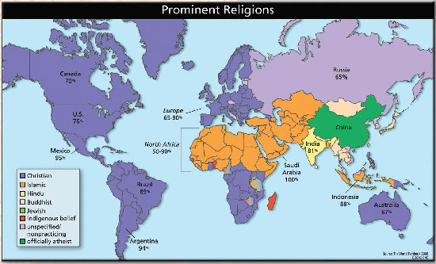

Slide 4
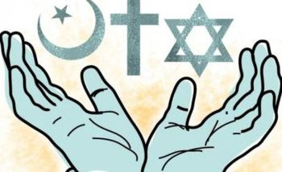
The Abrahamic Religions
Judaism
Christianity
Islam
All come from Abraham.
All tell the story of Abraham in their holy books.

Slide 5
Religious Discussions
Understanding religions will help us understand why the world is the way it is today.
It will help us understand the decisions that people make.
We are all learning (including me).

Slide 6
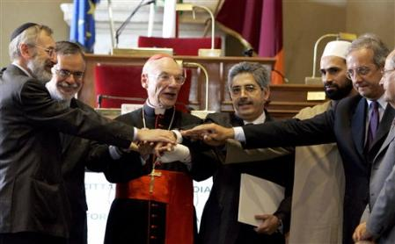
Religious Discussions
We teach about religions
We will be respectful
We won’t speculate about Truth (Capital T)
Every religion tells us something about humanity
Every religion can look strange from outside (ethnocentrism)

Slide 7
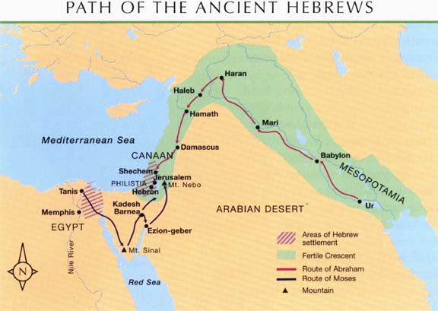

Slide 8
The Story of the Jews: Bad luck with big empires
God promises to protect Abraham’s people, and give them the land of Canaan (Israel).
The Covenant
Abraham promised to obey God. In return, God protects him and his descendants.
The people fail to please god= drought and famine.

Slide 9
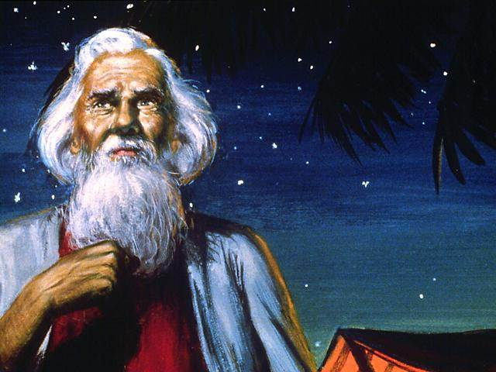
In a nutshell
Oldest western religion
Began in the Middle East—all western religions begin here
Belief in one God—Yahweh—who is the God of all (not just the Jews)
Yahweh chose the Jews to be his people
Series of stories result in Jews being promised a land of their own

Slide 10
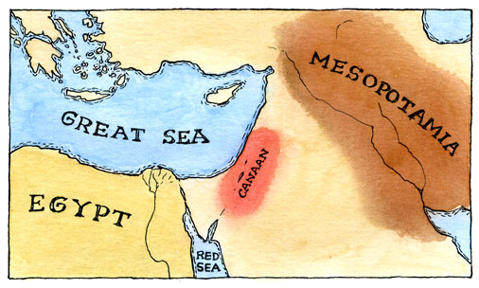

Slide 11
In a Nutshell
Several hundred years after creating the world (Adam/Eve) Yahweh makes contact with Abraham and his wife Sarah, who cannot have a child
Yahweh says, believe in me, and make me your God, and I will first give you a child and then make you the father of the entire Jewish race
Abraham → Isaac → Jacob → 12 sons = 12 Tribes of Israel = Beginning of Jewish race

Slide 12
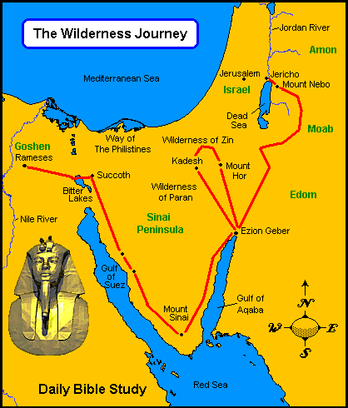
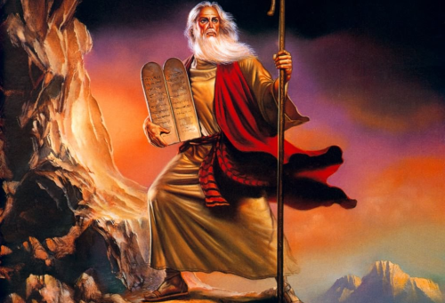
What happens next?
The Exodus.
What was it?
What holiday celebrates the Exodus?
Who led it?
What did God give to this leader?

Slide 13
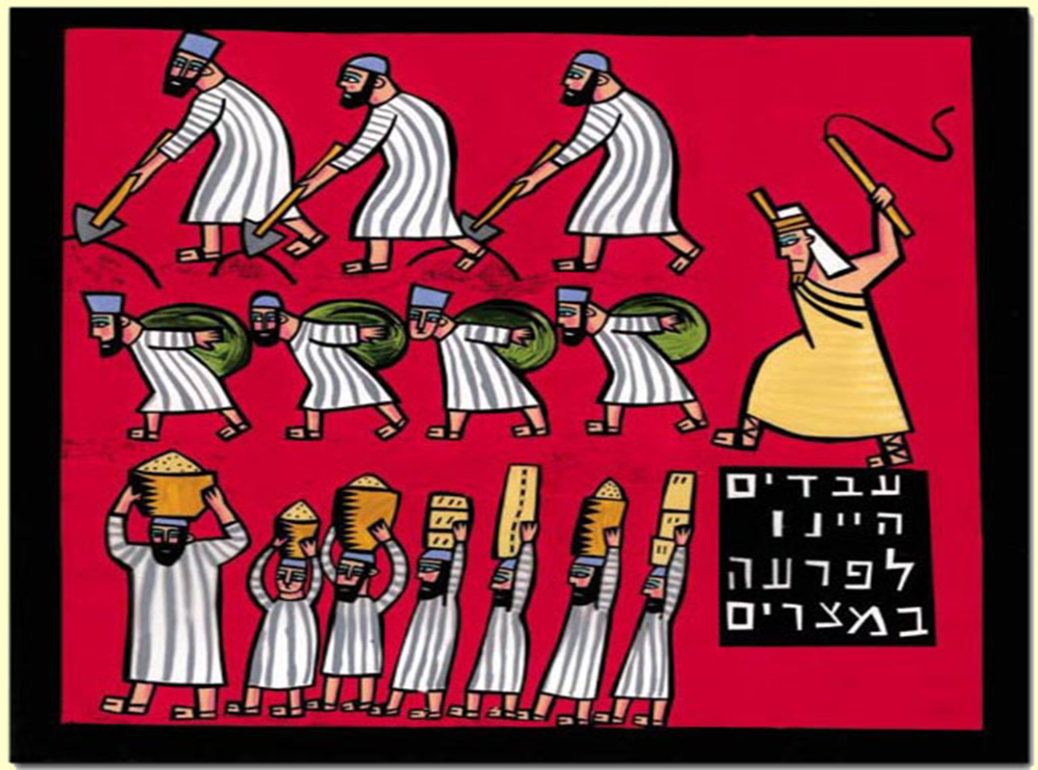
Big Problems
Through a series of errors, 12 tribes of Israel become slaves in Egypt
Yahweh selects one man, Moses, to lead the tribes out of Egypt and into the promised land
After a series of events, including death of first born, Moses leads the Jews out of Egypt and into the Wilderness

Slide 14
Big Problems
The Exodus.
Moses leads them out of Egypt.
Receives the Ten Commandments
The New Covenant

Slide 15
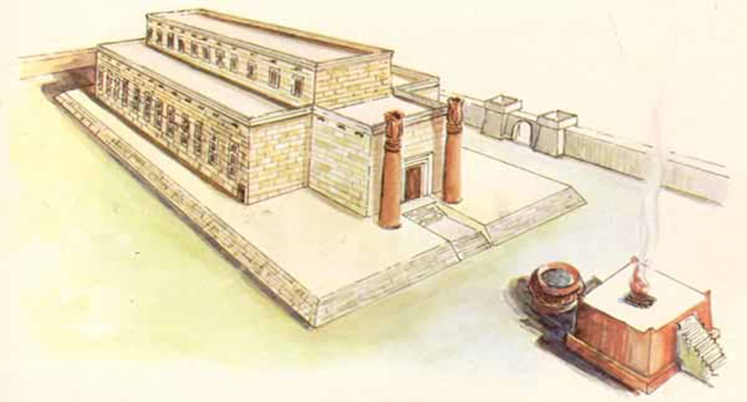
Kingdom of Israel
After receiving the promised land, a series of great Jewish leaders emerges
Saul, drives Philistines from Palestine
David is considered the great king of the Jews and ushers in a golden age
After a series of events, he is succeeded by the wise Solomon

Slide 16
Bad luck with Big Empires
The Jews are conquered by the Assyrians.
Jerusalem (and Solomon’s Temple) destroyed by Babylonian Empire.
What is the Babylonian Captivity?
King Nebuchadnezzar sends them to Babylon.
Keep religion alive in foreign land!

Slide 17
The Story of the Jews: Bad luck with big empires
Cyrus the Great allows the Jews to go back to Jerusalem.
The Jews build the Second Temple in Jerusalem.
The Romans take control of the Middle East. (Christianity begins).
The Jews rebel against the Romans (x2).
The Romans destroy the Second Temple.

Slide 18
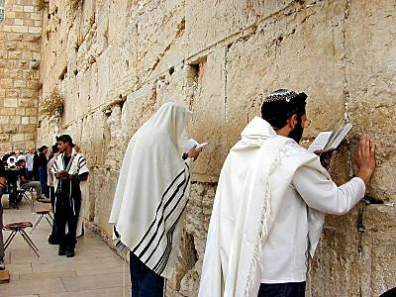
The Western Wall “The Wailing Wall”

Slide 19
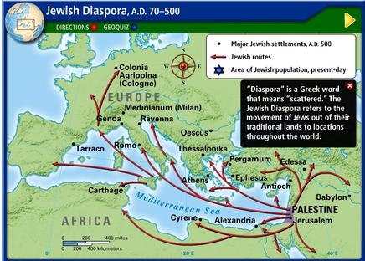
The Jewish Diaspora - 70 CE-1948 CE

Slide 20
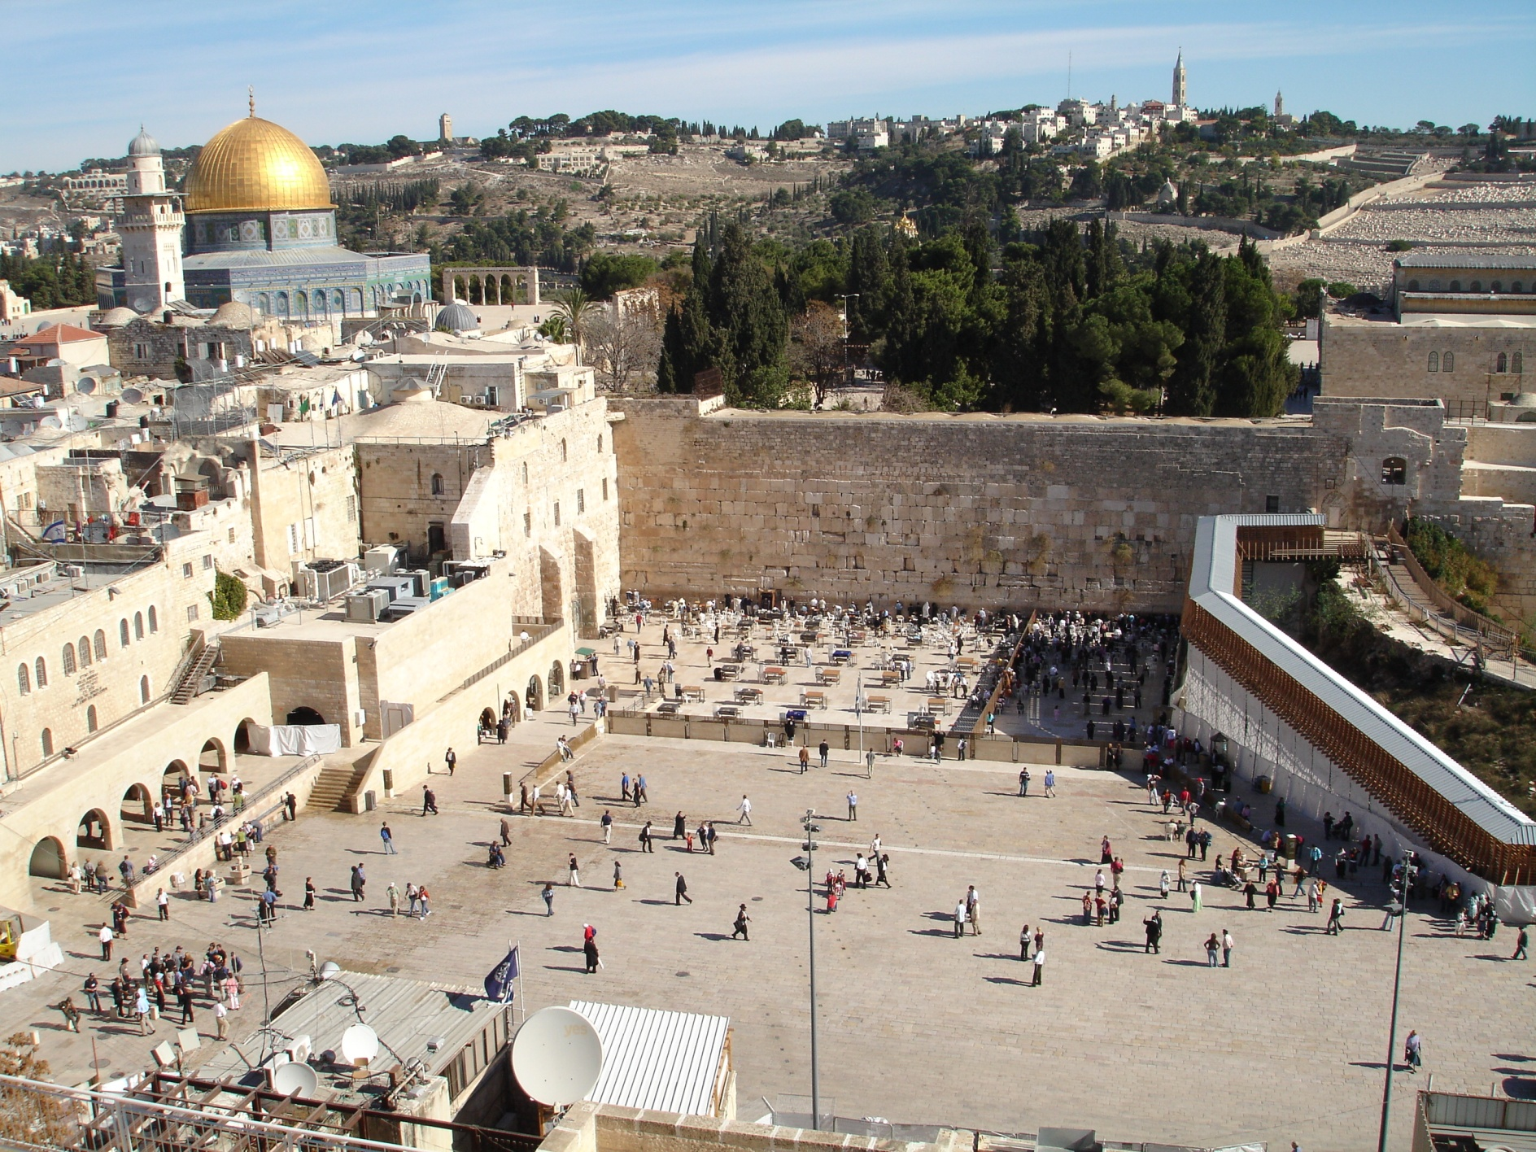
The Western Wall

Slide 21
With a partner, or two
Come up with a list of 10 MOST important terms/events/people for the origins of Judaism
Rank them
1 most important, keep going all the way to…
10 least important
Give reasons, in writing, for your ranking after each term

Slide 22
Triple Venn for Friday

Slide 23
Homework Due Tomorrow 11/14
Read and take notes on the Origins of Judaism. Guiding questions on website.
Due Wednesday 11/15: Read and take notes on Rise of Christianity. Guiding Questions on website.

Slide 24
Warm Up 11/14: With a partner, or two
Come up with a list of 10 MOST important terms/events/people for the origins of Judaism
Rank them
1 most important, keep going all the way to…
10 least important
Give reasons, in writing, for your ranking after each term
Take out reading notes for stamp and to use

Slide 25
November 13, 2017
Out for stamp:
Origins of Judaism Notes
Take out:
Paper to take notes
Agenda:
Rise of Christianity
Objectives:
*Contextualize Christianity
Homework:
11/15: Rise of Christianity
11/16: Origins of Islam
11/17: Triple Venn

Slide 26
Christianity Background
Second oldest Western religion, founded around 35 CE the Middle East
Same principles of Judaism, EXCEPT believes Jesus of Nazareth was messiah as prophesized in Isaiah
Sacred book commonly call The Bible
Traditional religion of Europe been spread to rest of the world (most widespread religion, but not largest)
Church as an institution involved in life is key
Ultimate belief rests in fact that God sent his son to save us, believe in him = go to heaven

Slide 27
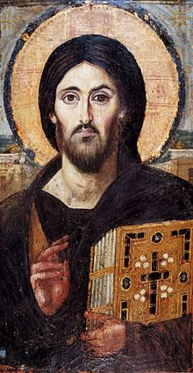
Jesus the Nazarene
Messiah or savior and central figure in Christianity
Born 4 BCE died 31 or 33 CE; crucified
descendant of King David
Parents = Mary & Joseph, Christians believe Mary was a virgin
Leader/preacher around Jerusalem (one of many) who acquired a select group of 12 followers
Is executed for virtually unknown reasons-by crucifixion
Resurrected in 3 days, spent 30 days with his disciples and went to heaven

Slide 28
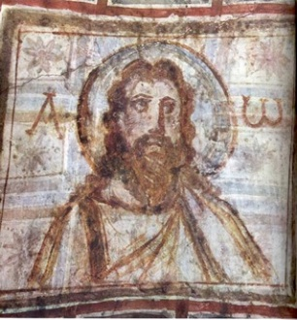
The Teachings of Jesus
If someone takes your coat, let him have your shirt as well.
Give to everyone who asks for something, and when someone takes what is yours, do not ask for it back.
Do for others only what you would want them to do for you.
Why did Jesus’ message appeal to people in Judea and beyond?

Slide 29
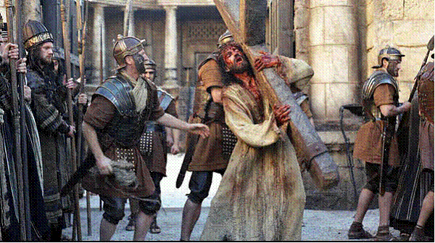
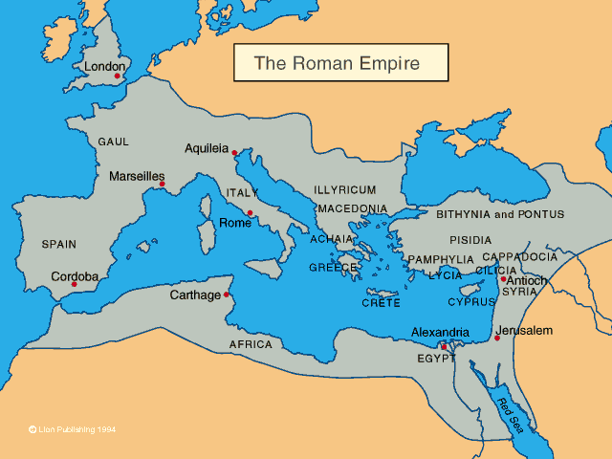
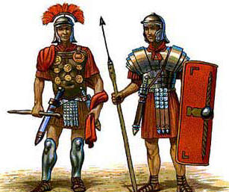
Jesus & the Romans
Why do you think that the Romans felt threatened by this poor carpenter?

Slide 30
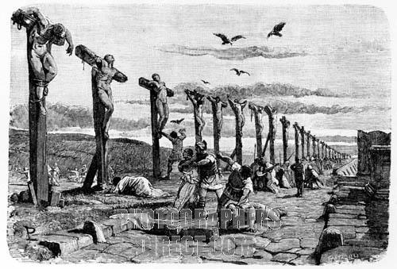
The Crucifixion of Jesus
Common form of torture and capital punishment used by the Roman Empire.

Slide 31
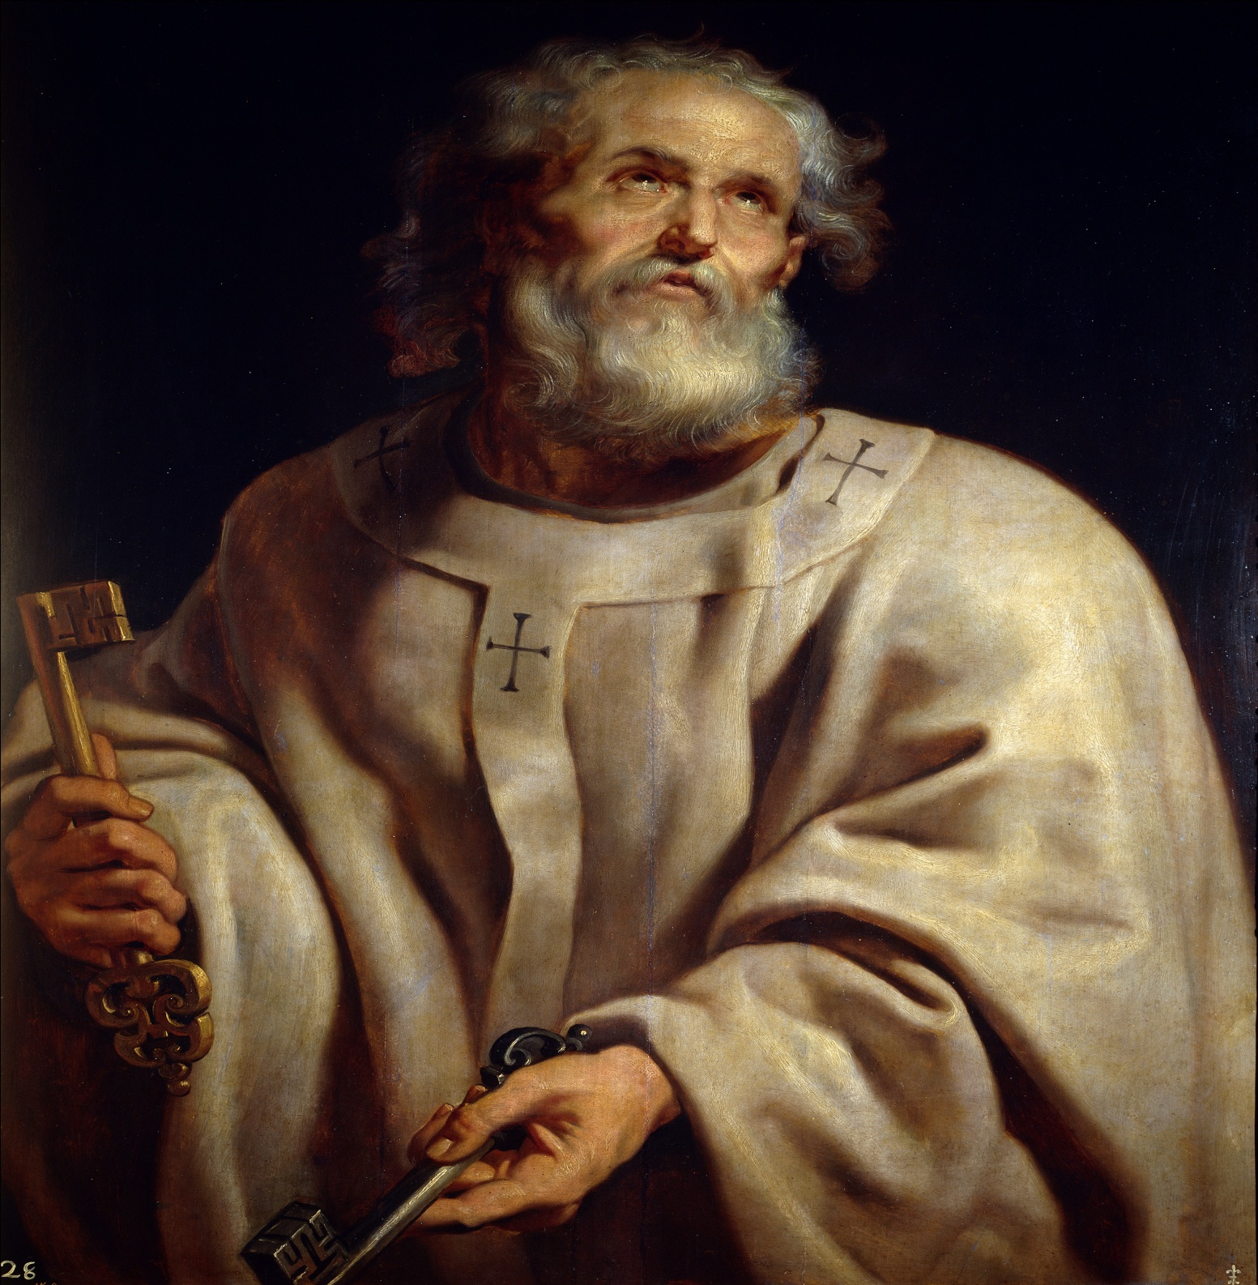
The Spread-Saint Peter
One of 12 Apostles
The First Pope!
Central authority for Early Christianity

Slide 32
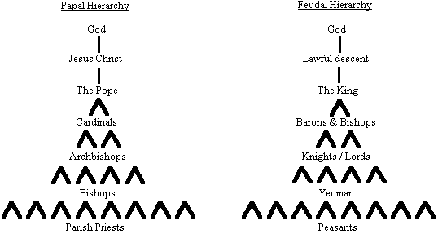
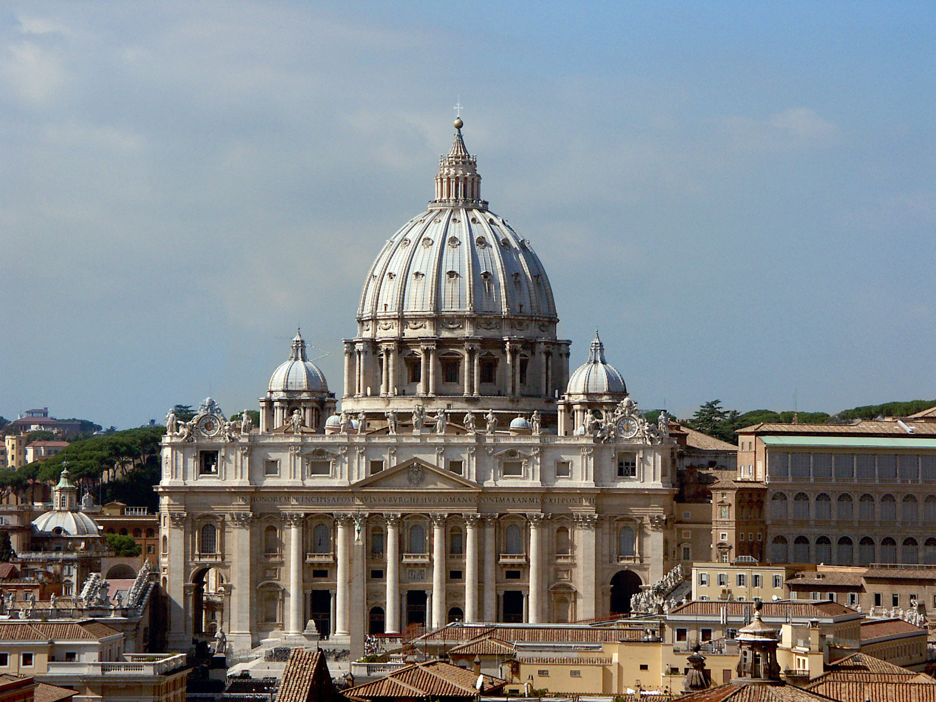

Slide 33
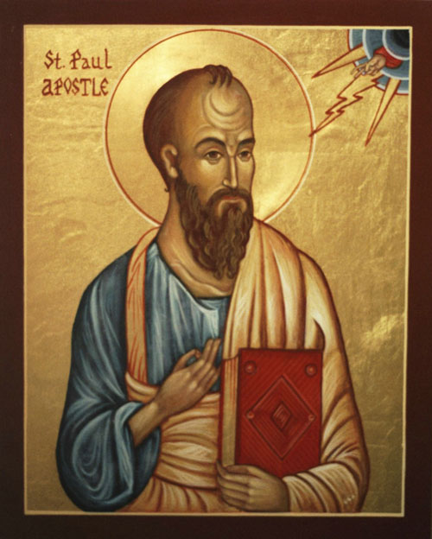
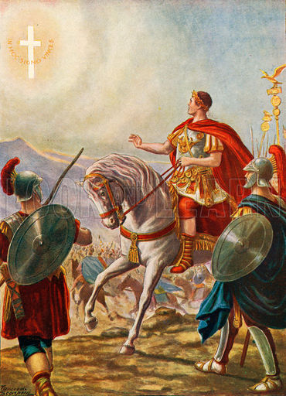
The Spread-Paul & Constantine
How does Paul advance Christianity?
How does Constantine advance Christianity?
What is the Edict of Milan?

Slide 34
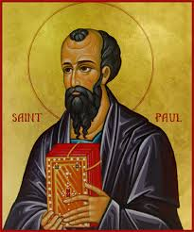
Paul the Apostle: 5AD- 67AD
Originally known as Saul
Book of Acts
Preached that anybody could become a Christian, not just Jews.
Christianity: a universal religion.

Slide 35
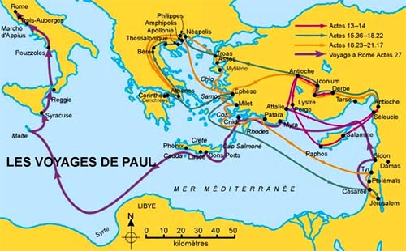

Slide 36
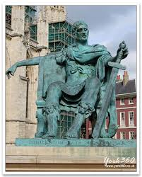
The Spread-Emperor Constantine
Roman Emperor
~312 AD/CE
Struggling for control of Empire

Slide 37
Emperor Constantine
Converts to Christianity
Edict of Milan:
Christianity no longer persecuted
Rights not extended to Jews-lost rights?

Slide 38
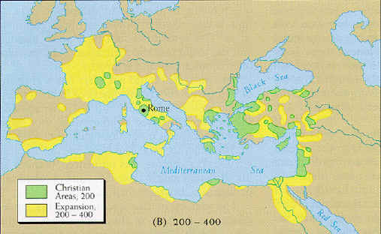

Slide 39
Christianity: The Ultimate Synthesis
Ideas and actions: Jesus
Persuasion and Spread: Paul
Universal Religion
Explained the ideas to Greek/Latin speakers
Hard Power: Constantine and the Roman Empire (after 315 CE)

Slide 40
With a partner, or two
Come up with a list of 10 MOST important terms/events/people for the origins of Christianity
Rank them
1 most important, keep going all the way to…
10 least important
Give reasons, in writing, for your ranking after each term

Slide 41
November 14, 2017
Out for stamp:
Rise of Christianity Notes
Take out:
Paper to take notes
Agenda:
Rise of Islam
Objectives:
*Contextualize Islam
Homework:
11/16: Origins of Islam
11/17: Triple Venn

Slide 42
With a partner, or two
Come up with a list of 10 MOST important terms/events/people for the origins of Christianity
Rank them
1 most important, keep going all the way to…
10 least important
Give reasons, in writing, for your ranking after each term

Slide 43
Islam
beliefs

Slide 44
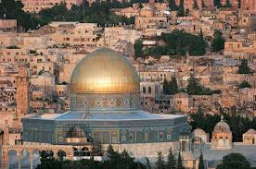
Background
World’s youngest religion
Founded by Muhammad in 610 CE
However most Muslims date founding to Abraham
World’s largest religion but not as diverse as Christianity
God = Allah
Third monotheistic God in Western Religion
YHWH, Christian God, Allah → each successive religion believes its God is built off the successive God, but also that its God is THE GOD.

Slide 45
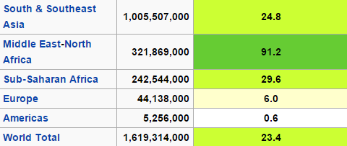
Worldwide Muslim Population

Slide 46
Crash Course on Islam
Questions 1. What was important to know about “the world Islam entered” (Muhammad’s society), according to John Green? 2. What is the focus of Islam? 3. Who was Muhammad and what did he do to develop the religion? 4. What is the Qur’an and how does it differ from the Torah and the Bible? 5. What is difference between Sunni and Shiite? 6. Why did Islam grow so quickly in the years following its creation (during the times of Abu Bakr, Umar, Uthman and Ali, and beyond)?

Slide 47
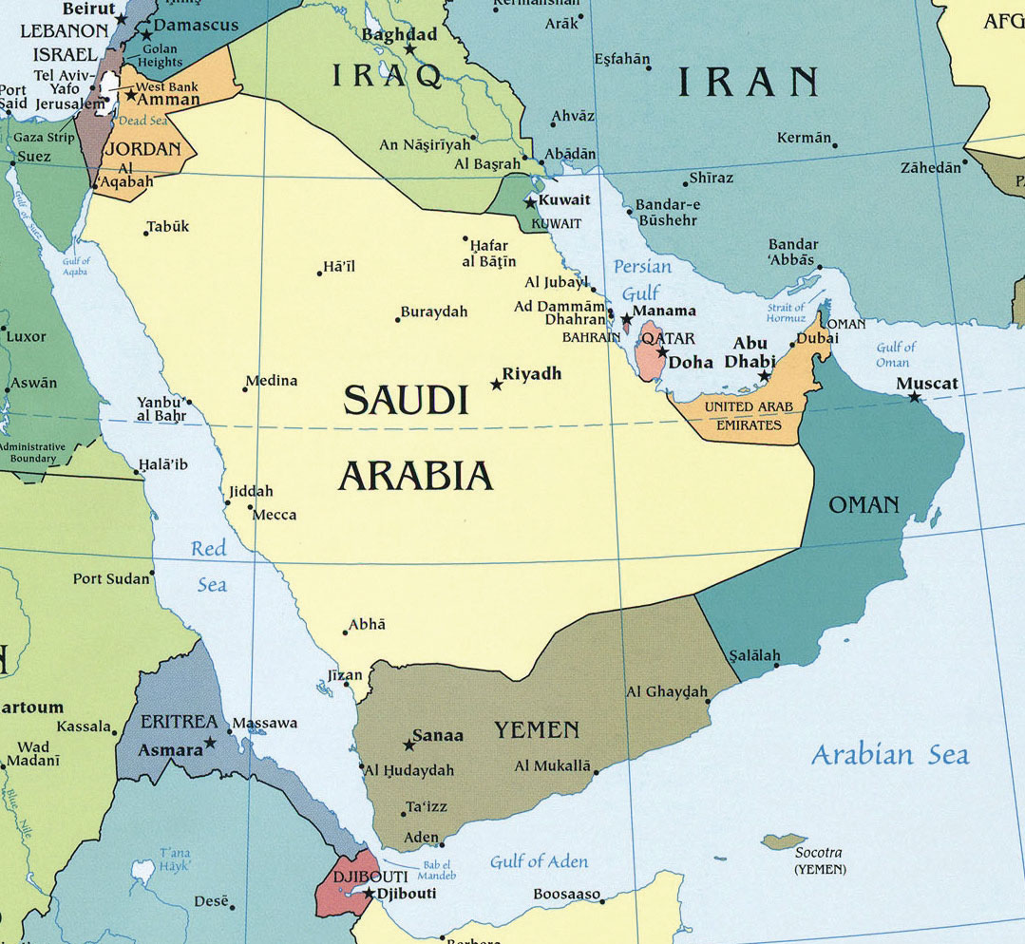
Geography
How did the geography of the Arabian Peninsula impact the development of Islam?
JG #1. What was important to know about “the world Islam entered” (Muhammad’s society)?

Slide 48
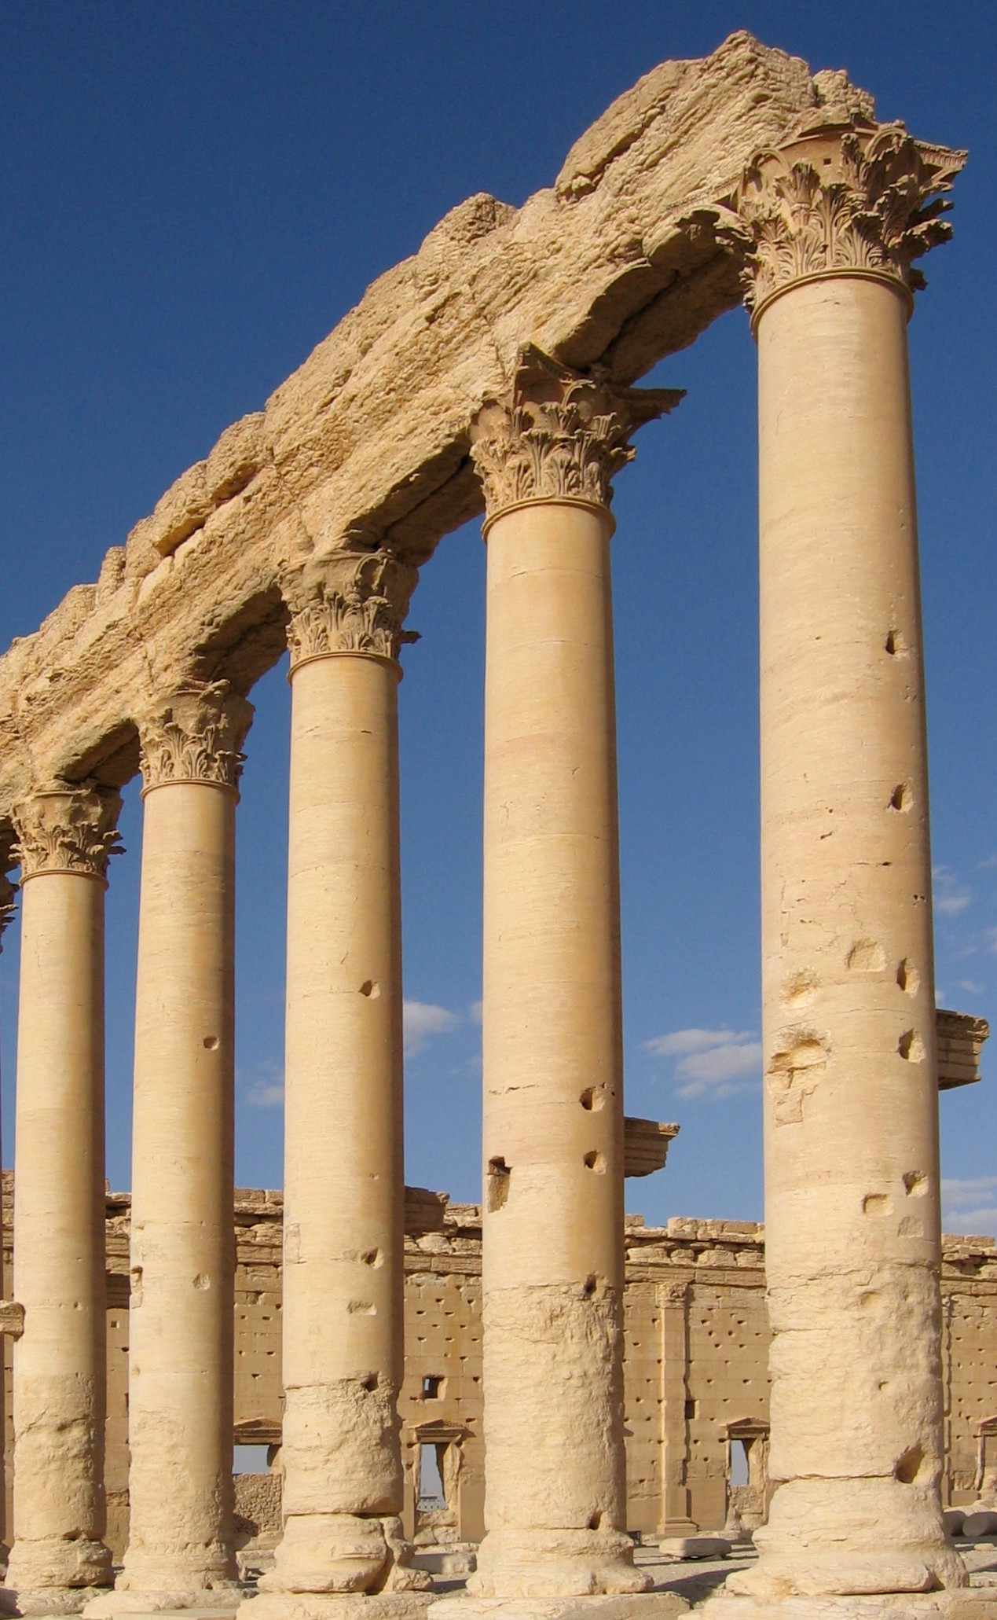
Five Pillars of Islam
What are the 5 Pillars of Islam?
What does this tell us about the religion?
JG # 2. What is the focus of Islam?

Slide 49
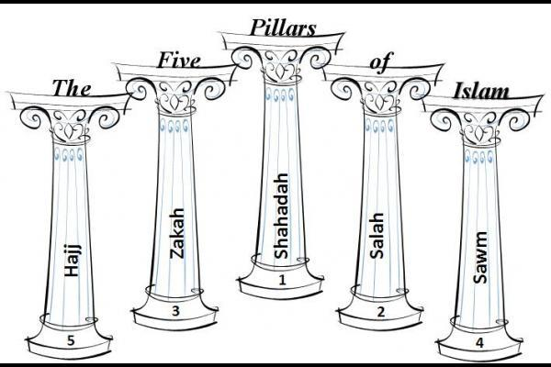
Five Pillars of Islam
Faith
There is no God but Allah
Prayer
Five times a day, facing Mecca
Alms
Religious tax- money for the poor
Fasting
Month of Ramadan, fast from dawn to sunset
Pilgrimage
The Hajj

Slide 50
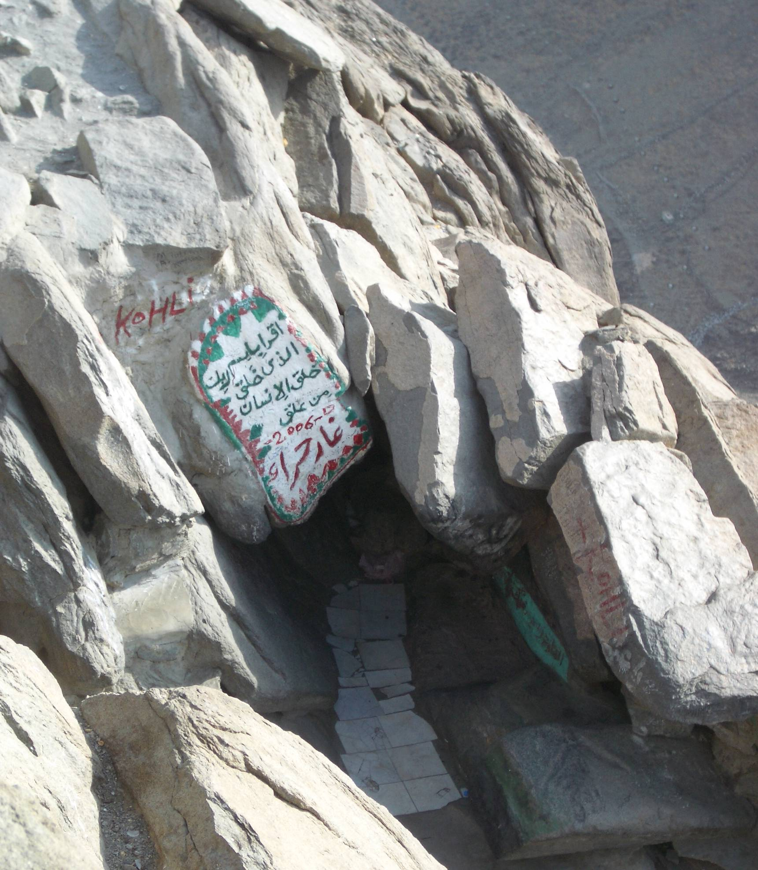
The Story of Mohammad
JG #3. Who was Muhammad and what did he do to develop the religion?
What does Islam mean?
What does Muslim mean?

Slide 51
Islam
Where does authority come from?
“There is no God but Allah, and Muhammad is his messenger.”
JG #4. What is the Qur’an and how does it differ from the Torah and the Bible?

Slide 52
Creation of Islam – in a nutshell
Descendent of Ishmael, born in Mecca in 570 CE
Grew up with uncles, who were powerful leaders of a local clan—traveled via trade
Heard of Christianity and Judaism in trading
In 610 CE, after meditating, the Angel Gabriel came and told Muhammad he was the final prophet

Slide 53
Creation of Islam – in a nutshell
Spent 3 years wrestling with vision before beginning to preach in 613
Preached Islam or Submission to the Will of God
Received Qur’an through series of revelations

Slide 54
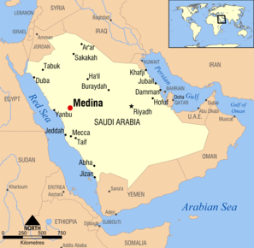
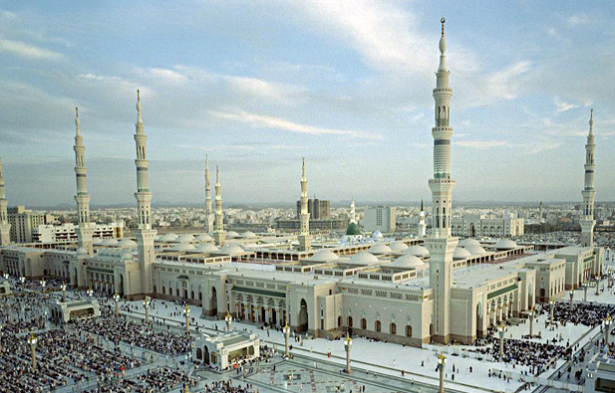
What is the Hijrah?
migration out of Mecca
Where did Muhammad go?
Medina. Establishes city and religion

Slide 55
Dome of Rock (The Western Wall)

Slide 56
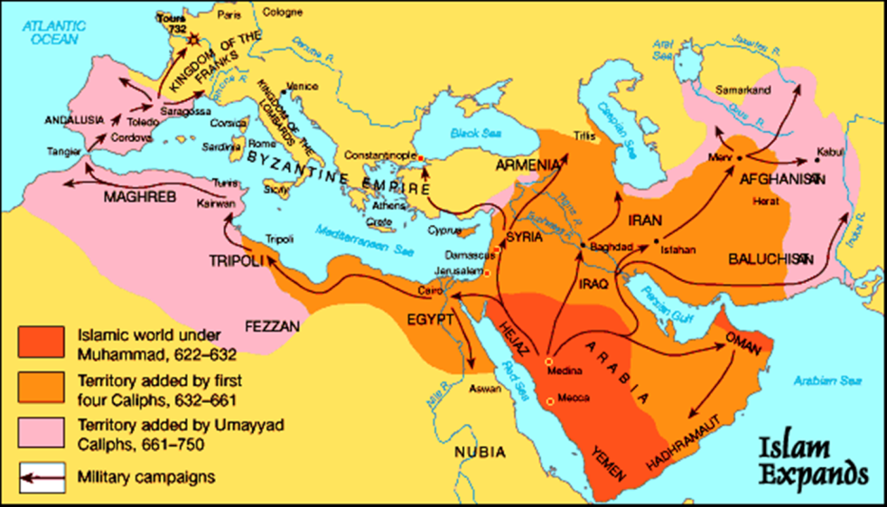
Islam After Muhammad
JG #5. What is difference between Sunni and Shiite?
JG #6. Why did Islam grow so quickly in the years following its creation (during the times of Abu Bakr, Umar, Uthman and Ali, and beyond)?

Slide 57
Islam After Muhammad

Slide 58
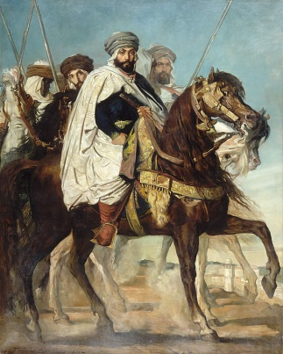
Islam after Muhammad
Muhammad dies in 632.
Arabs on the Arabian peninsula are politically united, powerful, and inspired to spread Islam.
But Muslims are divided on the issue of leadership.
They elect Caliphs
Caliph=deputy, successor
The Caliphs use Muhammad’s teachings to guide them.

Slide 59
With a partner, or two
Come up with a list of 10 MOST important terms/events/people for the origins of Islam
Rank them
1 most important, keep going all the way to…
10 least important
Give reasons, in writing, for your ranking after each term

Slide 60
Homework Due Tomorrow 11/16
Read and take notes on the Origins of Islam. You may take your own notes OR fill out the question sheet attached to the reading.

Slide 61
Warm Up 11/16
What is the most interesting thing you learned about Abrahamic religions?

Slide 62
Triple Venn Assignment
Today you will get in groups of 4 and make a Triple Venn diagram for Abrahamic religions.
Using your class notes, reading notes, and top 10 lists, you should fill out the similarities and differences of the 3 religions.
You will also add one symbol for each religion to your poster that represents that religion. (NO PROPHETS! And NO official symbols)

Slide 63
Triple Venn for Friday
Posters should be neat, have color, and include at least 10 items for each religion plus three images total. This is a culminating assignment that will be scored out of 40 so do your best work!!
You will give participation points to your group as well.

