Slide 1
Warm Up 1/8
What was life like for women during the Progressive Era? What was their status in the workforce, society, and politics?

Slide 2
Modern vs. Traditional Women

Slide 3
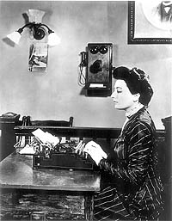
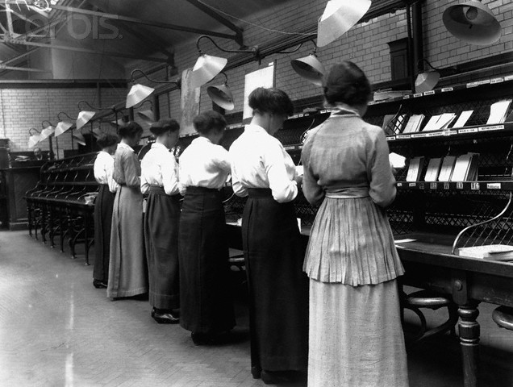
Women in the Workplace
Modern
More higher education
More jobs available
Working (especially single) women more accepted

Slide 4
Women in the Workplace
Traditional
College quotas
Barred from many jobs (doctors, lawyers, etc.)
Paid less than men
Expected to quit if they marry or become pregnant

Slide 5
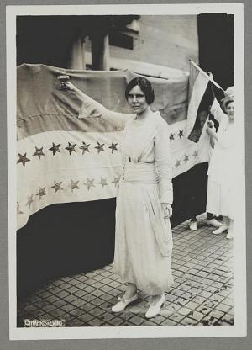
Women in Politics
Modern
19th amendment finally grants women right to vote
Activists like Alice Paul become role models for change
Women slowly gain influence

Slide 6
Women in Politics
Traditional
Only about 35% actually vote
in a survey in 1923 they surveyed women in Chicago that had not voted in the mayoral election. About 1/3 said that they lacked interest and another 11% said that they did not think women should vote at all.
Finding child care difficult
Often still discouraged by men
Feared women voting as a bloc

Slide 7
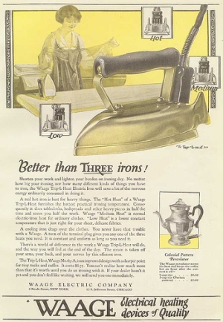
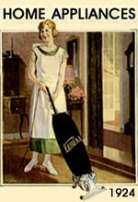
Women at Home
Modern
Marriage more often by choice (rather than arranged)
Divorce rates double in 1920s
Marriage viewed more as equal partnerships
More free time due to compulsory school and new appliances

Slide 8
Women at Home
Traditional
Main role to care for home and children
Husband still supposed to be breadwinner
Looked down on if you worked as a married woman

Slide 9
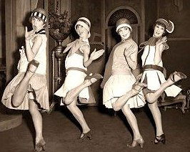
Women in Society
Modern
Flappers
Shorter hair, shorter skirts, make-up
Seen as a free modern woman
Smoking and drinking in public becomes more common
New lively dances
Dating (rather than arranged relationships
Sexual freedom
Symbolized a revolution in both manners and morals

Slide 10
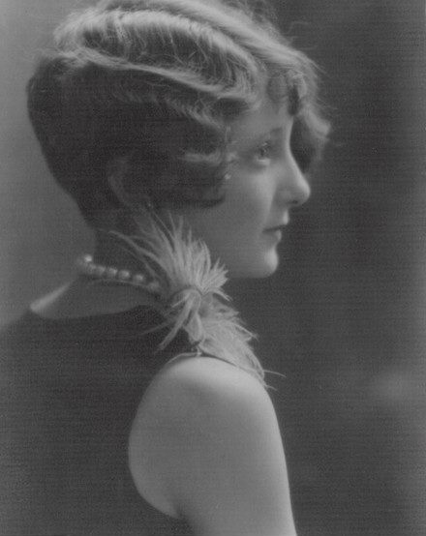
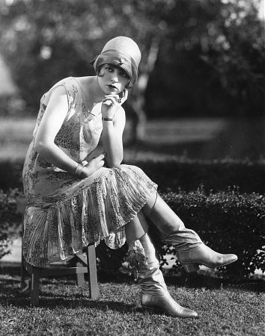
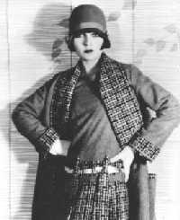

Slide 11
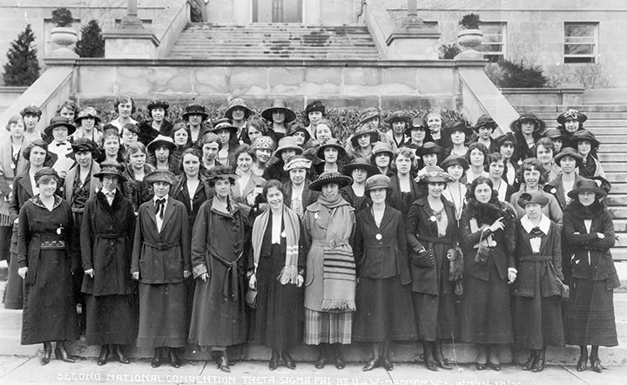
Women in Society
Traditional
Double standards
Expectations in behavior still different for men and women
Flappers looked down on by traditional church goers
Flappers in minority
Most women did not readily embrace new behaviors

Slide 12
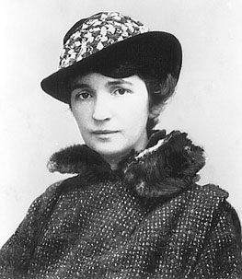
Rights for Women
Margaret Sanger
Advocate for birth control and
sex education
Saw birth control as a benefit
for society as a whole
Received huge backlash for ideas
Arrested on more than one occasion
Worked with low income women and opened birth control clinics
Evolved into Planned Parenthood
Still looked down on for ideas on Eugenics

Slide 13
Morality and Birth Control
Read Morality and Birth Control
Answer the following and give one piece of evidence for each
Why did Sanger think birth control was a good idea?
What were Sanger’s views on the morality of sexual behavior?
Why might some people take issue with Sanger’s ideas?
Due tomorrow!
We will also share some of your Flapper projects tomorrow

