Slide 1
Journal 10/13/17
What are the components of a thesis statement?
Explain what each piece of a thesis is supposed to do
How – The argument, your unique point of view
What – The topic (addressing your prompt)
So what – How your argument impacted something

Slide 2
Daily Agenda Friday 10/13/17
Agenda:
Review thesis statements
Discuss structure of an essay paragraph
Key Terms:
Body thesis statement
Evidence
Analysis
Transitional sentence
Skills:
Writing concepts

Slide 3
Paragraph Structure
What should a paragraph look like in an essay?
In other words – what are the components of a well structured paragraph?
Body thesis statement (not every paragraph needs one) or introductory sentence
Context
Evidence
Analysis
Transitional sentence
You should also include sentences that connect directly to your so what in your thesis.
Remember your so what is your big idea that you are attempting to prove in your essay
This is true for both LA and SS essays

Slide 4
Paragraph Structure
Recognizing a well written paragraph
We are going to read a couple of short paragraphs and look for the elements I just explained
You are welcome to write on the sheets that you are given
We are going to discuss this in small & big groups
Read the two paragraphs and answer the questions at the on the back using what you read
Some of this will be tough to answer, you may not understand, but do your best based on what you know

Slide 5
Paragraph Structure
Thesis –
How – it caused many deaths within the empires and it impacted farming
What – The tsetse fly had the biggest impact on the development of the Mali civilization, as well as Ghana civilization
So what - ultimately causing food shortages and a very weak economy.
What would you change?
It could be more specific, concise, and a non list
Example –
The Tsetse fly had the greatest impact on the development of the Mali because of the negative impacts it had on Mali society, ultimately destroying the Mali’s ability to grow as a civilization.

Slide 6
Paragraph Structure
2. What is a body thesis statement?
A sub argument that aids in proving your argument
Examples from essay –
Thesis – The tsetse fly had the biggest impact on the development of the Mali civilization, as well as Ghana civilization because it caused many deaths within the empires and it impacted farming, ultimately causing food shortages and a very weak economy.
BTS 1 – The Mali and Ghana civilizations suffered many deaths, decreasing populations of both humans and cattle, due to being bitten by the tsetse fly.
BTS 2 – The tsetse fly caused cattle populations to greatly decrease, in turn forcing farmers in the Mali and Ghana civilizations to shift from their traditional ways of farming, to new methods that did not require cattle.

Slide 7
Paragraph Structure
How to write a great sub argument of you main argument –
Create a mini thesis that is proving a smaller point that aids in proving your overall argument.
My Examples –
Thesis - The Tsetse fly had the greatest impact on the development of the Mali because of the negative impacts it had on Mali society, ultimately destroying the Mali’s ability to grow as a civilization.
BTS 1 –
The deaths caused by the Tsetse fly led to a decreased population of Mali, which slowed the Mali’s ability to grow as a civilization by creating a shortage of strong workers.

Slide 8
Paragraph Structure
3. What evidence did the author use?
Paragraph 1 –
One ruler of the Mali Empire, named Sundiata II, was bitten by the tsetse fly in 1374, and was later killed due to being affected by the sleeping sickness (Hunt).
Paragraph 2 –
"Cattle from North Africa could not survive below the Sahel because of the tsetse fly." (Willie 67)
Which piece of evidence is better for proving an argument?
Paragraph 2, it is a direct quote
Direct quotes should be strong pieces of evidence used for proving your point
Make sure you introduce you quote
What is paraphrasing?
More on this later…

Slide 9
Paragraph Structure
4. Analysis of evidence
What should analysis do?
Explain your evidence - if needed
Explain why your evidence is proving your argument
Explain how your evidence connects to your argument
You analysis should not…
Restate your evidence
Argue something that isn’t in your thesis/bts
Be someone else's argument (without properly citing it)
How does the essay do these things?

Slide 10
Paragraph Structure
5. Paragraph connections –
How well does the analysis of evidence connect it back to the thesis statement?
It does a poor job, it has little strong connection back to the thesis
Easiest way to do this is connect to the so what

Slide 11
Paragraph Structure
Thesis - The Tsetse fly had the greatest impact on the development of the Mali because of the negative impacts it had on Mali society, ultimately destroying the Mali’s ability to grow as a civilization.
BTS 1 – The deaths caused by the Tsetse fly led to a decreased population of Mali, which slowed the Mali’s ability to grow as a civilization by creating a shortage of strong workers.
Evidence - "Cattle from North Africa could not survive below the Sahel because of the tsetse fly." (Willie 67)
Analysis -

Slide 12
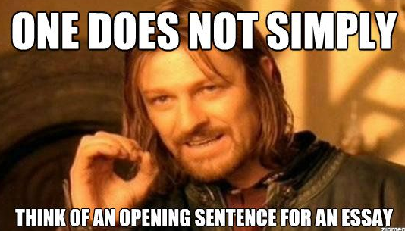
Journal Entry 9/21/17
What do you like about writing, what do you hate about writing (be honest, I won't get mad)?

Slide 13
Daily Agenda Wednesday 9/20/17
Agenda:
Review and refresh basic writing concepts
Discuss turnitin.com
Practice paraphrasing
Key Terms:
None
Skills:
Writing concepts

Slide 14
Writing Discussion
Discuss these questions at your table group, you have about 2 minutes, then we will discuss as a class…
What is a thesis?
What makes up a thesis (explain each part in detail)?
How important is a thesis when it comes to writing?
What is a good versus bad thesis?
Explain plagiarism.
What are the most important aspects of writing

Slide 15
Writing – Plagiarism
What is academic dishonesty?
Skyline Definition of Academic Dishonesty & Plagiarism…

Slide 16
Common Forms of Academic Dishonesty

Slide 17
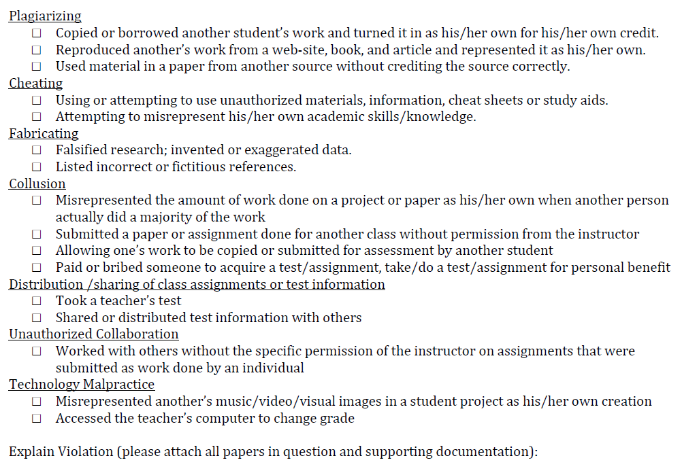

Slide 18
Turnitin.com
This is a great tool for you and teachers
Makes it easier to turn in assignments
Allows you and the teacher to receive/give great feedback
Awesome way to turn in assignments
It also allows me to see what is copied and what is not…

Slide 19
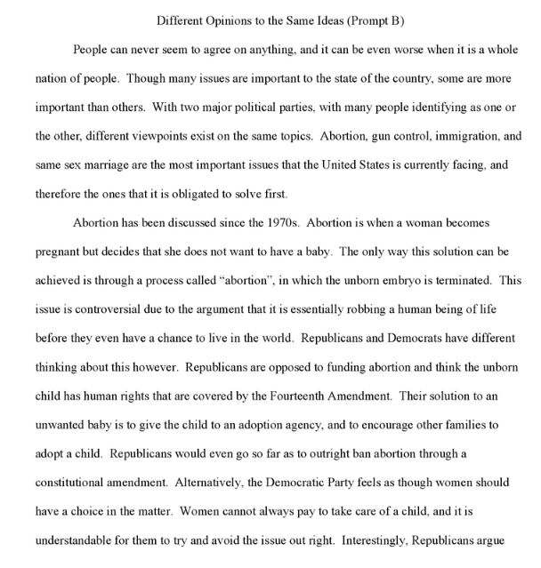
Little or No cited/copied work

Slide 20
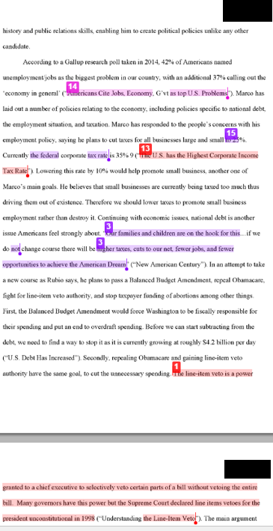
Some cited/copied work

Slide 21
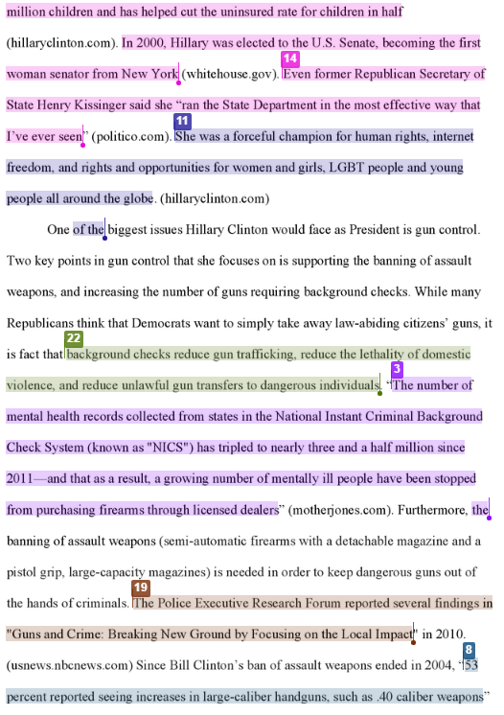
Lots of cited/copied work

Slide 22
What we want to see…

Slide 23
What we don’t want to see…

Slide 24
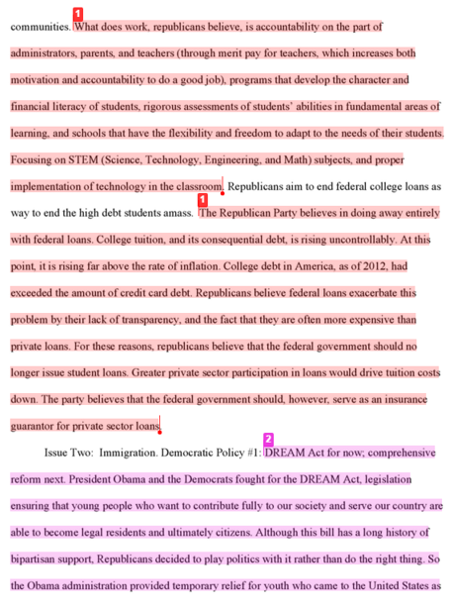
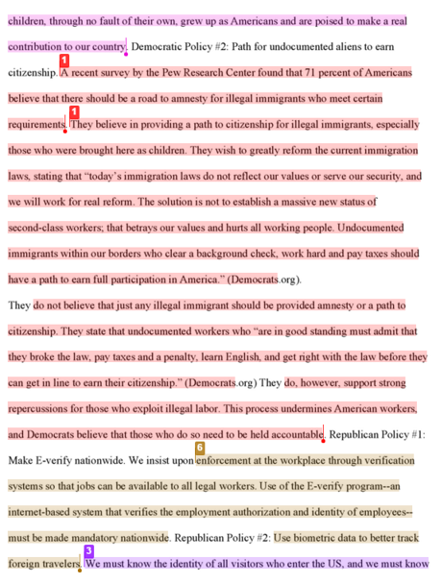
One example of a plagiarized essay

Slide 25
Plagiarism Reminder
Plagiarism is not just copying someone else work. It is also stealing their thoughts and ideas.
We know if you are creating your own thoughts and ideas or if you are taking them from someone else.
Ways to avoid plagiarism
Don’t take other information without citing it in your essay.
Don’t take ideas/thoughts without citing it.
Make sure you are doing proper MLA citations in the essay and proper MLA paraphrasing in your essay.

Slide 26
Writing – Citations Direct Quote
If you cite a direct quote you should have quotation marks around it, along with the authors last name and the page number
This is only from a text with a single author.
In the event that you are using a different source than a book with 1 author you may need to cite your source differently
Purdue Owl will set you free

Slide 27
Writing – Citations Paraphrase
Good paraphrase
Improper paraphrase

Slide 28
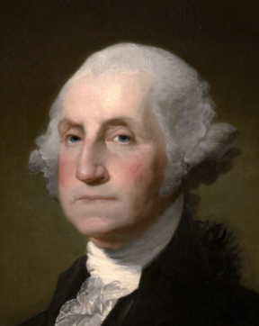
Paraphrasing Memes

Slide 29
Paraphrasing Memes

Slide 30
Paraphrasing Memes

Slide 31
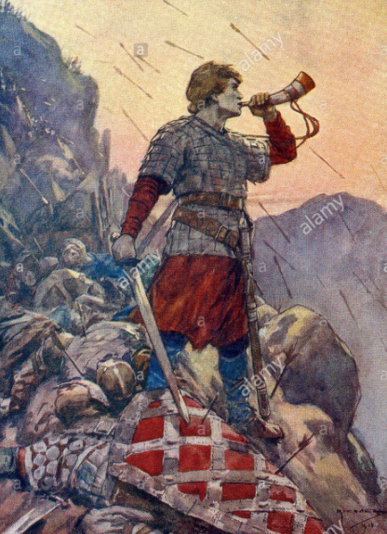
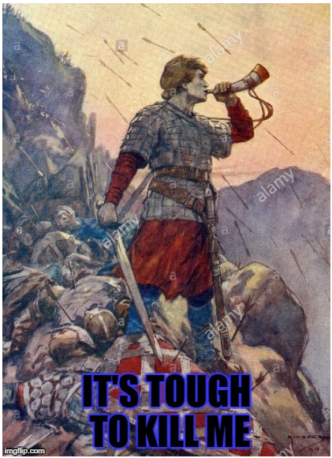
Paraphrasing Memes - Roland

Slide 32
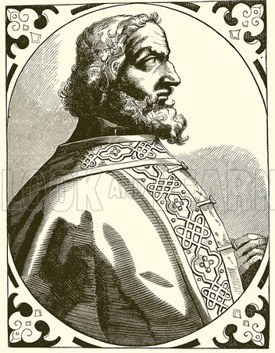
Paraphrasing Memes - Charlemagne

Slide 33
Paraphrasing Memes

Slide 34
Paraphrasing Memes

Slide 35
Paraphrasing Practice
Paraphrase this quote –
“This great plague originated in Asia. After disappearing from Europe and the Middle East in the Middle Age, bubonic plague continued to haunt areas of southwestern China. In the early 1300s, rats accompanying Mongol troops spread the plague into central China and by 1331 to northeastern China. In one province near Beijing, I was reported that 90 percent of the population died. Overall China’s population may have declined from 120 million in the mid-fourteenth century to 80 million by 1400.” (Spielvogel 300)

Slide 36
Paraphrasing Practice
Share the paraphrase with someone at you table group
Give them notes on whether or not the paraphrase captures the essence of the paragraph.
What did you feel was important enough to paraphrase

Slide 37
Writing - Academic Voice
All numbers under 10 are written out – one, not 1
Any history is written in the past tense
Have you referred to historical people in correct manner
First time talking about them using full name, then just last name on any reference after the first
Do not use contractions and do not use first person
Don’t, didn’t, etc… -- “I”, “me”, “my”, “our” or “we”
Avoid speculations
careful with words: would, could, should, may, might, probably… etc.
Avoid generalizations
careful with words: many, everybody, most, all, people, society… etc.
Avoid asking questions, you are answering a question

Slide 38
Writing - Analysis
Analysis is your words or your borrowed words which develops your argument.
Your analysis should accomplish the following…
Explain your evidence - if needed
Explain why your evidence is proving your argument
Explain how your evidence connects to your argument
You analysis should not…
Restate your evidence
Argue something that isn’t in your thesis/bts
Be someone else's argument (without properly citing it)
We are going to look at examples if proper and improper analysis next week

Slide 39
Writing - Three-level outline
Heading
Research Question
Thesis
Title
I. First Level (body thesis)
A. Second Level (general evidence - cited)
1. Third Level (further specific evidence and/or general analysis – ie: analysis – cited if necessary)
B. Second Level
1. Third Level
2. Third Level
C. Second Level
II. First Level
A. Second Level
1. Third Level
2. Third Level
B. Second Level
1. Third Level
2. Third Level
Every subordinate level must directly support the level above it.

Slide 40
Writing - Three-level outline Example
William Tecumseh Sherman
Mr. Myers
World Studies
7 December 2016
Prompt: Argue what the best high school in Washington state is.
Thesis: Skyline High School is the best high school because it has highly awarded teachers, and it has the strongest academics all of which create the paramount learning institution in Washington state.
Skyline = Domination
I. The teachers at Skyline are the best in Washington state because they are highly awarded and use unique teaching styles to reach their students.
A. “President Obama today named 108 mathematics and science teachers as recipients of the prestigious Presidential Award for Excellence in Mathematics and Science Teaching.” (whitehouse.gov)
1. Ms. Von Bargen was awarded the Presidential Award for Excellence indicating Skyline has teachers who are highly decorated for their practices.
B. “Teachers at Skyline High School participate in the block classroom model bringing together Language Arts and Social Studies.” (Hood)
1. The methodology of English and social studies teachers at Skyline is one where they teach together. This allows the participants in the classroom, both teachers and students, the opportunity to work in a unique environment that deepens their learning in a way that other schools cannot accomplish.
Every subordinate level must directly support the level above it.

Slide 41
What’s Due – Level Three Outline
You will have a typed three level outline. Include the following in your typed outline:
1) Full MLA Heading, Title, Research Question, Thesis at the top of the outline
2) Level One - Roman Numerals: Body Thesis (a complete sentence and be absolutely sure that this sentence directly relates to your thesis)
3) Level Two - Capital Letters: Think Evidence/Support/Facts (and be absolutely sure that the evidence relates to your body thesis)
4) Level Three – Arabic Numbers: General analysis and/or further more specific evidence
Notes:
Outlines do not need to be double spaced
For all researched information – cite the source in your outline as though you are citing in an essay
You may include a works cited page for feedback, however it is not required for this assignment.

Slide 42
Journal Entry 12/12/16
Explain the purpose of a paraphrase
Explain the purpose of analysis
Explain what a BTS is supposed to do
Exchange your thesis revision and score it based on the rubric

Slide 43
Writing – What’s Required in the Essay?
Introduction
Should include a hook – The first sentence, designed to get your reader interested in the essay
Contextual information – Any information your reader needs to know to understand your essay
Remember pretend like your reader knows nothing about what you wrote
Your thesis statement
Create your clear, concise argument

Slide 44
Writing – What’s Required in the Essay?
Body Sections – As many as you need to prove your argument
Each section should include a body thesis statement
Each section should include evidence that supports your argument
Each piece of evidence must be analyzed
You should also include transitional sentences
NOTE* Remember just because you have written a BTS you don’t have to write one paragraph, you can have multiple

Slide 45
Writing – What’s Required in the Essay?
Conclusion
Wrap up any major points you were making in your essay
Remind your reader what your major points were
Restate your thesis
Do not include any questions

Slide 46
Writing - Examples
Read the example that I have provided for you.
Look for the following information
Context
Thesis
Body thesis statements
Evidence
Analysis
Are the elements of a good introduction and conclusion there?
Do the body sections connect to the argument, is the paper proving the thesis?

Slide 47
Journal 12/13/16
Explain the purpose of a BTS
What elements should it have?

Slide 48
Outline Peer Edit
Things to consider…
Is the thesis clear, focused, and well written?
Is it arguable or just fact?
Is it specific or too broad?
Do the BTS’s have direct connection to the thesis?
The connection should not be inferred, it should relate very clearly
Do the BTS’s create a sub argument of the overall argument?
Does the evidence clearly relate to the argument?
Does the analysis of the evidence explain the importance of the evidence for the essay?

Slide 49
Journal Entry 12/16/16
Explain what analysis is.

Slide 51
Do:
Properly cite every quote or borrowed piece of information in MLA format
In-text eg
“Here’s your quote” (Myers).
And MLA FORMATTED WORKS CITED

Slide 52
Don’t:
Float quotes without context or connections

Slide 53
Do:
Introduce quotes to fluidly provide readability for your reader

Slide 54
Do Not:
Use contractions or non-academic language
This includes first person statements. Do not say “I” in your paper.

Slide 55
Do:
Use strong, organized academic language in you paper to effectively prove your thesis

Slide 56
Don’t:
Leave evidence without analysis, or force your reader to make connections

Slide 57
Do:
Provide direct, accurate analysis for your evidence to connect it back to the overall prompt

Slide 58
Don’t:
Start your conclusion with:
In conclusion
All in all
To sum it up

Slide 59
Do:
Include a creative, restated thesis in your conclusion
Summarize your overall argument
End with a parting shot of analysis to drive your point home

Slide 60
Do:
Use proper grammar and spelling
Include MLA format throughout
1” margins, 12 pt TNR, double space
Creative title
Appropriate heading and header
Works Cited Page
Cite at least 4 sources
Include 2 print sources
Cite every time you borrow information, even if paraphrased

Slide 61
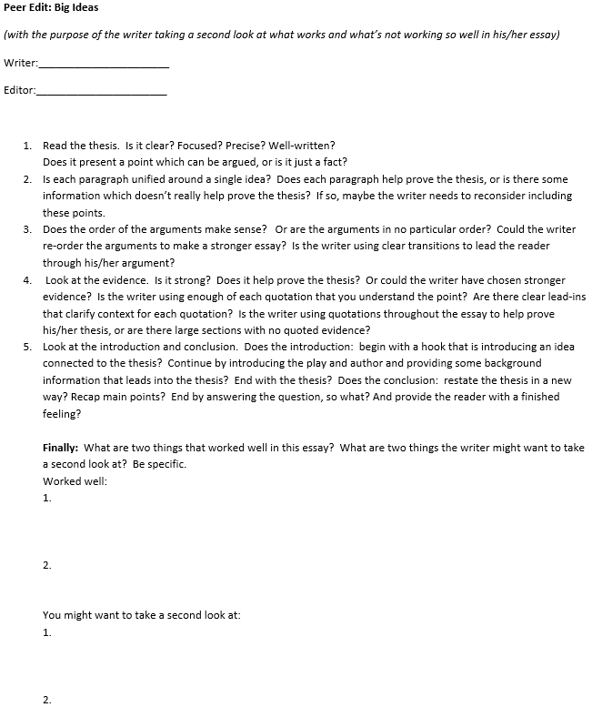

Slide 62
Essay Writing Reminders…
Remember that you need the following information in your essay…
Context
Tell your reader enough information so they understand why your essay is important
Transitional sentences
They connect your essay together
Create flow
Create continuity
Make sure your BTS(s) connect strongly to your thesis
Make sure they are helping prove your argument
Your evidence and analysis should connect to your BTS
Remember you need to explain your evidence
You need to explain why your evidence is important to your argument
Restate your thesis in your conclusion

Slide 64
Spring Essay 2017
Refining your essay…
You are now going to refine your topic/impact into a prompt
Prompt Examples:
How did _________ impact __________ ?
What role did ___________ play in __________?
What role did economics play in the 1st Crusade?
What role did economics/politics play in the Mughal Conquest of India?
What role did religion play in the European conquest of the Americas?
How did religion impact the colonization of Africa?
How did technology impact the Mongol Conquests?
You may need to be more specific than this when you craft your prompt. We are going to take a few minutes and work on this…
Now that you have written your research question you will need to write a paragraph explaining how each of the sources you have researched from step 2 will aid you in answering your question. You may need to do a little more research in order to accomplish this portion of the project.

Slide 65
Writing Refreshers - Research
Now that you have selected your topic, and are working on honing what impact you want to focus on consider the following things…
Ask yourself how the source will help you write your essay?
Is it basic context/background information you can use to explain what happened?
Is it a primary or secondary source?
If it is a primary source you are probably going to want to use it as a direct quote rather than a paraphrase
Is it going to help you explain what part of society is being impacted?
Will the source help at all?
If the source is garbage don’t use it, find something else.
Is it a print source or a digital source?
Remember you must have 3 print sources (at a minimum)
Have you written your full citation?
It is easier to write the full citation now, rather than go back and start over

Slide 66
Writing Refreshers - Evidence
What do you remember about how to use a paraphrase?
Use paraphrases as context or to develop/support your evidence
Do not use paraphrases as a strong piece of evidence that is going to prove your main point
Use lots of paraphrases
What do you remember about how to use a direct quote?
Direct quotes should be used sparingly
Use paraphrases to explain as needed
Around 2 per BTS
Direct quotes should be used to prove big points in your essay
Primary sources
Very direct (no pun intended)
Statistics
Hard facts
Paraphrases do not take the place of a direct quote, you need to use both

Slide 67
Writing Refreshers - Outline
You will be writing a four level outline.
Your outline does not need to include complete sentences for your analysis
Except for the thesis, the introduction/conclusion
Evidence should be complete quotes
Example:
MLA heading & page numbers
Thesis Statement
Introduction
BTS
Evidence
Analysis
Evidence
Analysis
Evidence
Analysis
BTS
Evidence
Analysis
Evidence
Analysis
Evidence
Analysis
Conclusion

Slide 68
Writing Refreshers - Introduction
What goes into an introduction in an essay?
Hook – quote that pertains to your essay or can be explained as part of your essay
Some contextual/background information
Enough for your reader to understand your thesis
Thesis – Should be the last sentence of the introduction.
If it isn’t your last sentence in your introduction you will be graded a zero for thesis.

Slide 69
Writing Refreshers - Conclusion
What needs to be included in the conclusion?
Wrap up any major points you were making in your essay
Remind your reader what your major points were
Restate your thesis
Leave a parting shot of analysis
If you included a quote for your hook connect your conclusion back to your hook
This is a really cool way to tie your intro/conclusion together
Do not include any questions

Slide 70
Writing Refreshers - Analysis
What is the purpose of analysis?
Explanation of what a direct quote means
Explain the connection to your thesis/so what
Remember that analysis is the meat of your argument, this is really where you make your main point
Simple Analysis Types – Fill out the graphic organizer as we discuss each type of analysis
Change:
When you use “change” as analysis you explain what happened and what changed as a result of your evidence
Your change does not need to include a positive or negative change, it just needs to explain what changed
Consequence:
When you use “consequence” as analysis you explain what the consequence of what happened
This can be either a positive or negative consequence
Significance:
When you use “significance” as analysis you explain how significant of the thing happening in the evidence is
The significance can be small/large, important/unimportant, or any other adjective to explain the significance
Can you use multiple styles of analysis when you analyze evidence?
Yes, you can explain the consequence or significance of change
The more types of analysis you use, the deeper and more meaningful your analysis becomes
Remember you need to connect each BTS to your “So what”
The “so what” is your big point, the major thing that is occurring as a result of your argument

Slide 71
Writing Refreshers - General
Context
Tell your reader enough information so they understand why your essay is important
You can include more context than what is in your introduction, you might need to include some under each BTS
Transitional sentences
They connect your essay together
Create flow
Create continuity
Make sure your BTS(s) connect strongly to your thesis
Make sure they are helping prove your argument

