Slide 1
Get out any notes you have on the Constitution. This includes class notes, reading notes, and your Constitution Scavenger Hunt.

Slide 2
Warm Up 10/19
When you are finished, turn in your test up front.
Then answer the following warm-up. Do your best work from what you remember. Give it some thought!
What are the 3 parts of a thesis statement? Explain what each part is supposed to do.

Slide 3
Thesis Statements
What – Basic (unique) argument. Answers the prompt
So What – Impact of your argument
How – How did your argument have an impact?

Slide 4
Thesis Statements
Let’s Work Together
We will create a thesis statement that addresses the following prompt:
Which guiding principle of the Constitution is most important for a stable government?

Slide 5
Thesis Statements
Let’s Practice!!
Create a thesis statement that addresses the following prompt:
Discuss whether the framers of the Constitution were successful in their goals for our government.

Slide 6
Warm Up 10/20
Get out the thesis statement you wrote yesterday. Read it over and write in your warm-up which part of the thesis statement you think you did the best, and which part you feel like you need to work on.

Slide 7
Agenda:
Review thesis statements
Discuss structure of an essay paragraph
Key Terms:
Body thesis statement
Evidence
Analysis
Transitional sentence
Skills:
Writing concepts

Slide 8
Paragraph Structure
What should a paragraph look like in an essay?
In other words – what are the components of a well structured paragraph?
Body thesis statement (not every paragraph needs one) or introductory sentence
Take part of the “how” in your thesis statement and use it to create a mini-thesis

Slide 9
Paragraph Structure
How to write a great sub argument of you main argument –
Create a mini thesis that is proving a smaller point that aids in proving your overall argument.
My Examples –
Thesis - The Tsetse fly had the greatest impact on the development of the Mali because of the negative impacts it had on Mali society, ultimately destroying the Mali’s ability to grow as a civilization.
BTS 1 –
The deaths caused by the Tsetse fly led to a decreased population of Mali, which slowed the Mali’s ability to grow as a civilization by creating a shortage of strong workers.

Slide 10
Paragraph Structure
Context - background/important facts
Evidence - facts/examples that support analysis
Analysis – interpretation of how evidence supports your so what
You should also include sentences that connect directly to your so what in your thesis.
Remember your so what is your big idea that you are attempting to prove in your essay
This is true for both LA and SS essays

Slide 11
Paragraph Structure
Transitional sentence - bridges between the parts of your paper
Cue readers to interpretations
Connects ideas/paragraphs so paper flows smoothly
https://owl.english.purdue.edu/owl/owlprint/574/

Slide 12
Paragraph Structure
Recognizing a well written paragraph
We are going to read a couple of short paragraphs and look for the elements I just explained
You are welcome to write on the sheets that you are given
Read Paragraph 1 and try to identify the main parts of the thesis statement by highlighting/underlining and annotating.
When you are done, discuss it with your table

Slide 13
Paragraph Structure
Now it’s your turn!
Read Paragraph 2 and answer the questions on the back using what you read
Some of this will be tough to answer, you may not understand, but do your best based on what you know
When you are done, discuss it with your table

Slide 14
Paragraph Structure
What should analysis do?
Explain your evidence - if needed
Explain why your evidence is proving your argument
Explain how your evidence connects to your argument
You analysis should not…
Restate your evidence
Argue something that isn’t in your thesis/bts
Be someone else's argument (without properly citing it)

Slide 15
Homework Due Tuesday 10/24
Using the thesis statement you created yesterday and your notes/knowledge of the Constitution, write one paragraph to develop your idea. Be sure to include the elements of a good paragraph that we discussed today.
Body thesis statement
Context
Evidence
Analysis
Transitional sentence
Feel free to research for additional evidence if you can’t find what you want in your notes. Just include a citation!

Slide 16
Warm Up 12/13
How did your rough draft go? What do you most need help on right now?

Slide 17
Introduction
Hook choices
Integrated Quote
Anecdote
Interesting Historical Content
DO NOT START YOUR PAPER WITH A QUESTION
Topical Introductory Content
Introduce the reader to the topic and the topic’s context in history.
Well-developed Thesis Statement

Slide 18
“The introduction and conclusion to a paper can be understood as a type of transition . . . At the beginning of a paper, the introduction serves as a transition by moving the reader from the world outside of your paper to the world within. At the end of the paper, the conclusion works in the opposite direction by moving readers from the world of your paper back to their own world ...” (Bacon 151)

Slide 19
Purpose of Introductions:
Hook (interest the reader whilst introducing the main idea)
Context (introduce the novel—by title and author—and summarize important information related to your thesis)
Thesis (state your argument)

Slide 20
INTRO. STRATEGIES:
HOOK
Anecdote, quotation, surprising fact, scenario, or interesting question
CONTEXT
Introduce the event/person/topic & summarize essential details (that the reader needs to know to understand your thesis)
THESIS
what + how + so what

Slide 21
Purpose of Conclusions:
RESTATE THE THESIS (reiterate your thesis using powerful word CHOICE)
synthesis (explain how your evidence fits together)
closure (transition the reader out of the essay)

Slide 22
CONC. STRATEGIES:
RESTATE YOUR THESIS
Review the “so what” component of the thesis – remind the reader what your point was
SYNTHESIS
Review key evidence by explaining how it connects together to fulfill a larger purpose
CLOSURE
Use a quote, scenario, an interesting question, make a connection, or bring your “hook” full circle

Slide 23
Samples
Look at Sample #1 & #2
Share with someone at table if needed
What is “good”?
What can be improved?

Slide 24
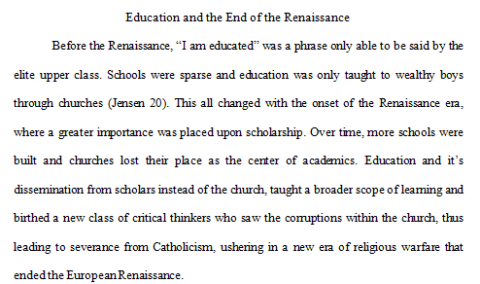
Sample #1 Introduction

Slide 25
Sample #1 Conclusion

Slide 26
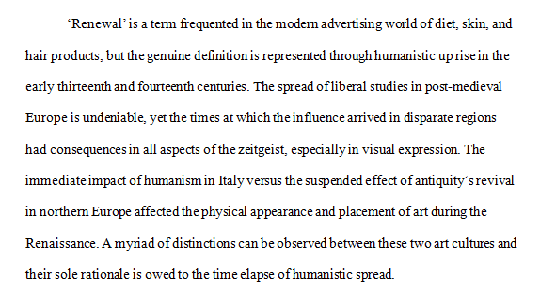
Sample #2 Introduction

Slide 27
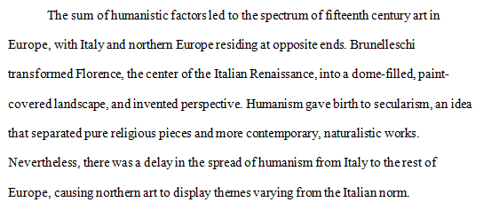
Sample #2 Conclusion

Slide 28
Academic Voice-Word Usage
All numbers under 10 are written out – one, not 1
Any history is written in the past tense
Have you referred to historical people in correct manner
First time talking about them using full name, then just last name on any reference after the first
Do not use contractions and do not use first person
Don’t, didn’t, etc… -- “I”, “me”, “my”, “our” or “we”
Avoid speculations
careful with words: would, could, should, may, might, probably… etc.
Avoid generalizations
careful with words: many, everybody, most, all, people, society… etc.

Slide 29
Academic Voice-Word Usage

Slide 30
Writing – What’s Required in the Essay?
Body Sections – As many as you need to prove your argument
Each section should include a body thesis statement
Each section should include evidence that supports your argument
Each piece of evidence must be analyzed
You should also include transitional sentences
NOTE* Remember just because you have written a BTS you don’t have to write one paragraph, you can have multiple

Slide 31
A Word About In-Text Citations
http://msbacon.com/documents/MLA_8.pdf

