Slide 1
Vietnam
Gallery Walk - Photos

Slide 2
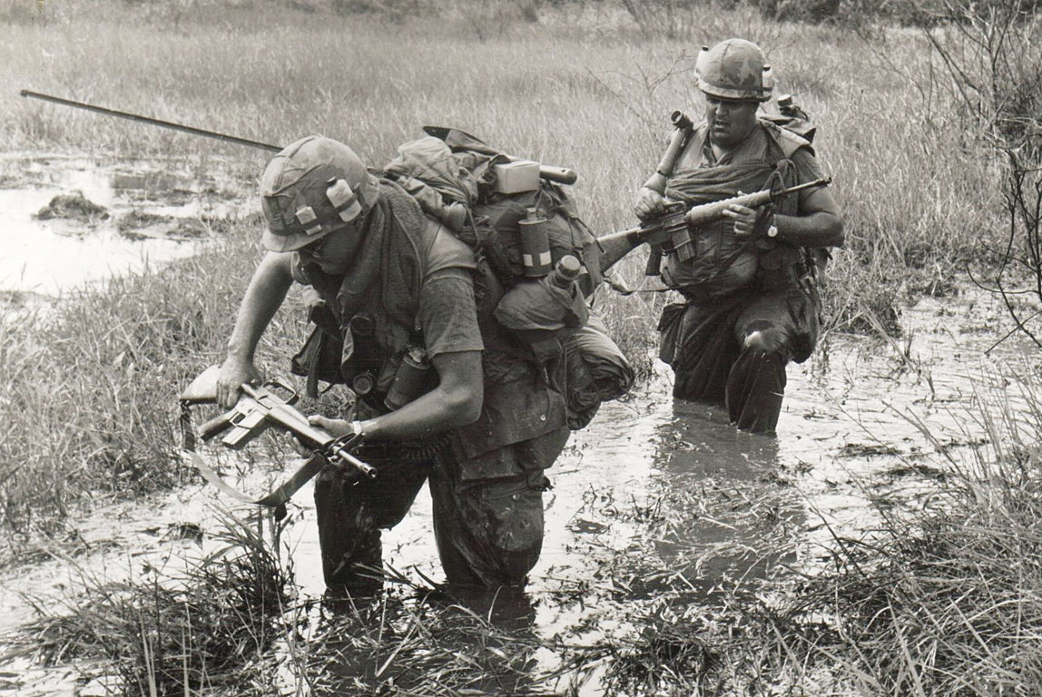

Slide 3
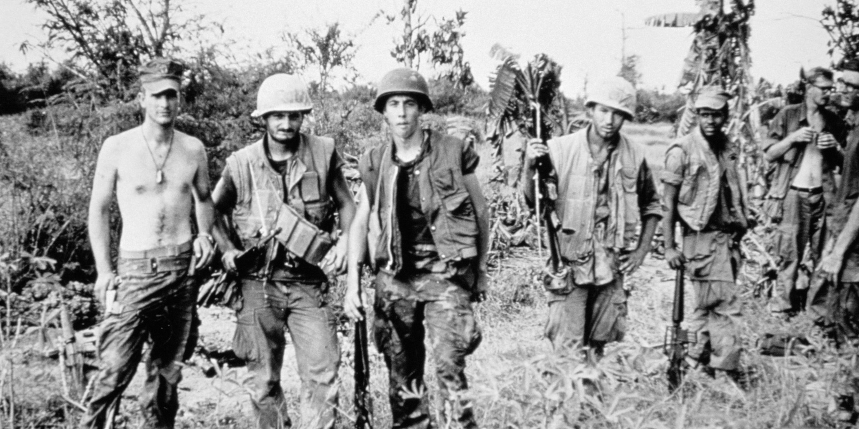

Slide 4
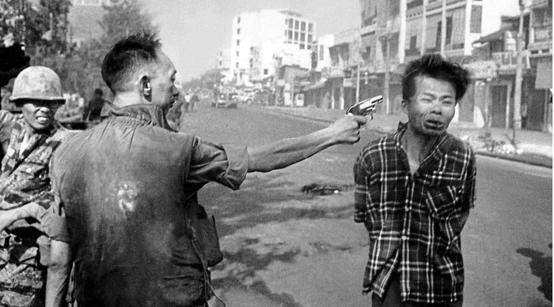

Slide 5
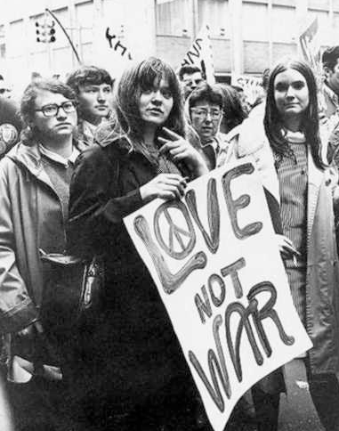

Slide 8
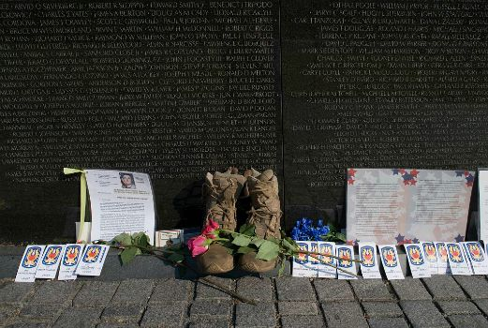

Slide 9
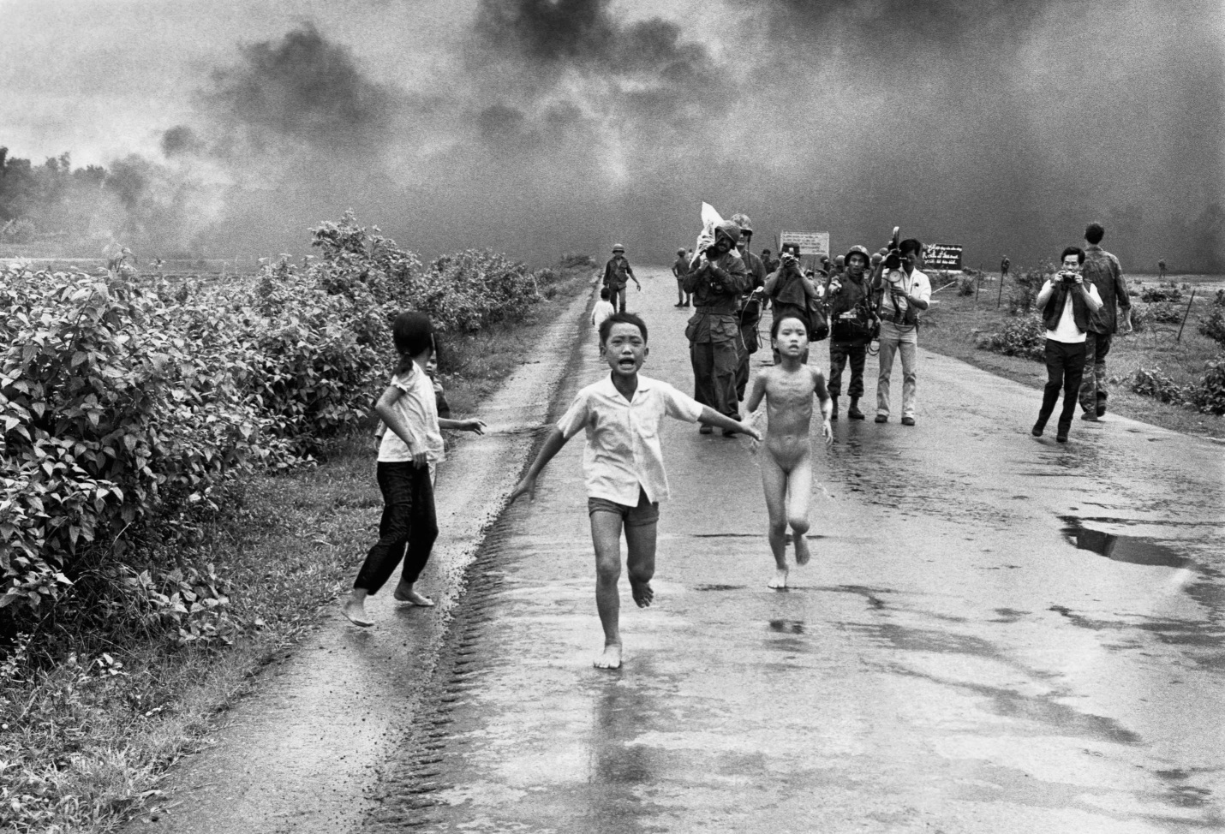

Slide 10
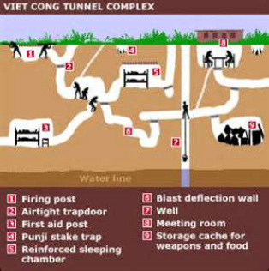

Slide 11
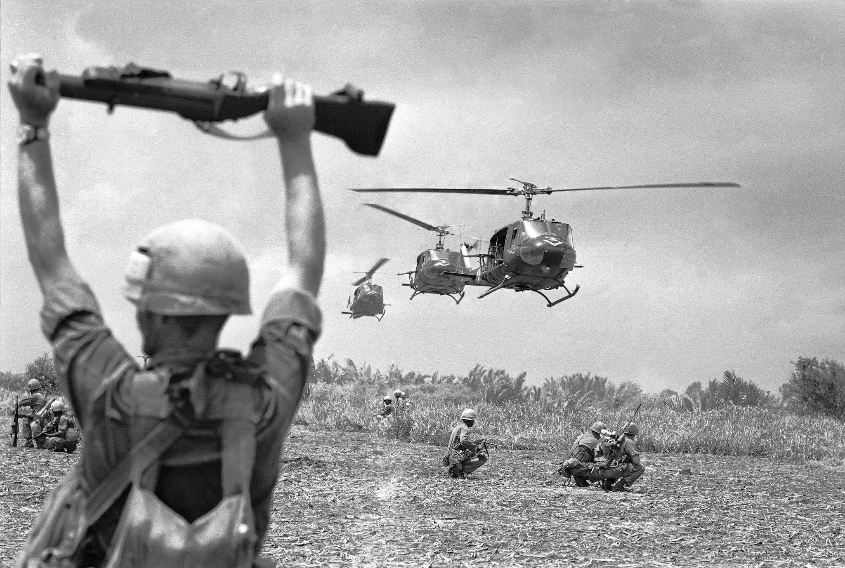

Slide 12
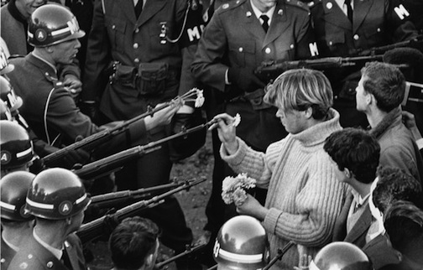

Slide 13
Warm Up 5/2 (#5)
Write down one thing you know about the Vietnam War.
When finished, turn in AIM/Chavez assignment (salmon) and 5 warm-ups.

Slide 14
May 2, 2018
Turn in:
AIM/Chavez questions
5 Warm Ups
Agenda:
CRM Quiz
Vietnam Gallery Walk
Skills:
Predictions and Analysis
Learning Target (I can…):
Make predictions based on primary source evidence.
Upcoming Dates
5/3: Reading Notes TCI Sections 50.1-50.2

Slide 15
During the Gallery Walk
Stop at each photo and complete the following:
Describe what is happening in the photo.
Why do you think the photographer took this photo?
What questions do you have about the photos?
What themes and/or characteristics do you see?
Summarize the Vietnam war based on these photos
Compare these photos to previous wars we have studied?

Slide 16
Homework Due 5/3
Read Sections 50.1-50.2 in TCI and take thorough notes on the early years of the Vietnam War.

