Slide 1
Warm Up 5/3 (#1)
Who was Ho Chi Minh?

Slide 2
May 3, 2018
Out for checkoff:
Chapter 50 Notes
Agenda:
Early War
Skills:
Finding main ideas
Learning Target (I can…):
I describe the First Indochina War and America’s early involvement.
Upcoming Dates
5/4: Hawk/Dove T-Chart

Slide 3
Essential Questions
What evidence is necessary in order to support an armed conflict?
2. Is it better to support a foreign leader who serves American purposes, but may not have the support of their people, or a foreign leader who serves their people, but is against American Ideals?
3. What role should the U.S./Western Countries have in other parts of the world?

Slide 4
The Vietnam War

Slide 5
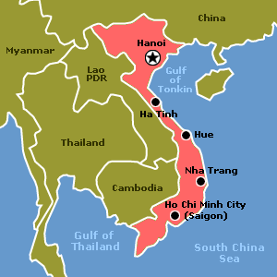
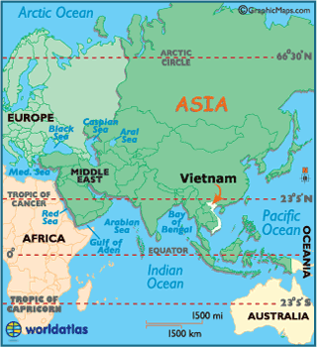

Slide 6
Vietnam the Country
Southeast Asia
Geography
South more tropical
North hot/rainy season – warm/dry season
Population: 93, 421, 835
Language: Vietnamese
Religions: Buddhist and Catholic
Agriculture
Rice, coffee, rubber, tea, sugar cane
Industry
Garments, shoes, food processing, mining/coal.

Slide 7
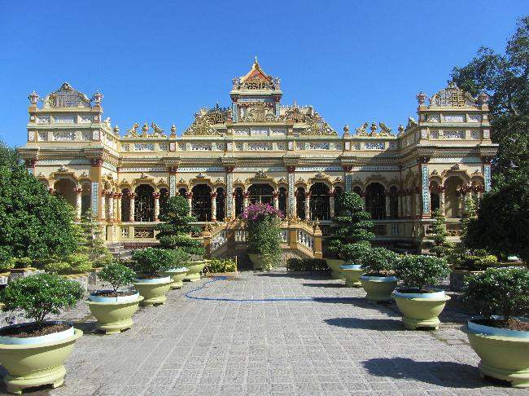
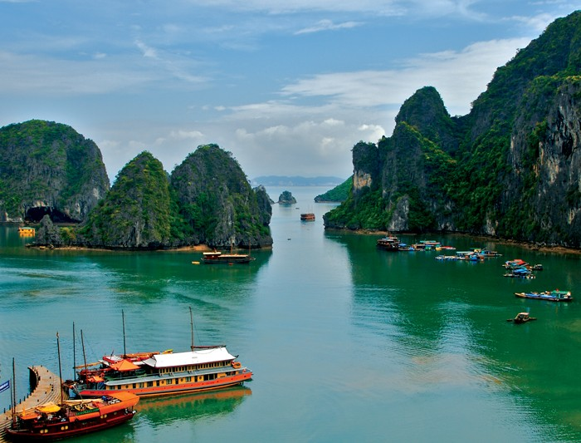
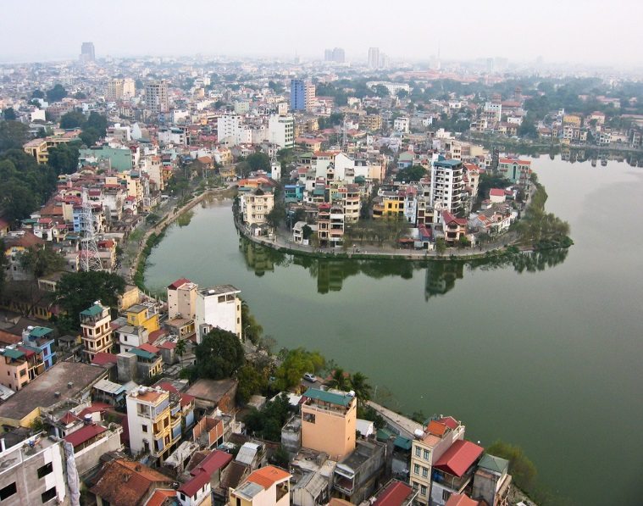
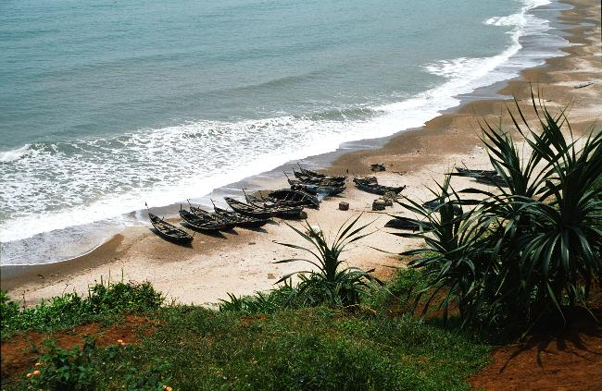
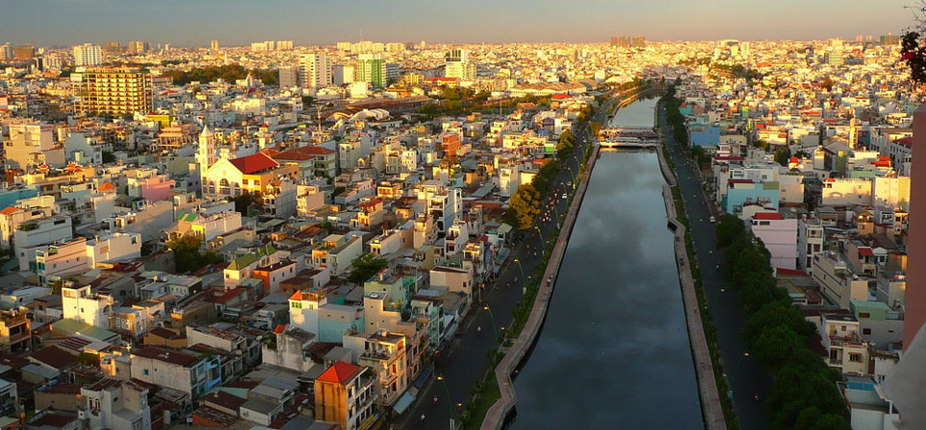

Slide 8
Vocab
Saigon: Largest city in the south, Ho Chi Minh City
Hanoi: Capital city of Vietnam
Viet Minh/Cong (VC): Vietnamese Communists in the south, phrase used by the US and the Saigon government
Army of the Republic of Vietnam (ARVN): South Vietnamese army supported by the U.S.
Americanization – the transition of military ground control in South Vietnam from South Vietnamese troops to American troops
Vietnamization – the gradual transition of military ground control in South Vietnam from American troops to South Vietnamese troops
POW – Prisoner of War

Slide 9
The Vietnam War Major Players

Slide 10
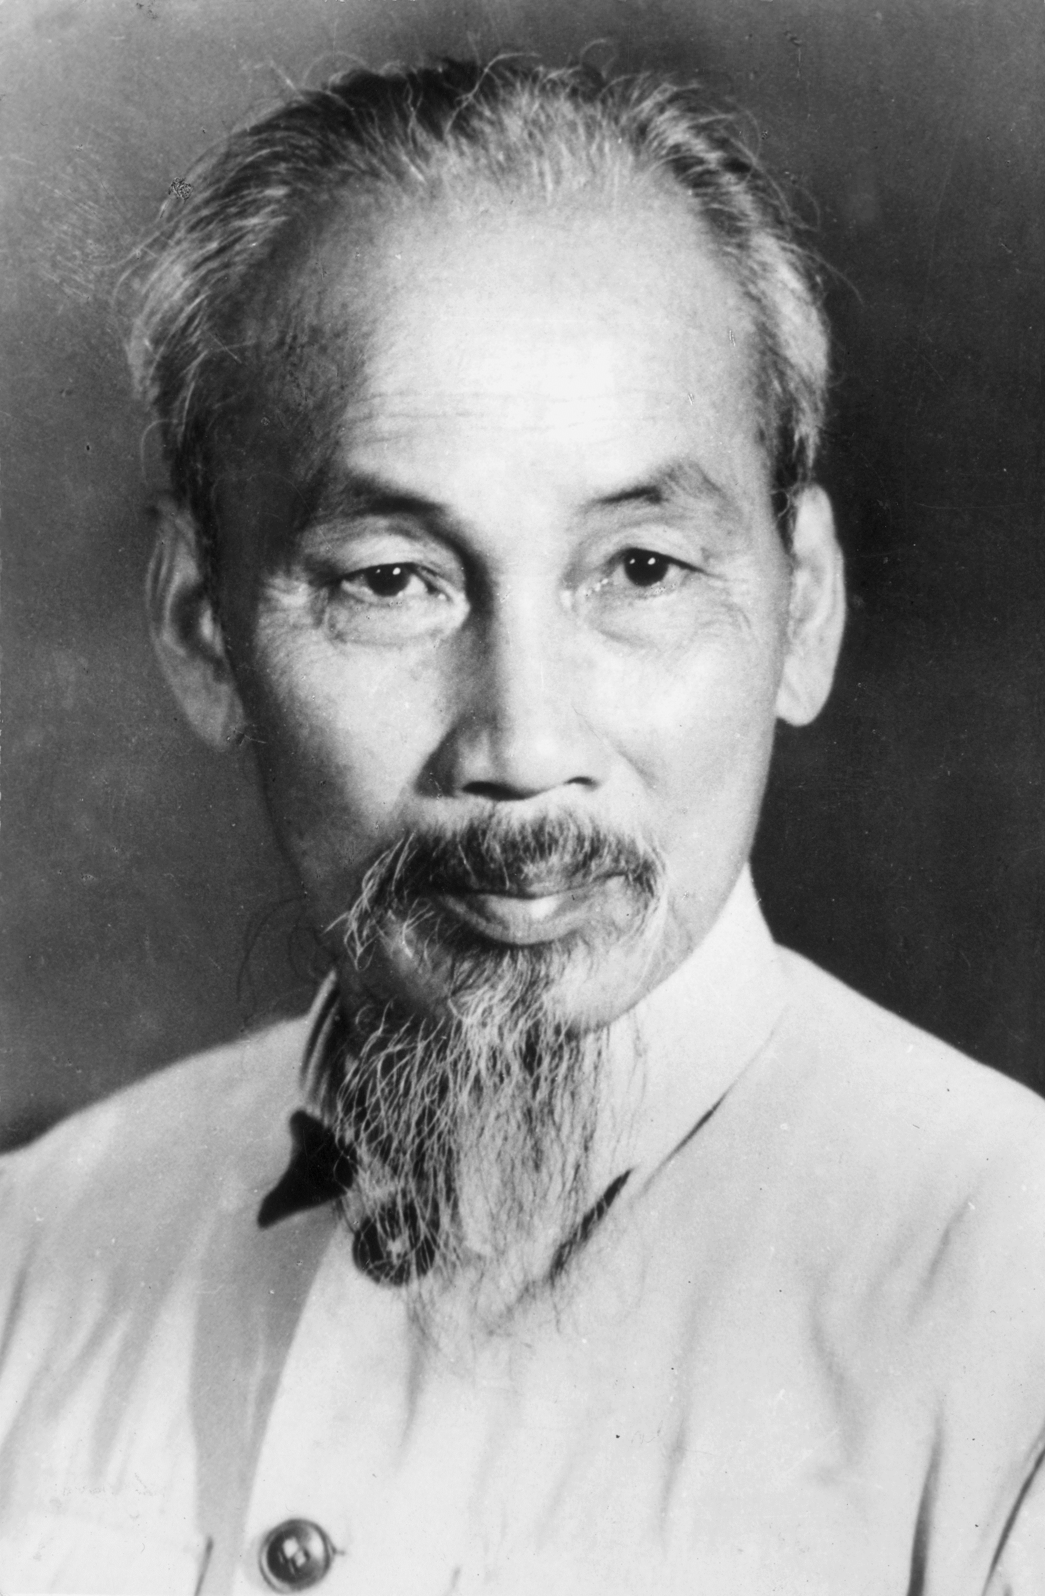
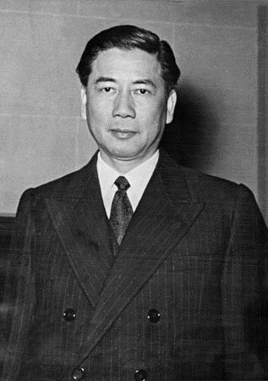
Ho Chi Minh
Vietnamese nationalist movement
Sympathized with communist ideals
President of North Vietnam from 1954
Died in 1969
Saigon renamed Ho Chi Minh city in his honor
Ngo Dinh Diem
Leader of South Vietnam from 1955 till 1963
Heavy handed ruler
Catholic
Anti-communist
Supported by US in early stages

Slide 11
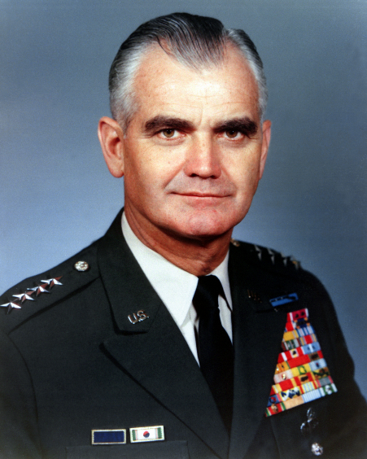
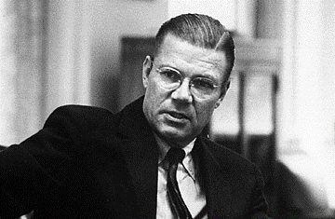
William Westmoreland
US Army general
Commander of troops in Vietnam
Four star general
TIME man of the year in 1964
Strategy of war of attrition
At first was very popular, but that changed as the war went on
Robert McNamara
Secretary of Defense
Republican
Business background
Ford Motor Company
‘Flexible response’
Cut cost
Modernize the military
Direct involvement

Slide 12
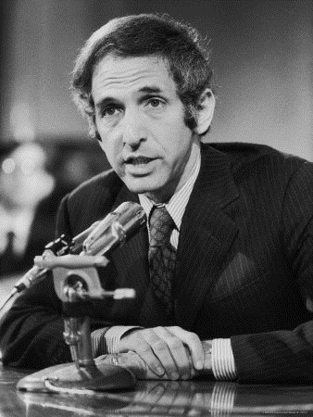
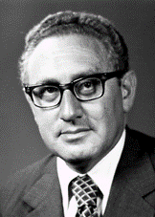
Daniel Ellsberg
Anti-war activist
Journalist
Government official
Leaked the Pentagon Papers
Evidence showing the government has misled the American people regarding involvement in Vietnam
Henry Kissinger
National Security Advisor
US Secretary of State
“Peace With Honor”
Troop withdrawals and bombing campaigns
Conversations help bring an end to the war
Nobel Peace Prize in 1973

Slide 13
Setting the Stage
French colonization
Vietnamese Nationalism
Geneva Accords
Divided near the 17th parallel
Eisenhower introduces domino theory
Theory that if one country falls to communism they all will
North Vietnam under Communist rule
Elections to be held in 1956 to unify country
South refused – remain divided
Notes:
First Indochina War = France v Viet Minh – Truman gives financial military aid (80% of the war)
Realizing he would lose Diem backs out of elections.

Slide 14
U.S. Military Involvement Begins
Repressive dictatorial rule by Diem
Diem’s family holds all power
Wealth is hoarded by the elite
Buddhist majority persecuted
Torture, lack of political freedom prevail
The U.S. aided Diem’s government
Ike sent financial and military aid
675 U.S. Army advisors sent by 1960.

Slide 15
National Security Meeting

Slide 16
Essential Questions
What evidence is necessary in order to support an armed conflict?
2. Is it better to support a foreign leader who serves American purposes, but may not have the support of their people, or a foreign leader who serves their people, but is against American Ideals?
3. What role should the U.S./Western Countries have in other parts of the world?

Slide 17
Hawks & Doves
Individually, critically read through the 8 primary source excerpts
Decide which documents represents ideals from the Hawks and from the Doves
On the appropriate side of the T-Chart indicate the number of the document AND a short summary in your own words of the argument the speaker used to support his/her position.

Slide 18
Prepare POTUS recommendation
Using the textbook (50.2 & 50.3)and the primary sources, craft a recommendation for President Johnson.
You will be writing two recommendations one from the Hawk perspective and one from the Dove perspective
You must include at least two supporting arguments
Answering the question:
Should the president significantly increase U.S. military involvement in Vietnam?

Slide 19
Warm Up 5/4 (#2)
Name one Hawk argument and one Dove argument.

Slide 20
May 4, 2018
Out for checkoff:
Agenda:
Americanization
Skills:
Persuasive arguments
Learning Target (I can…):
Explain the differing perspectives on increased military involvement in the war.
Upcoming Dates
5/4: Hawk/Dove T-Chart
5/7: Reading Notes TCI 51.1-51.2

Slide 21
National Security Meeting Agenda
Now that you have carefully crafted a recommendation for POTUS, you have been invited to a National Security meeting regarding the US involvement in Vietnam.
At this time please carefully read through your agenda and make any last minute preparations.

Slide 22
Meeting Agenda
Decide who will take on the role of President Johnson
Taking turns, you need to discuss/argue as many options/recommendations regarding involvement in Vietnam
Both Hawks and Doves should have opportunity to speak
Allow yourself time to prepare rebuttal arguments if needed.

Slide 23
Exit Slip
Please answer on a separate piece of paper– your ticket to leave class today
What did your group decide to do regarding Vietnam involvement? What was the reasoning behind this decision?
Why did the United States increase its military involvement in Vietnam? (50.2/50.3)
Did President Johnson’s decision to increase US Military involvement in Vietnam support or undermine American Ideals?
How would you respond if living at the start of the war?
1 new or interesting things you learned today.
1 question you still have.
Please staple the following together and turn in
Argument preparation (may be annotated sources)
Hawk/Dove T Chart
Exit Slip

Slide 24
Gulf of Tonkin
1964 : North Vietnamese torpedo boats had attacked US Destroyers in international waters in the Gulf of Tonkin
Sketchy details
Attack actually never happened
Johnson asked congress for a resolution to:
“Take all necessary measures to repel any armed attack against the US and prevent further aggression.”
Gulf of Tonkin Resolution
Unanimous vote
Johnson had nearly complete control over the US involvement in Vietnam

Slide 25
Johnson Americanizes the War
Johnson decided to send troops.
On March 1965, about 3,500 U.S. marines
marines’ job was to defend the air base at Da Nang,
home base for bombers taking part in Operation Rolling Thunder
They were sent on patrol to search/find and destroy enemy forces.
LBJ kept this shift to combat status a secret from the American people.

Slide 26
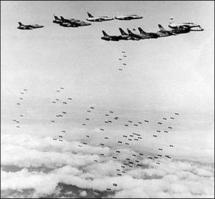
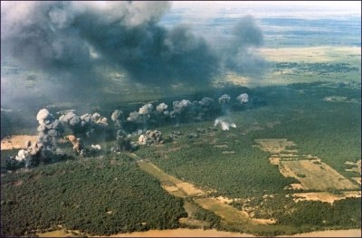
Escalation of War
Johnson devote almost all energy to Vietnam
Ho Chi Minh Trail
Supply route through Laos and Cambodia
Operation Rolling Thunder
Relentless bombing campaign
Damaged, but did not destroy
Search and destroy missions
Often failed to make significant impact
VC would just send more men

Slide 27
Escalation
End of April, President Johnson had approved the dispatch of 60,000 more combat troops to Vietnam.
LBJ did not officially declare war or ask Congress for permission to expand troop levels.
He based his authority to act on the Gulf of Tonkin Resolution.
Delivered troops by helicopter while battering the enemy with overwhelming firepower
Westmoreland continues to ask for more soldiers
By 1965 184,000 soldiers in Vietnam
By late 1967, nearly half a million Americans were serving in Vietnam

Slide 28
U.S. Troop Deployment in Vietnam
Kennedy’s advisors were clearly fighting a covert war by 1963.
JFK realizes Diem is a liability; offers quiet support to a Vietnamese military coup d’etat.
The coup results in the brutal murders of Diem and his brother
The Vietnamese generals overthrow one another. A relatively stable, but tyrannical government emerges. It is little better than Diem’s.

Slide 29
Americanization
The United States took over the main responsibility for fighting the war, adopting a two-pronged strategy.
First, U.S. marines would take key cities and other vital sites along the coast and transform them into modern military bases
Use those bases to launch search-and-destroy missions against the Viet Cong.
From that time forward, the South Vietnamese would play only a supporting role.
“This is no longer South Vietnam’s war. We are no longer advisers. The stakes are no longer South Vietnam’s. The war is ours.”

Slide 30
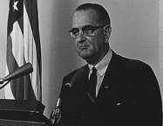
Remembers Truman’s “loss” of China → Domino Theory revived
“I’m not going to be the president who saw Southeast Asia go the way China went.”
Notes:
What Johnson told Congress
What he didn’t tell Congress:
He had already written the resolution before the “incident.”
The U.S. naval vessels were aiding ARVN in commando raids in North Vietnam at the time.
He learned that the attack probably hadn’t occurred.
The U.S. navy was not on the “high seas” but in N. Vietnam’s 12 mile territorial limit.

Slide 31
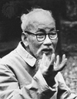
And in the End….
Ho Chi Minh:
“If we have to fight, we will fight. You will kill ten of our men and we will kill one of yours, and in the end it will be you who tires of it.”

