Slide 1
A few questions to consider
Compromise of 1850
What issues are left unresolved?
Popular Sovereignty
Arguments for/Arguments against?
Personal Liberty Laws
Are they Constitutional?
Sack of Lawrence & "Bleeding Kansas“
How is this a foreshadowing of what is to come?

Slide 2
Uncle Tom’s Cabin…in retrospect
This book is unequivocally important to the growth of the abolitionist movement among whites.
Stowe even goes so far as to point out the racist hypocrisy of northern abolitionists.
HOWEVER--it is also responsible for propagating racial stereotypes, and presenting races as innately different or separate.
It is definitely still a valuable read, but it must be read with two lenses--historical and modern, and evaluated with both.

Slide 3
Uncle Tom: A New Stereotype
While Stowe’s original work definitely used preexisting racial stereotypes, Uncle Tom is a noble figure that doesn’t adhere to one. However, ironically it led to a new stereotype.
In the decade following the publication, plays and retellings of the work shifted the character of Tom from a nonviolent martyr to a subservient one.
Uncle Tom today is a stereotype primarily used by African-Americans to insult other African-Americans that they feel are being subservient or passive to whites.

Slide 5
A few questions to consider
Dred Scott vs. Sanford
How did this Supreme Court decision impact much more than the issue of slavery?
Lincoln-Douglas Debates
What is public reaction to these views? What is the
significance to the greater era of history?
John Brown
Martyr or Murderer?
The Election of 1860 & Secession
What is the irony to the Election precipitating secession?

Slide 6
Constitution, Supreme Court, & Slavery
By the beginning of the Civil War, the Constitutional interpretations by the Supreme Court were SOUNDLY on the side of slavery
The Taney court had put down multiple decisions that solidified the Southern legal arguments
Early decisions such as Prigg vs. Pennsylvania (Fugitive Slave Law Supremacy) and Strader v. Graham (Movement to free state does not make one free) seemed to be at least grounded in Constitutional language
However, Dred Scott was only partially connected to Constitutional language, and relied heavily on INACCURATE and RACIST assumptions about the constitutional framers motives and ideas.
This is important because while the court will change members, it will remain conservative even after the Civil War which will DIRECTLY lead to the rise of Jim Crow

Slide 7
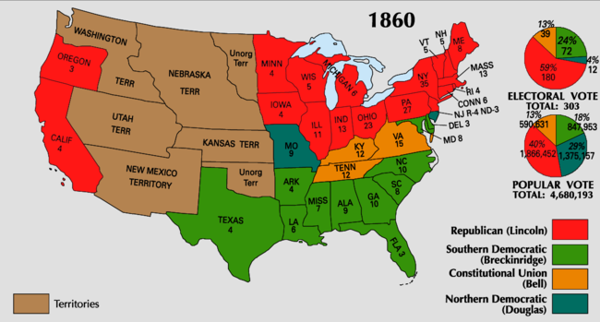

Slide 8
US Civil War at a Glance
Fought from 1861-1865 between the Union (North, yankees) and the Confederacy (South, rebels)
Most casualties of any war in US History*
War shows the emergence of modern warfare blended with traditional battlefield warfare
War could be considered revolutionary, but it will not play out as a revolutionary war
PERSPECTIVE will be key, as both sides are American, but view the war completely different

Slide 9
