Slide 1
April 30, 2018
Turn In:
Pink Thesis sheet with Thesis #2
Take Out:
Outline
Agenda:
Peer Editing
Rough Draft instruction
Learning Targets (I can…):
* Give helpful feedback to guide my peers in their writing
Homework:
Work on Rough Draft

Slide 2
Peer Editing
Edit for the following:
Are all parts of the thesis statement clear?
Does each BTS have an argument and so what that connects to the Thesis?
Does each BTS have TWO pieces of evidence?
Does each piece of evidence make sense with the BTS/Thesis?
Also, is it evidence and NOT analysis?
Does each piece of evidence have analysis that is clear?
Are they analyzing or just rewording their evidence? Look for connections to Thesis!
Ask questions! Can you give more? Does it need more context? In what way? Why is this relevant? How?

Slide 3
Paragraph Structure
How to write a great sub argument of your main argument –
Create a mini thesis that is proving a smaller point that aids in proving your overall argument.

Slide 4
Paragraph Structure
Context - background/important facts
Evidence - facts/examples that support analysis
Analysis – interpretation of how evidence supports your so what
You should also include sentences that connect directly to your so what in your thesis.
Remember your so what is your big idea that you are attempting to prove in your essay
This is true for both LA and SS essays

Slide 5
Paragraph Structure
Transitional sentence - bridges between the parts of your paper
Cue readers to interpretations
Connects ideas/paragraphs so paper flows smoothly
https://owl.english.purdue.edu/owl/owlprint/574/

Slide 6
Paragraph Structure
What should analysis do?
Explain your evidence - if needed
Explain why your evidence is proving your argument
Explain how your evidence connects to your argument
Your analysis should NOT…
Restate your evidence in different words
Argue something that isn’t in your thesis/bts
Be someone else's argument (without properly citing it)

Slide 7
Paragraph Structure
Recognizing a well written paragraph
We are going to read a couple of short paragraphs and look for the elements I just explained

Slide 8
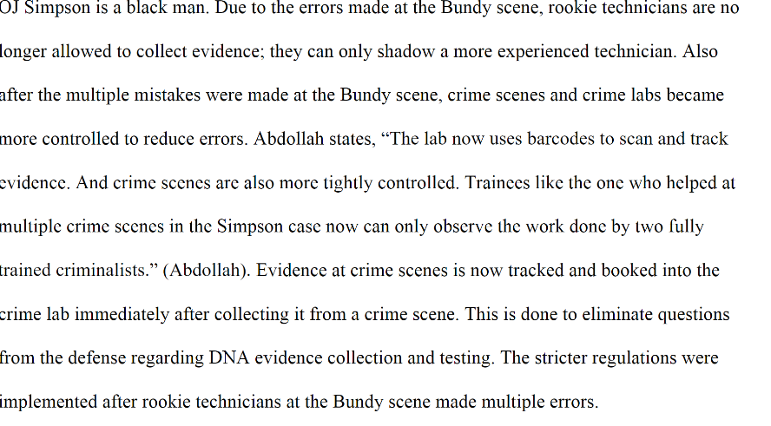

Slide 9
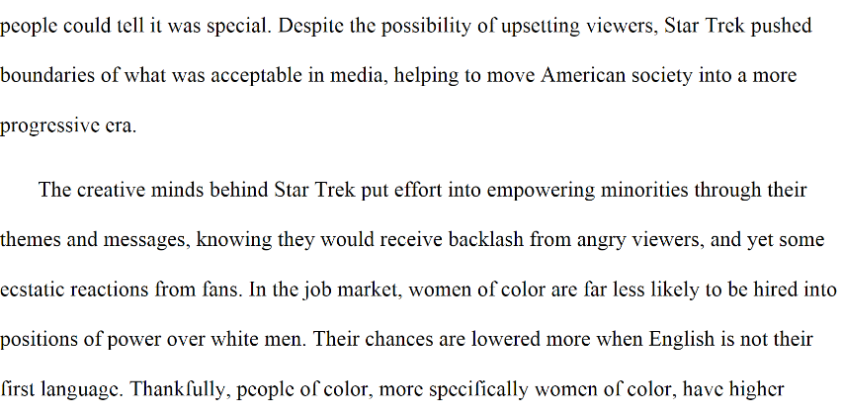

Slide 10
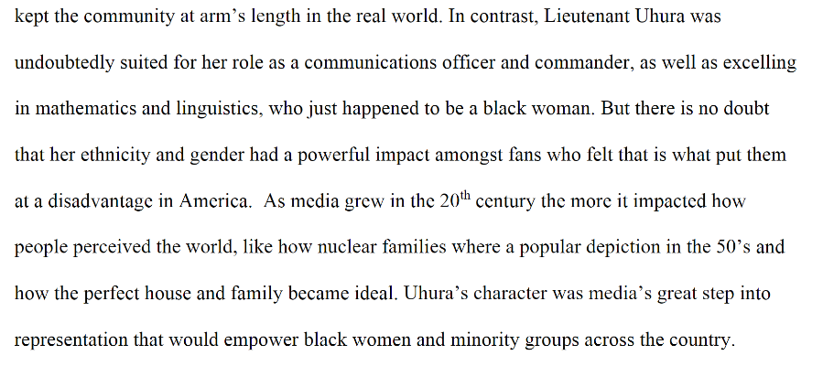

Slide 11
Let’s apply this!
Look at your BT statements.
Does each one have something to do with one of the points you want to make as mentioned in your thesis?
Does each one make some kind of argument?
If yes, great!! Move on to checking that your evidence in good proof.
If no, that’s OK! Work through it and begin making each one an argument statement.

Slide 12
Let’s apply this!
Look at your outline and the feedback given
Did they point out some gaps in your evidence or analysis?
How might you fix these things?
Look at your thesis statement?
What context will your reader need in the intro?
Now look at your BT statements.
What additional context might your reader need for each one? For each piece of evidence?

Slide 13
Let’s apply this!
Look at your analysis
Did you connect to your thesis/BTS and properly analyze or did you just restate your evidence?
If the latter, Congratulations! You have now paraphrased your evidence. Use that.
If needed, how could you give better analysis? Or further analysis?

Slide 14
Let’s apply this!
If completely finished with the above, begin throwing down some ideas for your intro and conclusion.

