Slide 1
Problems During the Qing Dynasty
Read the part assigned to you – write a summary of what the event was (include causes & consequences) (10 min)
B = look @ Boxer Rebellion
O = look @ Opium War
T = look @ Taiping Rebellion
When finished, share with your table group. (5 min)
Write down a few notes on the ones you didn’t read.

Slide 2
April 25, 2018
Turn In:
Source Analysis
Pink Thesis sheet
Take Out:
Chinese Dynasty Notes
Agenda:
Qing Dynasty
Learning Targets (I can…):
* Explain the problems that occurred in the Qing dynasty, leading to the fall of the dynastic cycle
Homework:
4/30: GCP Outline

Slide 3
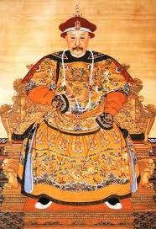
The Qing
1793: The Qing ambassadors from England arrive, despite Chinese distaste of foreigners
English ambassador brings clocks, globes, air-balloons, etc.
China rejected these offers due to their self-sufficiency

Slide 4
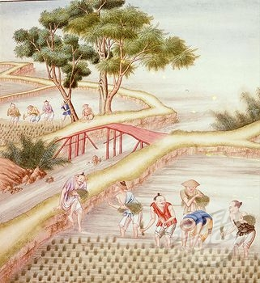
The Qing
Self-Sufficiency:
China’s agriculture flourished due to rice, maize, sweet potatoes, and peanuts
Mining and manufacturing provided work for Chinese laborers
This self-sufficiency meant China had no need to trade with Britain, which made Britain sad.
What should the British do?

Slide 5
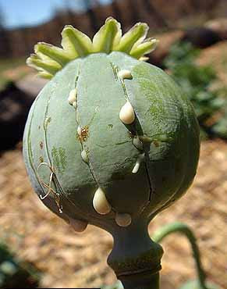
Opium
Habit forming narcotic from the poppy plant
Central narcotic of heroine, hydrocodone, morphine, oxycodone
18th Century: British merchants smuggled opium into China for non-medical use
By 1835: Up to 12 million Chinese became addicted to opium

Slide 6
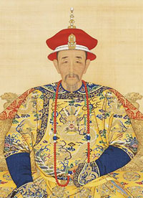
Opium
Opium abuse began to worry Qing Emperors
Lin Zexu (Qin Advisor)
“By what right do they use the poisonous drug to injure the Chinese people? I have heard that the smoking of opium is very strictly forbidden by your country; that is because the harm caused by opium is clearly understood. Since it is not permitted to do harm to your own country, then even less should you let it be passed on to the harm of other countries”

Slide 7
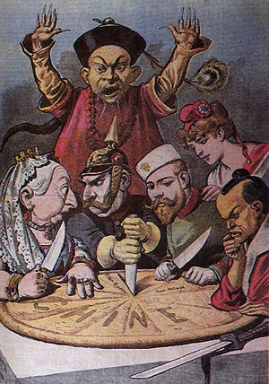
The Opium War
1839: Naval war between outdated Chinese ships and modern British gunboats
China suffers a humiliating defeat, leading to the Treaty of Nanjing
Gave British control over Hong Kong
Allowed the US (and other foreigners) economic rights in certain ports
Century of Humiliation

Slide 8
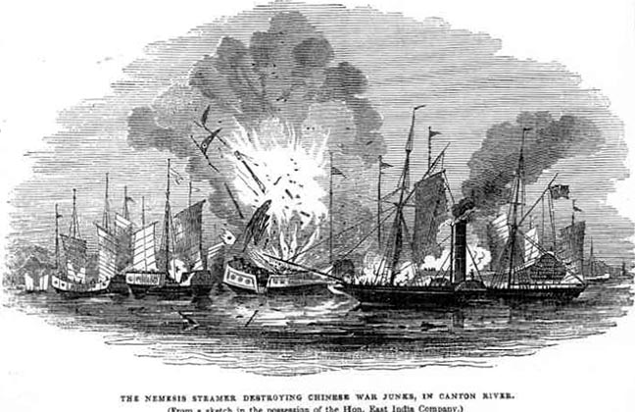

Slide 9
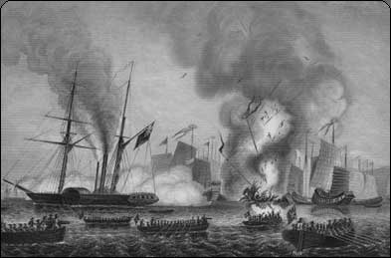

Slide 10
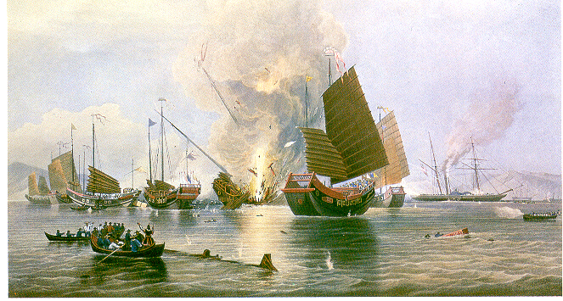

Slide 11
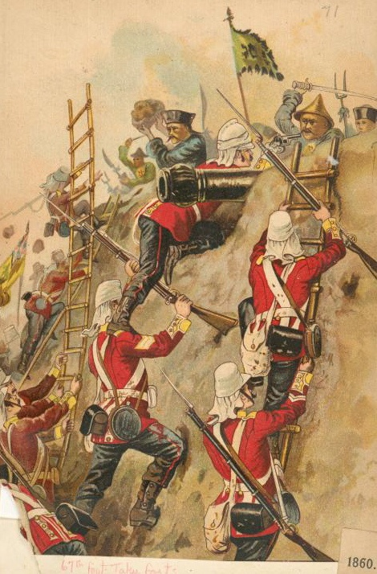

Slide 12
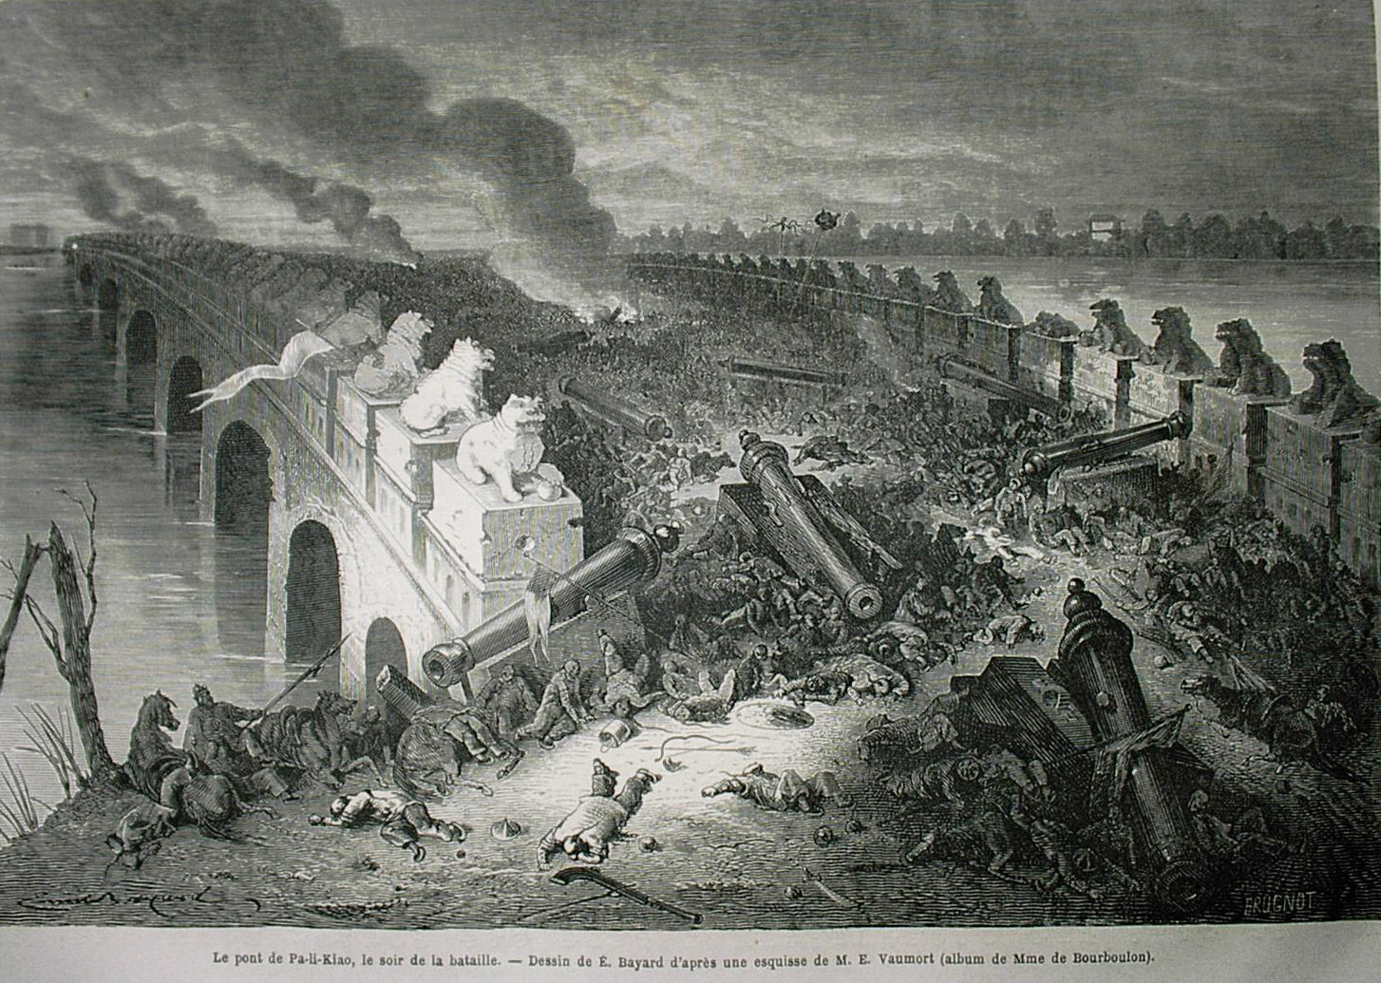

Slide 13
Problems
1850: Chinese population grew to 430 million
30% growth in 60 years
Food production remained stagnant…
What happens?

Slide 14
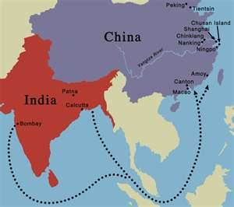
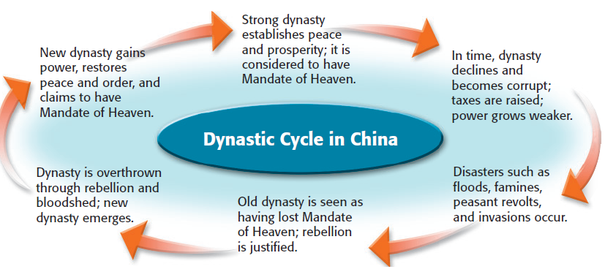
Problems Under Qing
According to the Mandate of Heaven system,
what should have happened after the Qing lost the Opium Wars to the British?

Slide 15
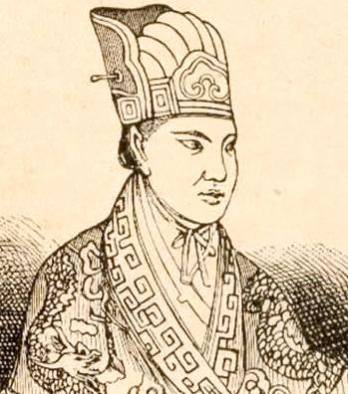
Hong Xiaoquong
Failed the imperial examinations three times.
After the third try, he was delirious for 30 days.
He had a dream: he believed he was related to Jesus
When he recovered, he believed that he had been chosen to change China (move forward):
Public ownership of all land and property
Equality of males and females

Slide 16
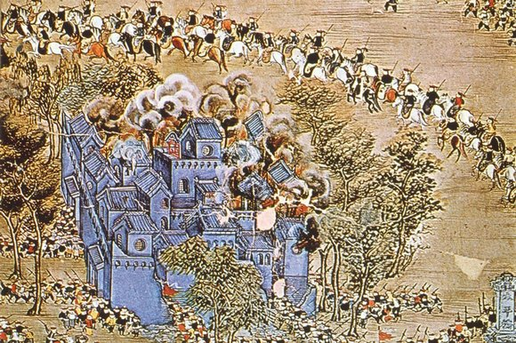
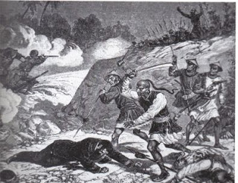
The Taiping Rebellion 1850-1864
The bloodiest civil war in history (20 million dead, mostly civilians)
Peasant (farmer) army: the farmers are fighting, not farming, so there is a famine (people starve).
Led by Hong Xiaoquong
Goal: Move China forward (failed)
Rebellion violently ended by British/Qing Army

Slide 17
Problems after rebellion
After the Taiping Rebellion ended, China was launched in chaos
Smaller rebellions followed, instability continued
Foreign nations took advantage of this, and established spheres of influence
Spheres of Influence: An area in which a foreign nation controls trade and investment
America instituted an “Open Door Policy” - America wanted to make sure that we would always be able to have access to Chinese products

Slide 18
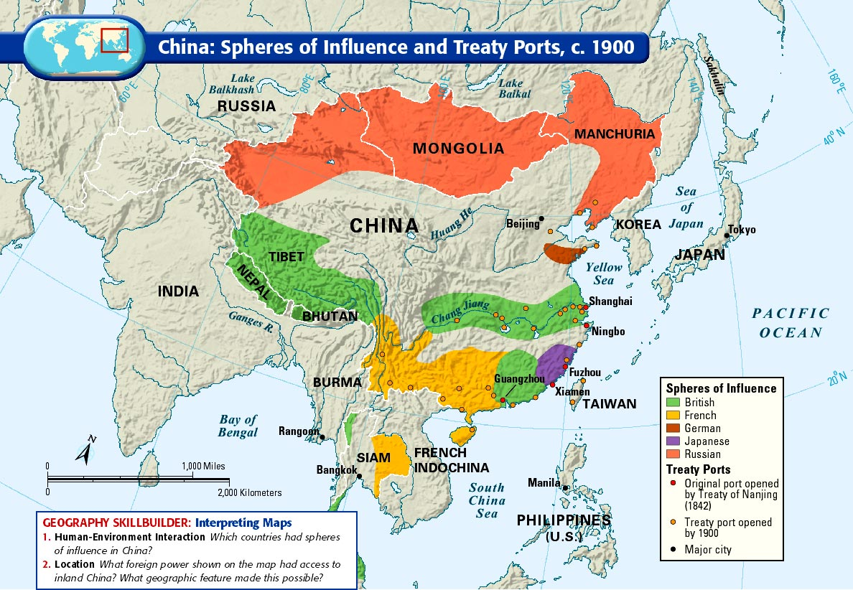

Slide 19
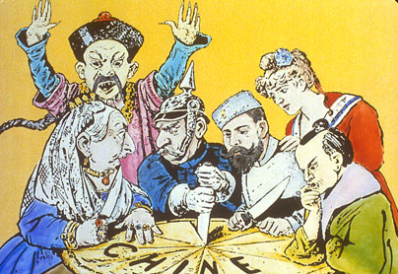

Slide 20
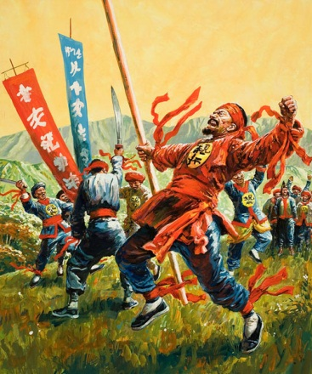
The Society of the Righteous and Harmonious Fists!

Slide 21
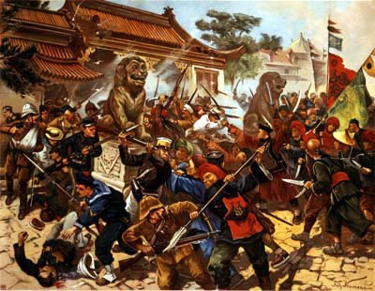
The Boxer Rebellion: 1898-1901
Opposed to imperialism
Believed that Chinese weakness came from outside influences
Anti-Christian, anti-foreigner
Slogans:
“Support the Qing, Annihilate the foreigners!”
"Take away your missionaries and your opium and you will be welcome."

Slide 22
The Boxer Rebellion: 1898-1901
Resulted in a growth of Nationalism in China
Nationalism: The belief that the needs/interests of a nation are of primary importance. Incredible pride in your nation.

Slide 23
Road to Reform
China’s dowager empress sees need for reform
Sends ambassadors to study other governments
On their recommendation, begins steps to establish a constitutional monarchy/government
It won’t be enough…

