Slide 1
Warm Up 1/10
Describe the significance of one event leading up to the Revolutionary War.

Slide 2
Prohibition
18th Amendment passed 1920
Banned manufacture, sale, transportation of alcoholic beverages
Result of nearly 100 years of temperance movements
Alcohol blamed for many societal problems from domestic abuse to work related accidents

Slide 3
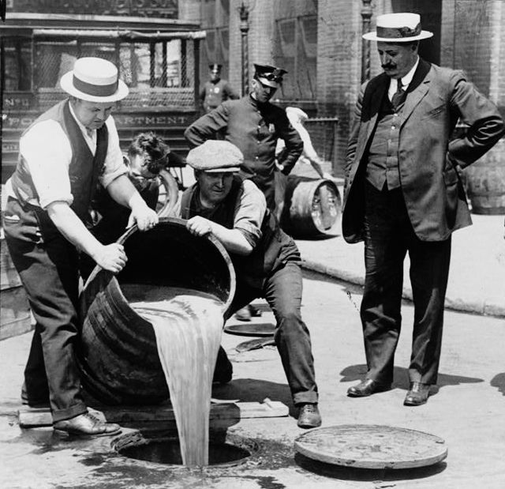
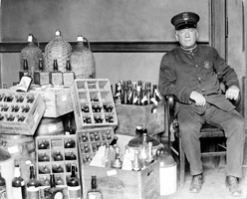
Prohibition
Promoted mostly by rural Protestants in South and West who praised the elimination of a social evil

Slide 4
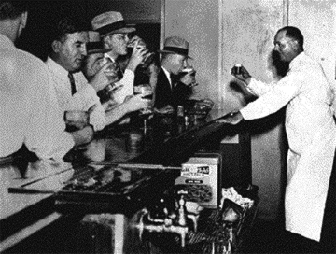
Prohibition - Problems
Underfunded and enforced
Volstead Act
Created Prohibition Bureau
1500 poorly funded agents to patrol entire country
Speakeasies
Hidden saloons/night clubs
More numerous than original saloons
Frequented by men and women of middle and upper-middle class
Could be found just about anywhere

Slide 5
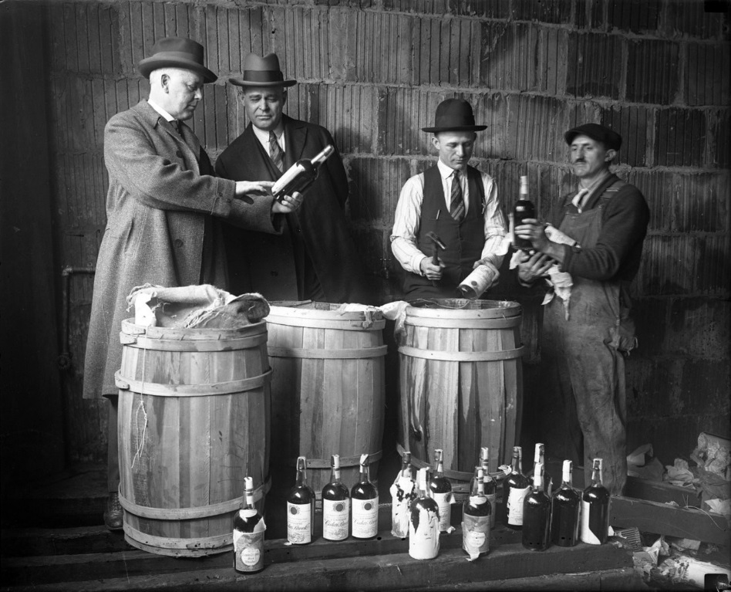
Prohibition - Problems
Bootleggers
Smugglers who manufactured or acquired and sold liquor illegally
Highly lucrative $$$
Bribed police to look the other way

Slide 6
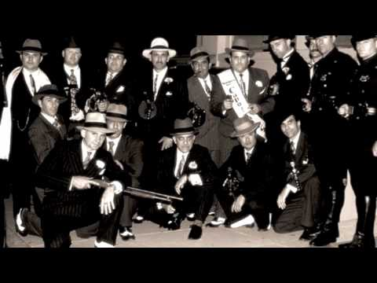
Prohibition - Problems
Organized Crime
Supplying illegal liquor was a complex business
Independent gangsters joined forces in the process
Leads to gang violence
Clashes over territory
Gang wars and murder become commonplace in big cities
Expands to gambling, prostitution, racketeering
Bribing police or government officials
Forcing local businesses to pay a fee for “protection”

Slide 7
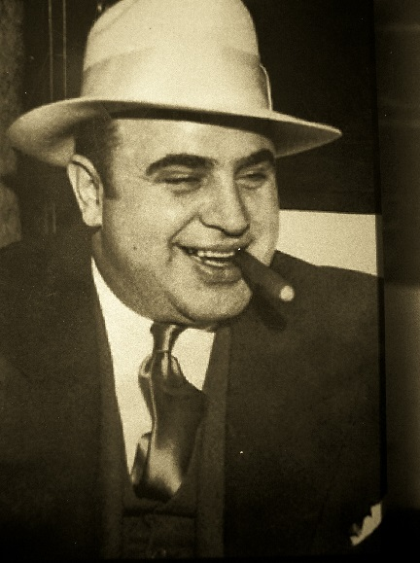
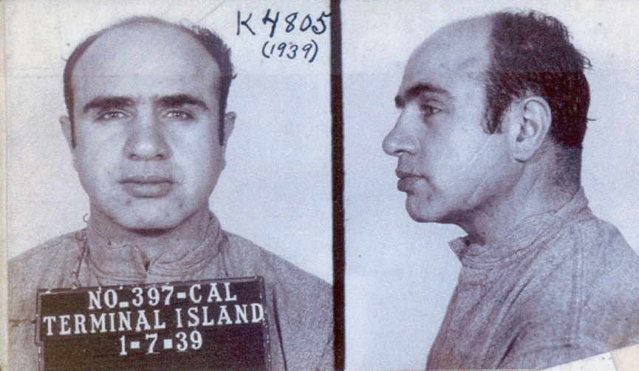
Prohibition - Problems
Organized Crime
Al Capone
Most infamous mob boss in Chicago
Murdered his way to the top of the Chicago liquor business
Had a knack for paying off officials and avoiding jail
Flashy and well known, almost a celebrity in the city
Irony: Eventually arrested and sentenced to 11 years in prison for tax evasion

Slide 8
Speakeasy Mingle

