Slide 1
Warm Up 12/4
What were political machines and why were they a problem?
Staple Works Cited to Source Analysis and turn in.

Slide 2
Gilded Age Political Reform
Laissez-faire economics
Business ran politics
Bribes and campaign gifts for favorable policies
Scandals
Credit Mobilier
Overcharging for railroad work, Congress receives stock to ignore it
Spoils System (started with Andrew Jackson)

Slide 3
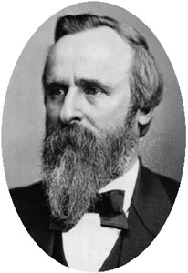
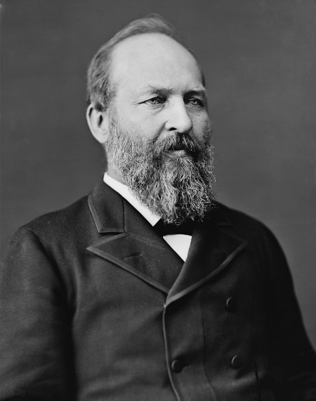
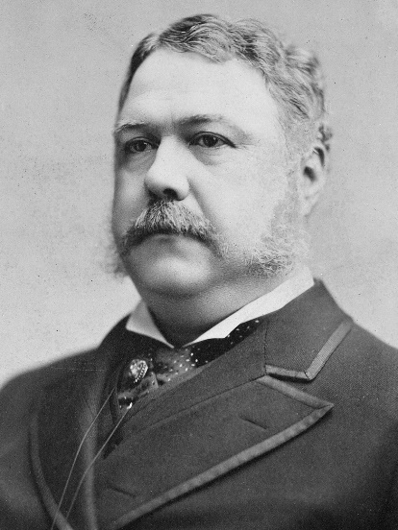
Gilded Age Political Reform
Reform
President Hayes
Appoints by qualifications
Cleans out corrupt departments
Garfield assassinated after not giving someone a job
Arthur
Pendleton Civil Service Act – 1883
Tests for civil service jobs

Slide 4
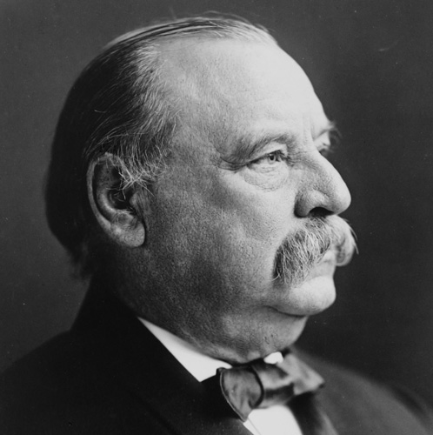
Gilded Age Political Reform
President Cleveland - 1884
First democrat since 1856
Railroad Regulation
Hard to enforce
Second Term (non-consecutive)
Failed to help the 1893 depression and angered unions along with many others

Slide 5
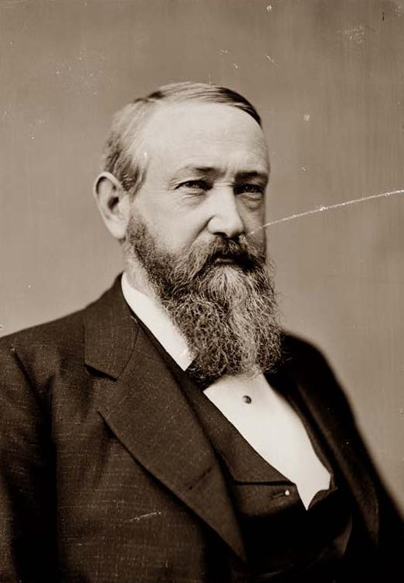
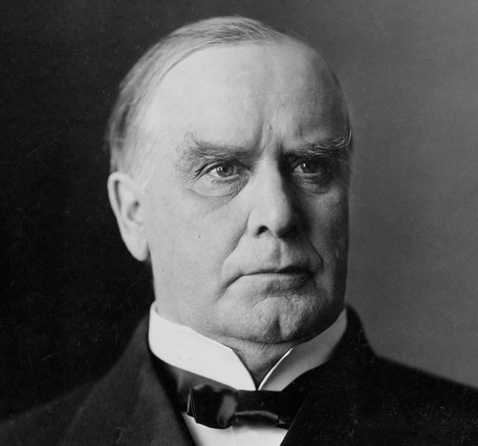
Gilded Age Political Reform
Harrison's actions
Sherman Anti-Trust Act
Huge tariff increase
Hurt economy
Pension to Civil War veteran dependents
McKinley
Wins 1896 election with promise of a "Full Dinner Pail"
New tariff and strong gold standard
Later Assassinated

Slide 6
The Progressive Era
What reforms have the people been working towards?
What problems haven’t yet been solved?

Slide 7
Progressive Era Overview
Purpose:
Expose and fix the problems of the Gilded Age
Focus:
Economic inequities
Environmental issues
Social welfare
Working condition
Rights for women, children, and minorities (small extent)
Government reform

Slide 8
Progressive Era Overview
Big Ideas:
Government can be an instrument of social change and justice
New laws and constitutional amendments can drive change
The public must be made aware of problems in order to call for change (muckraking)

Slide 9
Muckrakers
Journalistic “Voice” of Progressives
Investigative journalists who expose corruption and other problems that needed to be addressed
Profitable for magazines and newspapers
Term coined by T. Roosevelt with a negative connotation
Examples of work:
Upton Sinclair’s The Jungle
Lincoln Stephen’s The Shame of the Cities
Ida Tarbell’s History of the Standard Oil Co.
Ida B. Wells’s Lynch Law in America
Notes:
https://www.youtube.com/watch?v=vY0hyPjGjBE The Jungle

Slide 10
Local Reform successes
Reorganizing of municipal government to combat political machines
City takeover of utilities (to standardize and regulate)
Workman’s compensation
By 1907: 2/3 of states had abolished child labor
Florence Kelley helps bring minimum wage for child and women workers

Slide 11
Political/Election reform
Direct Primary
Direct election of senators
Initiative
Voters can submit bills for vote
Referendum
Voters can reverse unpopular bills
Recall
Voters can remove state leaders from office

Slide 12
Presidential Progressivism

Slide 13
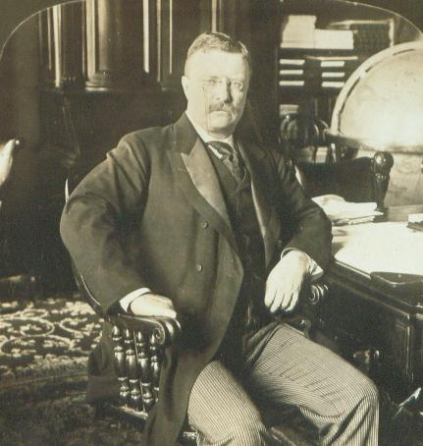
Presidential Progressives
Theodore Roosevelt- Republican
The true father of American Progressivism
All aspects of Progressive Era focus points were at least partially addressed during his administration

Slide 14
Presidential Progressives
Square Deal
Coal Miners strike
Shorter days, higher pay, no union recognition
Becomes new slogan
Trustbusting
Breaking up of monopolies using Anti-trust legislation (Sherman and later Clayton)
Rockefeller’s Standard Oil Co.
Break up led to the creation of smaller oil companies
Chevron
Mobil
Exxon
Amoco

Slide 15
Presidential Progressives
Health Reform
Pure Food and Drug Act
FDA (1930s): tested and approved drugs
Meat Inspection Act
Seal of approval
Inspired by The Jungle

Slide 16
Presidential Progressives
Environmental Reform
National Park System
Inspired by John Muir and Sierra Club
Focuses on preservation
WA example~ Olympic National Park
National Forest Service
Pushed through by Gifford Pinchot
Focuses on conservation
WA example~ Wenatchee National Forest

Slide 17
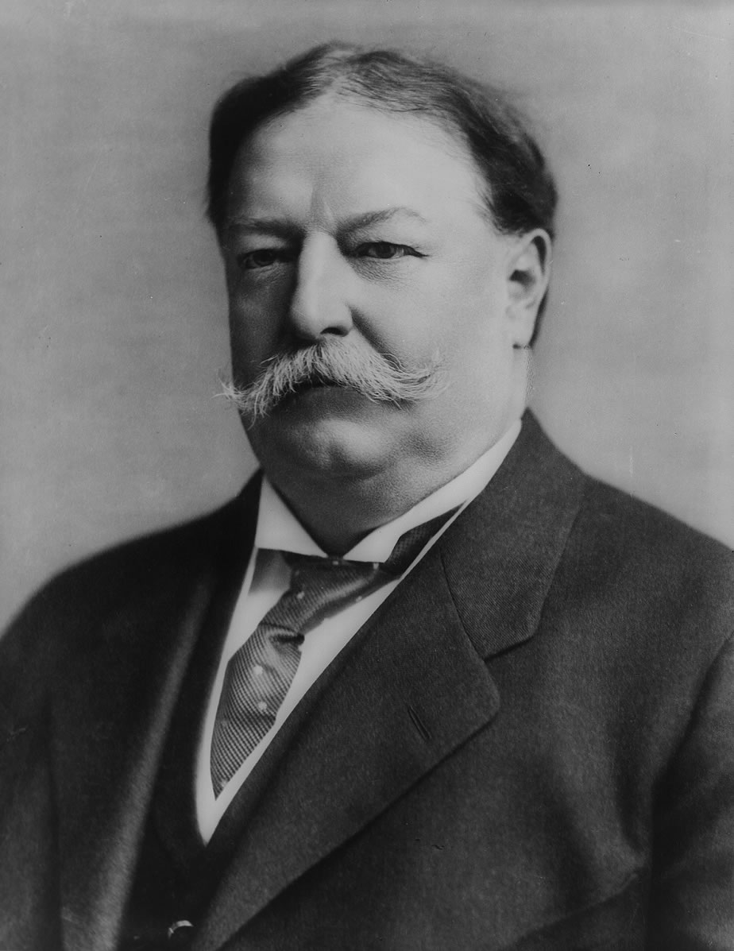
Presidential Progressives
William H. Taft- Republican
Hand-picked by Roosevelt
Continues progressive agenda
Perhaps takes it a bit far in some places(trustbusting) and not far enough in others (conservation)
Rift emerging between conservative/progressive Republicans impeded his presidential success
Woodrow Wilson- Democrat
Continued progressive financial agenda (tariffs, anti-trust action)
Not strong on issues of social justice

Slide 18
Election of 1912
Only time in US history that 3 presidents will run for office at the same time
Progressive Roosevelt (past)
Republican Taft (present)
Democrat Wilson (future)
There was also a 4th candidate
Eugene Debs, socialist
Roosevelt and Taft split the Republican vote, allowing Wilson to easily take the presidency

Slide 19
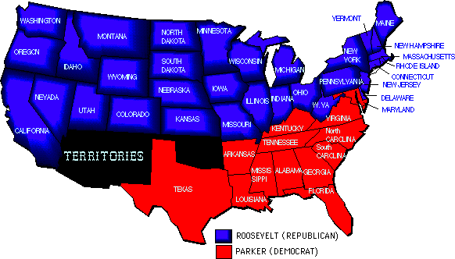
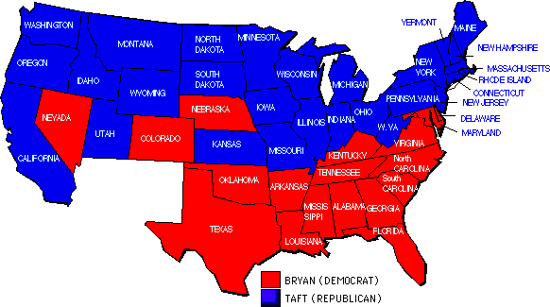
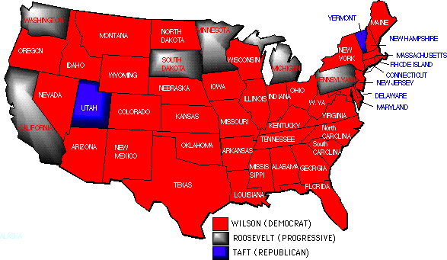
Election of 1904
Election of 1908
Election of 1912

Slide 20
Woodrow Wilson Presidency
Clayton Antitrust Act
Legalized Union and their activities
Tightens merger laws
Federal Trade Commission (FTC)
Enforce Clayton Act
Federal Reserve System
12 districts
Controlled amount of currency

Slide 21
Women’s Suffrage
Origins
Seneca Falls Convention 1848
Lucretia Mott, Elizabeth Cady Stanton
Susan B. Anthony
Two ways to get votes
Constitutional amendment
States rights
NAWSA (National American Woman Suffrage Association)

Slide 22
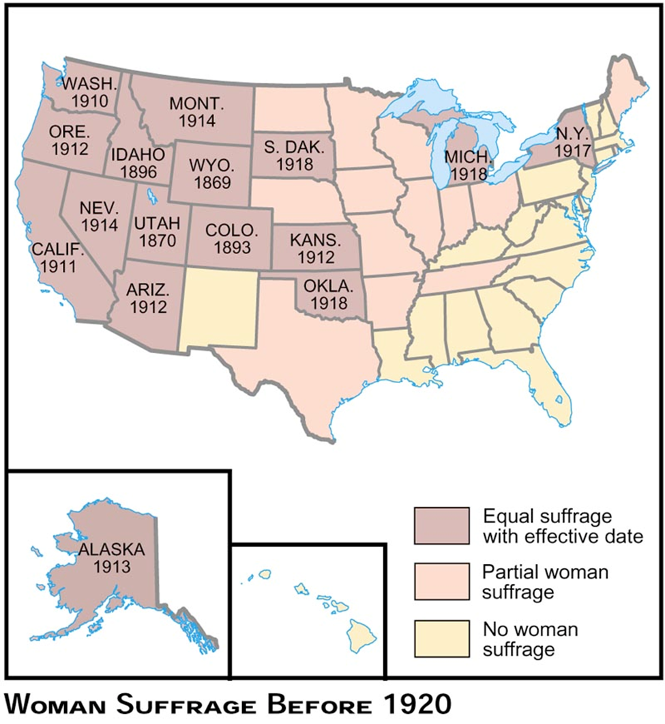

Slide 23
Rising Leaders
Alice Paul
Militant campaign
Borrowed from British
Congressional Union
Pickets, burning speeches, White House Fence, arrests, hunger strikes

Slide 24
Carrie Chapman Catt
Worked with state movements and amendment
Brought NAWSA up to 2 million
New York huge victory
Congress approves bill 1918
Ratified 1920

Slide 25
Progressive Era Amendments
16th Amendment
Federal Income Tax
17th Amendment
Direct Election of Senators
18th Amendment (Progressive?????)
Prohibition of Alcohol
19th Amendment
Women’s Suffrage

Slide 26
Progressive Era Omissions
This era saw the establishment of the NAACP (National Association for the Advancement of Colored People) and a more organized approach to Civil Rights
Roosevelt attempted to open dialogue about race relations and openly spoke out against lynching during his presidency, clearly articulating its illegality. However he backed off the issue when he received harsh pushback.
Wilson will actively speak against Anti-Lynching legislation. He will also formally segregate all D.C. government buildings/offices.

Slide 27
Wilson Quotes
“The white men were roused by a mere instinct of self-preservation—until at last there had sprung into existence a great Ku Klux Klan, a veritable empire of the South, to protect the Southern country.” "It is like writing history with lightning, and my only regret is that it is all so terribly true.“- about historically inaccurate and racist film The Birth of the Nation
"Segregation is not humiliating, but a benefit, and ought to be so regarded by you gentlemen."

