Slide 1
Warm Up 5/15 (#1)
What were the three R’s of the New Deal?

Slide 2
May 15, 2018
Out for checkoff:
Vietnam Legacy notes
8 Warm Ups
Agenda:
Rise and Fall of Nixon
Skills:
Learning Target (I can…):
Detail the major of events of Nixon’s political career
Upcoming Dates
5/16: Final due date for pre-Vietnam units late work
5/17: Final due date for all Vietnam late work

Slide 3
Nixon: Road to the White House
VP to Eisenhower
Campaign plagued with money scandals
Lost presidency to JFK 1960
Lost governor of CA 1962 and claimed to retire from politics

Slide 4
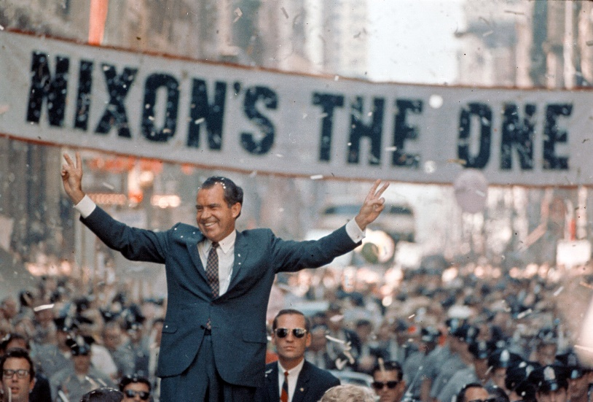
Nixon: Road to the White House
Uses turbulence of 1968 to propel himself to president
Stepping down of LBJ
Assassinations of MLK and Bobby Kennedy
Violence at DNC convention
Protests, draft dodging,
Nixon promises return to law and order
Wins by narrow margin

Slide 5
The Election of 1968
Richard Nixon only narrowly won the 1968 election, but the combined total of popular votes for Nixon and Wallace indicated a shift to the right in American politics.
The 1960's began as an era of optimism and possibility and ended in disunity and distrust.
The Vietnam war and a series of assassinations and crises eroded public trust in government and produced a backlash against liberal movements and the Democratic party.

Slide 6
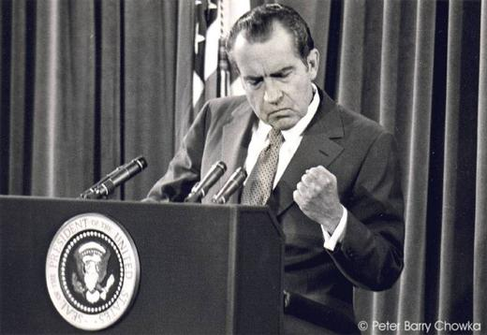
Nixon: Domestic Policy
New Federalism
Reduction of federal government through revenue sharing
States received tax funds to use as they saw fit
Popular with conservatives

Slide 7
Nixon: Domestic Policy
Reduction of federal gov’t inconsistent
Did away with some, expanded and created new ones
Creation
OSHA (Occupational Safety and Health Administration)
EPA (Environmental Protection Agency)
Family Assistance Plan (failed)

Slide 8
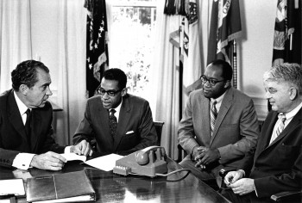
Nixon: Domestic Policy
Inconsistent with Civil Rights
Attempted to appoint segregationist judges
Tried to reduce oversight on Voting Rights Act
Fails and signs extension of act
Expanded Affirmative Action

Slide 9
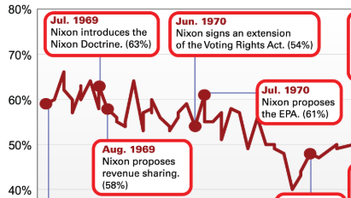
Nixon: Domestic Policy
What do you think Nixon’s approval rating looks like at this point?
Think back. What do you think caused this?

Slide 10
Nixon: Domestic Policy
Economic/Energy Crisis
U.S. in recession beginning 1970
Stagflation
Unemployment AND PRICES rise leaving America with stagnant economy and rapid inflation
Nixon implements 3 phase plan
First two help and unemployment lowers
Phase 3 lifts regulations on wages and prices and cost of living skyrockets
Fall of ’73: Middle East countries implement oil embargo to protest U.S. support of Israel
U.S. enters year long energy crisis

Slide 11
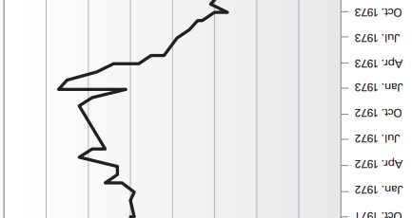
Nixon: Domestic Policy
What do you think Nixon’s approval rating looks like at this point?
Stagflation
Oil embargo

Slide 12
Nixon: Foreign Policy
Quick Review
How is Nixon handling Vietnam?
Promising to pull out
Stops bombing/continues bombing
Bombing of Cambodia
Invasion of Cambodia
Peace talks going/falling apart
Cease fire agreed to

Slide 13
Nixon: Foreign Policy
Realpolitik
Focuses on practical rather idealistic
Nixon Doctrine
Non-nuclear protection still given
Nation’s must do more to help themselves (vietnamization)
More aid to struggling countries rather than troops

Slide 14
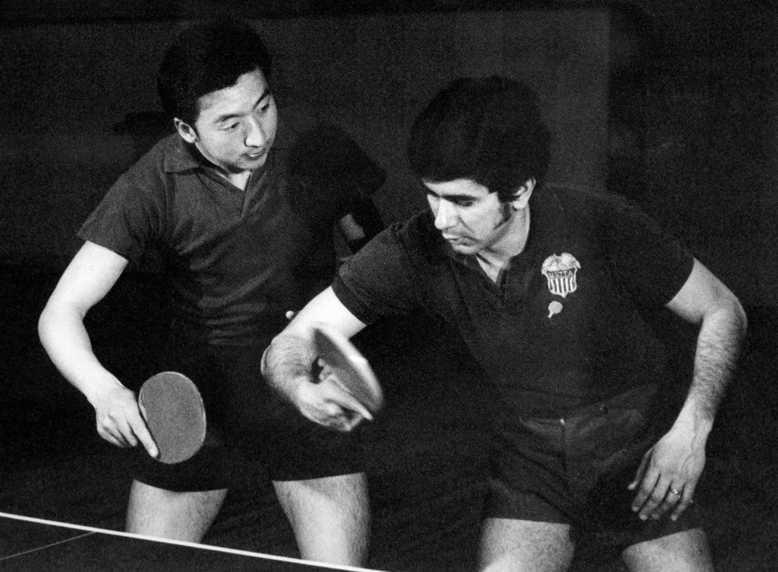
Nixon: Foreign Policy
Détente (relaxation of tensions)
focuses on China at first
American ping-pong players welcomed with open arms to competition in Beijing

Slide 15
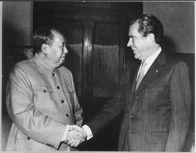
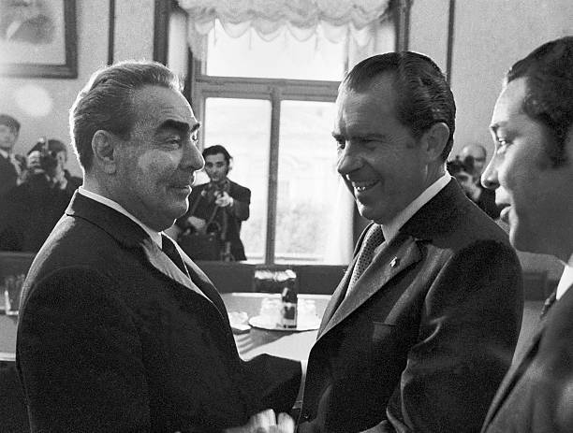
Nixon: Foreign Policy
Détente (relaxation of tensions)
focuses on China at first
American ping-pong players welcomed with open arms to competition in Beijing
Nixon announces visit to China
Marks turning point in U.S.-China relations
China takes seat in UN
Full diplomatic relations opened by 1979
Later becomes first president to visit Moscow
Negotiates trade agreement with Brezhnev
Strategic Arms Limitation Talks (SALT) to limit nuclear missiles

Slide 16
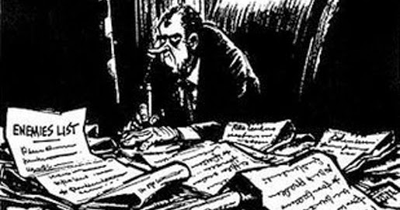
Nixon’s Fall: Watergate
Nixon is paranoid
Kept and “enemies” list that included people he considered unfriendly to his administration
Ordered wire taps/phone taps of staff and reporters
NOT authorized!
What might have caused this?

Slide 17
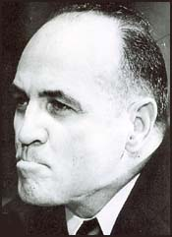
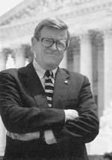
The White House Plumbers
After the release of the Pentagon Papers, the White House created a unit to ensure internal security.
This unit was called the Plumbers because they stopped leaks.
Howard Hunt
G. Gordon Liddy
James McCord
Chuck Colson

Slide 18
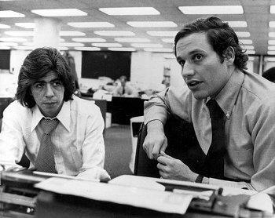
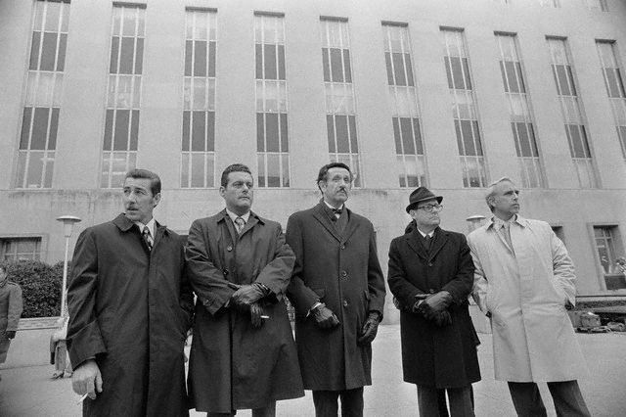
Nixon’s Fall: Watergate
June 1972: The plumbers are caught breaking into the Watergate building (DNC offices)
Bernstein and Woodward, Washington Post reporters, claim Nixon’s reelection campaign authorized the bugging of DNC offices, citing a source known as Deep Throat
While on trial, one of the plumbers implicates Nixon in a cover-up, claiming he’d been paid to lie

Slide 19
Watergate Enters the Nixon Campaign
The break-in was eventually tied to the Nixon reelection campaign through a $25,000 check from a Republican donor that was laundered through a Mexican bank and deposited in the account of Watergate burglar Bernard Barker.
Later it was discovered that Former Attorney General John Mitchell, head of Nixon’s “Committee to Re-Elect the President,” (CREEP) controlled a secret fund for political espionage.
Mitchell would later go to prison for his role in the scandal

Slide 20
The Election of 1972
Despite the growing stain of Watergate, which had not yet reached the President, Nixon won by the largest margin in history to that point.

Slide 21
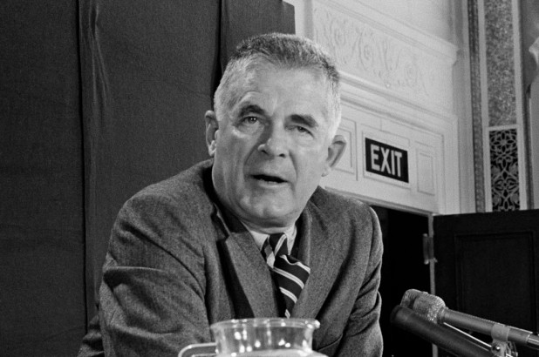
Nixon’s Fall: Watergate
Justice Department appoints Archibald Cox as special prosecutor
Lawyer outside gov’t appointed to investigate federal officials for misconduct while in office

Slide 22
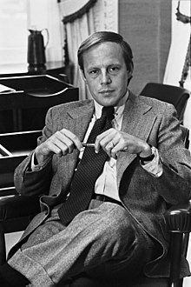
Nixon’s Fall: Watergate
Senate forms investigative committee
Mistake: Nixon fires key advisors
Later revealed that had refused to help in cover-up or were afraid of becoming scapegoats
John Dean and other former aides testify that Nixon installed recording devices in Oval office
Tapes could prove whether president ordered a cover-up
July 1973: Committee subpoenas Nixon tapes

Slide 23
Nixon’s Fall: Watergate
Mistake: Nixon claims executive privilege and attempts to withhold tapes

Slide 24
The Saturday Night Massacre
The Administration reached an agreement with the Senate Watergate Committee that its Chairman would be allowed to listen to tapes and provide a transcript to the Committee and to Special Prosecutor Archibald Cox.
The deal broke down when Cox refused to accept the transcripts in place of the tapes.
Since the Special Prosecutor is an employee of the Justice Department, Nixon ordered Attorney General Elliot Richardson to fire Cox.
Archibald Cox

Slide 25
The Saturday Night Massacre
When Richardson refused, he was fired.
Nixon ordered Deputy Attorney General William D. Ruckelshaus to fire Cox .
When he refused, he was fired.
Nixon then ordered Solicitor General Robert Bork (who was later nominated for the Supreme Court by Reagan) to fire Cox and he complied.
The Washington Post reported on the “Saturday Night Massacre.”
Robert Bork

Slide 26
Nixon’s Fall: Watergate
United States v. Nixon
ruled that Nixon must release his tapes
House committee approves 3 articles of impeachment

Slide 27
The Smoking Gun Tapes
Supreme Court forced Nixon to surrender the tapes.
Nixon was implicated from the earliest days of the cover-up:
authorizing the payment of hush money
attempting to use the CIA to interfere with the FBI investigation.
One tape has an 18 ½ minute gap.
Nixon’s secretary Rosemary Woods demonstrated how she could have inadvertently erased the tape, but no one bought it.
“The smoking gun tapes,” were released in August 1974, just after the House Judiciary Committee approved Articles of Impeachment against Nixon.

Slide 28
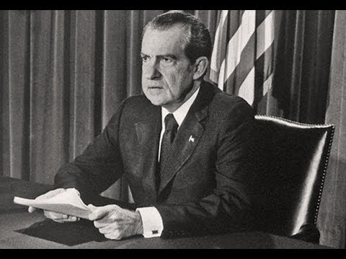
Nixon’s Fall: Watergate
United States v. Nixon
ruled that Nixon must release his tapes
House committee approves 3 articles of impeachment
August 1974: Nixon resigns

Slide 29
Aftermath
Ford announcing the pardon
More than 30 government officials went to prison for their role in Watergate.
Richard Nixon was NOT one of them.
In September 1974, President Gerald Ford gave Nixon a full pardon.
Woodward and Bernstein won the Pulitzer Prize.
They collaborated on 2 books, All the President’s Men and The Final Days.
Public remained disillusioned with political leaders
The identity of Deepthroat was kept secret until W. Mark Felt unmasked himself in 2005.

Slide 30
Watergate: The parallels
Other special prosecutors
Resignation and firing of White House staff
Those involved turning to testify
Firing of major officials (FBI, AG, etc)

Slide 31
Watergate: The parallels
Sydney, Danielle, Ashley L: 1970
Kellen, hari, Jake: 1971
Thomas, Jackson, Alex: 1972
Nikolas, elbert, marcus: 1973
Clara, Alexa, Sarah: 1974
Aidan, Carter, Mitch: 1975
Stevenson, jack, Caden: 1976
Hunter, Andrew, Andrew: 1977
Brendan, Cade, Sam: 1978
Kenta, Tomas, Tom: 1979
Lauren, Ella, Calvin: 1980
Maddie, Rachel: 1981
Sarah D., Lexi: 1982
Logan, Grant: 1983
Ashley, Dawson, Bich-Long: 1984
Hazel, Chloe, Macey: 1985
Kasey, jaielyn, Katie: 1986
Alison, Jahnavi, Julia: 1987
Jacob, John: 1988
Katie, Ajay, Christina: 1989

