Slide 1
The Empire that Mastered Unification
(Mughals I)
By Isaac Ketcham, Noah Jucht, and Eli Hayrynen

Slide 2
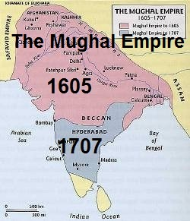
The Map of the Mughal Empire (Beginning to Akbar’s Death (1605)
1526-1605

Slide 3
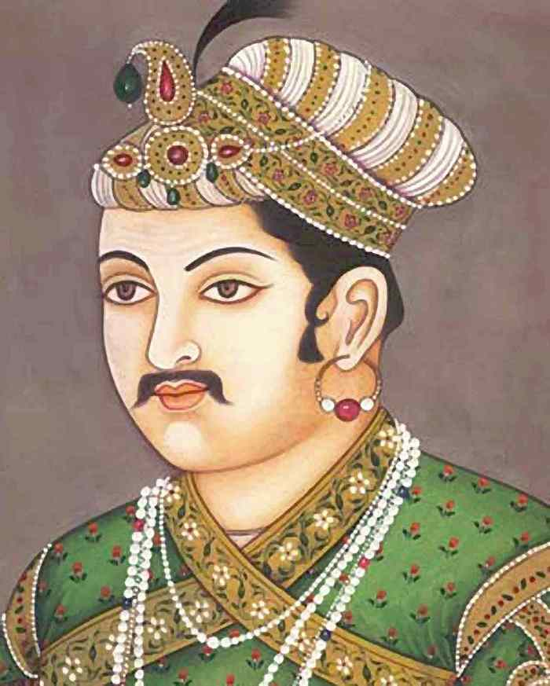
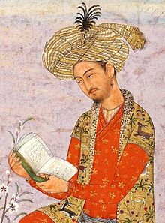
Important Leaders
Akbar
- Unified a land of over 100 million people
- Genius at cultural blending
- Military power was the root of his strength
- Was a devoted architect
Babur
- Led 12,000 troops to a victory against an army of 100,000 led by a sultan of Delhi
-Swept down India and laid the foundation of the Mughal Empire
-Thought to be a brilliant general

Slide 4
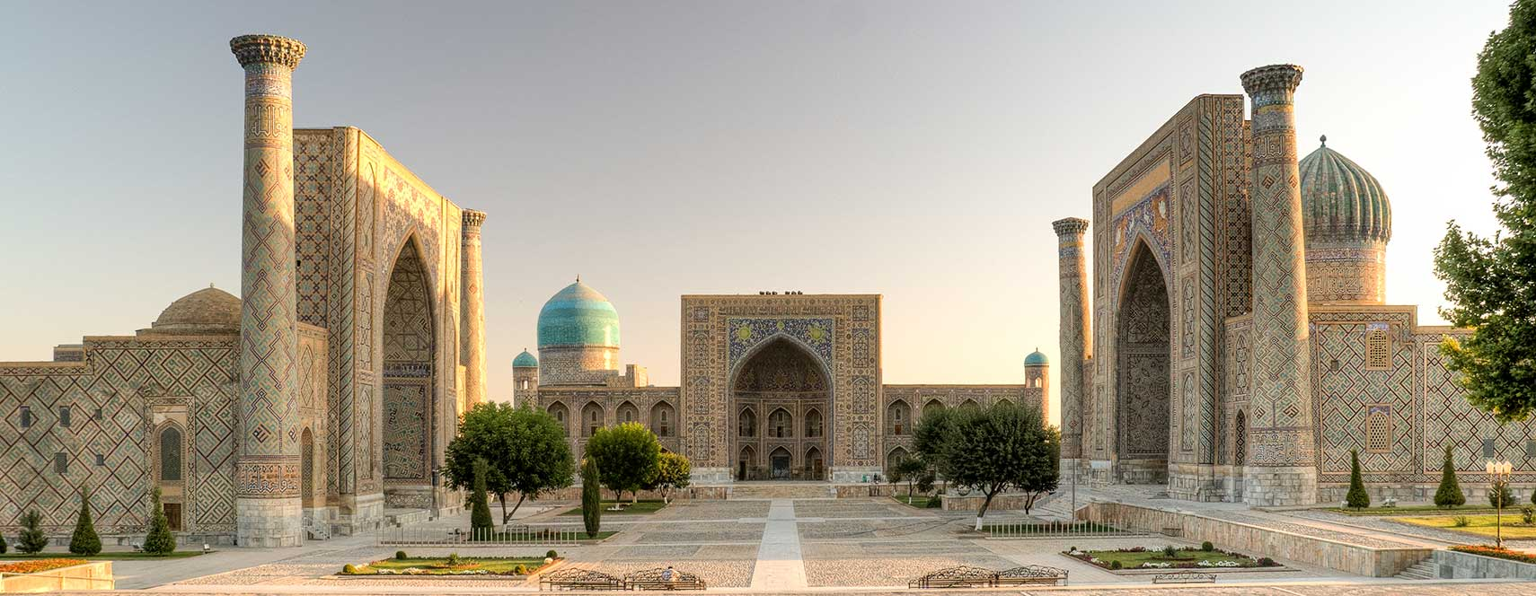
Key Events
- In 1526, the Mughal Empire was created by Babur in the area of today’s Uzbekistan and Tajikistan.

Slide 5
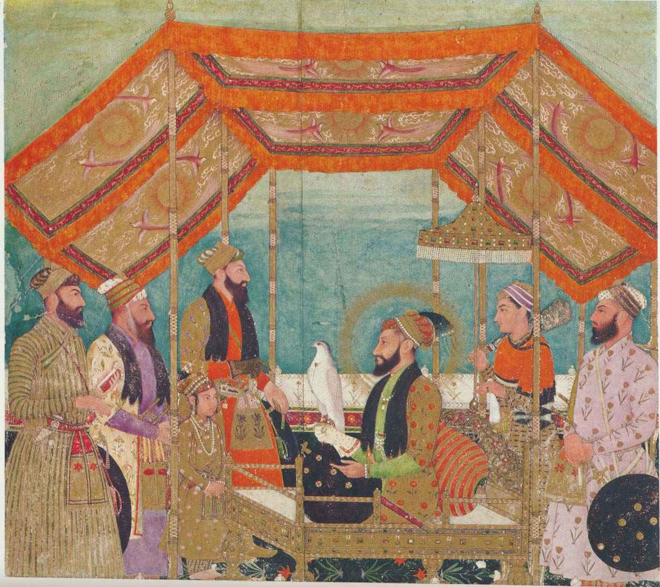
Key Events (continued)
- Akbar introduced cultural blending which positively influenced things such as art, education, politics, and language.

Slide 6
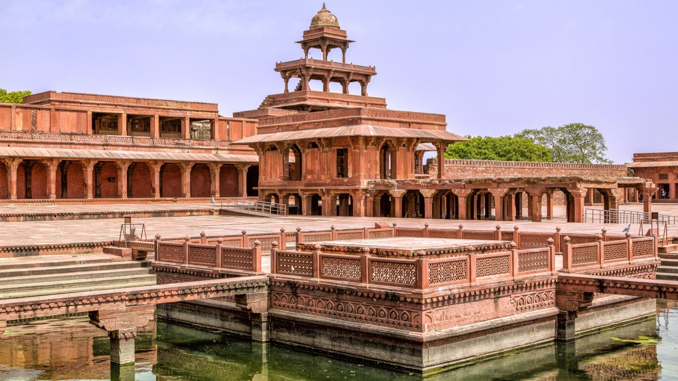
Key Events (continued)
Akbar built a red-sandstone city, called Fatehpur Sikri, which is the capital of the Mughal Empire. The huge structures decorated with beautiful stonework that Akbar had built in the capital city, showed his devotion to architecture

Slide 7
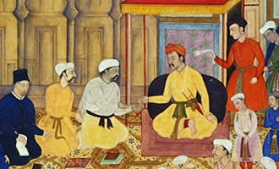
Cultural Aspects
Government: Due to the Mughals being Muslim and ruling over people that were mostly Hindu and Christian, the government allowed the practice of each religion freely. The government also abolished taxes on Hindu pilgrims and non-Muslims. It was also allowed that any religion could hold high governmental power.

Slide 8
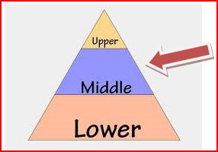
Cultural Aspects (continued)
Social Organization: The Mughal’s social structure functioned as most hierarchies do. The social organization was the rich class (such as kings and queens), the middle class (such as merchants and farmers), and the poor class (such as slaves and beggars).

Slide 9
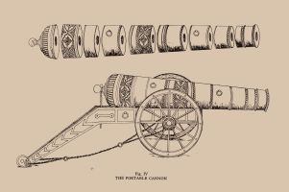
Cultural Aspects (continued)
Technology: Mughals were known for their advances in astronomy, which also lead to them building an observatory. The Mughals also took pride in the waterworks features (such as ones located in gardens and dams) and they were ahead of their time when it came to the construction of cannons and rocket missiles.

Slide 10
Fun Facts
Babur was invited by Sangram Singh (Rana Sanga), Alam Khan Lodhi and Daulat Khan Lodhi ( all Indian rulers of different provinces) to invade India and defeat the powerful Lodhi Sultan- Ibrahim Lodhi
Akbar was appointed as the governor of Ghazni when he was just nine.
Akbar introduced a new religion known as Din-i-Ilahi, which was a compendium of all the faiths.

Slide 11
Works Cited
“Babur.” Wikipedia, Wikimedia Foundation, 28 May 2018
Bodh, Kalden. “13 Interesting Facts About The Mughals You Should Know.” Bameslog, Burffee.
“Fatullah Shirazi in Mughal Period.” MARXIST, radhikaranjanmarxist.blogspot.com/2010/11/fatullah-shirazi-in-mughal-period.html.
Kästle, Klaus. “Uzbekistan.” Taoism - Chinese Customs and Beliefs, Nations Online, 2018.
“Life History of The Mughal Emperor Akbar.” Agra India – History, Architecture, Facts, Myths, Visit Timing & Entry Fee, Cultural India.
“Mughal Administration: It's Culture and Disintegration in India.” History Discussion, Discuss Anything About History, 8 Aug. 2015.
“Mughal Empire.” Life, Culture and Traditions of Jat People, Jatland Wiki.
“Walk through Fathehpur Sikri | Uttar Pradesh | AndBeyond.” Luxury African Safaris,South America & South Asia Tours, AndBeyond.
Walsh, Judith W. “Turks, Afghans, and Mughals in India.” A Brief History of India, Second Edition, Facts On File, 2011. History.
Wolpert, Stanley A., and R. Champakalakshmi. “India.” Encyclopædia Britannica, Encyclopædia Britannica, Inc., 2 May 2018.
“Social Class Pyramid.” Perceptiv, ivedi.preceptiv.co/social-class-pyramid/.
“The Story of India.” PBS, www.pbs.org/thestoryofindia/timeline/5/.

