Slide 1
Test Day!
Please staple you warm-ups (8), Forgotten War Video Notes, and Nonconformist Sources worksheet together. Make sure your name is on it and put it in the tray.
Clear your desk and fill in your ID number AND your write your name on your gradecam.

Slide 2
When finished…
Write name on test and turn in gradecam and test in separate piles. DO NOT staple.
Begin critically reading through JFK’s inaugural address. Look for the following:
Themes
Message
Tone
Key words/phrases
Due tomorrow 4/4

Slide 3
Warm Up 4/4 (#1)
What are the characteristics of a great president?

Slide 4
April 4, 2018
Out for Stamp:
JFK Address
Take out:
Agenda:
Kennedy intro
Skills:
Understanding differing perspectives
Learning Target (I can…):
Analyze a text from multiple perspectives
Upcoming Dates
4/17: All late work due for Quarter 3
*NO late work will be accepted after this day.

Slide 5
John F. Kennedy

Slide 6
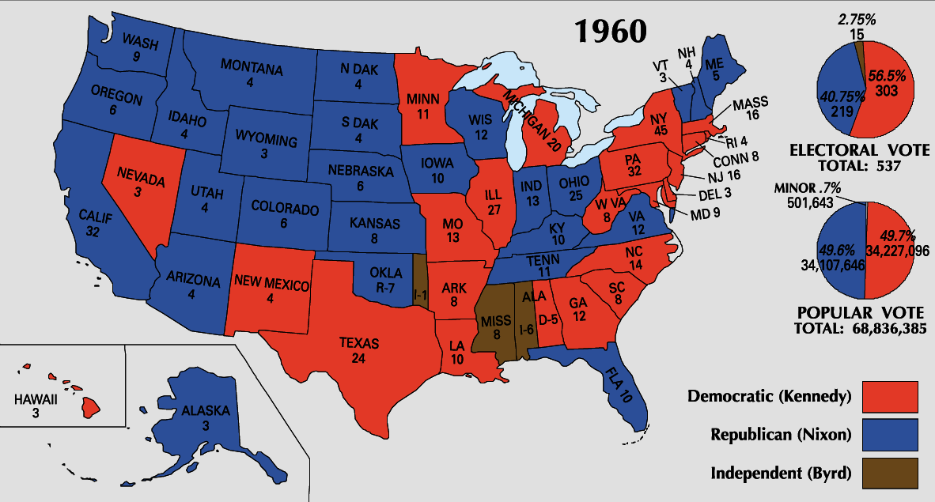

Slide 7
Debates/Image

Slide 8
Televised Debate Affects Vote
On September 26, 1960, Kennedy and Nixon took part in the first televised debate between presidential candidates
Kennedy looked and spoke better than Nixon
Journalist Russell Baker said,
“That night, image replaced the printed word as the national language of politics”

Slide 9
JFK: Confident and at ease during debate
Television had become so central to people's lives that many observers blamed Nixon's loss to John F. Kennedy on his poor appearance in the televised presidential debates
JFK looked cool, collected, presidential
Nixon, according to one observer, resembled a "sinister chipmunk"
https://www.youtube.com/watch?v=QazmVHAO0os

Slide 10
Discuss!
Do you agree with the comments about the debates?
How did this compare with debates we see today? How do the candidates compare?

Slide 11
Perspective is Important
Turn to your table group and share some of the messages/themes you found in your reading of Kennedy’s inaugural address. What was his overall tone?
Write you answers on your White question sheet.

Slide 12
Perspective is Important
We will now watch JFK’s inaugural address. Watch for the same things. What is his tone and focus? What are the major themes?
https://youtu.be/PEC1C4p0k3E
Share with your table group and answer questions 2 and 3 on your sheet.

Slide 13
Perspective is Important
Finally, how would your feelings about JFK’s speech change if you were part of a different social group than you are? A minority? From a foreign country? A communist sympathizer?
Discuss the three groups listed in question 4 and record you answer for each (may use back of paper). Be thorough!

Slide 14
https://youtu.be/yt8SBlx9P9I
https://youtu.be/X_TLztvV4ns

Slide 15
Warm Up 4/5 (#2)
What is MAD and how did it heighten tension during the
Cold War?

Slide 16
April 5, 2018
Out for Stamp:
Take out:
Notes
Agenda:
JFK Foreign Policy
Skills:
Learning Target (I can…):
Describe the Cuban Missile Crisis and why it was so dangerous
Upcoming Dates
4/17: All late work due for Quarter 3
*NO late work will be accepted after this day.

Slide 17
Reminder
Extra Credit assignment is on my website at the top of the agenda in pink.
Could start it over Spring Break.
Up to 20 points culminating. Pictures must have you in it! Must give good write up for each location detailing what you learned.

Slide 18
Foreign Affairs

Slide 19
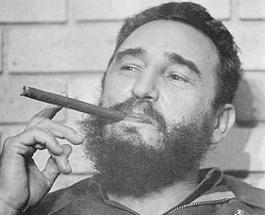
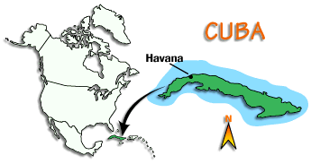
Crisis over Cuba
Fidel Castro Establish Communist regime in Cuba
Strong ties with USSR
Cubans who fled became known as exiles
Many settled in Florida

Slide 20
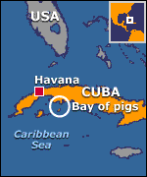
Bay of Pigs
In March 1960, Eisenhower gave the CIA permission to secretly train Cuban exiles for an invasion of Cuba
Kennedy learned of the plan only nine days into his presidency
CIA officials briefed Kennedy on the invasion plan
assured the new president that the invasion would inspire Cubans to rise up and rebel against Castro
Eager to show he was a strong Cold War president, Kennedy allowed the plan to move forward.
https://ezproxy.kcls.org/login?url=http://avod.infobase.com/PortalPlaylists.aspx?wID=3380&xtid=51869&loid=172462

Slide 21
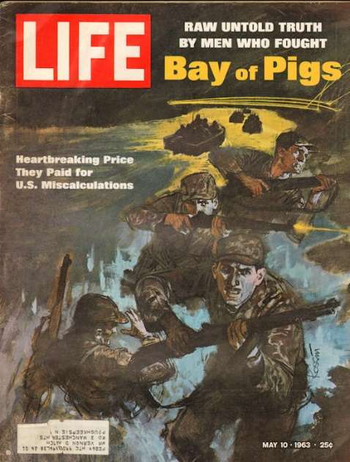
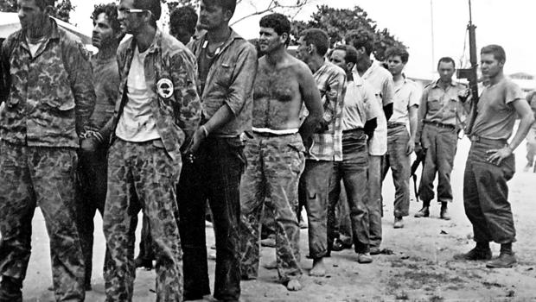
Bay of Pigs
On April 17, 1961
Small army of Cuban exiles sailed into the Bay of Pigs in southern Cuba.
The landing was a disaster. ☹
1,200 Cuban exiles met 25,000 Cuban troops backed by Soviet tanks and were soundly defeated
“Victory has a thousand fathers, but defeat is an orphan.”
https://ezproxy.kcls.org/login?url=http://avod.infobase.com/PortalPlaylists.aspx?wID=3380&xtid=2608

Slide 22
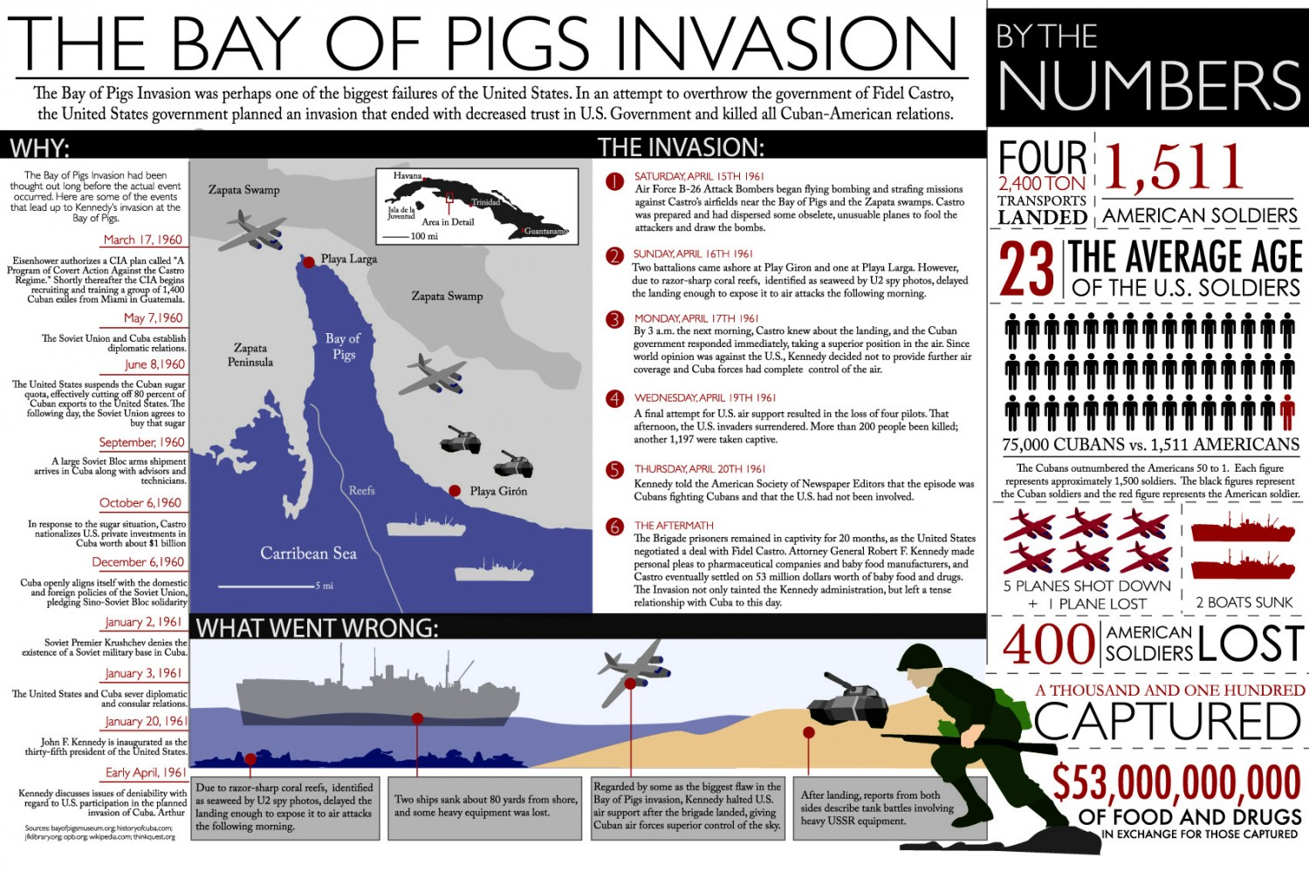

Slide 23
Cuban Missile Crisis
13 days on the brink of Nuclear War
Soviet Union was building missile-launching sites on Cuba
Easily get to the US
Seen as immediate threat to us security and safety
ExCom advise on how to deal with crisis
Executive Committee for National Security
12 most trusted advisors
Issues a quarantine
prevent USSR ships from bringing missiles to Cuba

Slide 24
Cuban Missile Crisis
Any nuclear missile launched from Cuba was an attack on the United States by the Soviet Union.
He also demanded that the Soviets remove all offensive weapons from Cuba.
For the next two days, Soviet ships continued to move toward Cuba
Two days later, Khrushchev ordered Soviet ships approaching Cuba to slow down or turn around.
“We’re eyeball to eyeball, and I think the other fellow just blinked.”
Kennedy proposed removing the Cuban missiles in exchange for the United States removing missiles it had placed in Turkey, which bordered the USSR.

Slide 25
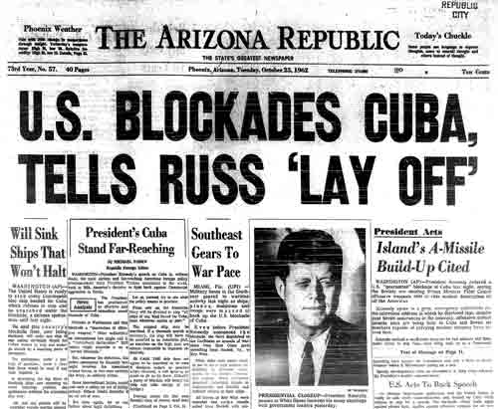
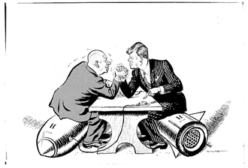
Cuban Missile Crisis
Kennedy had already decided to remove the U.S. missiles from Turkey, because they were outdated.
However, he did not want Khrushchev to think he was bowing to Soviet pressure.
The ExCom advised him to pretend he did not receive the second note.
Publicly, Kennedy accepted the first deal.
Privately, he sent Robert Kennedy to the Soviet embassy to agree to the second deal as well.
On October 28, Khrushchev agreed to remove all Soviet missiles from Cuba.
About three months later, the United States removed its missiles from Turkey.

Slide 26
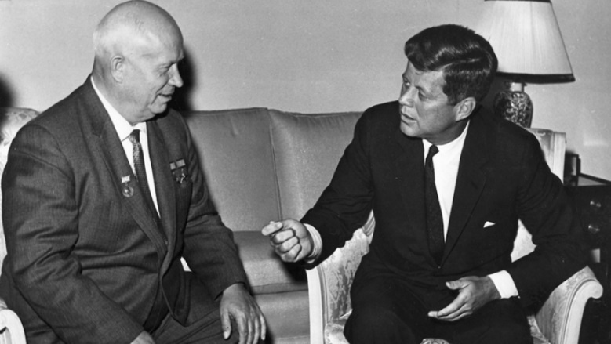
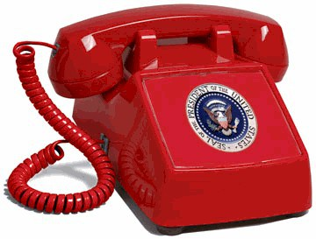
Easing COLD War Tensions
Kennedy wanted a flexible response to local Cold War conflicts.
Kenney and Khrushchev began looking for ways to ease tensions between the superpowers
Established a hot line between the two of them
The hotline still exists today and has been tested once an hour since 1963.
Test Ban Treaty
banned nuclear testing in the atmosphere, while allowing underground nuclear weapons tests to continue

Slide 27
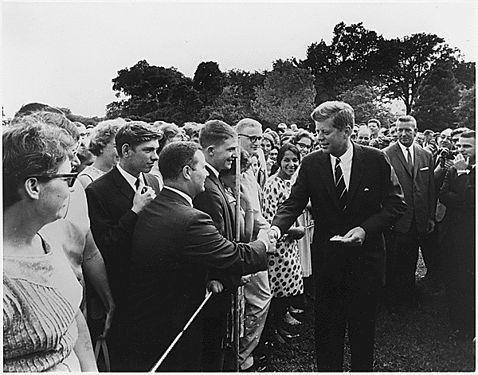
Peace Corps
Concerned about communism spreading to developing countries
Executive order to established the Peace Corps
Sent thousands of men and women to developing nations to support local communities in such areas as education, farming, and health care

