Slide 1
Introduction
Hook choices
Integrated Quote

Slide 2
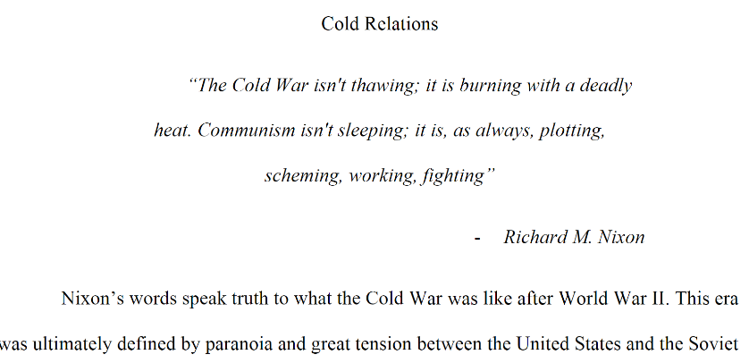
Not OK
Not Integrated

Slide 3
Better!
Integrated!
But!...
No transition (didn’t address the quote)
No citation

Slide 4
Introduction
Hook choices
Integrated Quote
Anecdote
Stay in third person
Connections to current day, paint a picture, etc.
Interesting Historical Content
DO NOT START YOUR PAPER WITH A QUESTION
Appropriate Context
Introduce the reader to the topic and the topic’s context in history.
Well-developed Thesis Statement

Slide 5
INTRO. STRATEGIES:
HOOK
Anecdote, quotation, surprising fact, scenario
CONTEXT
Introduce the event/person/topic & summarize essential details (that the reader needs to know to understand your thesis)
Give a time period!!
THESIS
what + how + so what

Slide 6
Purpose of Conclusions:
RESTATE THE THESIS (reiterate your thesis using powerful word CHOICE)
synthesis (explain how your evidence fits together)
Don’t just restate evidence, connect it!!
closure (transition the reader out of the essay)

Slide 7
CONC. STRATEGIES:
RESTATE YOUR THESIS
Review the “so what” component of the thesis – remind the reader what your point was
SYNTHESIS
Review key evidence by explaining how it connects together to fulfill a larger purpose
CLOSURE
Use a quote, scenario, an idea to think about, make a connection, or bring your “hook” full circle (NO QUESTIONS!)

Slide 8
Other Thoughts: Phrases to Avoid
To begin with
In Conclusion
All in all/overall
First, secondly, thirdly, lastly (you are not making a

Slide 9
Phrases to Watch
It is clear (must be supported)
Opinion statements!!
Don’t say things obviously evil/corrupt OR make assumptions without backing it up with clear facts!
Especially with current conflicts, don’t take speculation and opinion as fact. Unless there is definitive proof, it is not fact.
Your speculation about the intentions of another country’s leader is NOT fact!!
Ex: North Korea is an obvious threat. Their actions clearly show that they are corrupt and will send the world into war.
This has not been proven!! This is speculation. It is an ongoing conflict that is yet to be resolved (and is currently leaning the opposite way…)

