Slide 1
Warm Up 6/6 (#6)
Who was the leader of the Aztecs when they were conquered?

Slide 2
June 6, 2018
Turn In Today:
India Readings and Gandhi Questions
Take Out:
India Notes
Agenda:
Indian Independence debrief
Learning Targets (I can…):
Describe the main people and events associated with the Indian Independence movement
Homework:
6/13: Warm Ups due
6/13: Final Due Date for ALL late work

Slide 3
Gandhi
“Be the change you want
to see in the world.”

Slide 4
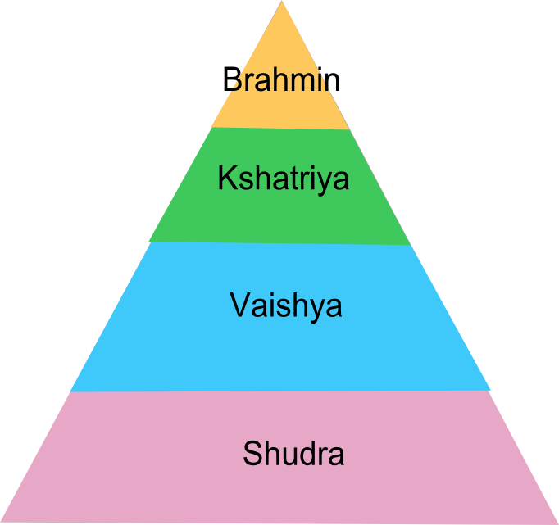
Interesting Facts
Mohandas K. Gandhi
Born in 1869 into the vaishya (merchant) caste
Entered an arranged marriage at the age of 13
Went to university in both India and England to become a lawyer
Suffered from terrible “stage fright”

Slide 5
Philosophy
Ahimsa: non-violence
Satyagraha: “devotion to the truth” or non-violent protest
Simplicity: dress, food, etc.
"There are many causes that I am prepared to die for but no causes that I am prepared to kill for".

Slide 6
Pacifism
Opposition to war and violence
Even when “fighting”
Are you a pacifist?
Scale 1-10

Slide 7
Goals:
Indian independence
Unity and peace between Hindus and Muslims
Eliminate poverty
Treating people in the castes system more equally and eventually get rid of most of it

Slide 8
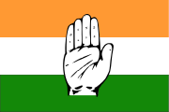
Nationalism
Nationalism starts to emerge in as a response to Westernization, Modernization, and being made second-class citizens in own country
Nationalism: Strong feelings of pride in one’s nation/language/culture. Usually leads to the desire of the nation to form a state.
Leads to two main groups in India: Indian National Congress: Mainly Hindu
Muslim League: Mainly Muslim

Slide 9
Which kinds of protest?
Protest - a statement or action expressing disapproval of or objection to something (power)
Hunger Strikes
Strike
Picketing
Riot
Taking Hostage
Boycott
Music/Art
Self-Immolation

Slide 10
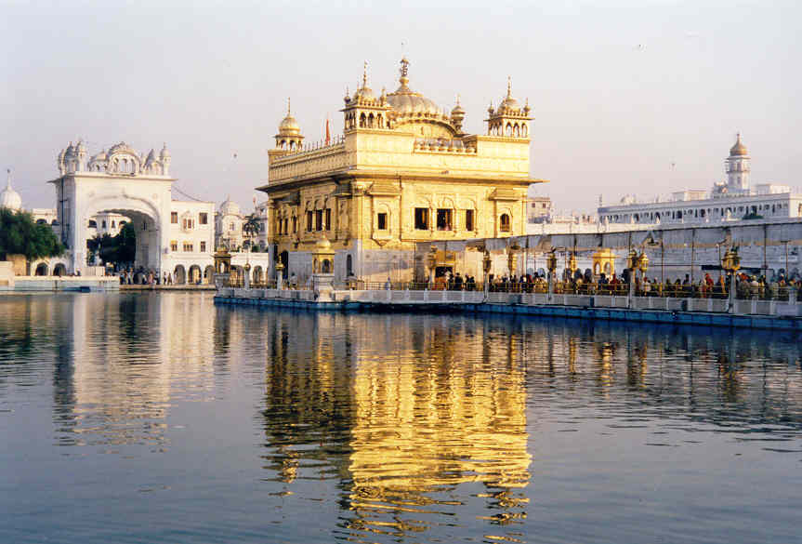
Amritsar Massacre
People motivated by Gandhi protested at Amritsar (a Hindu temple and court yard area). Gandhi was not there
He taught people to protest but not to “strike back” and “take the course of non-violence”
British soldiers came to scare the Indian protesters but General Reginald Dyer told his men to open fire in order to “teach a lesson to Indians”
379 wounded and 1,600 (some estimate more) non-violent protesters were killed

Slide 11
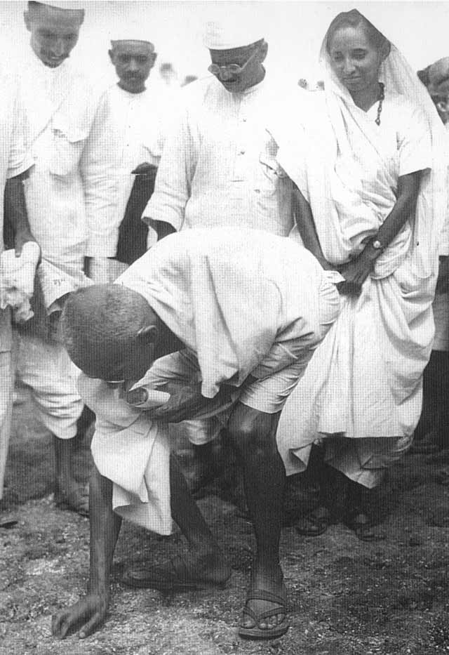
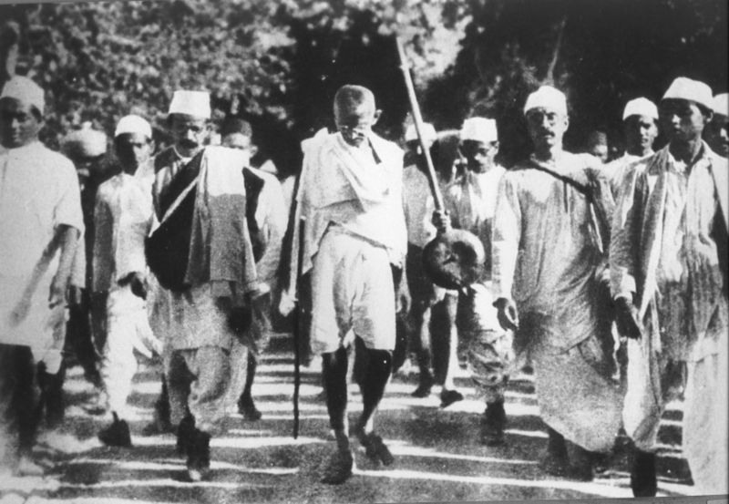
The Salt March
Gandhi lead a 200 mile march in which people protested the salt trade that the British had control of.
It was illegal for Indians to make and sell their own salt.
Because of the media coverage of this event the world looked down upon the British for their actions.
Perfect example of Gandhi’s main tactic of Civil Disobedience

Slide 12
Salt March
Gandhi sent a letter to the Lord Lieutenant, "Dear Friend (...) Whilst, therefore, I hold the British rule to be a curse, I do not intend harm to a single Englishman or to any legitimate interest he may have in India (...) My ambition is nothing less than to bring round the English people through non-violence to recognize the injustice they have done to India. I do not intend to be offensive to your people. Indeed, I would like to serve your people as I would my own (...)."

Slide 13
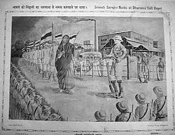
Raid on Salt Works
Gandhi was arrested just before the raid
He did not participate in it
Jailed for urging people to do unlawful activities
Other leaders continued the fight
Gandhi’s wife was one of them
Woman poet and freedom fighter, who warned the satyagrahis, "You must not use any violence under any circumstances. You will be beaten, but you must not resist: you must not even raise a hand to ward off blows.“
After this Time Magazine made Gandhi man of the year in 1930

Slide 14
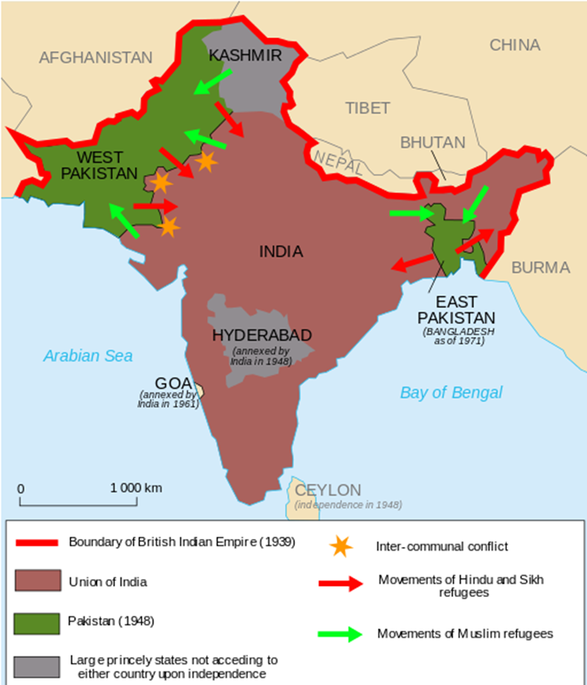
Nehru (Hindu leader) emphasized economic modernization, military strength, and Hindu identity
Not unity or pure democracy (had socialism aspects)

Slide 15
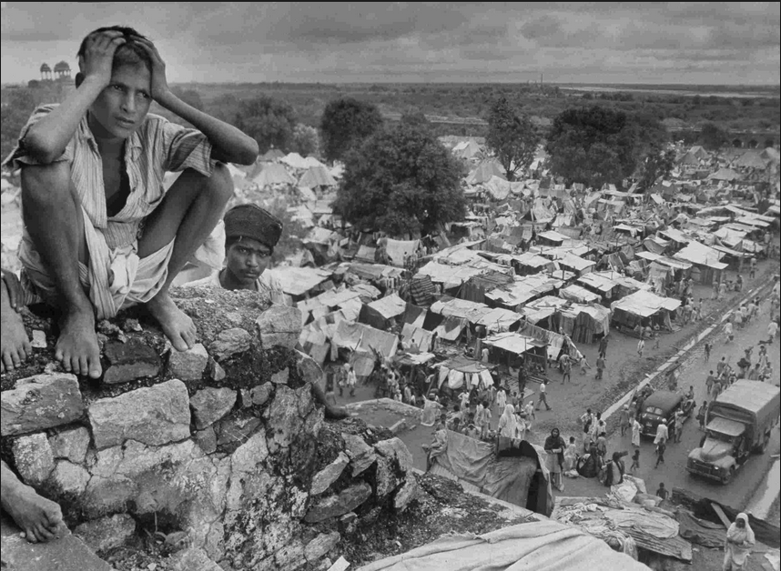
Partition
1947
Muslim League, Jinnah
Indian National Congress, Nehru
“Leave India to God. If that is too much, then leave her to anarchy.” — Mahatma Gandhi, May 1942
“A moment comes, which comes but rarely in history, when we step out from the old to the new, when an age ends, and when the soul of a nation, long suppressed, finds utterance.” Nehru

Slide 16
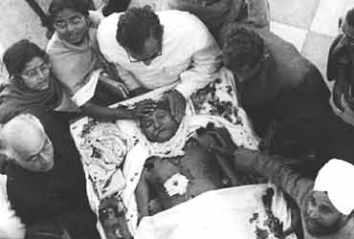
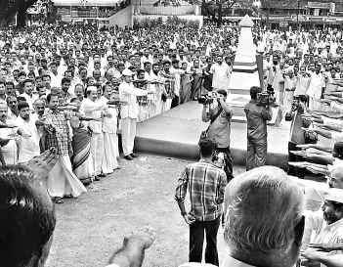
Gandhi’s Death
Killed by radical Hindu
Why did you want to kill Gandhi?
Gandhi was a hypocrite. Even after the massacre of the Hindus by the Muslim, he was happy. The more the massacres of the Hindus, the taller his flag of secularism
Did you not admire his principles of non-violence?
Non-violence is not a principle at all. He did not follow it. In politics you cannot follow non-violence. You cannot follow honesty. Every moment, you have to give a lie. Every moment you have to take a bullet in the hand and kill someone. Why was he proved to be a hypocrite? Because he was in politics with his so-called principles. Is his non-violence followed anywhere? Not in the least. Nowhere

