Slide 1
Warm Up 11/30
What are some push and pull factors influencing immigration?

Slide 2
Source Analysis (Due Monday)
Emphasis on ANALYSIS!
If you can’t tie your evidence to your thesis, either you’re not analyzing or your evidence is no good.

Slide 3
Outline (hard copy tomorrow)
Three level
Thesis full sentence
I. Body Thesis full sentence
A. Evidence (bullet point)
1. General analysis (explanation)

Slide 4
Immigration and Urbanization
What were push-pull factors of immigration?
What were negative consequences of the explosion of immigration?
What were key problems with rapid urbanization?
How were these problems addressed?

Slide 5
Immigration
Motives
Dream of Riches/Land
Overpopulation in Europe
Freedom from poverty or totalitarian regimes
Religious Freedom
Jews flee pogroms (anti-Semitic campaigns)

Slide 6
Immigration
Eastern Portal (Ellis Island, Boston)
http://www.pbs.org/destinationamerica/usim_wn_flash.html
Shifts in countries of origin will allow the nativist, racist, and religiously intolerant anti-immigration movement to grow

Slide 7
Immigration
Nativism
Showing favoritism towards native-born Americans
Fear Catholic and Jewish immigrants
Encourages immigrants to settle together in common neighborhoods known as ghettos
Quotas issued on immigration from certain European countries

Slide 8
Immigration
Quota Systems will emerge in response to WWI, racism, and nativism
Initialized through literacy tests in 1917 during WWI and fully formalized in 1924
Allowed 2% of total population from each country as of the 1890 census into US each year
Very discriminatory to Eastern Europe
Banned ALL immigration to US for those who could not be naturalized
Specifically Asian populations who had been banned from becoming naturalized citizens in 1870

Slide 9
Immigration
Chinese Immigration
Primarily 1848-1882
Chinese Exclusion Act (not repealed until 1943)
Japanese Immigration
Primarily 1880-1907
Many came through Hawaii
Gentleman’s Agreement
Informal “Agreement” between US and Japan in 1907
Japan would deny passports to the US to Japanese laborers in exchange for San Francisco lifting school segregation order
Filipino Immigration
US acquires the Philippines in the Spanish-American War in 1898
Results in steady immigration of Filipino population

Slide 10
Warm Up 12/1
Take out your paper outline. Find a partner and quietly edit/give feedback.
Check for the following:
Clear thesis (what, how, so what?)
Clear BTS in logical order
Evidence makes sense for BTS
Analysis explains Evidence

Slide 11
Urbanization – Gilded Age
Skyscrapers
Increased population and limited space lead to building up instead of out
Elevators
New designs increase use for skyscrapers
Public transportation
Cable Cars, subways
Water filtration
Chlorination and filtration developed to stop spread of disease
Automatic fire sprinklers
Fire constant danger in packed housing
Sprinklers and full time firefighters increase

Slide 12
Urbanization – Beneath the Gilt
Tenement Housing
Immigrants take over housing left behind by working class moving to suburbs
Multiple families take over single dwellings
Overcrowding and fires
Wooden houses and lack of water
Great Chicago fire 1871 kills 300, 3 square miles destroyed (17,500 buildings)
Clean water and sanitation
Piped water not available everywhere
Trash not picked up frequently
Disease spreads rapidly
African American migration to North
Escaping violence and oppression in South
Prejudice and inadequate education led to similar conditions in cities

Slide 13
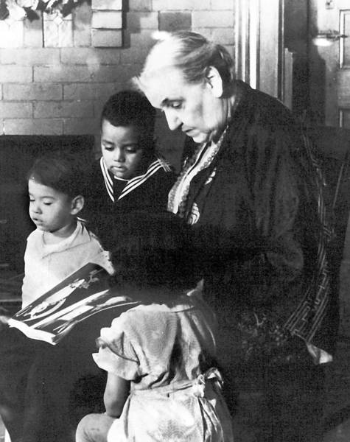
Gilded Age Reform
Social Gospel Movement
Church movement
Treat problems that led to immoral behaviors
Better living and working conditions
Ideas of charity and justice
Settlement Houses
Jane Addams – Hull House
Community activities, classes, child-care, summer camps
Henry Street Settlement
Health care to poor, expanded
400 by 1910

Slide 14
Oppression and Marginalization
As the idea of the American Dream flourished, many groups of people were clearly oppressed and marginalized.
What different groups of people fit this description? What is the cause of their oppression and/or marginalization?
Are these the same groups that we still see marginalized today?
How are stereotypes affected by this oppression and marginalization?

Slide 15
Urbanization – Political Corruption
Political Machines
Controlled political party in cities
Offered services to voters in exchange for political/financial support
Machine boss controls municipal jobs, licenses, public funds
Immigrants
Political machines offered sympathy and solutions to naturalization and poverty
Fraud and Grafts
Voter fraud to pad elections
Grafts (kickbacks)
Bribes and political favors

Slide 16
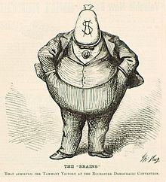
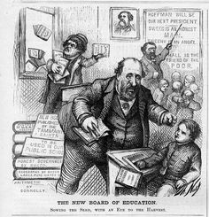
Urbanization – Political Corruption
Boss Tweed
Head of New York’s Democratic political machine Tammany Hall
Made as much as $200 million in kickbacks and bribes
Outed by Thomas Nast and sent to jail

