Slide 1
Warm Up 4/19 (#5)
What were the defining characteristics of LBJ’s Great Society?

Slide 2
April 19, 2018
Learning Target (I can…):
Explain the key features of the Great Society
Upcoming Dates
4/20: LBJ Great Society chart
4/20: JFK-LBJ Quiz and warm-ups due
Take out:
Notes
Agenda:
LBJ’s Great Society
Skills:

Slide 3
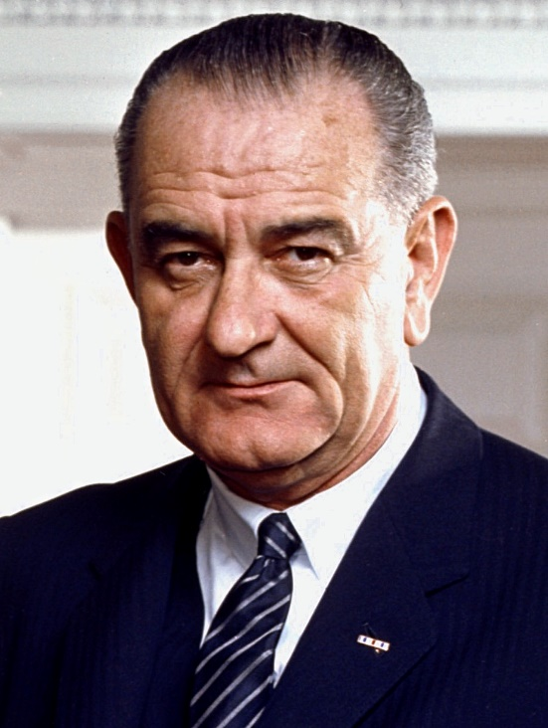
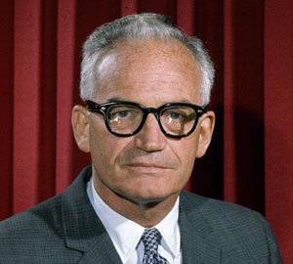
Election of 1964
Lyndon B. Johnson v. Barry Goldwater
LBJ wants to continue what JFK started
Goldwater almost extreme conservative
No government regulation
Focus on defense
https://youtu.be/dDTBnsqxZ3k

Slide 4
Election of 1964
LBJ wins by a landslide!
Widest margin to that point

Slide 5
Great Society
Focus on ending poverty and racial injustice

Slide 6
Great Society – getting it done
LBJ very good and getting what he wanted from Congress
Economic Opportunity Act: anti-poverty programs; Office of Economic Opportunity
Job Corps: job skills to disadvantaged youth
Head Start: low-income preschool

Slide 7
Great Society – getting it done
VISTA: job training/education to poor communities; basically domestic Peace Corps
Housing and Urban Development: revitalizing urban neighborhoods
Medicare/Medicaid: healthcare coverage for elderly and low-income
Also provided federal funding for education and the arts/humanities

Slide 8
Great Society – getting it done
Public Broadcasting Act: TV/radio; Sesame street!
Immigration Act of 1965: eliminated nationality quotas; quadrupled immigration
Also instituted emission standard and seat belt requirements for cars

Slide 9
Great Society – the debate
What is the government’s role?
How much government regulation is too much?
Left: Many great society programs were underfunded (lots of regulation, not enough money to implement it)
Right argued it was too expensive

Slide 10
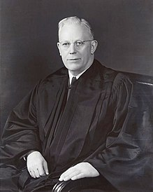
Warren Court
A court of activism
Not afraid to change and reassess
Baker v. Carr: district reapportionment a federal issue
Reynolds v. Sims: districts must be apportioned equally “one person, one vote”
Engel v. Vitale: no prayer in public schools

Slide 11
Warren Court
Mapp v. Ohio: can’t use evidence obtained illegally
Miranda v. Arizona: must inform persons of rights upon arrest

Slide 12
Government Regulation
How much is too much? What is the government’s role?
Share with your table your answer about which government programs you think we need/don’t need.

Slide 13
Let’s Review!!
https://play.kahoot.it/#/k/a81e7398-22ac-4ccc-a8be-19b6db725cd9

