Slide 1
Warm Up
Where do you get your news?
How credible do you think most of the news is and why?

Slide 2
What is News?
Turn and discuss

Slide 3
Assessing the News
Why is it important?
Why can’t we just trust what we read/hear?

Slide 4
News vs. Entertainment
Truth vs. Ratings
https://youtu.be/HOlPsUbAHJo

Slide 5
Misrepresentation
If it sounds too good too be true… it probably is.
Sensationalist claims hidden behind credible jargon
A new study shows…
Experts are saying…
Facts taken out of context
https://youtu.be/0Rnq1NpHdmw?t=5m9s

Slide 6
Media Bias
Feel or show inclination or prejudice for or against someone or something.
Generally leans either right or left (Conservative or Liberal)

Slide 7
Media Bias Examples
Omission – leaving one side out of an article or a series of articles over a period of time
Selection of Sources – including more sources that support one view over another
Story Selection – a pattern of highlighting news stories that support one side of an issue over another
Placement – the location in the paper or article where a story or event is printed; a pattern of placing news stories so as to downplay information supportive of one side

Slide 8
Media Bias Examples
Labeling – comes in two forms:
1. Tagging of person from one party or group with extreme labels while leaving the other side unlabeled or with more mild labels.
2. A reporter not only fails to identify a liberal or conservative as such, but also describes the person or group with positive labels, such as “an expert” or “independent consumer group”
Spin – occurs when the story has only one interpretation of an event or policy, to the exclusion of the other. Spin involves tone- a reporter’s subjective comments about objective facts

Slide 9
Ignoring Facts
Tend to be extremists
Goal is discredit the other side using any means
Appeal to emotion
Stories usually include statements that are factually incorrect and can be easily disproven

Slide 10
How Do We Do It?

Slide 11
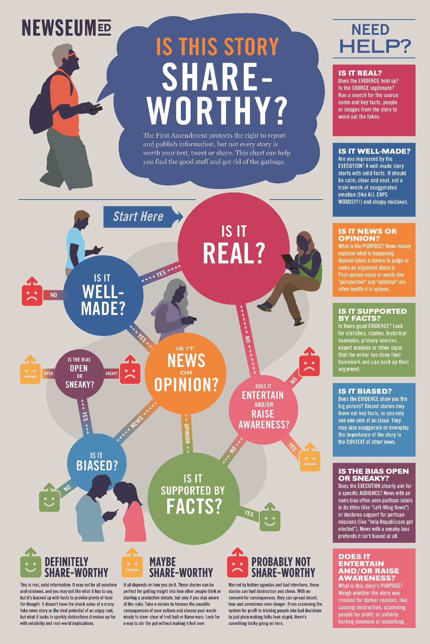
How Do We Do It?

Slide 12
Resources
Allsides.com
Factcheck.org
Politifact.com
Sunlight Foundation
Opensecrets.org
Snopes

Slide 13
Credible News Sources
Politico.com
Associated Press
New York Times
CNN
USA Today
BBC
Reuters
Heavily Biased
MSNBC
Fox News

Slide 14
Off Limits Sources
Infowars
Daily Kos
Breitbart
Huffington Post
Salon
Anything that reports more celebrity news than current events
The Blaze

Slide 15
Homework
Find and print a news article (preferable a credible source but your choice)
Must be about a current event or world/national issue
Bring to class

