Slide 1
Warm Up 10/9
Do this separately from your other warm ups as you will turn it in when you are done.
Reflect on our Socratic Seminar
What do you think you did well?
What did the group as a whole do well?
What can you work on next time?
How can our group as a whole improve next time?

Slide 2
Socratic Seminar
What went well
Excellent use of evidence
Great analysis overall
Good group dynamic overall
Shout outs
Aiden, Amelia, Annette, Emma, Nate

Slide 3
Socratic Seminar
What to work on
Speaking over others/out of turn
More/deeper analysis
Don’t be afraid to jump in!

Slide 4
Executive Branch
Qualifications
35 years old
Native-born citizen
14 year in country residency
Elected by electoral college
Impeachment only removal process
Accused by majority in House of Reps
Trial held by Senate
2/3 majority to convict
Andrew Johnson/Bill Clinton impeached, not convicted

Slide 5
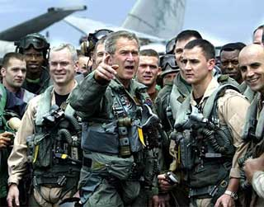
Executive Branch
Constitutional Powers
Commander in chief of military
Power to pardon/grant amnesty
“Take care that laws be faithfully executed”
Executive version of elastic clause
Notes:
President Carter amnesty to men who fled to avoid Vietnam draft

Slide 6
Executive Branch
Organization
Chief of Staff
Manages staff of about 400
Controls access to president
Executive Office of the President (EOP)
Office of Management/Budget
Council of Economic Advisors
National Security Council
New offices can be created to fit presidential agenda

Slide 7
Executive Branch
Organization
Executive Departments: Heads = Cabinet members
Justice Department
Treasury Department
Department of Homeland Security
State Department
Veterans Affairs
Department of Education
Department of Defense etc.
Agencies (within departments)
FBI
U.S. Mint
NASA
CIA
FCC
FDA
Peace Corps

Slide 8
Executive Branch
State/Local Level
Governor = chief executive
State rules on qualifications vary
Even looser for mayors
Most elected by popular vote
Some by plurality, some by majority
Historically more varied in gender, race, and education/experience
Wyoming first to elect female governor in 1924
Many states offer recall elections if public is dissatisfied with governor
Arnold Schwarzenegger

Slide 9
Executive Branch
Bureaucracy
Civil servants: paid civilians working in government
Discuss! Is bureaucracy good or mostly a problem?

Slide 10
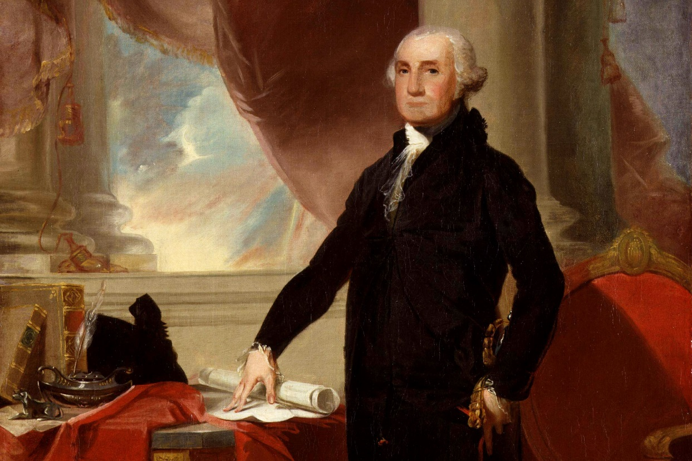
Executive Branch
Washington’s Precedents
Title of Mr. President
Two term limit
Cabinet appointments
Originally meant to bring both sides together
Dignity, strength
Notes:
President Carter amnesty to men who fled to avoid Vietnam draft

