Slide 1
Warm Up 4/23 (#1)
What were Jim Crow Laws? Give an example.

Slide 2
April 23, 2018
Learning Target (I can…):
Explain the key features of the Great Society
Upcoming Dates
4/23: Brown v. Board reconsidered questions
5/2 or 5/3: Socratic Seminar
Take out:
Notes
Agenda:
Segregation and Brown v. Board
Skills:
Analysis

Slide 3
Socratic Seminar Essential Question
What role does differing perspectives on American identity play in creating conflict and inspiring change in our society?
Civil Rights Movement – change and conflict
1950s/60s culture/counterculture
1950s politics/McCarthyism

Slide 4
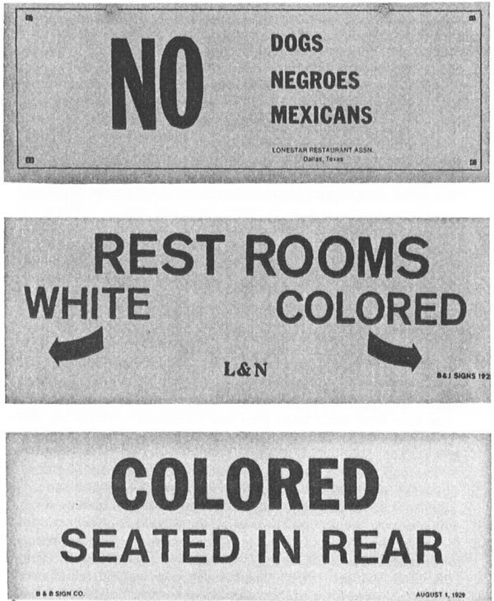
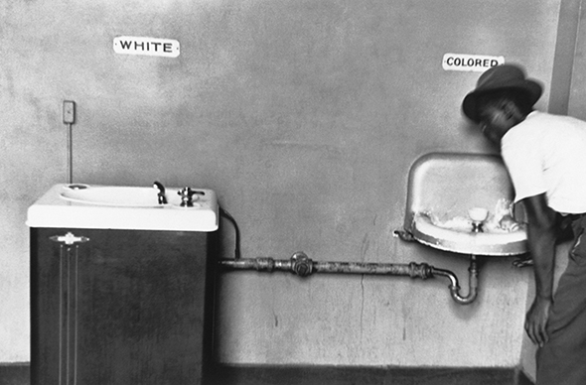
Plessy v. Ferguson
Separate but Equal
If adhered to, usually only worried about number (one for white, one for black) with far inferior facilities for African Americans
Rule often ignored completely (not well enforced)

Slide 5
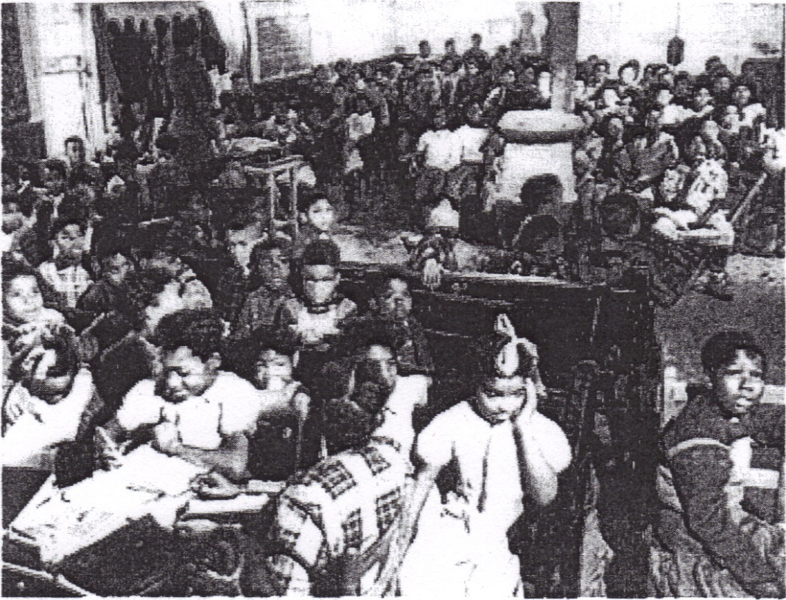
Segregation
Schools
“Black” schools usually underfunded, understaffed, and had inferior buildings
Students often walked miles to get to school as busses not provided

Slide 6
Segregation in housing
De facto
Segregation by custom
More often seen in northern cities
Ex: not selling homes in certain neighborhoods to African Americans
De Jure
Segregation by law
Racial zoning laws usually seen in the South

Slide 7
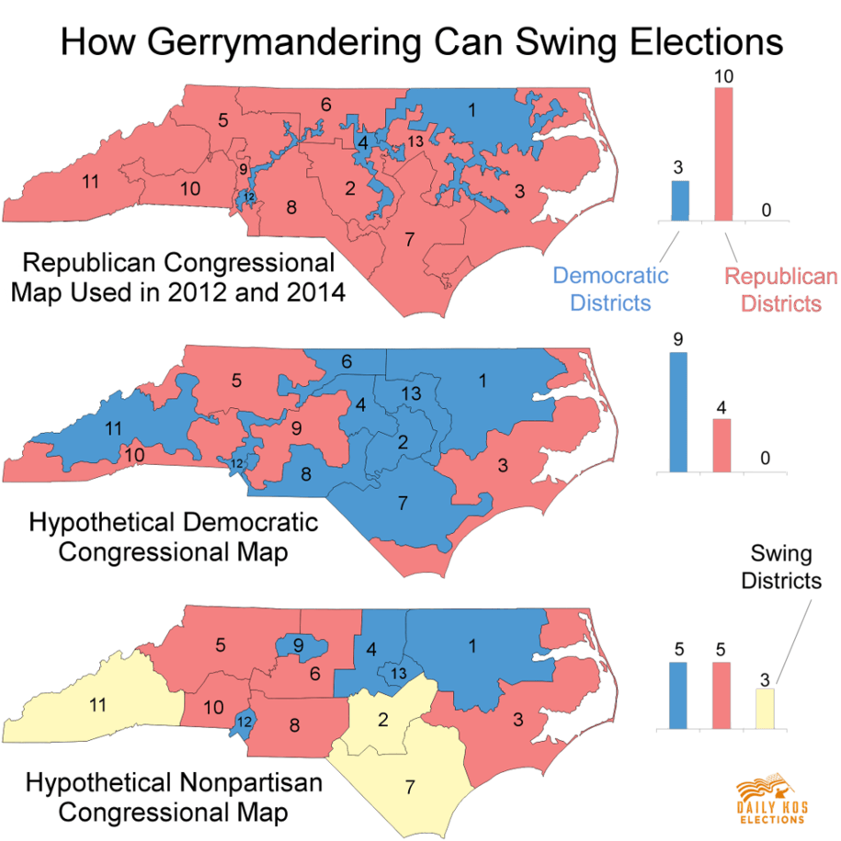
Segregation - other
Laws against interracial marriage
Based on ideas of racial purity
Disenfranchisement
White primaries
Poll taxes
Gerrymandering

Slide 8
Slow progress
Executive Order 9981
Desegregated armed forces
CORE
Student non-violent protests
National Urban League
Fight against problems from Great Migration in the North
NAACP
Fought for Civil Rights legislation

Slide 9
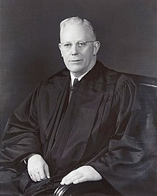
Brown v. Board of Education
Linda Brown passes white school every day as she travels miles to her own school
Father, Oliver Brown, reaches out to NAACP to push for desegregation
Local courts deny and case becomes class action lawsuit that reaches supreme court.
New chief justice, Earl Warren, takes over
What do we know about the Warren court?

Slide 10
Brown v. Board of Education
Rules that idea of “separate but equal” is unconstitutional and states must desegregate schools with “all deliberate speed”
Becomes precedent by which future cases against segregation in other areas are judged

Slide 11
Brown v. Board reactions
I couldn’t imagine they would ever change their minds and allow their children to go to school with me, no matter what laws those men on the Supreme Court made. -Melba Patillo Beals (Little Rock 9)
Northern white people more likely to accept decision
White southerners often react harshly
Protests
KKK demonstrations
Refusal to comply with ruling
Would later take federal government action to enforce.

Slide 12
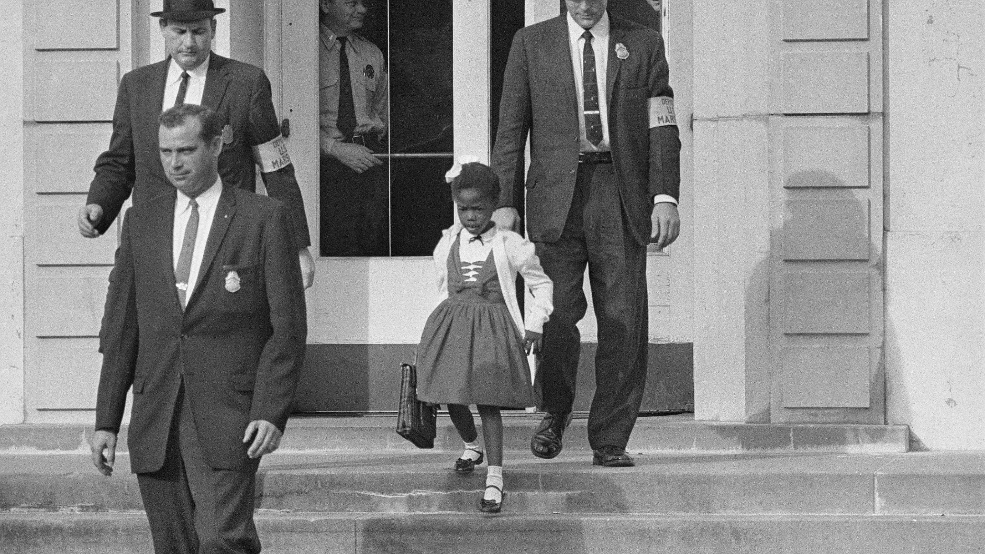
https://lsintspl3.wgbh.org/en-us/lesson/osi04-soc-ush-civil-reconsider/3

