Slide 1
Warm Up 6/4
What is the Social Hysteria Formula?

Slide 2
June 4, 2018
Out for checkoff:
Bush v. Gore reading
Agenda:
Election of 2000
9/11
Skills:
Learning Target (I can…):
Describe the problems with the Election of 2000
Analyze the impact of September 11, 2001
Upcoming Dates
6/13: Final due date for all late work for semester 2 due

Slide 3
Indecision 2000
Bush v. Gore election

Slide 4
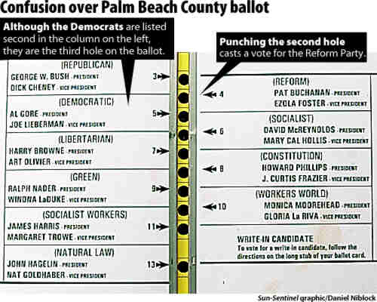
http://www.cc.com/video-clips/r127by/the-daily-show-with-jon-stewart-dancing-bush-fan
http://www.cc.com/video-clips/dwyr9r/the-daily-show-with-jon-stewart-indecision-2000---choose-and-loose
http://www.cc.com/video-clips/d9h4uc/the-daily-show-with-jon-stewart-indecision-2000---recount
http://www.cc.com/video-clips/5pbw5a/the-daily-show-with-jon-stewart-indecision-2000---decision-delivery
http://www.cc.com/video-clips/f9faj8/the-daily-show-with-jon-stewart-headlines---indecision-2000---victory--bush
http://www.cc.com/video-clips/woqxfl/the-daily-show-with-jon-stewart-exclusive---the-bush-years---jon-s-dubya-impression Dubya impression

Slide 5
https://www.youtube.com/watch?v=1Tx0dXsZW2s
https://archive.org/details/cnn200109110848-0929
https://www.youtube.com/watch?v=IjXgbpkKnKo
https://archive.org/details/nbc200109110954-1036
https://www.youtube.com/watch?v=ZR24kKaToio

Slide 6
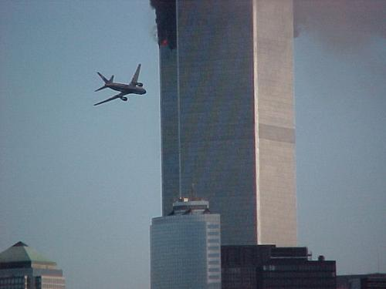
9/11/01:
September 11 Television Archive
· On September 11, 2001, the international terrorist group al-Qaeda, led by Osama bin Laden, attacked the U.S. in New York City and Washington, D.C.
· With the use of airliners, the World Trade Center in New York City was destroyed, and the Pentagon building in Washington, D.C. was severely damaged.
· Approximately 3,000 Americans lost their lives in these attacks.
CNN Video Part I – play at 1 min. 29 sec. Part II – play at 4 min. 30 sec.
South Tower Collapses Part I Part II
Notes:
https://www.youtube.com/watch?v=x7OcSFF84vg

Slide 7
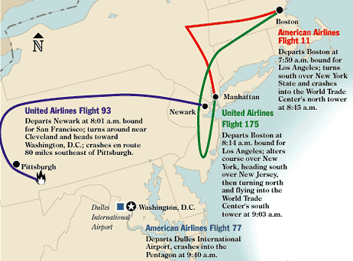

Slide 8
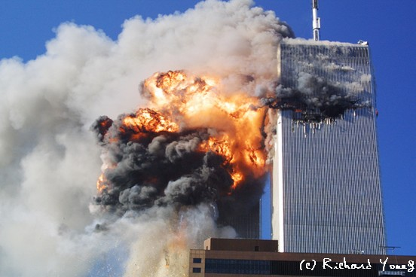

Slide 9
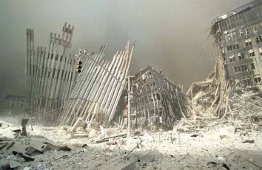

Slide 10
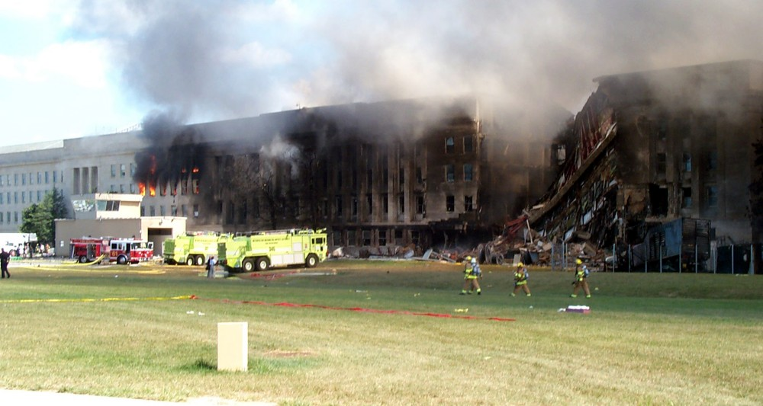
The Pentagon Building, 9/11/01

Slide 11
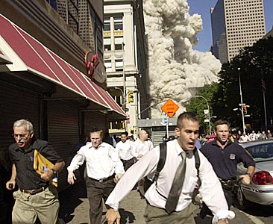

Slide 12
A Post 9/11 World
Bush takes action, drawing us into the War on Terror which later expanded into Iraq in pursuit of presumed weapons of mass destruction
War on Terror shifts idea of peace as the norm as it becomes a war with no boundaries or timeline
Americans came together for a time as fear and a newfound vulnerability caused many to cling to a stronger sense of patriotism
Notes:
https://www.weforum.org/agenda/2016/09/15-years-after-9-11-how-has-the-us-changed/

Slide 13
A Post 9/11 World
Security increased leading to ongoing debate over individual rights versus national security
Racial profiling
Immigration laws
Department of Homeland Security and The Patriot Act
Continued debate over Guantanamo Bay and military trials as evidence of prisoner torture comes to light
Notes:
https://www.weforum.org/agenda/2016/09/15-years-after-9-11-how-has-the-us-changed/

Slide 14
Discussion Questions
Has the concept of ‘What does it mean to be an American?’ changed since 9/11
To what extent have the founding American ideals changed since 9/11 (Democracy, Liberty, Freedom, Opportunity, Equality, Rights)
Is it causing more harm to refer to our world as ‘post 9/11’?
Discuss with your table group. Pick one and write down your thoughts and turn in to tray.

