Slide 1
Warm Up 10/16
Why do you think propaganda is so powerful in politics?

Slide 2
Today’s Objectives
Analyze class propaganda projects in Gallery Walk
Gain a basic understanding of the structure of the Constitution
Assign homework reading
Skills
Analysis
Note taking
Following Instructions

Slide 3
Gallery Walk
You will have 20-25 minutes to go around the room and look at each propaganda poster
For each poster analyze and answer the following:
Which guiding principle of the Constitution is being portrayed?
What type of propaganda is most prominent?
Do you think the poster would be effective in promoting the Constitution?
After you are done, write down which poster was your favorite and turn in your assignment on the front table.
Return to your seat.

Slide 4
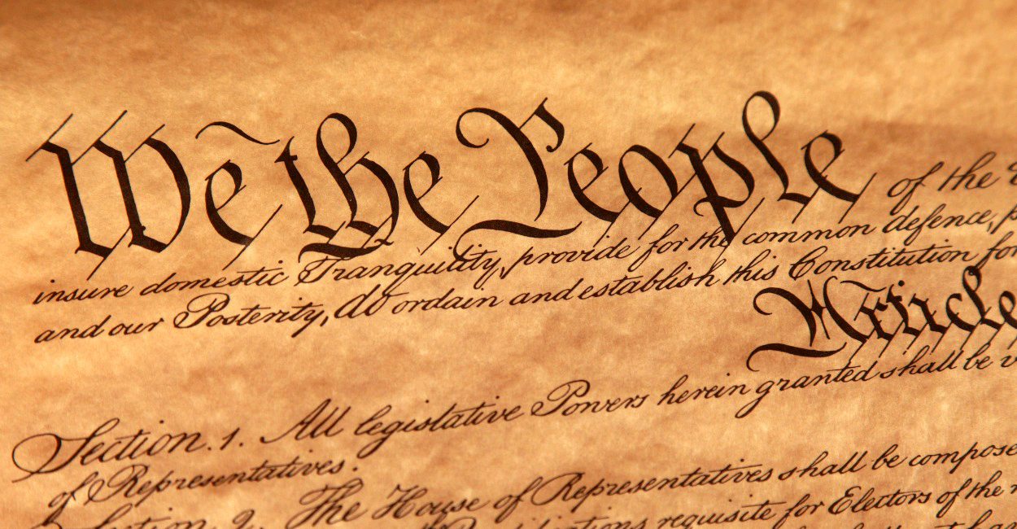
Constitution Structure
Preamble
Sets the purpose
7 Articles
I – Legislative Branch
II – Executive Branch
III – Judicial Branch
IV – State relations
V – Amendment Process
VI – Supremacy of Constitution
VII – Ratification Process

Slide 5
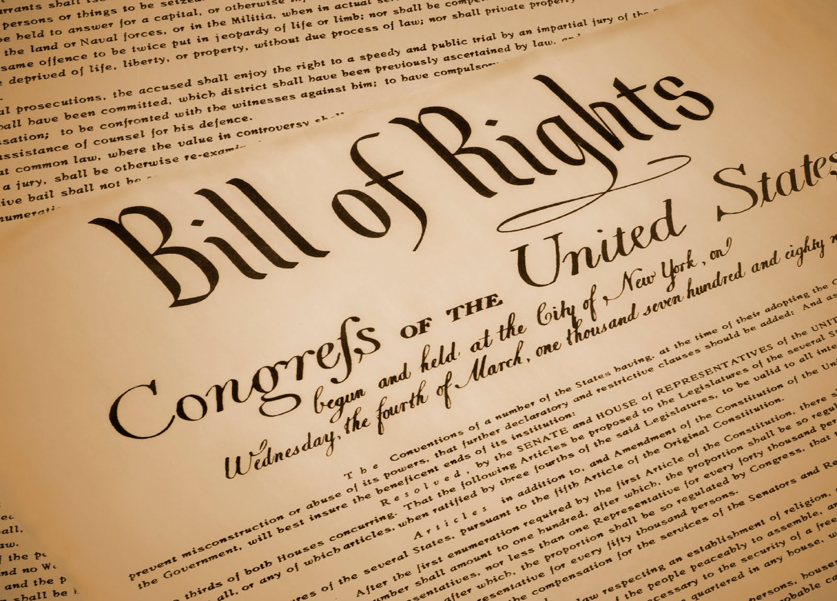
Constitution Structure
Bill of Rights
First 10 Amendments
Essential for ratification
Guaranteed Freedoms
Other Amendments
11-12: strengthen
13-15: Civil War Era
16-18: social/political reform
20,22,28: Governance
19,23,24,26: Voting Rights

Slide 6
Homework Due Tomorrow 10/17
Read Section 4.2-4.3 in TCI book.
Create outline or graphic organizer notes that include the following:
Article topics (include major clauses or key words)
Amendment process
Any important to remember amendment categories (Analyze!)

Slide 7
Warm Up 10/17
How did your reading notes go last night? Do you feel like your note-taking was better/more productive?

Slide 8
Constitution Scavenger Hunt
When I say, grab a book and turn to page 352 .
Using the information you have and the clause descriptions given in your book, answer the questions on your sheet.
Work quickly! The first 5 people with 100% accuracy get a prize!

