Slide 1
Warm Up 11/1
What do you think are the qualities of a good citizen?

Slide 2
Agenda
Understand how we came to define citizenship.
Define the process for becoming a citizen
Key Terms
Citizenship
Dred Scott v Sanford
13th Amendment
14th Amendment
Naturalization
Legal Permanent Resident

Slide 3
Citizenship
How did the Founders define citizenship in the Constitution?
They didn’t.
Why might this be a problem?
Think, what does the constitution protect?

Slide 4
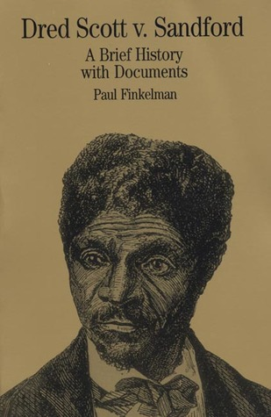
Dred Scott v. Sanford
Dred Scott, born a slave in Virginia (slave state)
Moved to New York (free state) with his owner, John Sanford
Dred Scott sued his owner for freedom, claiming that he was legally free while living in New York
What did the Supreme Court decide?

Slide 5
Dred Scott v. Sanford
Supreme Court ruling (1857):
The general words . . . seem to embrace the whole human family . . . But it is too clear for dispute, that the enslaved African race were not intended to be included, and formed no part of the people who framed and adopted this declaration [of Independence].
—Chief Justice Roger Taney, Scott v. Sandford, 1857
Notes:
“he could never be a citizen of the US”

Slide 6
Dred Scott v. Sanford
Basically:
You were never meant to be included in that.
You are a slave, not a citizen, so you have no rights.
Notes:
“he could never be a citizen of the US”

Slide 7
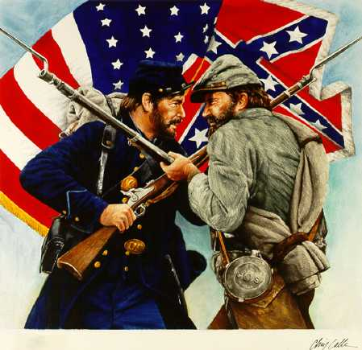
The Civil War: 1861-1865
The North won.
It was about slavery.
North and South split, reunified
Changes the idea/redefines citizenship
Civil War resulted in 3 key amendments being added to the US Constitution:
13, 14, 15

Slide 8
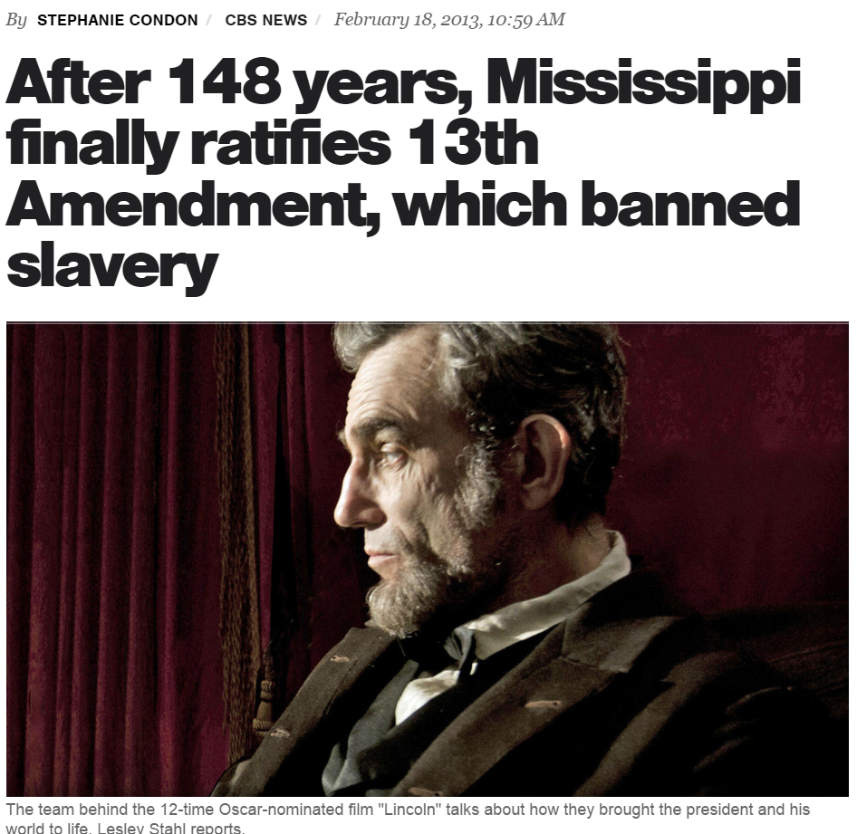
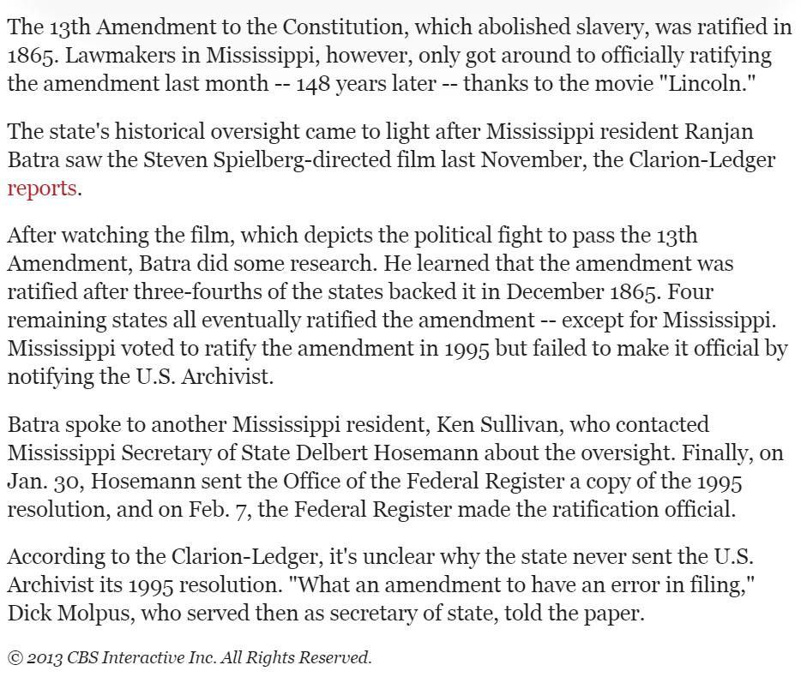
Redefining Citizenship
13th Amendment: Abolishes slavery
14th Amendment: Grants citizenship to all persons born or naturalized in the U.S.
What does naturalized mean?

Slide 9
Becoming Naturalized
Naturalization: The process by which a person born outside the United States gains citizenship status
So how is this done?

Slide 10
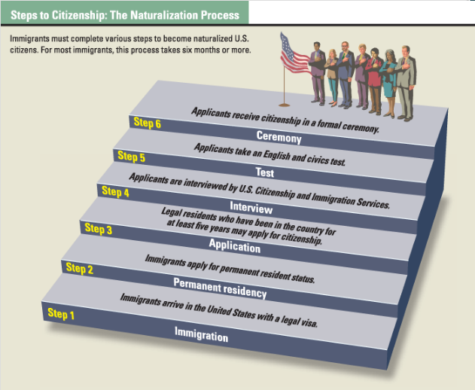

Slide 11
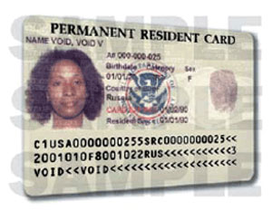
Citizenship
What is the difference between a citizen and a legal resident?

Slide 12
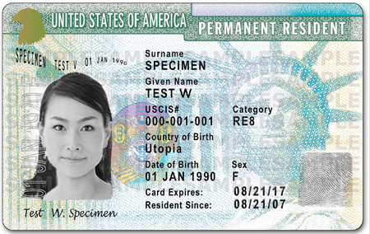
Citizenship
Lawful Permanent Resident:
Immigrants to the United States with legal residency. Issued identification card (Green Card) as proof of legal right to live in the United States. Access to public utilities, pay taxes.

Slide 13
Becoming Naturalized
Could YOU be naturalized?
https://www.youtube.com/watch?v=WJlY9C7YWzI
https://www.youtube.com/watch?v=zZ0cwMkOFPQ

Slide 14
Becoming Naturalized
Could YOU be naturalized?
Exit Ticket!
Answer as many questions as you can. On the back, answer the following:
Would you have passed? (60%)
How do you feel about your inability to answer these basic citizenship questions?

Slide 15
Homework
Review your Supreme Court Case Notes. Quiz on Friday!

Slide 16
Warm Up 11/2
What is our most basic/coveted right as American citizens?

Slide 17
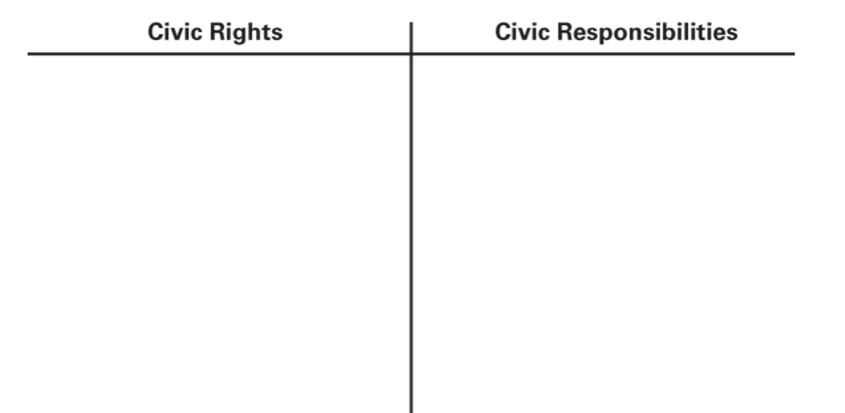
Voting
Hold Public Office
Welfare/Healthcare
Federal jobs
Legal Rights (BofR)
Education
Jobs/Unions
Voting
Taxes
Obeying laws
Register for military
Volunteering
Civic Duty
Be informed!

Slide 18
Voting
What are the requirements to vote?
What should the requirements for voting be?
What is voter suppression?
Who has this impacted in the past?
What does disenfranchisement mean?

Slide 19
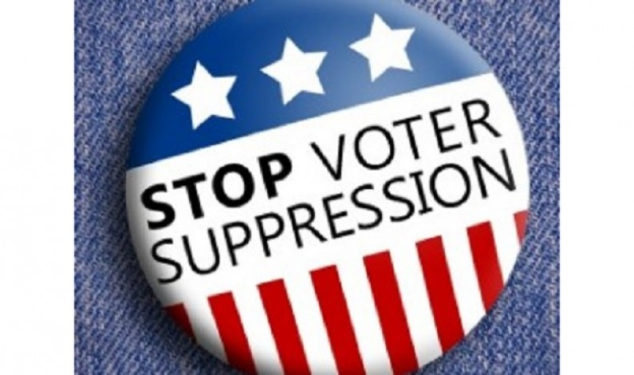
Voting
Types of Direct Disenfranchisement:
Violence
Race/Gender Requirements
Poll Taxes
Literacy Tests

Slide 20
Voting
1789
Requirements to Vote:
White
Male
Property Owning
21 years old
6% of population able to vote

Slide 21
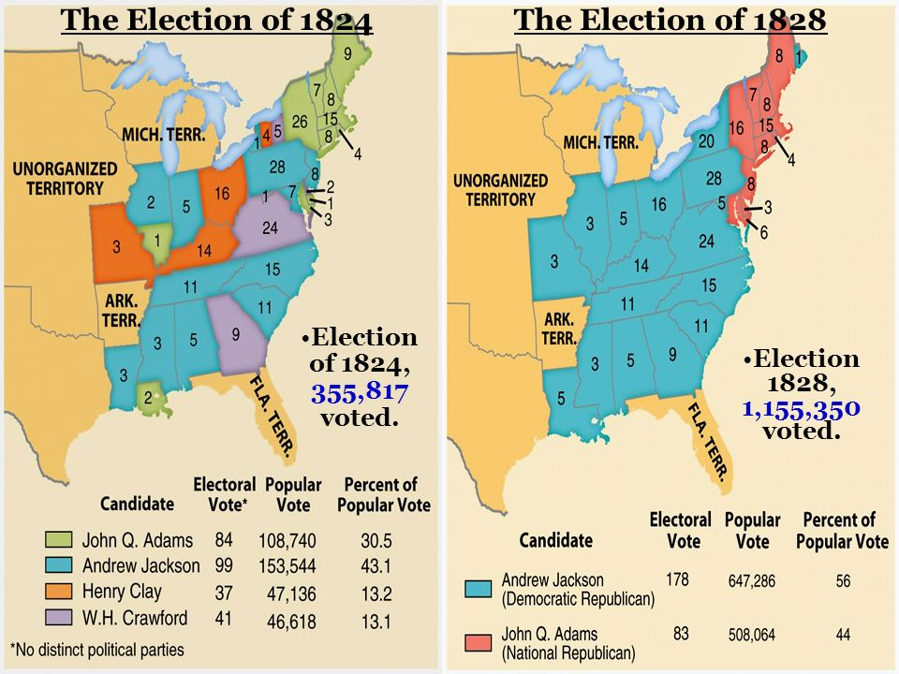
Voting
1820s:
Property requirements eliminated, opening voting rights to all white males over the age of 21 in the United States

Slide 22
The 15th Amendment
“Section 1. The right of citizens of the United States to vote shall not be denied or abridged by the United States or by any State on account of race, color, or previous condition of servitude.
Section 2. The Congress shall have power to enforce this article by appropriate legislation.”
What is this saying?
Voting cannot be denied based on race, color, or previous slave status
Did it instantly give the vote to everyone?

Slide 23
Fighting for the Vote
Southern states still frequently found ways to disenfranchise (deny the vote to) African Americans
Jim Crow Laws: Literacy tests, grandfather clauses
Poll taxes
Violence
Civil Rights Act
Outlawed voting laws that discriminated against and disenfranchised specific voting groups

Slide 24
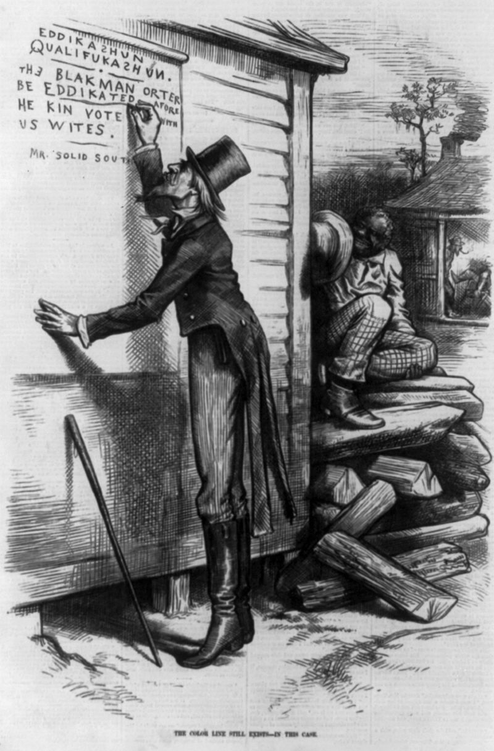
Civil Rights Movement
Literacy Tests:
Tests administered to Black Americans to test their "ability" to vote effectively
Adopted in late 1800s when 40-60% of Black Americans were illiterate
Also included Grandfather Clauses
Graded at registrars discretion

Slide 25
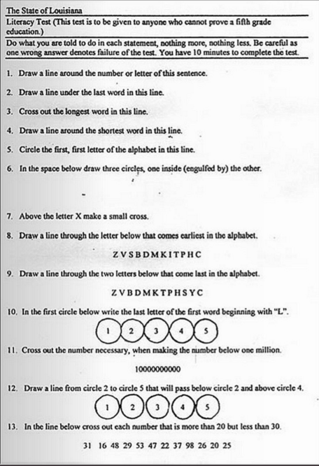

Slide 26
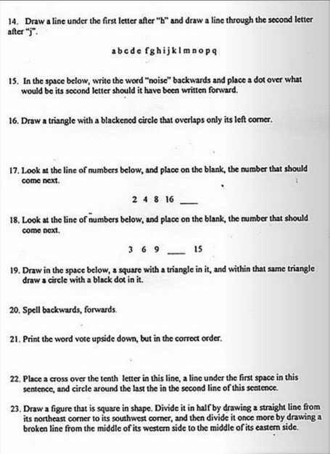

Slide 27
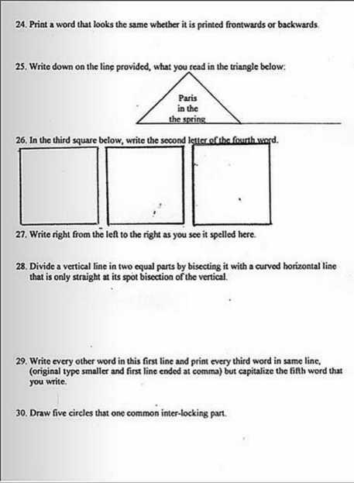

Slide 28
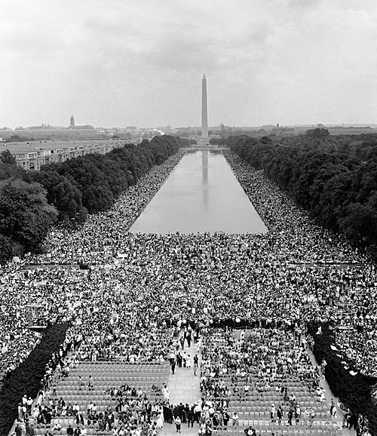
I Have a Dream
March on Washington:
250,000 people
Propelled the US Congress to act on Civil Rights
Eventually led to the passage of the Civil Rights Act in 1964

Slide 29
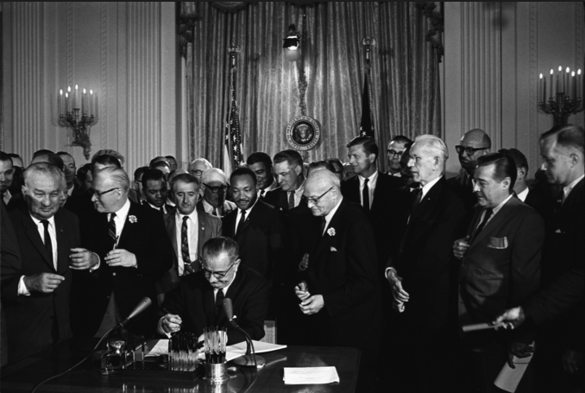
Civil Rights
1964: Civil Rights Act of 1964 signed into law after a year of inaction by the senate
Banned discrimination based on race, sex, religion, or national origin

Slide 30
Civil Rights
January 1964:
Twenty-fourth amendment ratified by Congress
Section 1. The right of citizens of the United States to vote in any primary or other election for President or Vice President, for electors for President or Vice President, or for Senator or Representative in Congress, shall not be denied or abridged by the United States or any State by reason of failure to pay any poll tax or other tax.
Section 2. The Congress shall have power to enforce this article by appropriate legislation

Slide 31
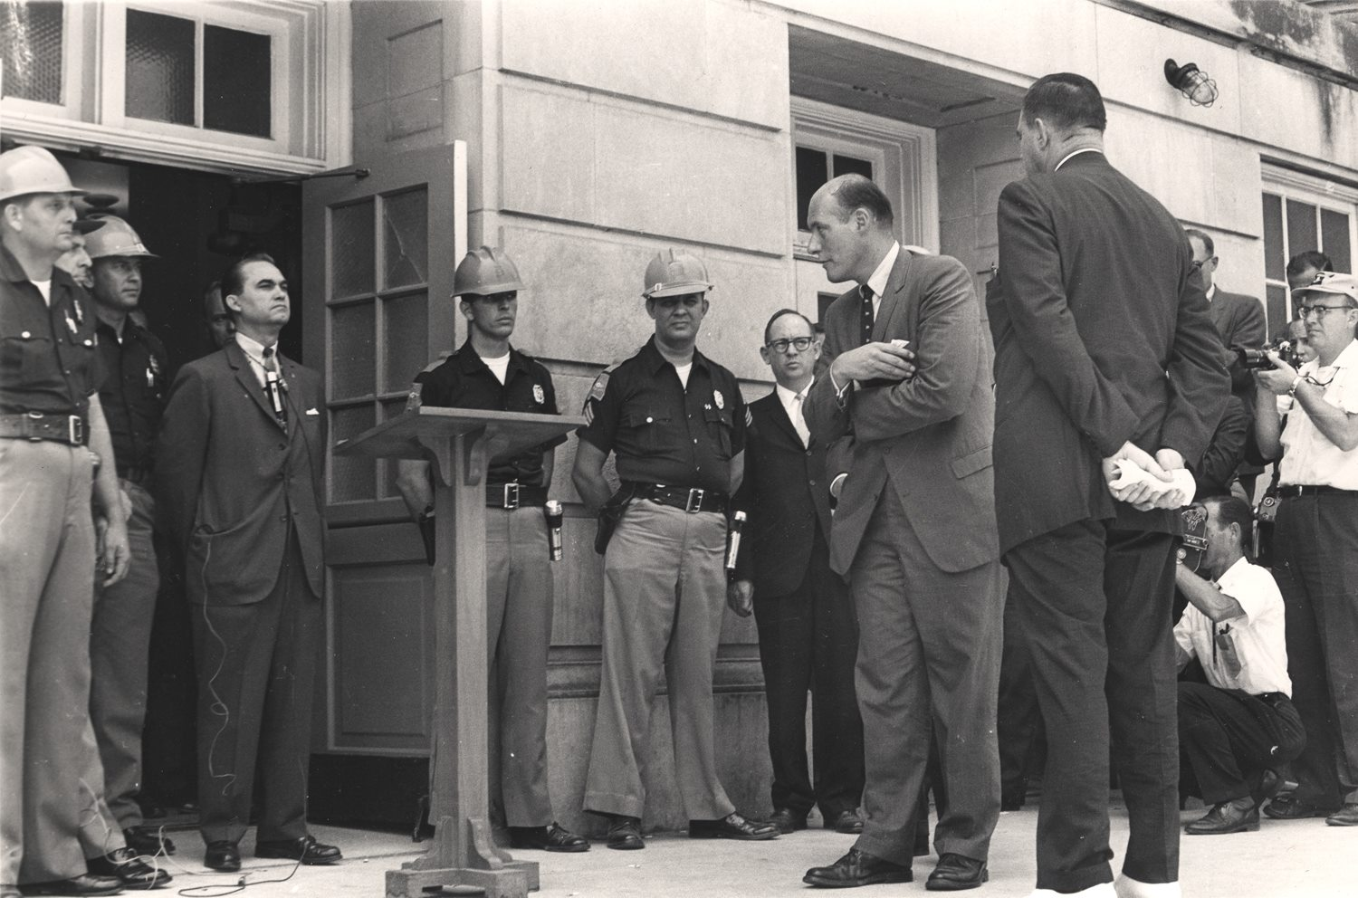
Civil Rights
August 1965: Voting Rights Act of 1965
Outlawed literacy tests
Required the government to monitor voter registration
1964: <7% of eligible blacks in Mississippi registered to vote
1968: >59%
Overall numbers of black voters in the South tripled

Slide 32
The 15th Amendment
“Section 1. The right of citizens of the United States to vote shall not be denied or abridged by the United States or by any State on account of race, color, or previous condition of servitude.
Section 2. The Congress shall have power to enforce this article by appropriate legislation.”
Who does this exclude?

Slide 33
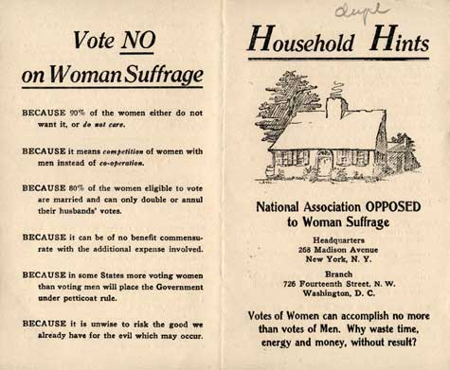

Slide 34
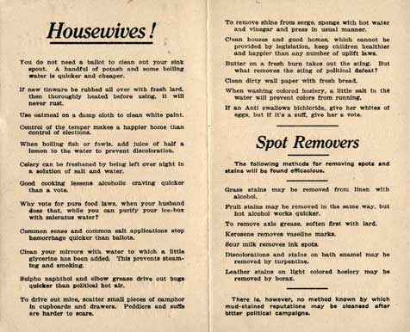

Slide 35
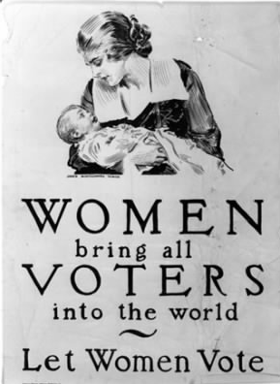
The Fight for Suffrage
1869: Wyoming Territory
1870: Utah
1883: Washington Territory
August 18th, 1920:
19th Amendment Ratified

Slide 36
The Fight for Suffrage
The right of citizens of the United States to vote shall not be denied or abridged by the United States or by any state on account of sex. Congress shall have power to enforce this article by appropriate legislation.

Slide 37
Expanding the Vote
19th Amendment: Gives the vote to women
Indian Citizenship Act: Grants citizenship and voting rights to Native Americans (1924)
26th Amendment: lowers voting age to 18

Slide 38
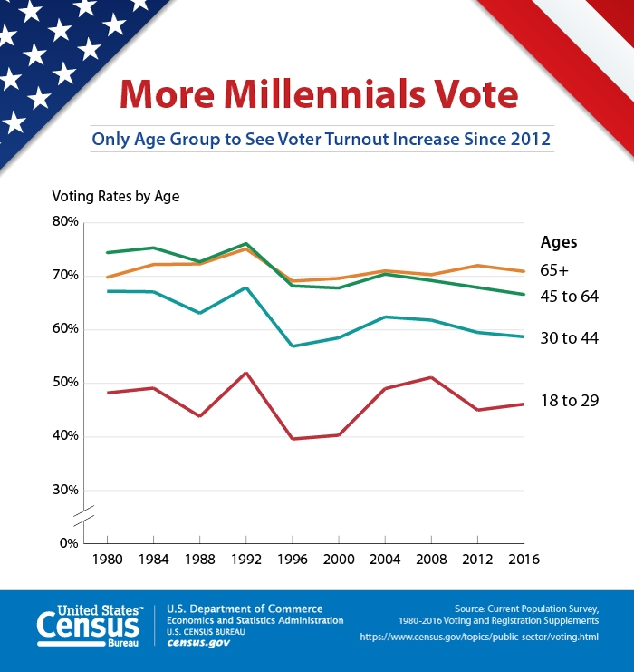

Slide 39
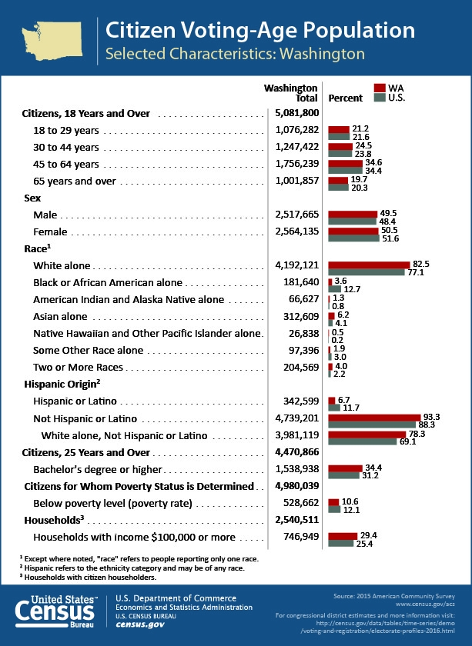

Slide 40
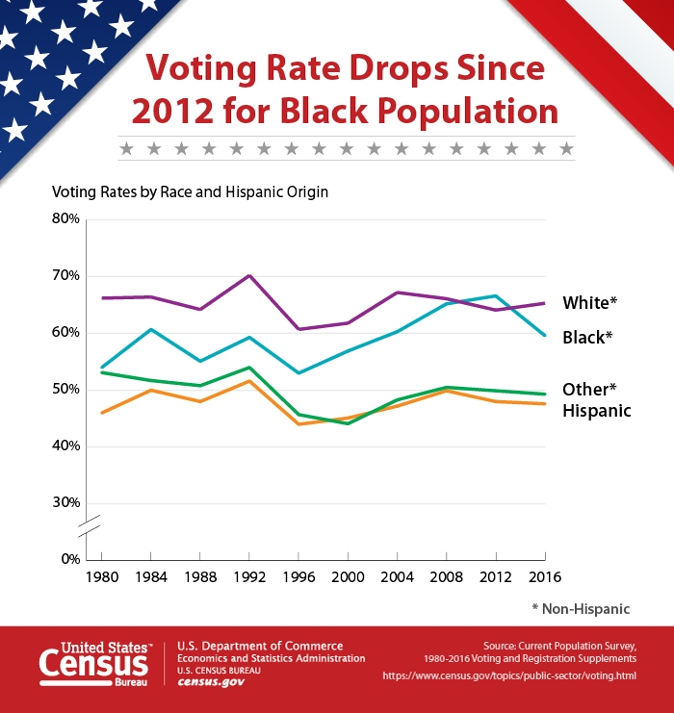
http://www.pewresearch.org/fact-tank/2017/05/15/u-s-voter-turnout-trails-most-developed-countries/
http://www.cnn.com/2016/11/11/politics/popular-vote-turnout-2016/index.html

Slide 41
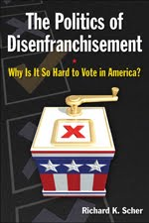
Civil Rights
How can legislators still disenfranchise voters?
What is indirect disenfranchisement?

Slide 42
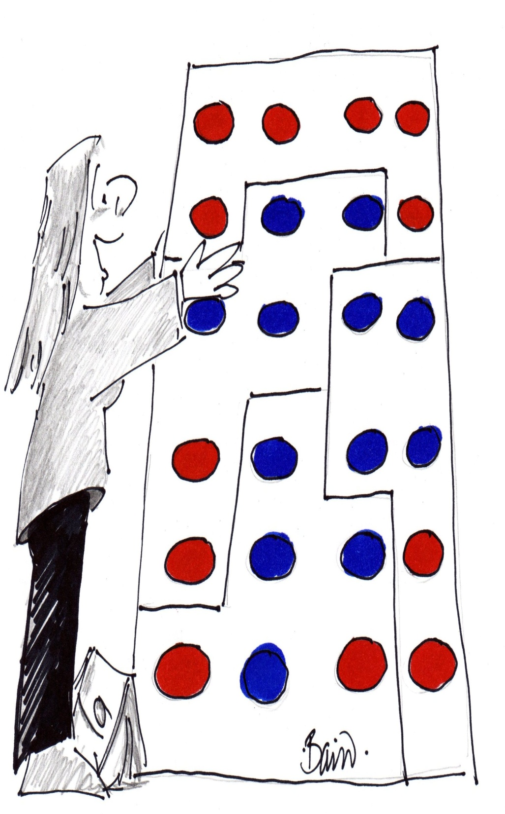
Political Segregation
Despite the 15th amendment, Southern Whites worked to disenfranchise black voters
Gerrymandering also utilized to break up black voters in favor of white districts

Slide 43
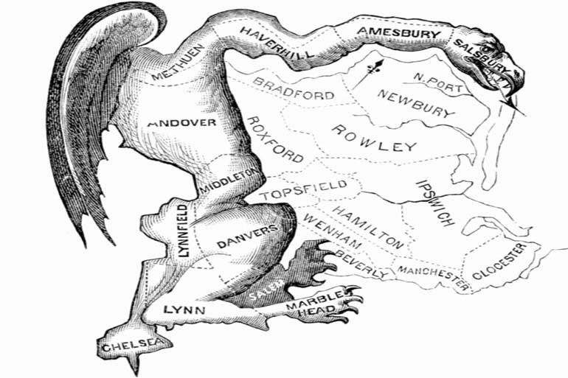
Federalism
Role of State Legislatures
Laws, Budgets, Redistricting
Apportionment
Distribution of seats in U.S. House of Reps and state legislature
Redistricting
Redrawing of voting districts to reflect population changes
Gerrymandering
Drawing district boundaries to benefit people or parties
https://www.youtube.com/watch?v=24yc5pOGn2Y

Slide 44
Homework

Slide 45
Warm Up 11/3
Briefly explain what the efficiency gap is.

Slide 46
The Efficiency Gap
A way to measure wasted votes used to secure legislative seats to determine if a district is gerrymandered.
Not yet decided on by the Supreme Court.

Slide 47
The Redistricting Game
Go to redistrictinggame.org
Click Play Game. Then choose Basic on Mission 1. Follow instructions to create an equal population district.
If you finish, go to mission 2. Now you will gerrymander for one party.

Slide 48
Warm Up 11/7
Is DACA a good solution for childhood arrival illegal aliens? Why/Why not?

Slide 49
DACA
Deferred Action for Childhood Arrivals
What does this mean?
Apply for a 2 year deferment of action
NOT amnesty
NOT citizenship
Must arrive before June 15, 2012 and be under age 16 at time of arrival.
Why is it unique?
Legal gray area – no well defined legal status
We simply don’t carry out policy

Slide 50
DACA
What do they get?
Work Permit
Pay taxes but can NOT collect on any government programs
Scholarship programs for college
Does NOT help parents/families

Slide 51
DACA
What does this have to do with citizenship?

Slide 52
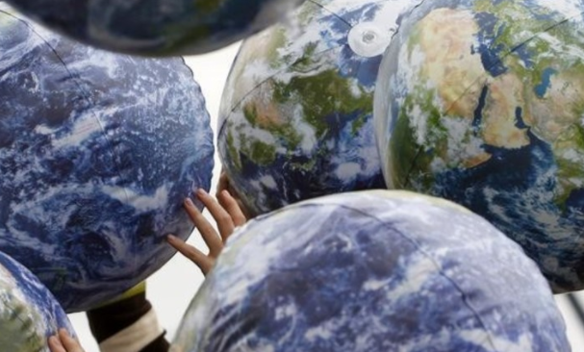
Civic Participation
What is a Civil Society?
Voluntary associations and institutions that exist between government and individuals

Slide 53
Civic Participation
What are the four areas of Civic Engagement?
Electoral Specialists
Civil Specialists
Dual Activists
The Disengaged
Which one are you?

Slide 54
Why is this important?
Why do we need to be informed, active, and involved in our civic society?
Remember GoodSpaceGuy?
He’s not even the worst one…

Slide 55
Warm Up 11/8
What are some different forms of civic participation?

Slide 56
Turn and Discuss
Add to your civic participation list.
Discuss which ones you are most likely to be involved in.

Slide 57
Turn and Discuss
How effective is protest?
Name some instances where protest has been successful.
What makes a protest less effective?
http://www.pbs.org/newshour/extra/lessons-plans/lesson-plan-civic-engagement-and-ways-for-students-to-get-involved/
Would you ever consider running for office?

Slide 58
Candidate Research
Select 3 candidates to read about and answer the following
What is their stance?
Do they talk about the issues or do they use general/personal statements?
Would you consider them a good candidate? Why/Why not?
You may do this in pairs.

Slide 59
Warm Up 11/9
Which forms of civic participation do you see yourself participating in?

Slide 60
Current Events…Thursday!
Today you will be looking at the election result in pairs. You will answer the following:
Which states had big elections yesterday (governor, U.S. congress seats, multiple state legislative seats, etc.)?
Did any of the major positions flip (change party hands)? If so, which ones?
What trends do you see?
Which groups gained ground politically?
Predict what impact these trends may have on politics over the next 1-2 years.
When you are finished, look at the results for Washington

