Slide 1
Warm Up 5/10 (#2)
“Firstly, do not fear hardship, and secondly, do not fear death.”
-Mao Zedong
What can you infer (guess) about Mao as a leader based on this quote?

Slide 2
May 10, 2018
Turn In:
Take Out:
China notes and something to write with
Agenda:
The Rule of Mao
Learning Targets (I can…):
Explain Mao Tse Tung’s rise to power
Describe the different phases of Mao’s rule
Homework:
5/11: Final Draft of Paper

Slide 3
To Bring on Friday
Final draft of paper
Peer edited outline
Peer edited 1st draft
Peer edited 2nd draft

Slide 4
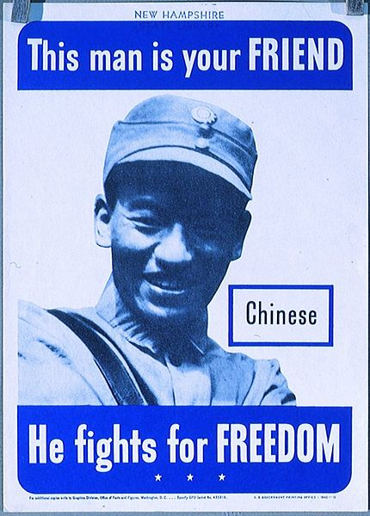
World War 2
World War 2 destroyed China
22 million dead
Mao and the Communists establish a stronghold in North China
Mao and the Communists gain favor with the peasants by providing food and defending them against the Japanese

Slide 5
World War 2
Meanwhile…
Chiang Kai-shek and the Nationalists controlled Southern China
The US Government decides to support the Nationalists, sends $1.5 billion dollars to the Nationalists
The Nationalists decide to spend the money on themselves instead…

Slide 6
Civil War Resumes
Nationalists still receiving support from U.S. (because we hate communism)
China’s failing economy causes thousands to desert to the Communist side
October 1949: Mao wins and declares the People’s Republic of China
Nationalists flee to Taiwan and set up government
Both countries still claim to be the rightful government of all China
Though communists not officially recognized at first, most countries today will not recognize Taiwan as an independent country due to the economic power of China

Slide 7
China expands
Troops expand into southern Mongolia and Tibet
Tibetans flee to India creating tension between India and China
Originally promised autonomy but as control tightens, Dalai Lama will flee Tibet, never to return

Slide 8
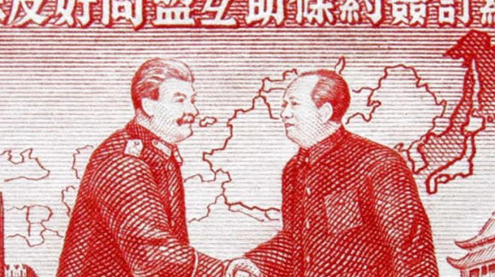
Mao’s First 5 Year Plan (‘53-’57)
Transition to Socialism
Soviet influence (gave technical and monetary aid
Kills landlords and divides land among peasants
Farms then collectivized – made into government owned farms run by hundreds of families
Focus on expanding industry

Slide 9
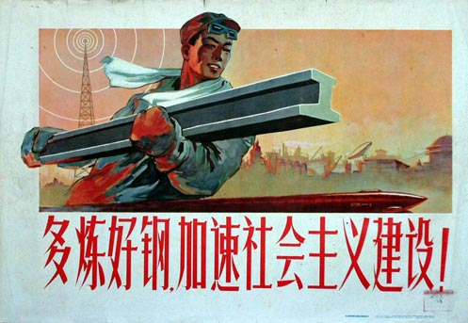
Mao’s First 5 Year Plan (‘53-’57)
Success:
Agriculture thrived
Impressive industrial growth

Slide 10
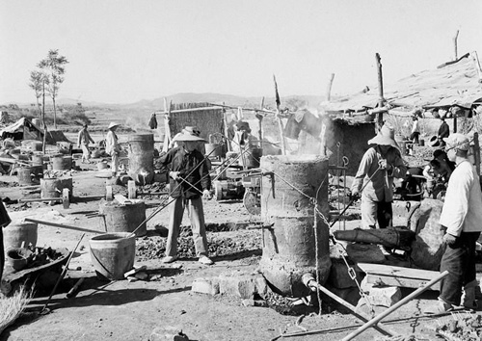
The Great Leap Forward
Intended to push rapid industrialization
Collective farms turned in massive communes
Everything done as community (working, eating, sleeping, child rearing)
Families urged to created backyard furnaces
Massive fail due to lack of experience

Slide 11
The Great Leap Forward
DID NOT WORK

Slide 12
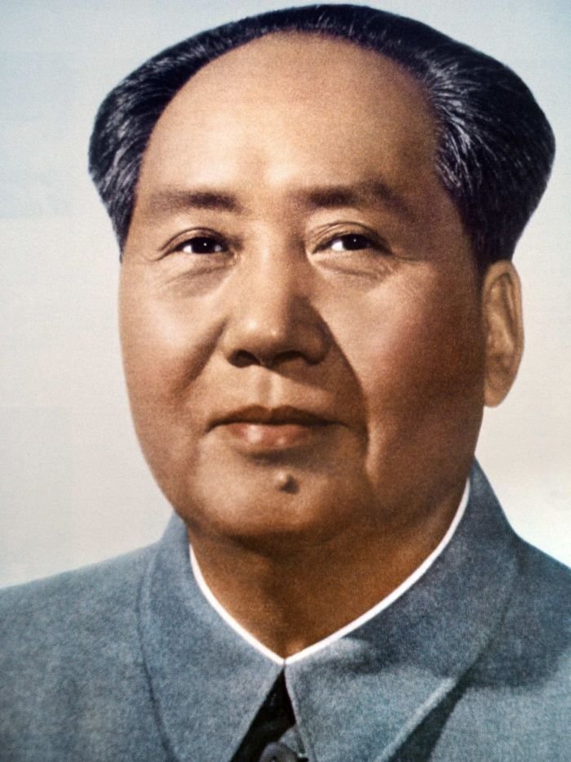
The Great Leap Forward
Triggers massive famine
Roughly 20 million people die
State owned enterprises
Little incentive to be efficient as surplus goes to the state
Mao won’t accept responsibility for failure (refused to accept his policies were at fault)
Blamed peasants (hoarding food)
Blamed local officials (incompetence)
Blamed bad weather (affected harvests)

Slide 13
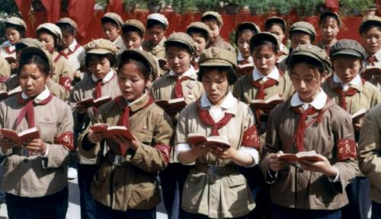
Political Shifts
Mao pulls back a bit
Ties with Soviet Union severed
More competition introduced in farming and industry
Mao sees weakening of socialist ideals and urges youth to revolt
Students leave school and form Red Guard
Young civilians fighting against democratic society

Slide 14
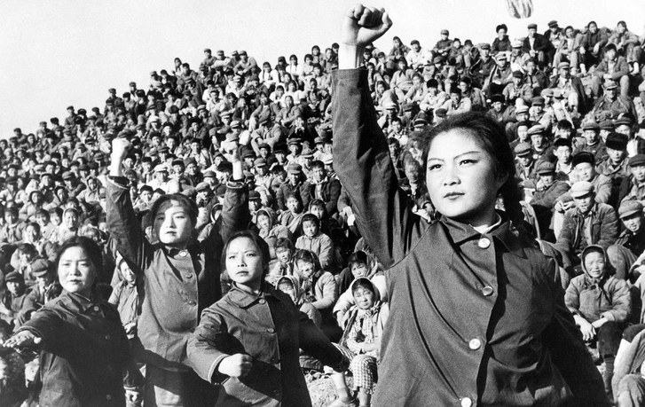
Cultural Revolution
Mao seeks to reassert his dominance by eliminating opposition
Claims more books read, the more unintelligent you are and seeks to re-educate youth
Teens sent to farmland to be “re-educated” by peasants/ farmers
130 million stopped attending school
Economy collapsed
Notes:
Rice and cotton production decreased→ increased prices
Industrial production= abandoned to focus on agriculture

Slide 15
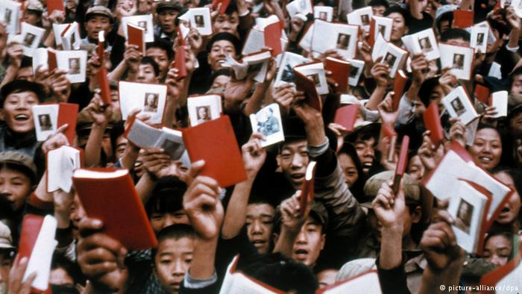
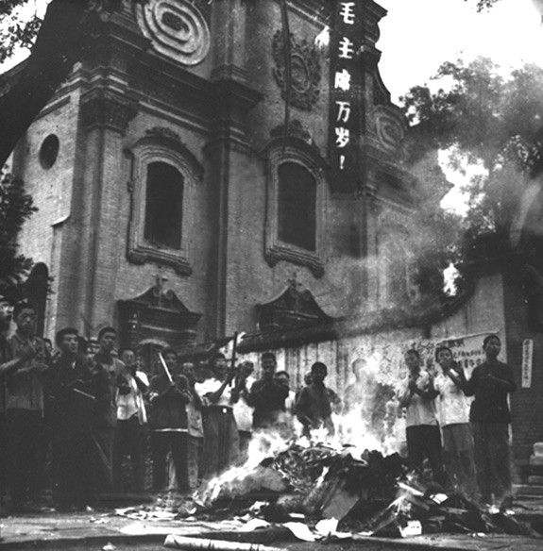
Cultural Revolution
Denounces the 4 olds
Ideas
Customs
Habits
Culture

Slide 16
Cultural Revolution
Values of proletarian society (class of wage-earners)
Religion was attacked as one of the “four olds”
Replace religion with loyalty to party (Maoism)
Doctors targeted for bourgeois lifestyle, damaging healthcare
IMPACT: Thousands of years of Chinese culture/history lost
Books burned because deemed politically incorrect
Only literature, art and media that promoted Chinese themes= allowed
Artists resisted= sent to labor camps for “reeducation”
People too afraid to resist destruction of traditional culture

Slide 17
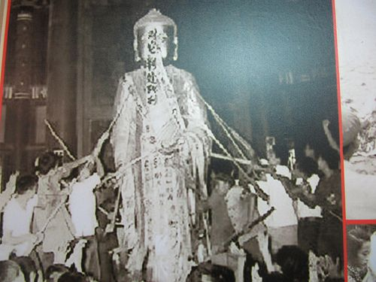
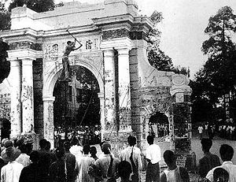

Slide 18
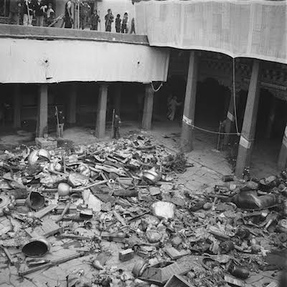
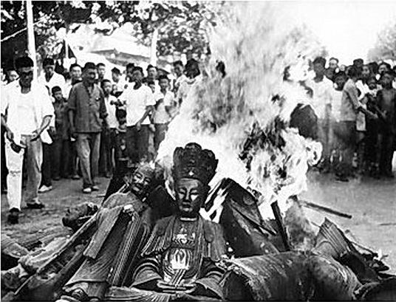

Slide 19
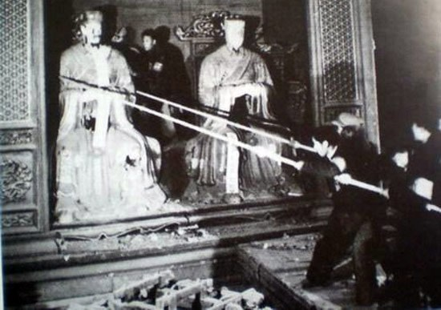
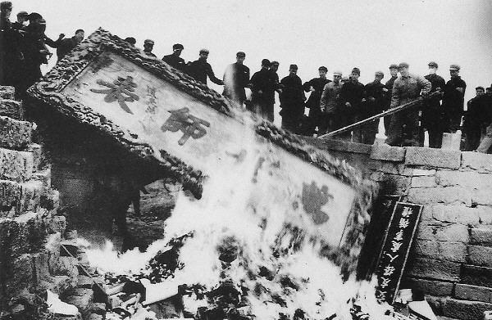

Slide 20
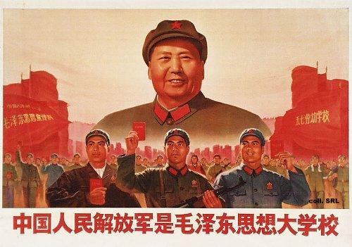
Cultural Revolution
By 1968 Mao admits the experiment needs to stop
Orders army to put down Red Guard and Mao attempts to stabilize country
Much of the Red Guard is moved to countryside to decrease disruption
Much of the cultural revolution ideals continue as Mao continues to put down opposition.

Slide 22
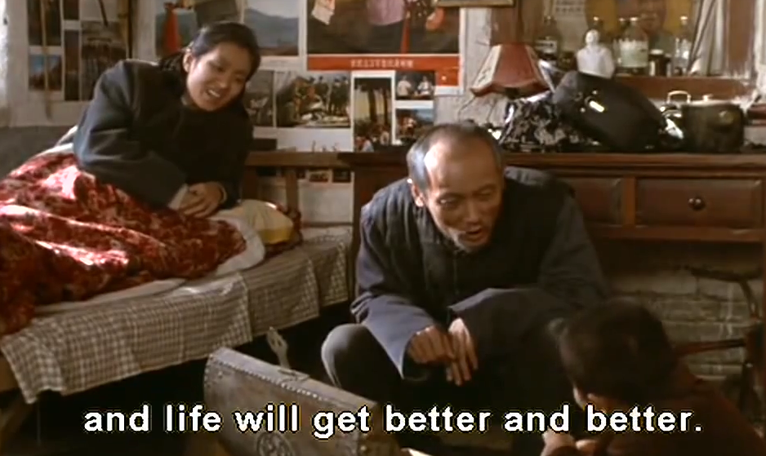
1970s: Chinese people don’t want any more experiments.

Slide 23
To Live

