Slide 1
The Aryan Angels
by: Amber Beeks, Audrey Daynes, and Pedro Neves

Slide 2
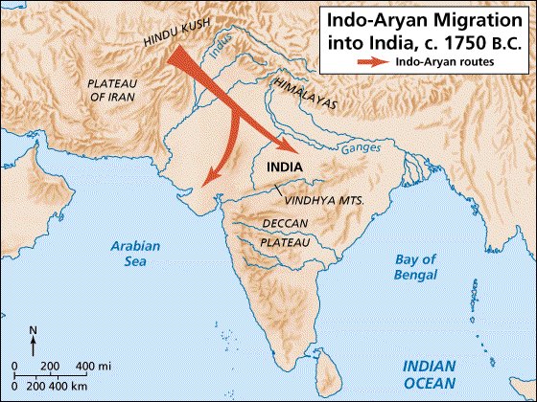
1500 BC - 500 BC
MAP
Vedic Age

Slide 3
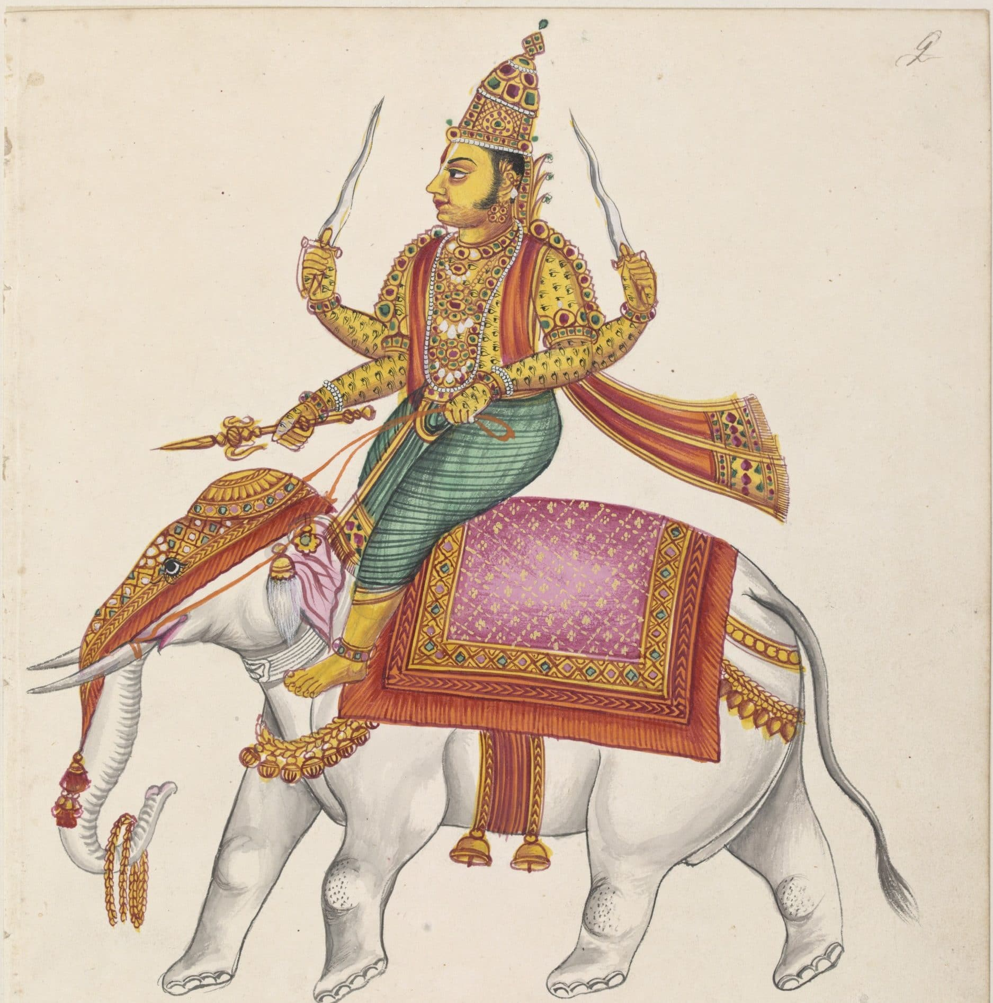
Polytheistic
Indra
God of War
Weapon: Thunderbolt
Destroyed demons
Announced arrival of rain, which was crucial to Indian life
Varuna
God of order and creation
Agni
God of fire and the messenger who communicated human wishes to the gods

Slide 4
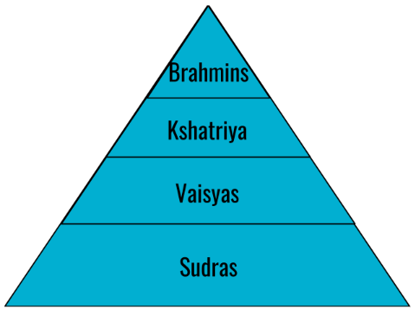
Caste System
GODS

Slide 5
Caste System
High Class
Brahmin
Priests
Kshatriyas
Warriors
Low Class
Vaisyas
Herders, farmers, artisans, and merchants
Sudras
Farmworkers, servants, and other laborers
Little or no aryan heritage

Slide 6
Caste System
GODS
Dalits
Were not considered part of the Caste system
Did work others would not do
Ex. making leather from animal skins
Dalits

Slide 7
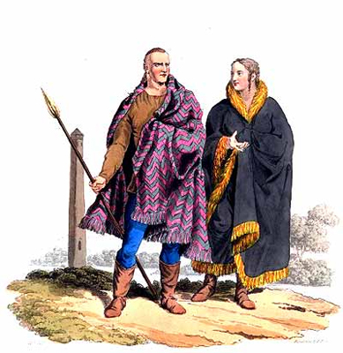
Key Events
2000 B.C. - 1500 B.C.
Nomadic people migrated slowly with herds of cattle and horses
Intermarriage with locals = Aryans!
Syncretism

Slide 8
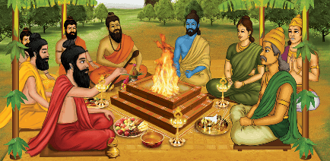
Key Events
1500 B.C. - 500 B.C.
Vedic Age
Aryan priests memorized and recited Vedas
Vedas: collection of hymns, chants, ritual instructions, and other religious teachings.

Slide 9
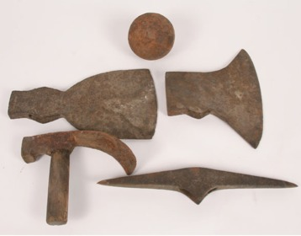
Key Events
800 B.C.
Tools made of iron

Slide 10
Work Cited
Ackermann, Marsha E., et al. “Major Themes in World History, Prehistory&Ndash;600 CE.” Encyclopedia of the Ancient World: Prehistory to 600 CE, Facts On File, 2016. History,
online.infobase.com/Auth/Index?aid=150531&itemid=WEHRC&articleId=237397. Accessed 28 May 2018.
Adiez. "FlowVella." Ancient India, FlowVella, flowvella.com. Accessed 29 May
2018.
Aryan." Britannica Library, Encyclopædia Britannica, 27 Apr. 2015. library.eb.com/levels/referencecenter/article/Aryan/9750. Accessed 24 May. 2018.
"Aryan Civilization." Weebly, aryancivilizationelijah.weebly.com/. Accessed 24
May 2018.
"Aryan Life." World History, kidspast.com. Accessed 29 May 2018.
Burgan, Michael. “Introduction to Ancient Persia.” Empires of Ancient Persia, Chelsea House, 2016. History,
online.infobase.com/Auth/Index?aid=150531&itemid=WEHRC&articleId=397212. Accessed 28 May 2018.
"Early Vedic Gods." Early Vedic Period, DISHA, 3 Sept. 2017, dishalokseva.com.
Accessed 29 May 2018.
Jain, Shubham. "Why Indra is not worshipped? Why there are no temples of Indra?"
Myth Gyaan, Aug. 2017, mythgyaan.com. Accessed 24 May 2018.
"South Asian Civilisations Until the Mid-Eighteenth Century.". History Study Center,
http://gateway.proquest.com/openurl?url_ver=Z39.88-2004&res_dat=xri:ho-us&rft_dat=xri:ho:sup:1232.

