Slide 1
Warm Up 5/21 (#4)
What was the purpose of the WPA?

Slide 2
May 21, 2018
Out for checkoff:
Agenda:
Assemble Museum boards
Skills:
Learning Target (I can…):
Showcase the major events of the ’70s/’80s
Upcoming Dates
5/22: ‘70s/’80s museum project
5/29: 70s/80s quiz (open note)

Slide 3
Warm Up 5/21 ()
1970s displays – left side of room (if facing back)
1980s displays – right side of room

Slide 4
Highlights to Look For
Jimmy Carter
Energy Crisis
Iran-Hostage Crisis
Three Mile Island
Environmentalism
Feminism
Reagan election
Reagan’s economics
Iran Contra Affair
HIV/Aids Epidemic
Star Wars/SDI
Fall of Berlin Wall
Tiananmen Square
Persian Gulf War
These should not be your only notes. Write down a couple highlights from each year. Just make sure to look for the above.
Get a general feel for the culture of each decade. Write down some highlights for technology and pop culture.

Slide 5
Warm Up 5/23 (#5)
The decisions at Yalta were said to have led to what?

Slide 6
May 23, 2018
Out for checkoff:
Agenda:
Debrief ‘70s/’80s
Skills:
Pulling out main ideas
Learning Target (I can…):
Showcase the major events of the ’70s/’80s
Upcoming Dates
5/29: 70s/80s quiz (open note)

Slide 7
The 1970s

Slide 8
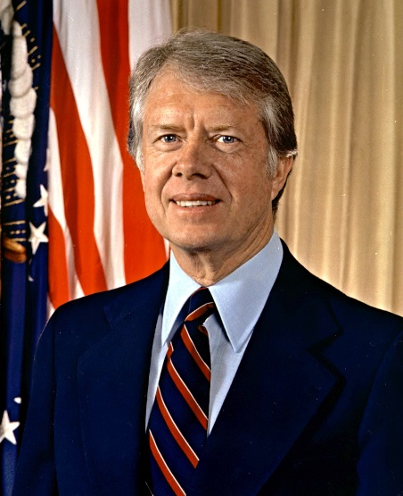
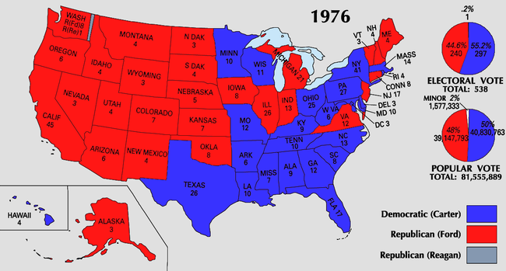
Jimmy Carter
Barely wins in ‘76

Slide 9
Jimmy Carter
Camp David Accords
Returns Sinai Peninsula to Egypt
Egypt recognizes Israel in diplomatic relations

Slide 10
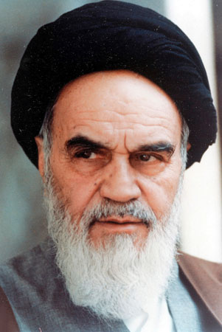
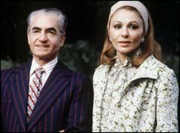
Iran-Hostage Crisis
Shah of Iran forced from throne by revolutionary army under Ayatollah Khomeini
Carter allows exiles Shah to enter U.S. for medical treatment

Slide 11
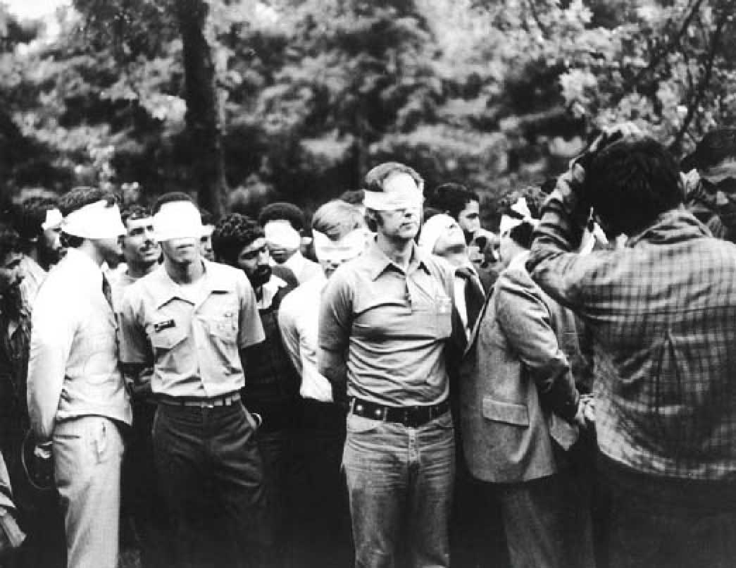
Iran-Hostage Crisis
Militant students storm Tehran embassy and take 66 hostages
Carter tries and fails at diplomatic and military attempts to rescue hostages
Not resolved until 1981
Made Carter look weak

Slide 12
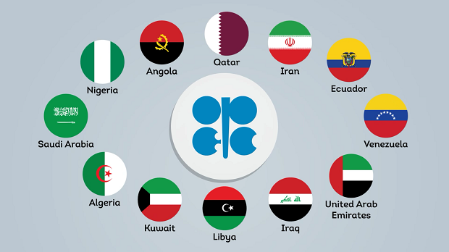
America’s energy Crisis
OPEC
Countries that depend on oil for income
Oil prices increase dramatically by ‘76
Carter’s response
National Energy Act
Tax credits for energy conservation (insulation, alternative energy, etc)
U.S. still dependent on oil, energy crisis worsens in ‘79

Slide 13
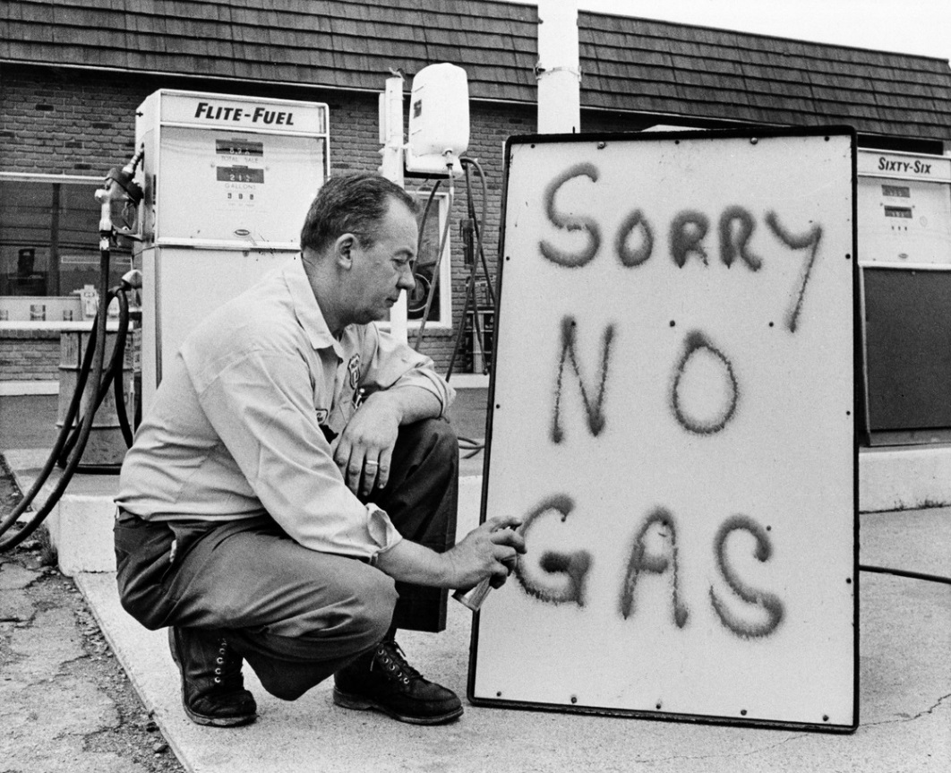
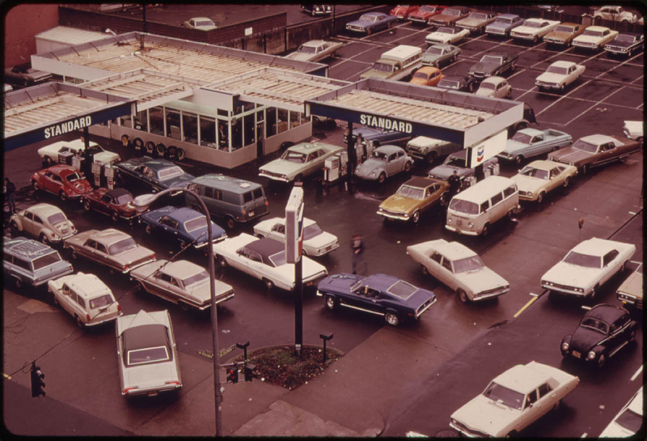

Slide 14
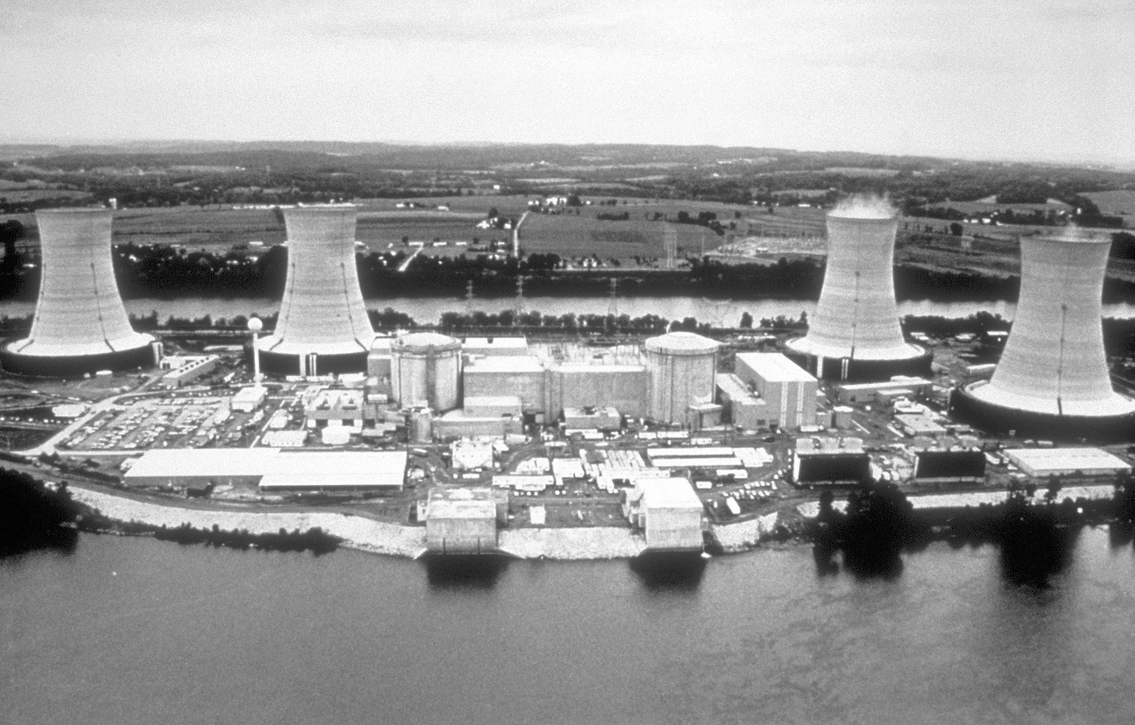
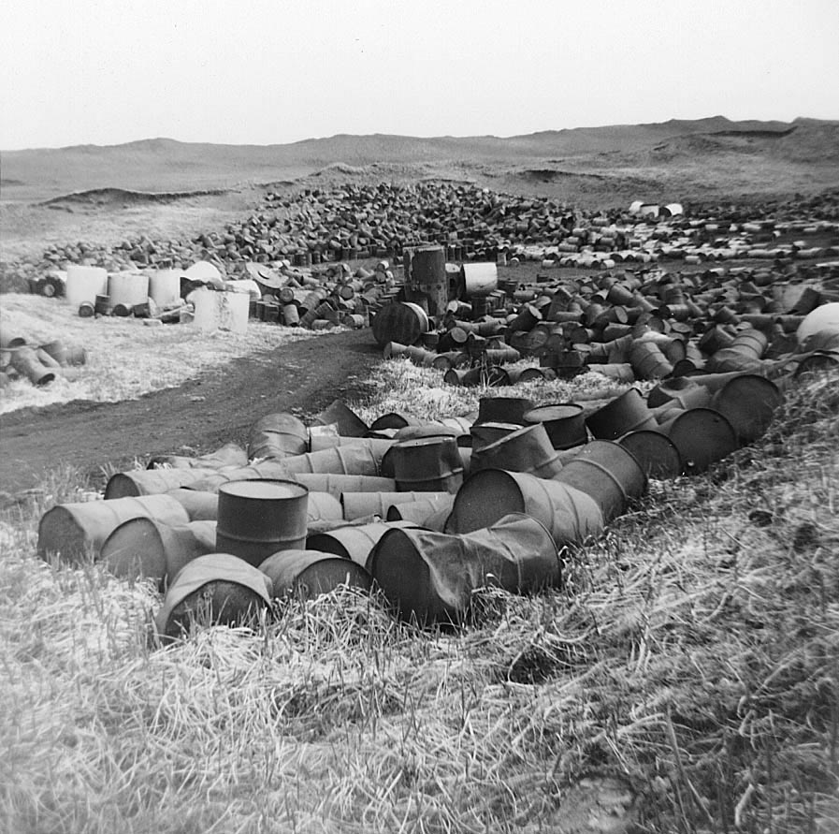
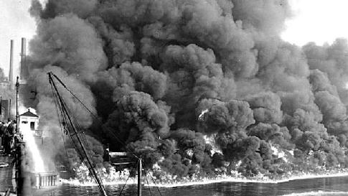
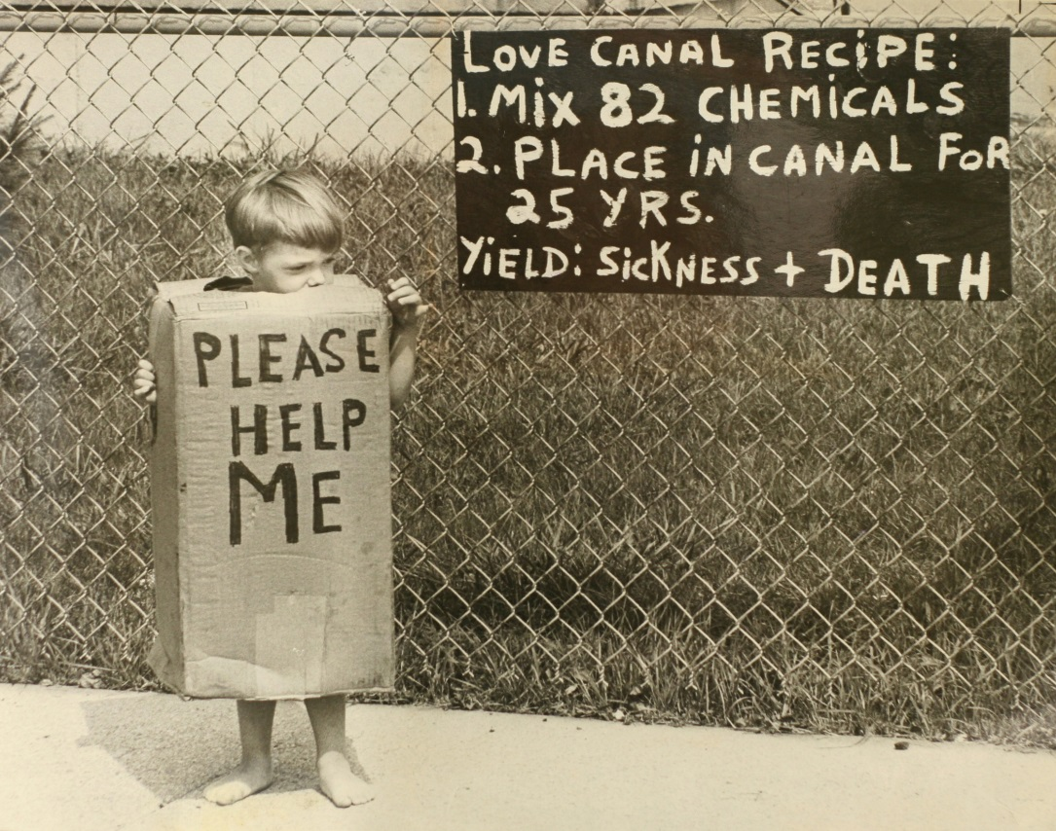
Environmentalism
Environmental Protection Agency (EPA) created 1970
Clean Air Act
Clean Water Act
Safe Drinking Water Act
Three Mile Island
No new plants since 1979

Slide 15
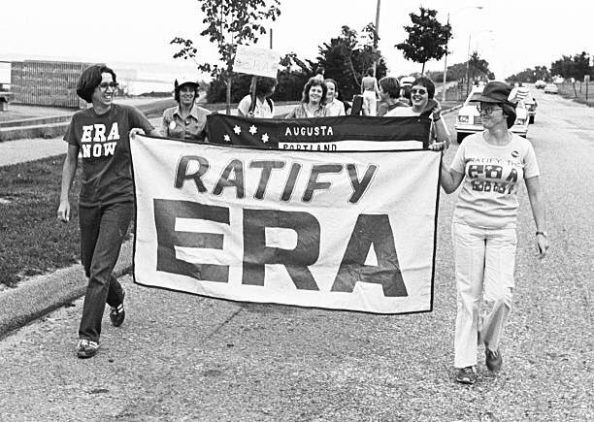
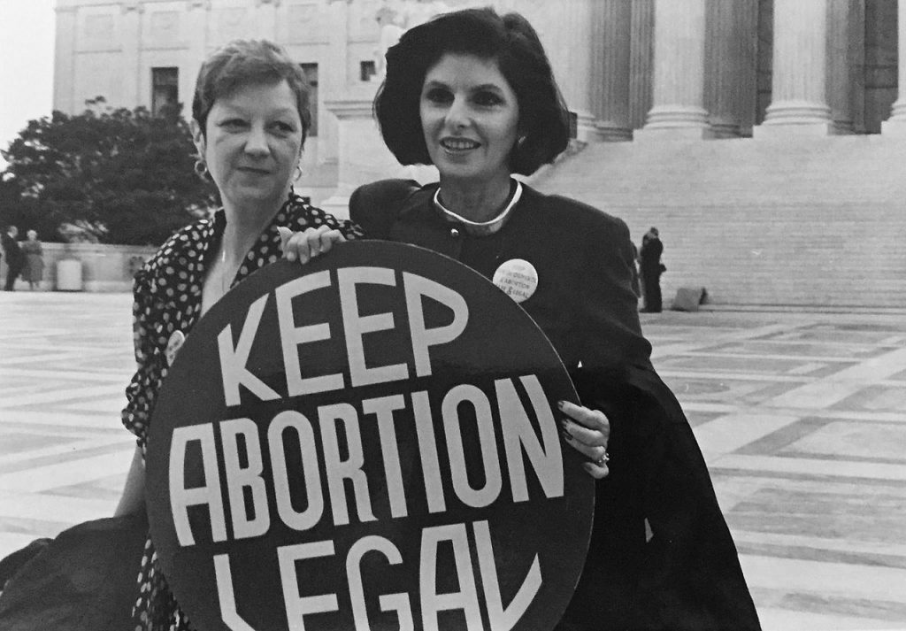
Feminism
Women fight for workplace equality and child care
Make gains military service and traditionally male dominated fields
Roe v. Wade – 1973
Equal Rights Amendment - 1972

Slide 16
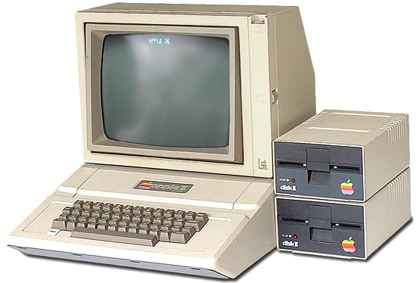
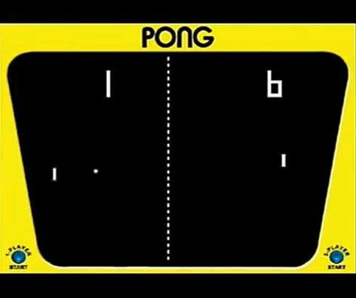
Tech Advances
PCs
Video games

Slide 17
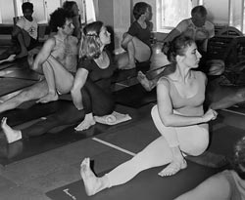
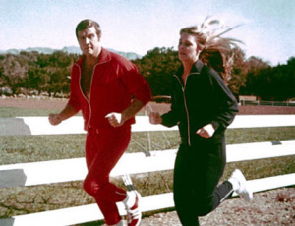
Third Great-Awakening
Focus on self-improvement
“remaking, remolding, elevating and polishing one’s very self”
Increase in new religious groups
Yoga gains popularity
Exercise and jogging
Acupuncture

Slide 18
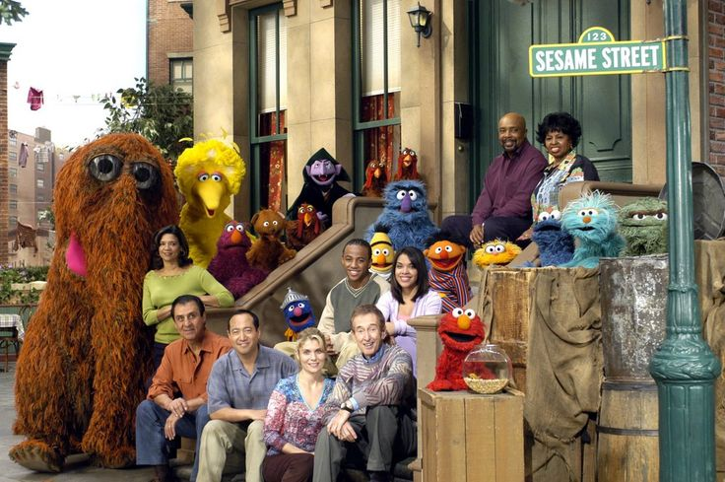
Cultural Identity
Exploring one’s cultural identity
Reclaim their ethnic background
1974 – Office of Ethnic Affairs
Sesame Street

Slide 19
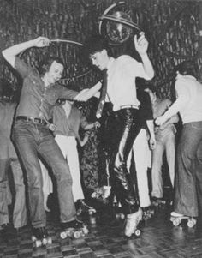
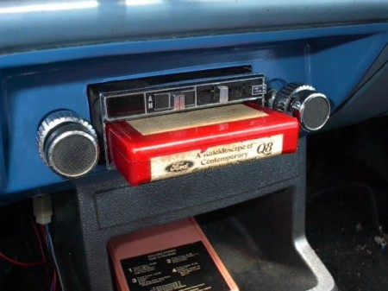
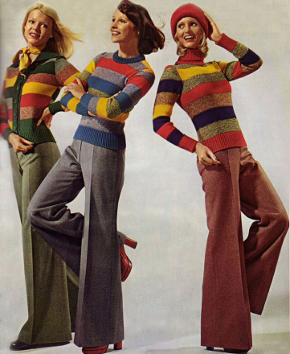
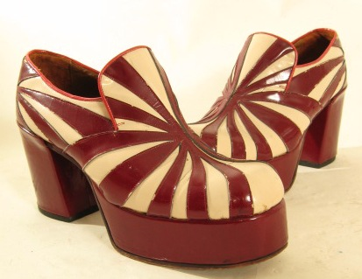
Fads and Fashion
Disco
Dance clubs
Pet rocks
Platform shoes
Bell-bottoms
Mood rings
8-track tape
Lava lamps

Slide 20
The 1980s

Slide 21
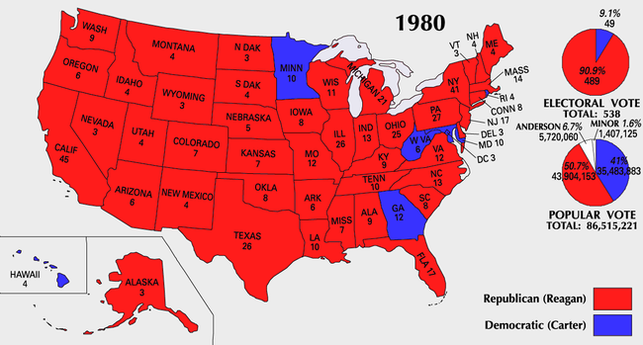
Election of 1980
Are you better off that you were 4 years ago?

Slide 22
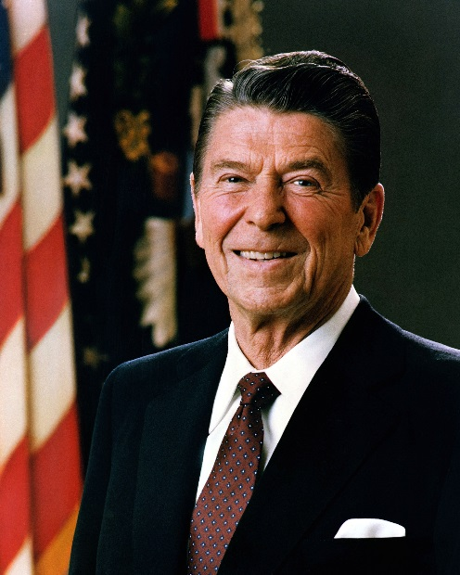
Reaganomics
New Federalism
Handed special programs to states with block grant funding
Supply side economics
Increase supplies by cutting taxes
Generally doesn’t work
Deregulation
Increased debt and deficit spending
Leads to RECESSION

Slide 23
Reaganism?
Reagan would later raise taxes 11 times, effectively canceling half the original reduction
Reagan also provided amnesty to illegal immigrants, was a skilled negotiator both in Congress and foreign policy, and was not afraid to make concessions when necessary to achieve a bigger goal
Santos Soapbox: Currently held in almost worshipped esteem by modern republican politicians, though only in his 1981 form
Reagan’s policies would begin a dangerous era of increased deficit spending and deregulation of Wall Street and the Federal Reserve

Slide 24
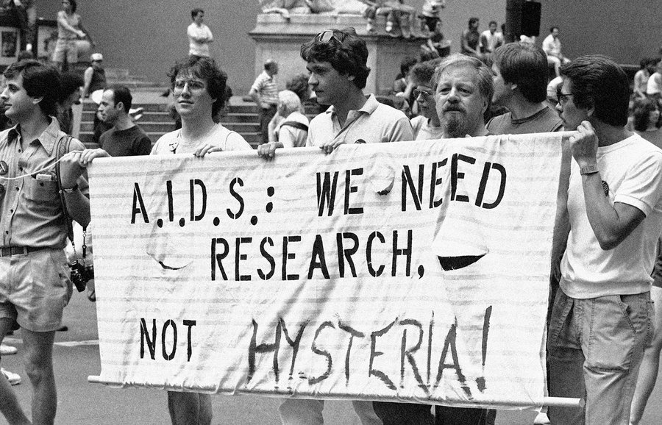
Drugs and Disease
HIV/Aids
DARE
Education; didn’t do much long term as crack use increased among urban youth
New Jersey v. T.L.O
Legalized search of student property if reasonable suspicion exists

Slide 25
Iran-Contra Affair
Communists expanding power in Nicaragua
Reagan begins funding Contras (rebel group) to oust Communists
Congress bans further aid in ‘84 after discovering placement of land mines
Also funded Salvadoran military in Civil War which had shaky human rights record
U.S. invades Grenada to overthrow communist leader in 1983

Slide 26
Iran-Contra Affair
Meanwhile in Lebanon…
Reagan negotiates creation of UN peace keeping force to diffuse war between Israelis and PLO (Palestine Liberation Organization)
Muslims angry and bomb embassy
Increased terror attacks against American in Middle East

Slide 27
Iran-Contra Affair
Lebanese magazine reveals secret sale of U.S. arms to Iran.
Arms sold to Iran to gain release of hostages
Americans shocked: Reagan had promised never to deal with terrorists
Scandal grows
Monday from arms sales used to fund Contras in violation of 1984 law
Reagan only briefly loses popularity
Mostly criticized for not keeping closer watch and making sure laws were upheld

Slide 28
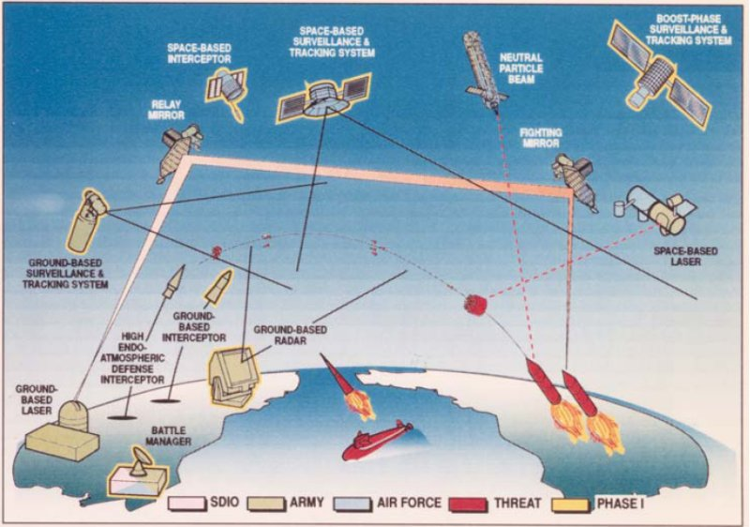
Star Wars
Strategic Defense Initiative
Reagan’s plan to create anti-missile defenses
Criticized for viability and possible increased arms race

Slide 29
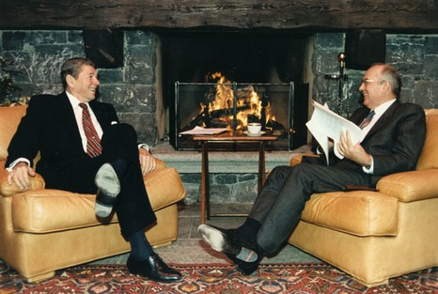
Ending the Cold War
Meetings with Gorbachev
Reagan attends multiple summits to negotiate better relations and nuclear limitations
INF Treaty
Agreement between U.S. and USSR after multiple summits to destroy missiles with a specific range

Slide 30
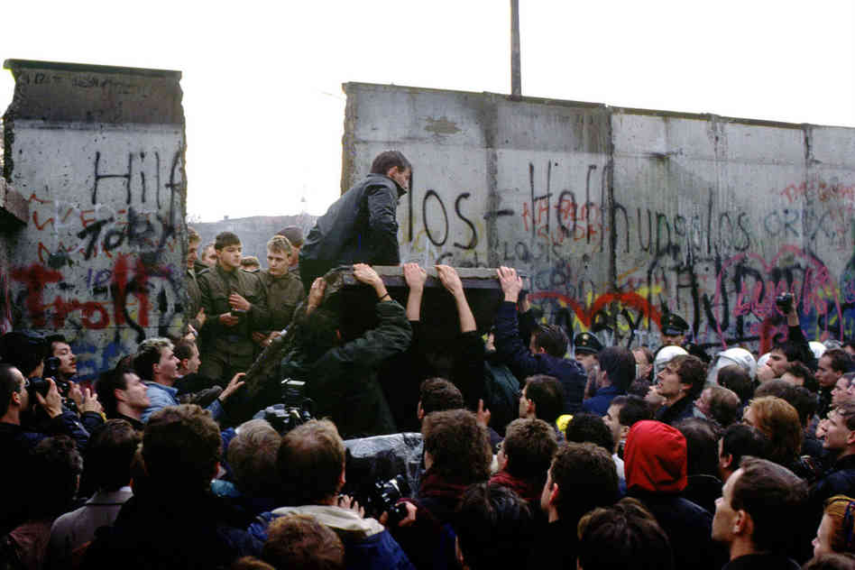
Ending the Cold War
Berlin Wall opened in 1989 after Gorbachev announces end to interference in other communist countries

Slide 31
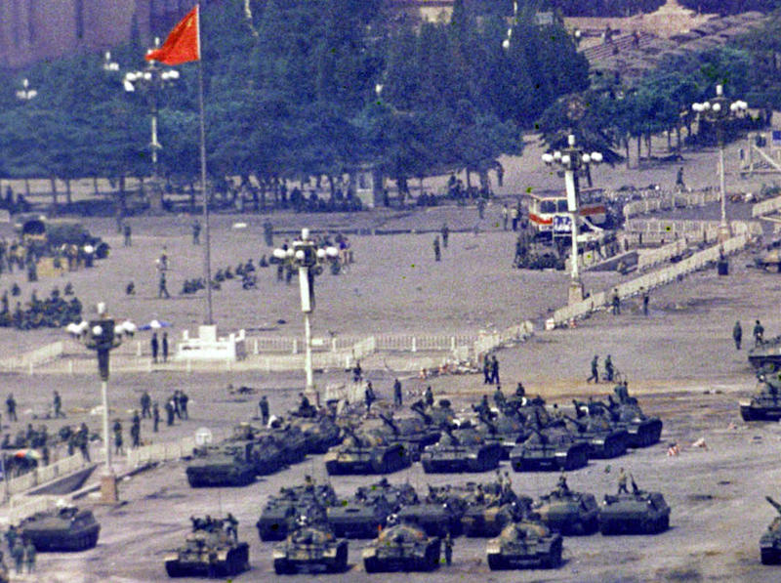
Ending the Cold War
Multiple East Europe dictators fall
Communism endures in China after failed student protest (Tiananmen Square)

