Slide 1
Warm Up 11/7
How would you describe civilization?

Slide 2
November 7, 2017
Turn in: None
Take out:
*Place to take lecture notes
Agenda:
*Shift to civilizations…
*Time to work on Reading Notes
Objectives:
*Identify why civilizations developed and what are the main characteristics
Homework:
*Due 11/8: Finish Reading Notes

Slide 3
Ancient Civilizations
A new direction…

Slide 4
Ancient Civilizations & Abrahamic Religions
Course
Introduce ancient civilizations: 2-3 Days
Egypt and Mesopotamia Jigsaw
Abrahamic Religions: About 2 Weeks
Judaism
Christianity
Islam
Purpose
Ancient Civilizations
Case study in general structure and life of ancient civilizations
Purpose (continued)
Abrahamic Religions
Understand the basic tenets of Judaism, Christianity, and Islam
Understand how all three of the Abrahamic Religions are interconnected
Understand basic impacts of these religions on the lives of the people who practice these religions
Unit Assessment
Small “tiz” (20-35 questions) at the end of the unit
Possible group assessment

Slide 5
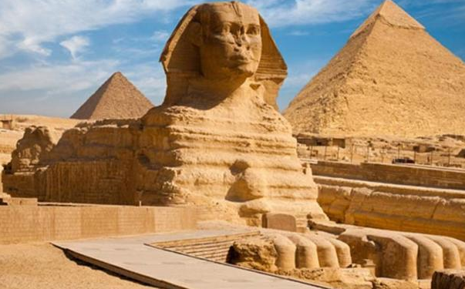
Ancient Civilizations
Why do we study ancient civilizations?

Slide 6
Understanding Dates
B.C. or B.C.E
Essentially mean the same things
B.C. – Before Christ
B.C.E. – Before Common Era
This is a recent change over from B.C.
A.D. or C.E.
Also essentially mean the same things
A.D. – Anno Domini (in the year of our lord)
Also known as After Death
C.E. – Common Era
All are based designed around the Julian or Gregorian Calendars (the calendar we follow)

Slide 7
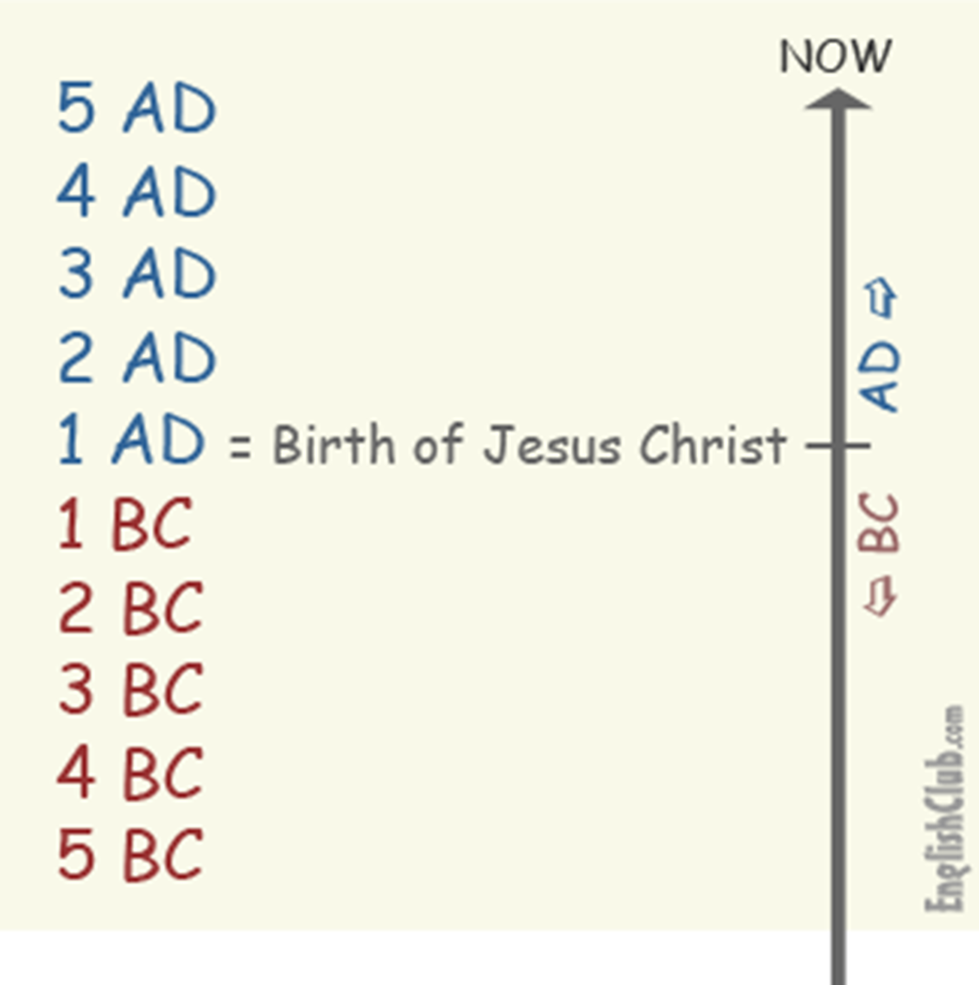

Slide 8
Emergence of Humans
Anthropologists vs Archaeologists
Anthropology: The study of various aspects of human history started about 150 years ago
Archeology: Sub group of anthropologists that focus on the study of past people and cultures through their material remains
Mary and Louis Leakey
Found remnants of early Hominids in the bottom of the Olduvai Gorge in Tanzania in the 1930s
Bottom of the gorge is 1.7-2.1 million years old
Found tools & skulls

Slide 9
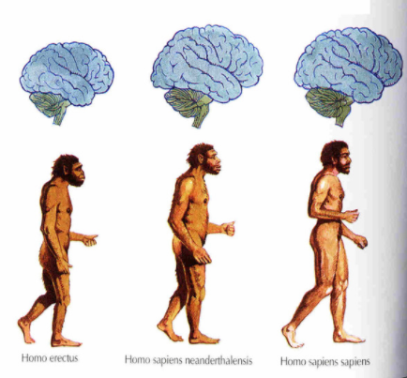
Emergence of Humans
First Homo Sapiens emerged around 100,000-250,000 years ago
According to scientific study Homo Sapiens emerged either in Africa or in various locations around the world (its an argument) from Homo Erectus
Around 50,000-30,000 years ago Neanderthals disappeared and modern humans were the only hominids on earth

Slide 10
Emergence of Humans
Neolithic Revolution: The transition from a nomadic lifestyle to sedentary lifestyle
Nomad: Group of people (20-30) that moved around who hunted and gathered for survival
Starts around 10,000 B.C. with the end of the Paleolithic Period
Neo. Rev. stated with the domestication of plants and animals
Domesticate - Raise them in a controlled way that makes them best suited for human use
Dog was first about 15K years ago
8,000 B.C.-6,000 B.C. goats, sheep, pigs, cattle, llamas, & alpacas
10,000 B.C.-6,000 B.C. yams, rice, squash, barley, chickpeas, peas, lentils, & wheat

Slide 11
Neolithic (Agricultural) Revolution

Slide 12
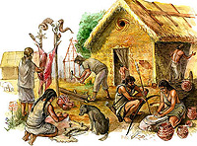
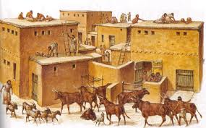

Slide 13
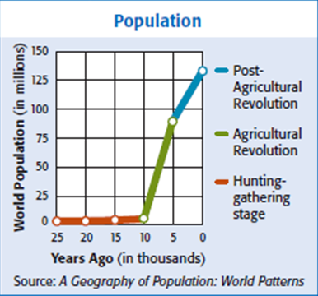

Slide 14
Today and Homework Due 11/8
Read the article on Ancient Civilizations
Answer the questions on a separate sheet of paper.

Slide 15
Ancient Civilizations
What do the following terms mean:
empire, cultural diffusion, polytheistic, city-states
What did all the earliest civilizations have in common?
What is a civilization?
What are the basic features of a civilization?

Slide 16
Ancient Civilizations
What do the following terms mean…
What did all the earliest civilizations have in common?
Near water traditional economies
Surpluses of food
What is a civilization?
Cities
Social order
What are the basic features of a civilization?
Organized Governments, complex religions, job specialization, social classes, arts/architecture, public works, and writing

Slide 17
Ancient Civilizations

Slide 19
Rise of Civilizations
What impact did the environment have on ancient civilizations?
What is cultural diffusion, how did it affect civilizations?
What is a city-state, is it the same as a modern city today?

Slide 20
Mesopotamia & Egypt Jigsaw
Steps – in partners, you will each be learning about one of the civilizations & then teaching it to your partner…
Each student will research all of the basic elements of a civilization regarding either Mesopotamia or Egypt
Work out who is researching (in charge of) which civilization
Figure out the 8 basic features of the civilization you are in charge of (I suggest making a table)
Each student will write a thesis statement answering the following:
Argue the most significant cultural aspect of the civilization you are in charge of.
3. Read the reading associated with your civilization
Record the information in a clear way (I suggest a table)
Use details and be specific! (Evidence)

Slide 21
November 8, 2017
Turn in: None
Take out:
*Beginnings of Civ. Reading Notes
*Egypt/Mespot work
Agenda:
*A quick word about SHS Databases
*Egypt & Mesopotamia jigsaw work time
-use it wisely or it goes away
Warm Up: Yes (time permitting)
Objectives:
*Identify what is means to be human and why we have society/culture
*Describe and explain the significance of the Mesopotamian civilization
*Describe and explain the significance of the Egyptian civilization
Homework:
*11/9: Egypt & Mesopotamia Jigsaw

Slide 22
What to work on today
Look up information on databases
Record information on your civilization (I suggest a table)
Once done researching work on:
Thesis
Argue the most significant cultural aspect of the civilization you are in charge of.
How will you present this information to your partner
Study guide?
Questions?
Any thing else you need

