Slide 1
Homework Due 6/1
Read and take notes on TCI Section 57.1-57.3

Slide 2
Warm Up 5/30
What was Executive Order 9066?

Slide 3
The 1990s

Slide 4
Big Events

Slide 5
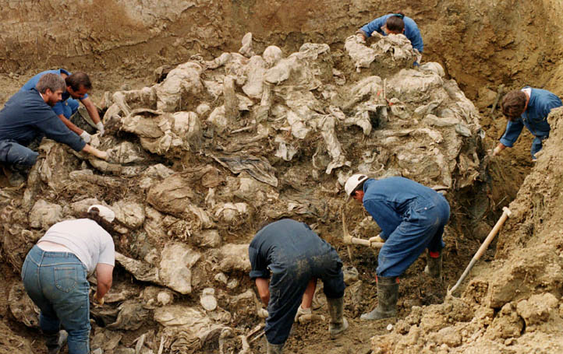

Slide 6
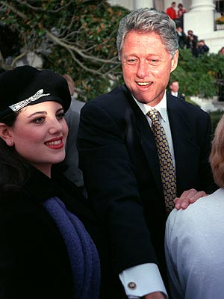

Slide 7
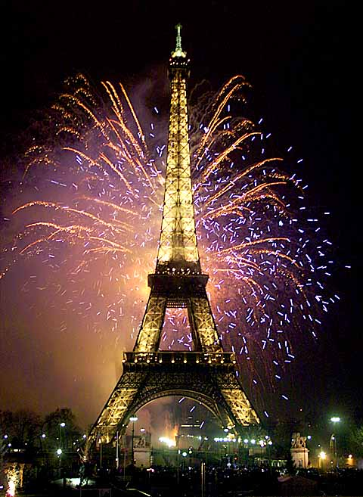
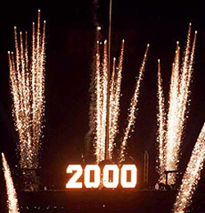

Slide 8
1990s Society

Slide 9
Fashion

Slide 10
Fashion

Slide 11
Fads

Slide 12
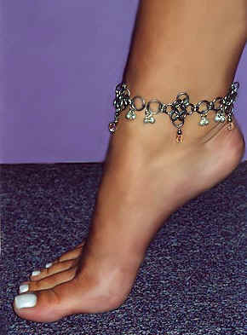

Slide 13
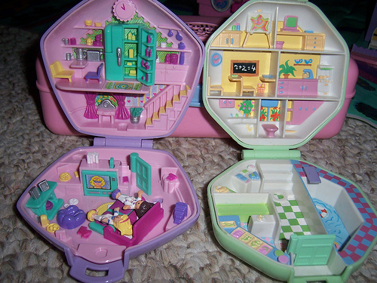

Slide 14
Books

Slide 15
Movies

Slide 16
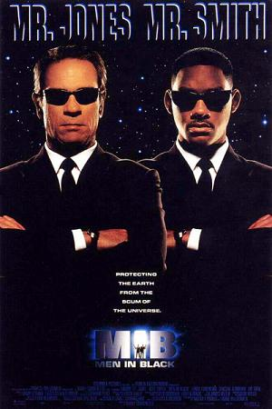

Slide 17
T.V.

Slide 18
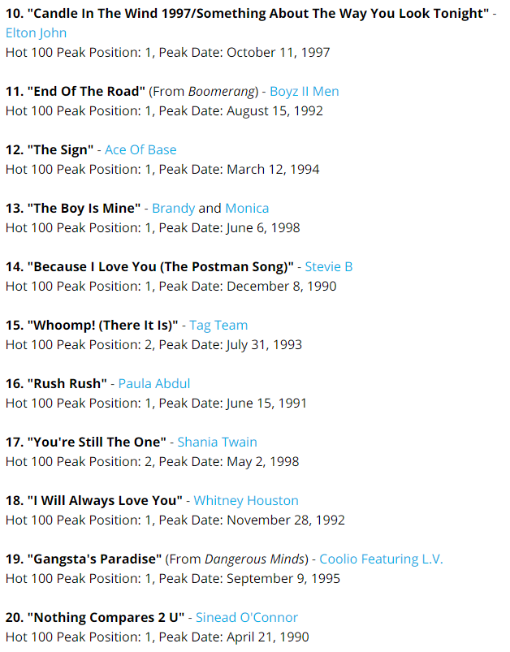
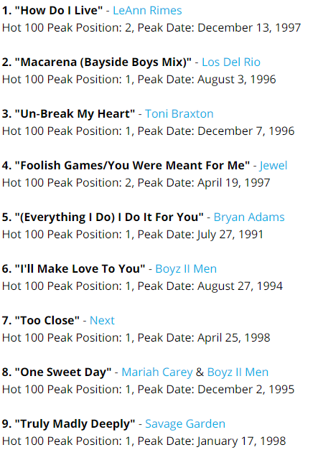
Music
Notes:
http://www.thisisinsider.com/best-90s-songs-party-playlist-2017-8#the-power-of-love-celine-dion-16

Slide 19
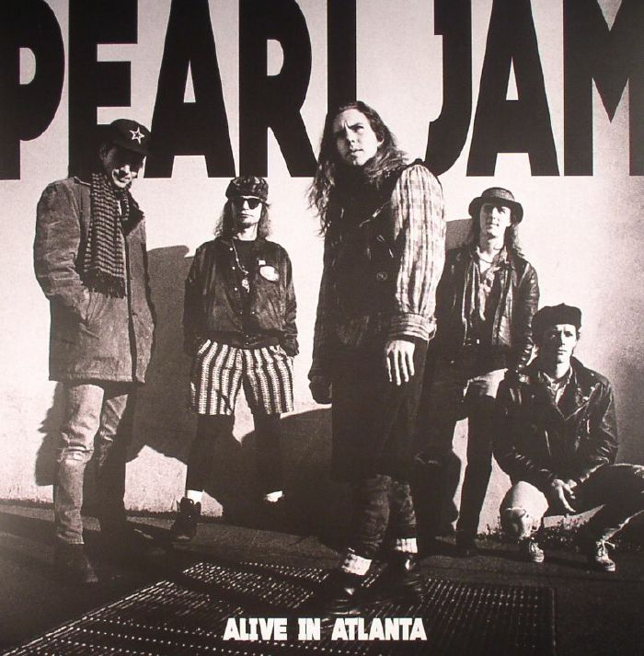
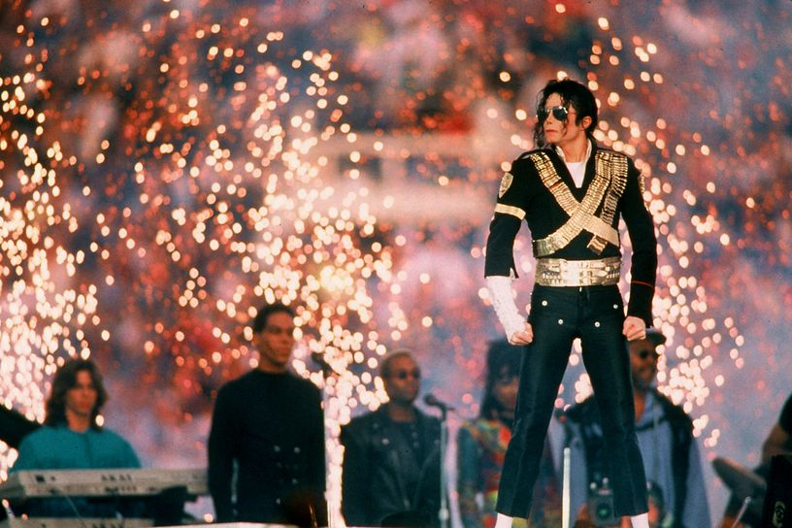
Music
Notes:
Short - https://youtu.be/gat1gB92nX4
Long - https://youtu.be/_-YyK3RaAAs

Slide 20
Warm Up 6/1
What happened on September 2, 1945?

Slide 21
June 1, 2018
Out for checkoff:
Chapter 57 Notes
Agenda:
1990s Bush and Clinton
Skills:
Learning Target (I can…):
Explain the changing politics and major events of the 1990s
Upcoming Dates
6/4: Bush v. Gore reading due
6/13: Final due date for all late work for semester 2 due

Slide 22
The Brief Bush Years
George H. W. Bush wins election of ‘88
Persian Gulf War 1991
Iraq invades Kuwait and head towards oil fields of Saudi Arabia
U.S. fearing Iraqi control of ½ the world’s oil, launches Operation Desert Storm to free Kuwait
Led by Norman Schwarzkopf (Stormin Norman)
Praised for quick success, ignoring heavy casualties suffered by mostly civilians in Iraq

Slide 23
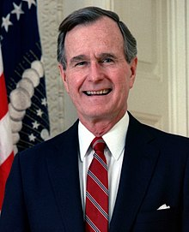
The Brief Bush Years
H. W. failed to address problems of a continued recession at home
Forced to renege on campaign promises and raise taxes
Lack of action loses him the election of ‘92

Slide 24
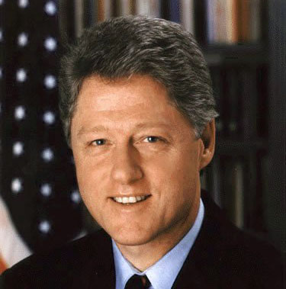
The Clinton Presidency
1993-2001
Former governor of Arkansas
Highly successful
Plagued with rumors of scandal
First Democrat to win 2 terms since FDR
Ran as “New Democrat”
https://youtu.be/XoBFL6iwid4
https://youtu.be/Pt-LDpxS5iQ

Slide 25
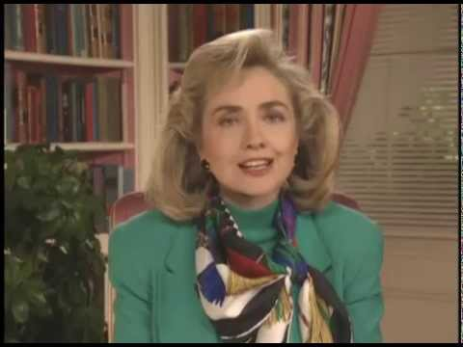
The Clinton Presidency
Democratic policies
Universal Health Care
Ultimately failed
Appointment of Hillary controversial
Seen as too socialist

Slide 26
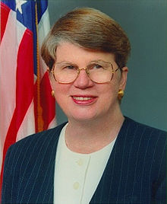
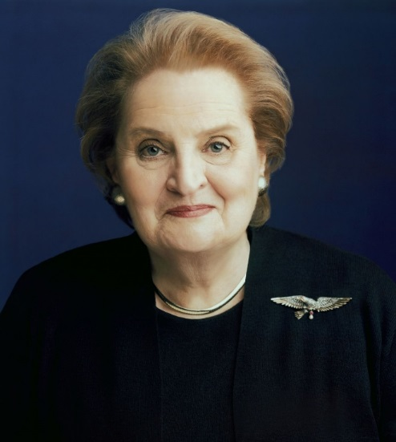
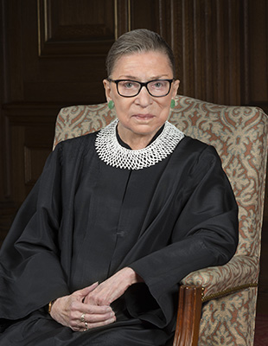
The Clinton Presidency
Democratic policies
Female appointments
Janet Reno (attorney general)
Madeleine Albright (Sec. of State)
Ruth Bader Ginsburg (2nd female justice)

Slide 27
The Clinton Presidency
Democratic policies
Social Reform
Violence Against Women Act
Family and Medical Leave Act

Slide 28
The Clinton Presidency
Right/Centrist Compromises
Don’t Ask Don’t Tell
Defense of Marriage Act (ironic much?)
Strict Immigration laws
Repeal of Glass-Steagall
No longer required to separate commercial/investment banks, eventually leading to 2008 economic collapse
https://youtu.be/gCVFWWZ-gRM

Slide 29
The Clinton Presidency
Plagued by Scandal
Early appointments resigned
Monica Lewinsky
Impeachment
Not for having the affair, but for lying about it

Slide 30
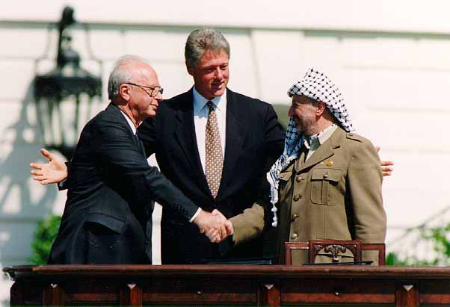
The Clinton Presidency
Foreign Policy
NAFTA
North American Free Trade Agreement
Peace-keeping during Bosnian genocide
Oslo Peace Accords
Attempted peace talk agreement between Israeli-Palestinian leadership

Slide 31
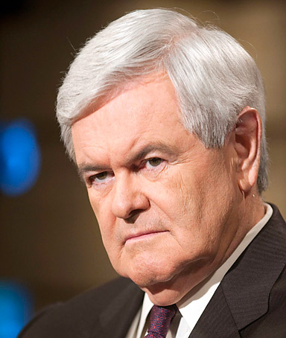
Newt Gingrich and the change in American Politics
1994 Contract with America
detailed the actions the Republicans promised to take if they became the majority party in the United States House of Representatives
in part using text from former President Ronald Reagan's 1985 State of the Union Address
Offered specific legislation in detail
Nationalized the Congressional Election

Slide 32
Gingrich Politics
Gingrich literally created the vocabulary of modern conservatism. During the 1980s, he hired marketing professionals to identify issues, “65 percenters,” that would resonate with a majority of the public. He then turned to a political action committee, GOPAC, to create tapes that were distributed to aspiring Republican candidates. The tapes developed a vocabulary of positive words (magnets) to use to describe Republican initiatives — liberty, freedom, truth, opportunity — while using “bad” words (wedges) to label the Democrats — decay, corrupt, permissive, and pathetic. The tapes taught an entire generation of young, combative Republicans to speak “Gingrich.”
The “wedges” and “magnets” would find their way into the 1994 “Contract with America” — perhaps Gingrich’s greatest political achievement. The contract turned Tip O’Neill’s dictum that “all politics is local” on its head. Instead, Gingrich nationalized 435 local races, turning them into a referendum on President Bill Clinton. Using GOPAC as a recruitment and training organization, Gingrich spent more than $8 million identifying the strongest potential Republican challengers and providing them with the themes, the “wedges and magnets,” to use against their Democratic opponents. Every month, GOPAC sent tapes to Republican candidates with ideas, tips, and advice from Gingrich.

Slide 33
Gingrich Politics
Turning Government officials into full time politicians:
Gingrich’s acceleration of congressional money grubbing. As Lawrence Lessig, a Harvard Law professor and campaign-finance-reform obsessive, charged during Newt’s 2012 presidential run: “The transformation to this ‘Fundraising Congress’ began in 1993. Newt Gingrich was its leader.” Having ridden to power on a flood of money, Gingrich had every intention of staying there, noted Lessig. “The four years between 1994 and 1998, Republican candidates and party committees would raise over $1 billion. Never before had a party come anywhere close to raising that amount of money, because never before had any party’s leaders so effectively focused the energy of their members on this single task: fundraising.”
Then, of course, there was Gingrich’s push to nationalize congressional elections, making the qualities of any individual candidate less important than voters’ devotion to the overall party (or at least their antipathy toward the opposing team). And let us not forget Gingrich’s shortening of the congressional work “week” to three days. (Do not get House conservatives started on the insanity of the current schedule!)
http://fortune.com/2016/04/04/john-oliver-congress-fundraising-money/
https://www.cbsnews.com/news/60-minutes-are-members-of-congress-becoming-telemarketers/
Notes:
Citation: https://www.huffingtonpost.com/steven-m-gillon/the-gingrich-revolution-a_b_8272054.html

Slide 35
Gingrich Politics
Gingrich’s strategy succeeded brilliantly. Not a single Republican incumbent for Congress or governor was defeated. Republicans seized control of both houses of Congress for the first time in 40 years. In Senate races, they won all nine open elections and defeated two incumbent Democrats. Republicans also scored well in the states, where they controlled the governor’s mansions in eight of the nine most populous states.
The new freshmen were “Gingrich’s children,” and they reflected his combative style of politics. They were young — over half were under the age of 45. They viewed themselves as outsiders, not professional politicians. Since they all won election in 1994 campaigning on the same platform of balancing the budget, reforming welfare, and cutting taxes, they were convinced they had a mandate to change the way politics was practiced in Washington. They were going to force change, not make deals.
On election night, Gingrich sat in his Atlanta headquarters waiting for the results. “How are we doing?” he asked one of his advisors. “Do you want the good news or the bad news?” the advisor responded. “Both,” Gingrich said. “The good news is that we are going to pick up a lot of seats.” Gingrich then asked for the bad news. “Wait until you meet them,” the advisor responded. “You won’t believe what a bunch of ideologues you are going to have to deal with,” he said, predicting: “They are going to kill you.”

Slide 36
Gingrich Politics
Unfortunately for him, an entire generation of Republicans have come to power adopting his strategy and his message, but failing to appreciate the distinction between means and ends. Today’s “Freedom Caucus” has embraced Gingrich’s strident political style, but they lack his appreciation of the art of governance. They seem nostalgic about the Gingrich-led government shutdowns in his first year as Speaker, but they forget that after initially overreaching, Gingrich worked closely with Clinton on a number of important legislative achievements, including a balanced budget bill…
http://abcnews.go.com/Politics/government-shutdown-president-obama-threatens-veto-house-republican/story?id=13314777
https://www.youtube.com/watch?v=Gj5-G01iRyk
Notes:
Citation: https://www.huffingtonpost.com/steven-m-gillon/the-gingrich-revolution-a_b_8272054.html

Slide 37
Gingrich Politics
Gingrich’s willingness to work with Clinton outraged conservatives — many of whom he had helped elect — who attacked him for making deals with the devil. After an abortive coup, they eventually forced him out of office
Notes:
Citation: https://www.huffingtonpost.com/steven-m-gillon/the-gingrich-revolution-a_b_8272054.html

