Slide 1
Warm Up 5/8 (#4)
“We are the unwilling working for the unqualified to do the unnecessary for the ungrateful.”
What does this quote tell us about conditions and sentiments during the Vietnam War?

Slide 2
May 8, 2018
Out for checkoff:
Ch. 51 Notes
Into the Dark
Agenda:
1968 Changes the War
Skills:
Analyzing events
Learning Target (I can…):
Describe the events of 1968 and their impact on the war.
Upcoming Dates
5/7: Reading Notes TCI 51.1-51.2
5/8: My Lai Critical Read

Slide 3
Essential Questions
What evidence is necessary in order to support an armed conflict?
2. Is it better to support a foreign leader who serves American purposes, but may not have the support of their people, or a foreign leader who serves their people, but is against American Ideals?
3. What role should the U.S./Western Countries have in other parts of the world?
Notes:
My lai effect on America http://www.pbs.org/video/american-experience-my-lai-massacre-national-shame/

Slide 4
My Lai
With your table group, discuss each of the following:
What happened at My Lai?
Why did it happen and who was involved?
Why was it covered up?
What is something that stood out to you in the reading?
What does the story of My Lai tell us about the nature of the Vietnam War?
How will this affect public perception of the war?
Notes:
My lai effect on America http://www.pbs.org/video/american-experience-my-lai-massacre-national-shame/

Slide 5
My Lai
What happened at My Lai?
Small village in South Vietnam
Rumor VC were being sheltered there
Lt. William Calley was in charge (claimed to be following orders from superior)
Attacked women, children and old men
More than 500 killed
None were armed and no enemy soldiers were found
Notes:
My lai effect on America http://www.pbs.org/video/american-experience-my-lai-massacre-national-shame/

Slide 6
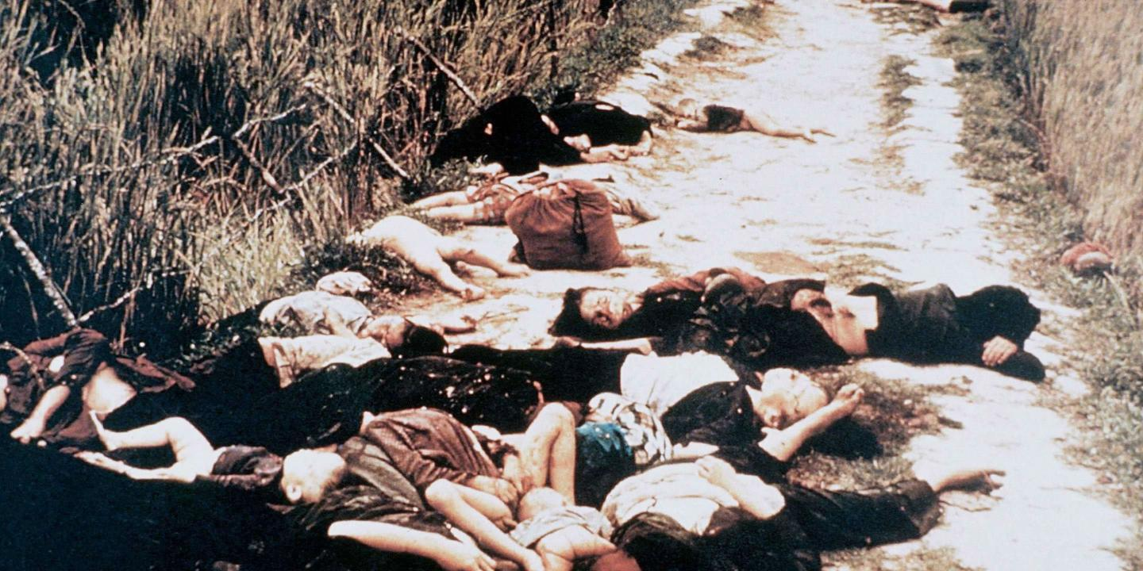

Slide 7
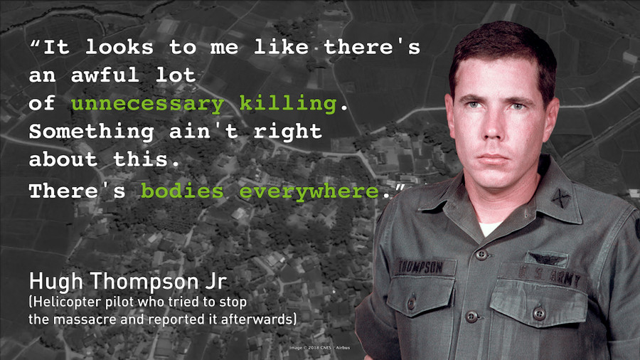

Slide 8
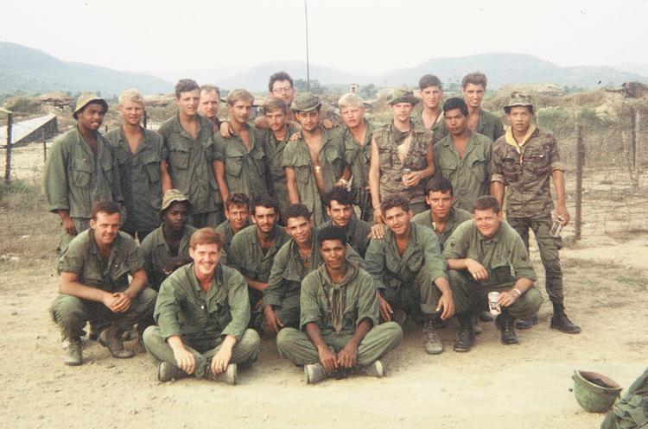
My Lai
Why did it happen and who was involved?
Charlie Company
Tensions high, war brutal, hard to say who really gave the order
Notes:
My lai effect on America http://www.pbs.org/video/american-experience-my-lai-massacre-national-shame/

Slide 9
My Lai
Why was it covered up?
What is something that stood out to you in the reading?
What does the story of My Lai tell us about the nature of the Vietnam War?
How will this affect public perception of the war?
http://www.pbs.org/video/american-experience-my-lai-massacre-national-shame/
Notes:
My lai effect on America http://www.pbs.org/video/american-experience-my-lai-massacre-national-shame/

Slide 10
1968 Shifts the War

Slide 11
Americans begin to Question
Living room war
Constant television coverage of the war
People see images and news stories of the atrocities
Televised Fulbright hearings question government policy and create uncertainty about purpose of Vietnam
Credibility Gap
Government constantly giving positive view of successes in Vietnam
Television journalists emphasize the difference between government portrayal and reality of the toll of the war

Slide 12
Tet Offensive 1968
Pacification not going well
NVA wants to show it
Tet: Vietnamese New Year
Viet Cong and NVA launch simultaneous attack (now led by Vo Nguyen Giap, hoping to break stalemate)
NVA/VC (mostly VC) attack major cities, military bases, VC hits villages and attempt uprising in the country (backfires)
blow hole in wall around U.S. embassy
Pushed back and VC loses most of its numbers.
Notes:
My lai effect on America http://www.pbs.org/video/american-experience-my-lai-massacre-national-shame/

Slide 13
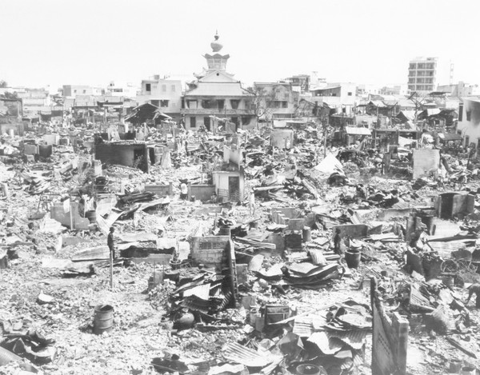
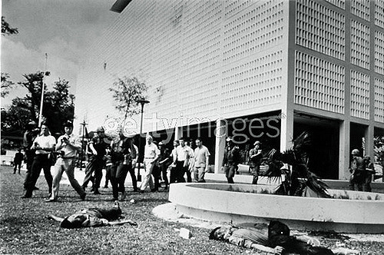
Tet Offensive 1968
Credibility gap widens as gov’t paints push back of enemy as a success while Americans are inundated with images of the destruction
Notes:
My lai effect on America http://www.pbs.org/video/american-experience-my-lai-massacre-national-shame/

Slide 14
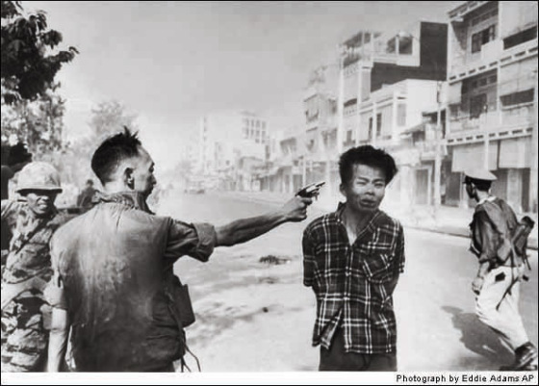
What did North Vietnam gain from this? What did they lose?

Slide 15
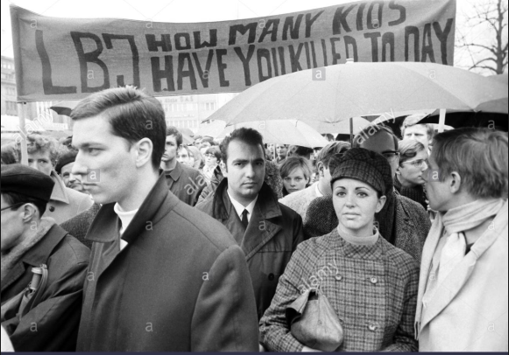
1968 Election
High casualty counts
Public perception shifting
Protests for peace rise around the country as war becomes known as Johnson’s war
“Hey Hey LBJ! How many kids did you kill today?”
Notes:
My lai effect on America http://www.pbs.org/video/american-experience-my-lai-massacre-national-shame/

Slide 16
1968 Election
Walter Cronkite, while reporting on Vietnam, basically declares the war to be unwinnable https://youtu.be/Nn4w-ud-TyE
“That's it. If I've lost Cronkite, I've lost America.” -LBJ
LBJ announces plan to limit war and states he will not seek reelection even as soldier count reaches all time high of 549,000
Notes:
My lai effect on America http://www.pbs.org/video/american-experience-my-lai-massacre-national-shame/

Slide 17
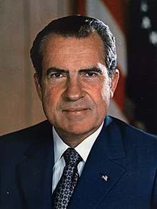
1968 Election
When the strongest nation in the world can be tied up for four years in a war in Vietnam with no end in sight, when the richest nation in the world can't manage its own economy, when the nation with the greatest tradition of the rule of law is plagued by unprecedented lawlessness . . . then it's time for new leadership for the United States of America.
—Richard M. Nixon, August 8, 1968
Notes:
My lai effect on America http://www.pbs.org/video/american-experience-my-lai-massacre-national-shame/

Slide 18
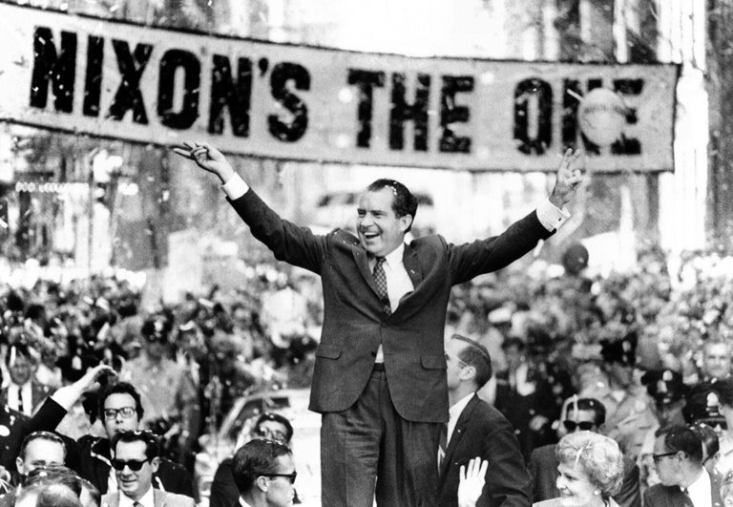
1968 Election
Nixon promises to maintain law and order at home and obtain “peace with honor” abroad
After Democrats fail recover from disastrous convention and Nixon wins election
Notes:
My lai effect on America http://www.pbs.org/video/american-experience-my-lai-massacre-national-shame/

